Slide 1
Notes:
-FATHERS DAY (SHOUT OUT TO ALL DADS)
-YA’S RAISE YOUR HANDS (YASS)
-SUMMER IN THE SPIRIT INTRO
-RECAP WEEK 1 & WEEK 2
-TODAY WE’RE BEGINNING W/ 7 CHURCHES FIRST IS THE CHURCH OF EPHESUS.

Slide 2
What was it like when you first met Jesus?
Notes:
-PRAYER W/DENNY’S &-PRAYER @ X-RAY’S,
-EVANG @VSU & STUDYING W/TYSHAWN
-REFUND CHECK
-THE FEELING OF COMPLETION
-JOY OF THE LORD
-(ASK QUESTIONS AGAIN)
-ARE YOU STILL DOING THOSE FIRST WORKS?
-IF NOT THEN MAYBE LIKE THE COE, YOU HAVE LEFT, OR FORGOTTEN YOUR FIRST LOVE
-IF THAT IS YOU, HS IS REMINDING YOU OF THE 3R’S…
-LET’S READ!

Slide 3
REVELATION 2:1-7
ESV
Notes:
SLOW DOWN….YOU GOT THIS. TRUST GOD AND HAVE FUN ☺

Slide 4
Notes:
-EPHESUS WAS A LOT LIKE YOU AND I, BUSY!
-BUZINESS CONGESTS OUR MIND/DISABLING US TO HEAR/3R’S/GO-MODE
-WE’RE BUSY BUT THE WORKS ARE GOOD LIKE THE COE

Slide 5
Rev 2:2-3 I know your works…
WORK
PATIENCE
HATE FOR SIN/EVIL
EXPOSING FALSE APOSTLES
BANNER OF JESUS
ENDURANCE
Notes:
-JESUS KNOWS AND SEES EVERYTHING WE DO FOR HIM AND UNTO HIM.
-(NS)
-THE PROBLEM IS THIS…

Slide 6
Our business is causing us to abandon our love for Jesus

Slide 7
Rev 2:4
But I have this against you, that you have abandoned the love you had at first.
Notes:
YOU: NOT ANBODY ELSE, BUT YOU! KNOW WHEN TO FOCUS ON YOU!
ABANDONED: LEFT OR TO FORGET
FIRST: GREEK WORD PROTOS (PROTOTYPE) WHICH IS THE ORIGNIAL MODEL
LOVE: AGAPE--- HIGHEST, NOT BASED ON FEELINGS, UNCONDITIONAL
-QUOTE OF COURTNEY DUNN-I MIGHT BE DISCONNECTED, BUT I’M NOT LOST
-LIKE COE, WE’RE LYING TO OURSELVES -WE ARE DISCONNECTED.
-LET’S GET CONNECT BACK TO JESUS! STARTS W/ REMEMBERING

Slide 8
REMEMBER
(REV 2:5 “REMEMBER THEREFORE FROM WHERE YOU HAVE FALLEN;…”)
Notes:
-REMEMBER----NOT ONLY RECOLLECT, BUT TO REHEARSE MENTALLY!
-COLD MARRIAGES? STOP CHASE & WE STOP REMEMBERING/REHEARSING
-WE’RE CONTENT & FORGET WHY WE FELL IN LOVE.
-NO MORE CHASE, DN’S, INTIMACY, ROMANCE, FLOWERS, LONG WALKS, ETC.
-QUESTION: WHAT WAS IT LIKE WHEN YOU FIRST MET JESUS? (NEXT SLIDE!)

Slide 9
REMEMBER
(REV 2:5 “REMEMBER THEREFORE FROM WHERE YOU HAVE FALLEN;…”)
Notes:
-BUT WHEN WE REHEARSE/REMEMBER CONSTANTLY, MARRIAGE TO A HIGHER LEVEL & CHASE CONTINUES.
-AND IT’S THE SAME WITH JESUS
-SPIRIT: “REHEARSE THE WONDERFUL MOMENTS YOU HAD WITH JESUS”
-(NOT TO LOOK BACK AND NOT GROW, BUT TO BE REMINDED OF PSALM 34:8 AT FIRST)
-WE ALSO NEED TO THINK ABOUT THINGS OR PEOPLE THAT ARE GETTING IN THE WAY OF OUR LOVE FOR JESUS AND THAT’S WHEN WE REPENT

Slide 10
REPENT
(REV 2:5 “REPENT, AND DO THE WORKS YOU DID AT FIRST”)

Slide 11
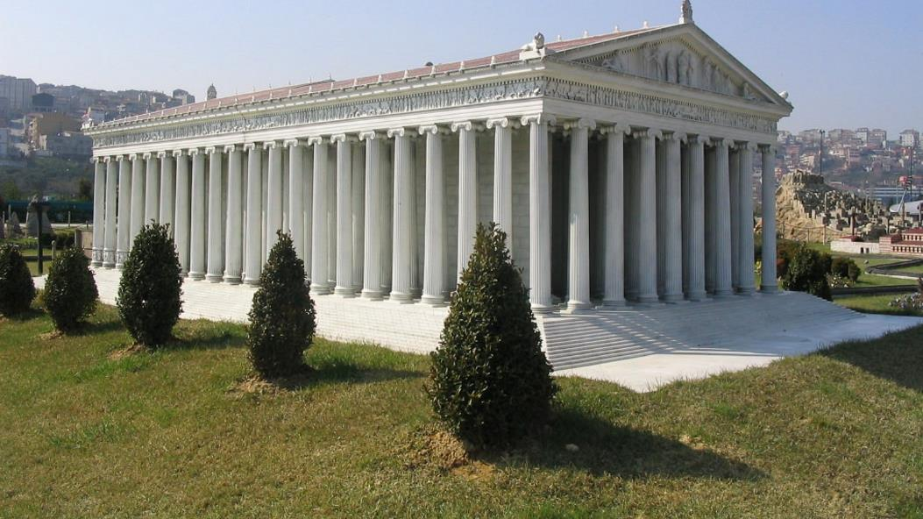
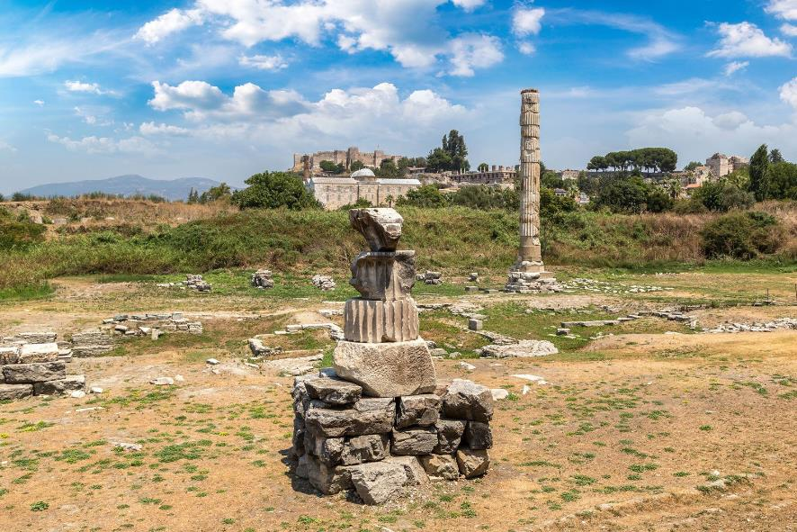
Notes:
-GREEK GODDESS ARTEMIS & HER TEMPLE
-ACTS 19:21-41/PAUL VISITS & PLANST CHURCH
-JESUS COMES AND GIVES REBUKE TO COE
-TEMPLE DESTROYED & BURNED FINALLY AFTER 7 RE-BUILDS
-WHY?? BC THEY DID 3R’S…
-DON’T GO BACK AND RE-BUILD THAT ALTAR

Slide 12
RETURN
(REV 2:5 “REPENT, AND DO THE WORKS YOU DID AT FIRST”)
Notes:
-WHAT WERE THE OTHER WORKS THEY DID?!

Slide 13
FIRST WORKS
SEEKING HIM AT ALTAR
STUDYING THE SCRIPTURES
JOURNALING
PRAYER WALKS
WITNESSING/EVANGELIZING
JBC TIME

