Slide 2
But these are written that you may believe that Jesus is the Christ, the Son of God, and that by believing you may have life in his name
John 20:31

Slide 3
John is trying to help you see
and believe The One who can
give you, and guide you to, true life
John knows we live in a world of
darkness and confusion that
keeps us from knowing Jesus
Notes:
So in John 1 - he tells us
In the beginning was the word
Just like Genesis 1 - this world is dark and no understands Jesus
In fact this is what John 1 is about

Slide 4
John 1 (Genesis 1) :“In the beginning . . .
John 1:4-5,10
“The light shines in the darkness, but the darkness has not understood it. . . . He was in the world, and though the world was made through him, the world did not recognize him.”
John 1:19-51
Notes:
No one really knows who He is - they are guessing - can’t see
A lot like the book of Job - his friends can’t see / job is struggling - once his eyes see him
And then the next 9 chapters are all about Jesus trying to show who he is
Through I AM statements, throught signs - and through his teachings
But the question is will anyone really see who he is?
And it leads us to that question -
do we really see Jesus they way we should - so we can have life!

Slide 5
WHAT KEEPS US FROM SEEING JESUS
1. Our schedules & stresses | Wedding at Canan (c2)
2. Our self-serving religion | Clearing the Temple (c2)
3. What we think we already know| Jesus & Nicodemus (c3)
4. Our past & prejudices | Women at the well (c4)
5. Our traditions | Jesus heals on the sabbath (c5)
6. Focusing on temporary things | Passover & feed 5000 (c6)
7. ______________________ | Feast of Tabernacles (c7-10)
Notes:
All of these keep people from seeing Jesus
Even though in every one of these he either says or does something
(like a sign) so people will see him and the life he offers
But we come to the final section of Jesus mission to see
Its c7-10 and the final show down with the phariees who refuse to see
And it shows us the one thing that keeps so many of us from seeing Jesus - and how to heal or live

Slide 6
After this Jesus went about in Galilee.
He would not go about in Judea and Jerusalem, because the Jews were seeking to kill him. Now the Jews’ Feast of Booths [Tabernacles] was at hand.
John 7:1-2
Notes:
Final section begins
The Jewish leadership has refused to see!!!
Despite all the miracles, the signs, the teaching.
And at first Jesus doesn’t go back down to where they are
But then he does - and again and again we see the one
thing that blinds us more than anything else

Slide 7
“About the middle of the feast Jesus went up into the temple and began teaching. . . Has not Moses given you the law? Yet none of you keeps the law. Why do you seek to kill me?” The crowd answered, “You have a demon! Who is seeking to kill you?”
John 7:19-20
Notes:
Jesus had healed on the sabbath - accused of breaking the law.
And here it is!!!! Instead of listening to Jesus
THEY LABEL JESUS TO IGNORE OR NOT SEE JESUS
He has healed a paralyzed man, made water into wine
healed official’s son, fed 5,000.
But he is messing with our traditions, schedules, prejudices . . label

Slide 8
“Nicodemus . . . said to them, “Does our law judge a man without first . . . learning what he does?”
They replied, “Are you from Galilee too? Search and see that no prophet arises from Galilee.”
John 7:46-50
Notes:
People are divided between
His miracles and goodness
And their fears, tradition, greed, power
So they label him again
And here is why!

Slide 9
If I label you
I don’t have to
listen to you
Notes:
Labels disable your value, the truth - your importance
Labels limit your power and your worth
This is something you have to understand about
The dakrness of this world, sin and satan

Slide 10
How do we see people?
God’s Kingdom: the image of God
World’s Kingdom: the labels of man
Satan’s Kingdom: the condemnation of sin
Notes:
In God’s image - means you are like me, you have value
LABELS MEAN U AREN’T LIKE ME- what u say isn’t 4 me
Satan - Labels always lead to condemnation (cancel culture)
we don’t have pretend like the exist or should exist
Labels cover God’s image and seek to destroy

Slide 11
Labels blind us to
- the truth of God
- the value of others
- the evil in our own hearts
They give us permission to destroy relationships, families & communities.
Notes:
“The road to hell is paved with overly simplistic labels”
Labels steals our true identity and future, our health & our hope
Satan’s key goal - destroy the image of God you are

Slide 12
“The thief comes only to steal and kill and destroy. I came that they may have life and have it abundantly. I am the good shepherd.
John 10:10
Notes:
Labels do all three || Homosexuality - steal you of your true ID & peace
Gender Confusion & Pronouns - kill you and relationships (suicide rate)
Abortion - kill - not a life - fetus, inconvenience, a choice
Racism - those people (won’t mention labels) - destroy community
Politics - give us permission to hate (godly indignation never bitterness)
And not only Satan does this - he uses this in RELIGIOUS PEOPLE

Slide 13
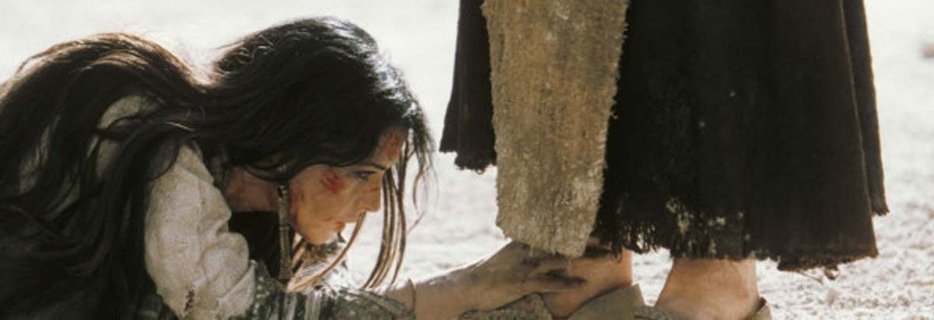
“Teacher, this woman has been caught in the act of adultery. Now in the Law, Moses commanded us to stone such women.
So what do you say?” (8:4-5)

Slide 14
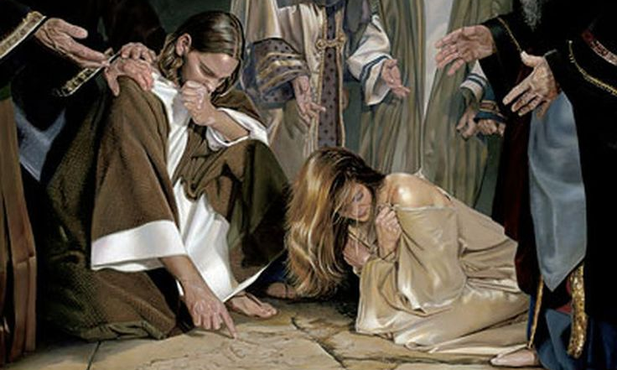
“ Jesus bent down and wrote with his finger on the ground. And as they continued to ask him, he stood up and said to them,
“Let him who is
without sin
among you
be the first
to throw a
stone at her.”
(8:6-7)

Slide 15
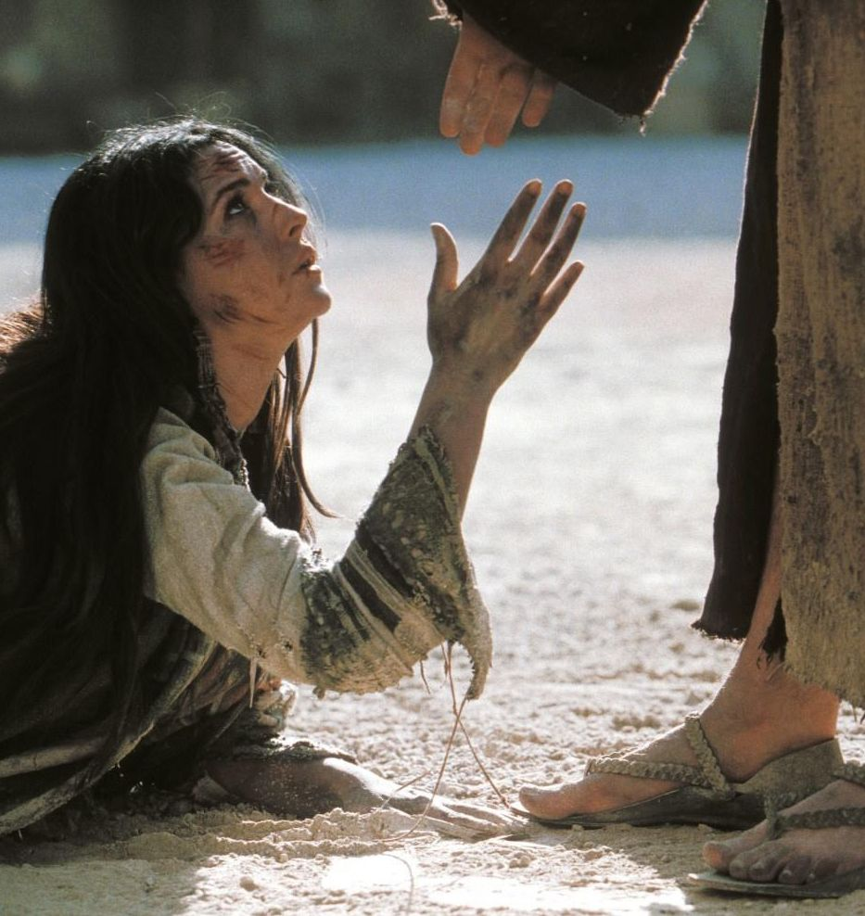
they went away one by one, . . Jesus stood up and said to her, “Woman, where are they? Has no one condemned you?” She said, “No one, Lord.” And Jesus said, “Neither do I condemn you; go, and from now on sin no more.” (8:9-11)
Notes:
Neither do I label you
You can be more - you don’t have to be that
Im not comdemning you or cancelling you
I can free you from it
You are not your sin
You are in the image of God (me)

Slide 16
This is “good news” of Jesus:
He shreds the labels that condemn us
This is the “bad news” of Jesus:
He shreds the labels that make us proud
Notes:
Look at the next story involving lables
Still in the same story of The Feast of Booths
Other Jewish leaders - don’t believe
Jesus - He is the light of the world
He can set people free

Slide 17
They answered him, “We are offspring of Abraham and have never been enslaved to anyone. How is it that you say, ‘You will become free’?” Jesus answered them, “Truly, truly, I say to you, everyone who practices sin is a slave to sin. . . if the Son sets you free, you will be free indeed.
John 8:9-11
Notes:
They are blinded by but also using a lable to defend themselves
Jesus - your label is blinding you from your true need and your true identity

Slide 18
This is “good news” of Jesus:
He shreds the labels that condemn us
This is the “bad news” of Jesus:
He shreds the labels that make us proud
This is the “sad news” of Jesus’ followers:
He has to shred the labels we give others

Slide 19
As Jesus passed by, he saw a man blind from birth. And his disciples asked him, “Rabbi, who sinned, this man or his parents, that he was born blind?” Jesus answered, “It was not that this man sinned, or his parents, but that the works of God might be displayed in him
John 9:1-2
Notes:
Whose the sinner -
We’ve labeled him and so we don’t think he’s valuable
We don’t think God’s glory could come through him
Jesus - stop labeling and limiting what God can do through him

Slide 20
The Jewish leaders answered the blind man [who gave glory to Jesus], “You were born in utter sin, and would you teach us?” And they cast him out. Jesus heard . . . and found him he said, “Do you believe in the Son of Man?” He answered, “And who is he, sir, that I may believe in him?”
John 9:34-35
Notes:
Rest of the story - jews refuse to see this miracle as proof -
They refuse to see anyone who declares him
That is what the spirit of the world & Satan does
You’re a white evangelical
You’re a black liberal
You’re uneducated, too educated, too poor, too rich

Slide 21
Jesus said to him, “You have seen him, and it is he who is speaking to you.” He said, “Lord, I believe,” and he worshiped him. Jesus said, “For judgment I came into this world, that those who do not see may see, and those who [think they] see may become blind.”
John 9:37-40
Notes:
Irony of the story
Jesus says to the physical blind man - you see
Jesus sets a label on those who reject him - blind

Slide 22
What keeps us from seeing Jesus:
1. Our schedules & stress | Wedding at Canan (c2)
2. Our self-serving religion | Clearing the Temple (c2)
3. What we think we already know| Jesus & Nicodemus (c3)
4. Our past & prejudices | Women at the well (c4)
5. Our traditions | Jesus heals on the sabbath (c5)
6. Focusing on temporary things | Passover & feed 5000 (c6)
7. THE LABELS WE ACCEPT & GIVE | Tabernacles (c7-10)
Notes:
We are in this season of fasting
Get the world away from me so I can see the banquet
Get the world away so I can see you are with me
FAST OUR LABELS
But the truth - just like every story
We need Jesus to shred them for us
This fast - given food, social media, time - labels

Slide 23
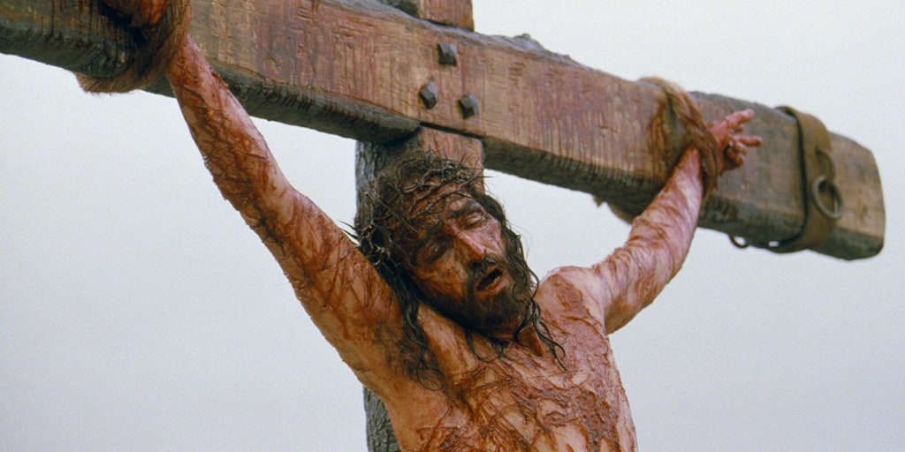
Notes:
As we continue to fast and stay in God’s Word (Bible Recap) God wants us to . . . repent of the labels we have accepted & given.
Stop labeling people and trust God to work in their lives
Stop labeling yourself

