Slide 1
Notes:
Read - John 1 (Page 4 handout)
Studying the Christmas story according to John
John is very unique in how he tells the story (no mary, joseph, shepherds
John shares the big picture of Christmas
Like the Kids Play - Jesus is the light & word of God into this world
This is important to John . . .

Slide 2
John tells us the Christmas story his way to help us understand that . . .
God’s Word brings His light
His Light brings His Peace
Notes:
And this is the one thing John wants people to have
Real peace - peace that doesn’t go away
And so he shares how on Christmas
God delivered Jesus who would bring peace
And we should all relate th this . . .
How many crazy amazon shoppers / trucks at your house eveyr day

Slide 3
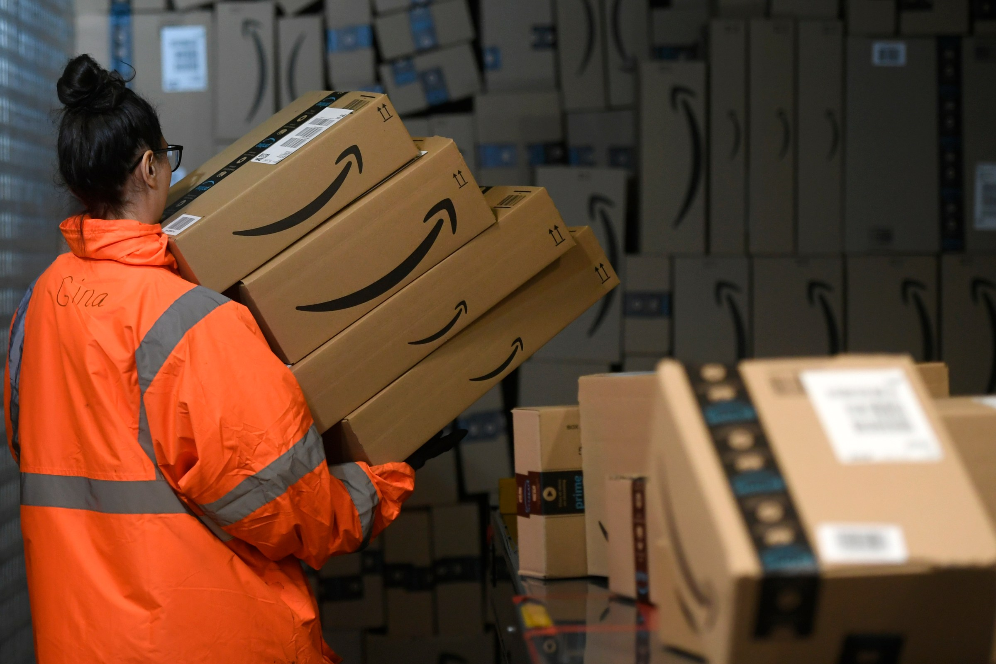
66,000 packages
delivered per hour
Notes:
Amazon deliver 5.9 billion packages in 2023,
1.6 million packages each day,
More than 66,000 packages per hour
4% not received - 2,640 packages are never recieved

Slide 4
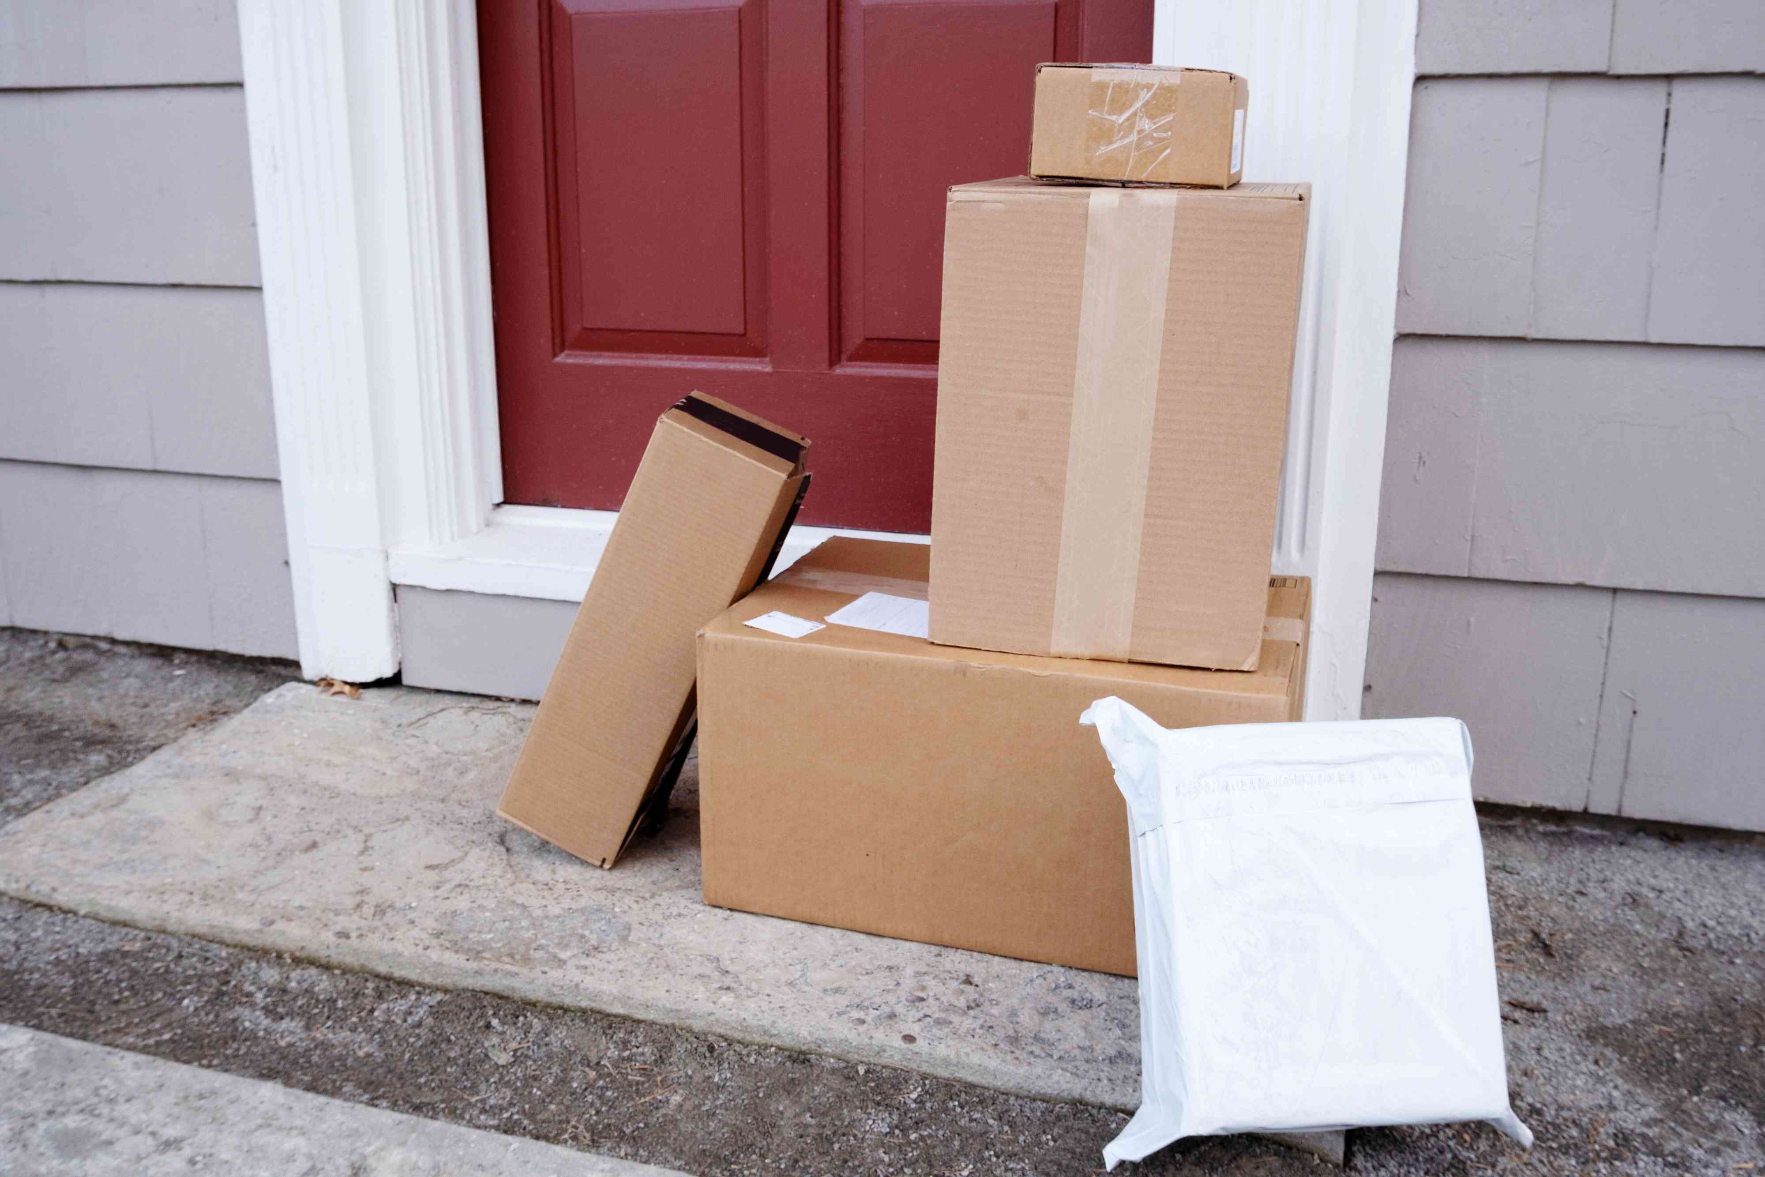
2,640 packages
never received
per hour!
Notes:
They were delivered but the
Person never received it
Some of the greatest gifts like
(Funny ex. ) never received
And that’s kind of the point of Christmas

Slide 5
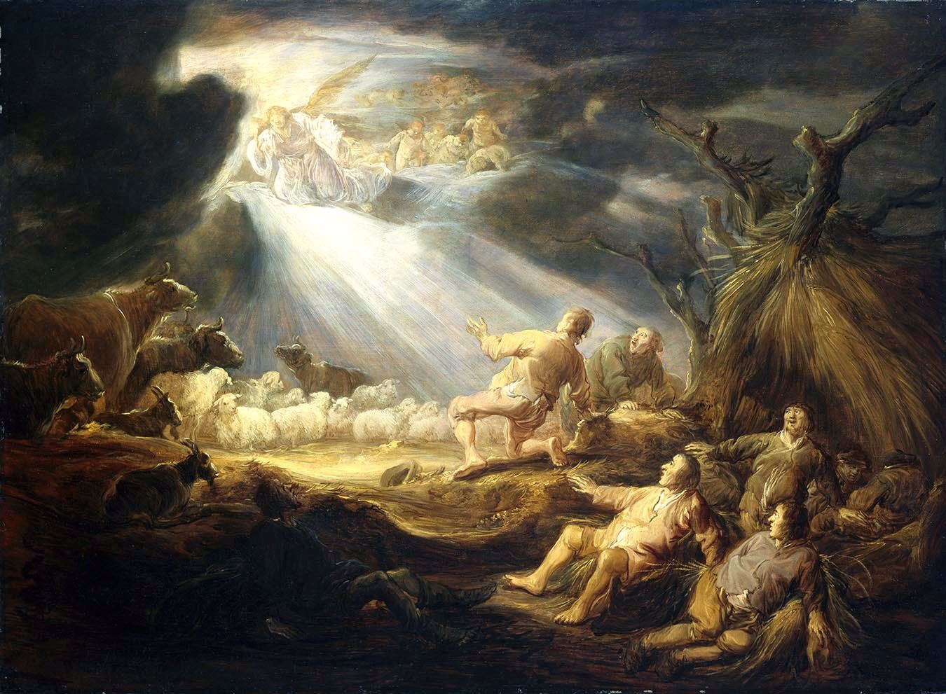
“there was with the angel a multitude of the heavenly host . . . saying, “Glory to God in the highest, and on earth peace [delivered] among those with whom
He is pleased!”
Luke 2:13-14
Notes:
God delivered the thing we need the most
Peace that would last (eternal)
Not of this world
(angels told the shepherds where it was dropped off)
But only a few received it

Slide 6
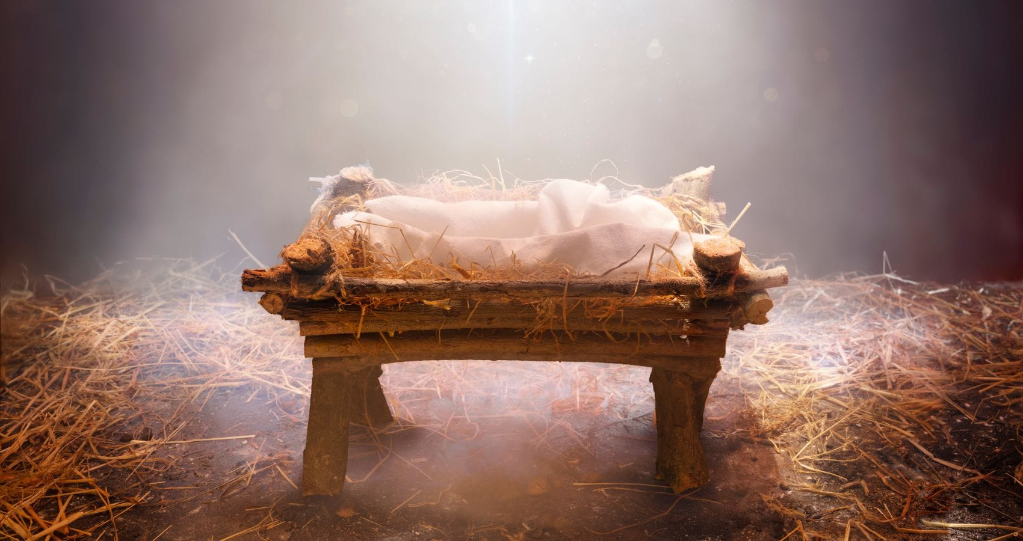
For to us a child is born, to us a son is given . . . And he will be called . . . Prince of Peace.
Of His . . . peace there will be no end. (Isaiah 9:6-7)
Notes:
This baby, Jesus
One of the most verified facts in all of history
Was the prince of peace
The one who would give peace without end
Something our world, family and you need so much!!!
It was delivered but here is what John says . . .

Slide 7
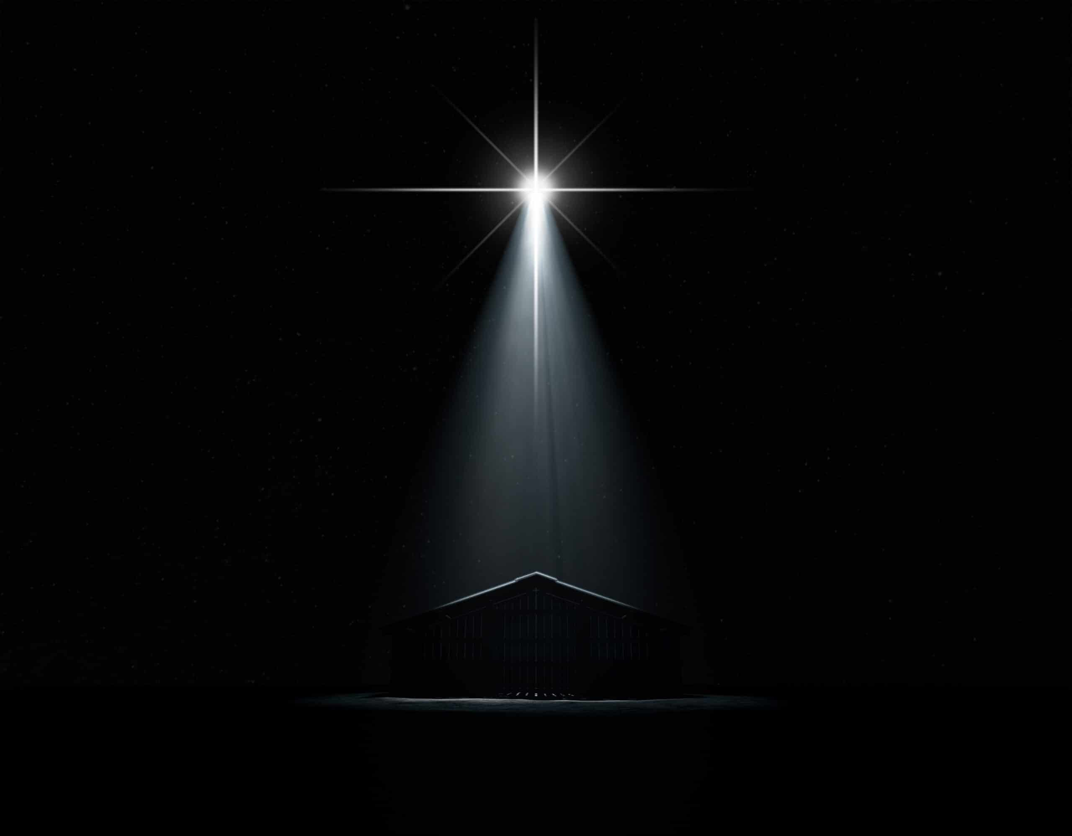
The true light that gives light to every person was coming into the world. . . He came to that which was his own, but his own did not receive him.
John 1:9,11
Notes:
John says it this way
The light of God was delivered
But never received
600,000 in Israel - only a few shepherds received the gift
Not just happened over 2000 years ago - still happens today

Slide 8
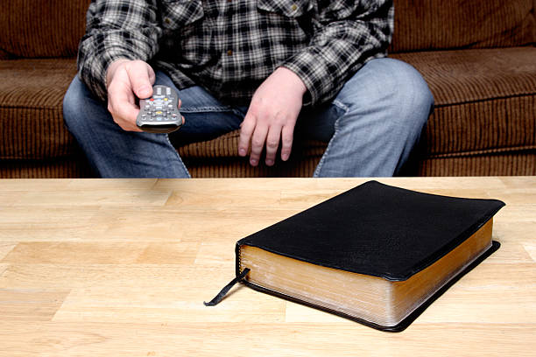
“He was in the world, and though the world was made through him, the world did not recognize him. ”
John 1:10
Notes:
The message - the word of Jesus and His peace
Is still not recognized and missed by so many
John makes sure we get that the word of Jesus isn’t just another religious idea
Its was created the universe, created you and can recreate you
And if you want to receive it
(90% Of high schoolers - anxiety | 2/3rds of adults)
Here is how to receive it

Slide 9
1. Get your order straight
Peace is not the absence of problems.
It’s the presence of everything Jesus gives
“in Me you may have peace. In this world you will have trouble. But take heart! I have overcome the world.” - John 16:33
Notes:
Ever order something on amazon and then get it - this is not what I wanted?
Jesus says - that the peace the world gives isn’t the real thing - knockoff
Most of us hate getting knock offs but accept them in our hearts all the time

Slide 10
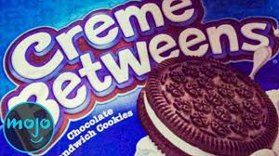

Slide 11
The world offers
“Pieces” not “Peace”
Notes:
Pieces - not enough
Not the entire answer
Not anything will last

Slide 12
Kingdom
of God
The Presence Of Jesus, His light & life
Kingdom of this World
The Absence Of Problems
Kingdom
of Satan
The Destruction of Enemies
Notes:
Biggest problem is you are trying to have no problems
Losing weight / having kids / falling in love
You don’t need absence of problems to have peace
Just like I don’t need the absence of darkness to have light
Light is about what I turn on not what I shut off
King of Satan - always their fault - cancel/outrage/destruction culture

Slide 13
Peace: Shalom [Hebrew] & Eirene [Greek]
When something is complete and whole.
Nothing that is needed is missing and all parts are working together correctly.
The experience of thriving, flourishing and reaching potential.
A state of calm and renewal between you, God and the world around you.
Notes:
Jesus offers peace
John 14:27 / page 4 - my peace I leave you!
Real peace in a broken world
You don’t need the world to have a good life or peace
You can find your peace in Jesus - but you have to . . .

Slide 14
2. Acknowledge The Truth
You love darkness (all pleasure)
You hate the consequences (no peace)
You and your relationships are stuck (total prison)
This is the verdict: Light has come into the world, but men loved darkness instead of light because their deeds were evil. - John 3:19
Notes:
Ever order something and it doesn’t do what promised!
(dehumidifier - nothing. /right product - taking out water every night)
You love it s pleasure but hate it’s consequences
Here is how you know if its darkness - brings you please but pain to those who love you
And you’re trapped by it
So . . You got to do with it (25% of gifts - return it) - who is my returners?

Slide 15
3. Open The Door To His Grace
You can’t save yourself and you are wrong.
You need who He is and what He is bringing.
Behold, I stand at the door and knock. If anyone hears my voice and opens the door, I will come in to him and eat with him, and he with me. - Revelations 3:20
Notes:
You have to open the door and you look a mess?
Accept His sacrifice and grace
Isaiah 53:5 / John 1:9 - light for every person!
I don;’t need - everyone around you knows you need it but you
Stop trying to pretend you have light
But what will people think - they will think you’re a person

Slide 16
4. Slow Down & Get Alone With God
You have to take the time to recognize what Jesus has given you and how you experience it.
“If only you had paid attention to my commands, your peace would have been like a river” - Isaiah 48:18
Notes:
We never know who the package is for - someone has to open it up
Slow Down!!
PACE is not PEACE

Slide 17
Being still is hard because that’s when our anxieties, fears and insecurities come to the surface. If you don’t believe me, look at how much your reach for your phone . . . These days, anytime we have to wait or be in silence or talk to someone, we all seem to almost panic and reach for our phones.
- John Starke, The Possibility Of Prayer

Slide 18
We need to learn how to be alone with God (solitude). . . Our phones exploit the human desire for connection with a darker isolation than we realize. . .
Solitude is the opposite. It drives us, not deeper into ourselves, but toward the true love and purposes of God. There, God shows us who we are, and He gives us security that frees us to love (instead of perform for) others.

Slide 19
Philippians 4:6-7, ESV
do not be anxious about anything, but in everything by prayer and supplication with thanksgiving let your requests be made known to God. And the peace of God, which surpasses all understanding, will guard your hearts and your minds in Christ Jesus.

Slide 20
5. Step Up & Follow The Instructions
Stop asking Jesus to bless your solutions for peace and step up to the Cross for His.
If only you had paid attention to [and obeyed] my commands, your peace would have been like a river - Is. 48:18
Notes:
A good life is more than the quick guide of a new gift
You can’t have peace and live by your wisdom and ways
All have blind spots | What we need the most we see the least
we can’t pick and choose what we do - die to ourselves and live for Christ

Slide 21
How to receive the peace & light of Jesus
Get Your Order Straight
Acknowledge The Truth
Open The Door (To His Grace)
Slow Down (Get Alone With Jesus)
Step Up (Follow His Instructions)
Notes:
Here is the two realities this Christmas
Nothing you buy yourself or someone else can make peace - distract, bribe, feed sin
Nothing you do your way - bring peace
“I’ve done everything I can - no you haven’t - you’ve done everything you’ve wanted to do - what you decided was acceptable
You haven’t done everything you can do - you’ve done what was acceptable to you
Decide the peace you and your spouse, your family needs - step up and do it his way

