Slide 1
https://youtu.be/ordhsDeAt60?si=lsjMv1RegzeRzLYS

Slide 2
Our Continued Study In The Gospel of John
& God’s Heart For The Lost in Chapter 4

Slide 3
When it all seems wrong, Jesus can do everything right

Slide 4
When it all seems wrong, Jesus can do
everything right
Believe Again in Jesus

Slide 5
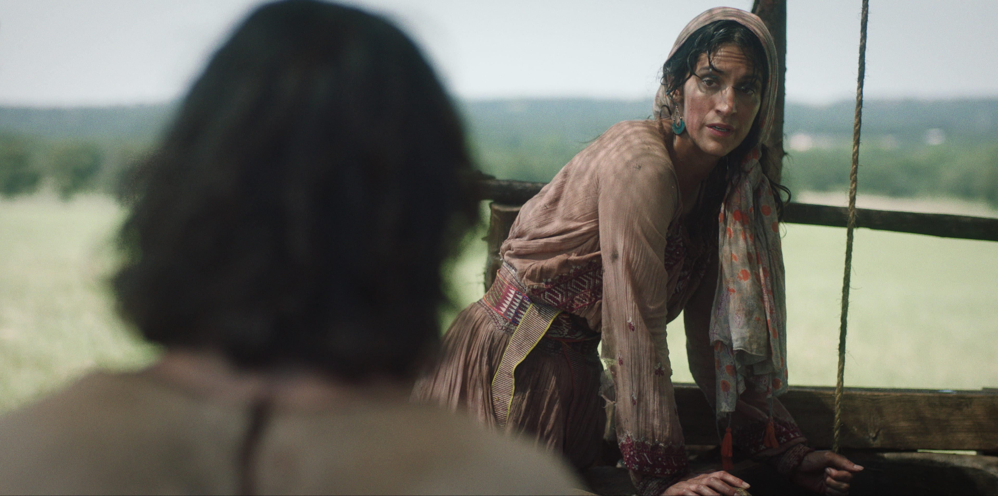

Slide 6
You are exactly who Jesus is looking for

Slide 7
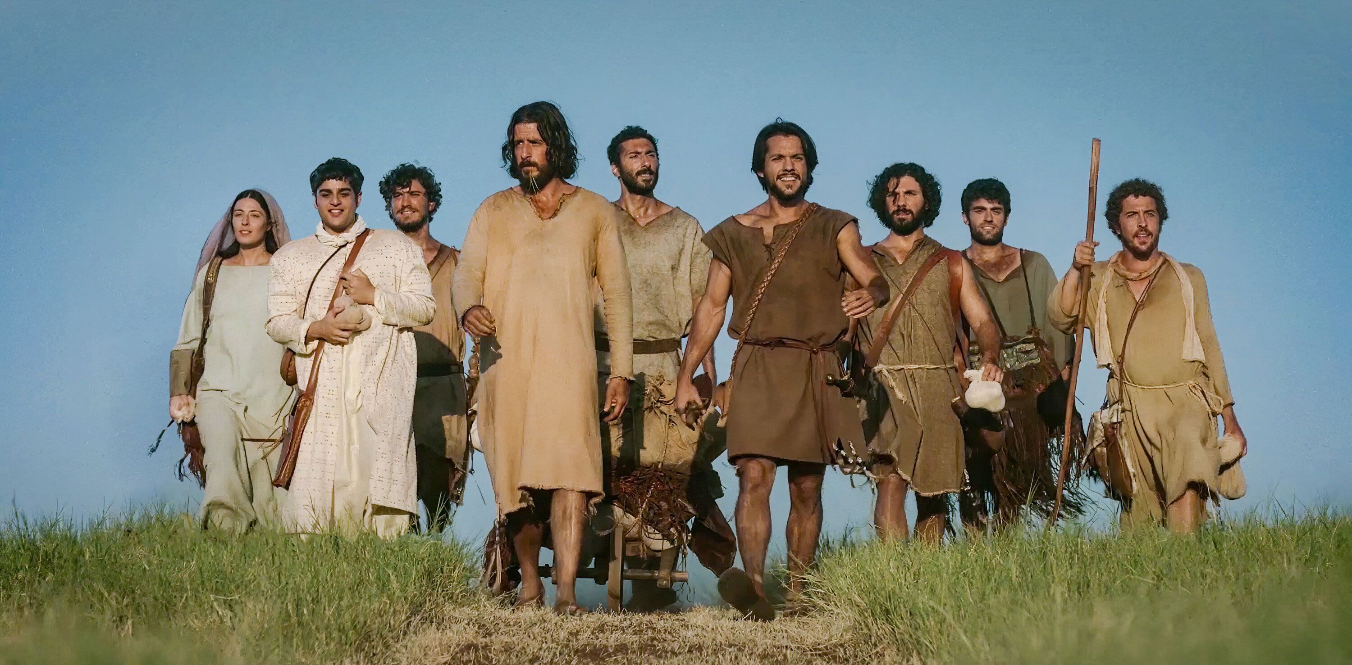

Slide 8
Wrong about what they needed
Jesus said, “I have food to eat that you know nothing about” (v32)
I am refreshed by nourishment hidden from you
Notes:
Because you think lke the world
When it’s the world that’s making you weary
“My food . . . is to do the will of him
who sent me and to finish his work.” (v34

Slide 9
Wrong about what time it was
Do you not say, ‘Four months more and then the harvest’? I tell you, open your eyes and look at the fields! They are ripe for harvest. (v35-36)
It’s time to thrive not survive
- to reach out & not isolate.
Notes:
Because you think lke the world
When it’s the world that’s making you weary
“My food . . . is to do the will of him who sent me and to finish his work.”

Slide 10
Wrong about what would bring joy
“even now he harvests the crop for eternal life, so that the sower and the reaper may be glad together...I sent you to reap ... and you have reaped the benefits” (36-38)
Joy comes from giving not taking
- from obedience not comfort

Slide 11
This story and
the Kingdom of God are filled with “contradictions”
Notes:
Are you tired of being tired?
Are you live in fear and survival?
Are you empty or too full with yourself?

Slide 12
Tired? Work at doing and finishing God’s will
Surviving? See and lead others to Jesus
Empty? Give your first and best for God’s glory
Notes:
Started marriage - but you’re not working at God’s will for your marriage

Slide 13
3 ways to share a
“little Jesus” by Thursday
1 new person to come
with you Friday, 5:30p
6 minutes of prayer
daily for the lost (fasting)
A Final Week
Community
Worship Night
THIS FRIDAY

Slide 14
Pray 6 Minutes Each Day (at 3:16p)
¹ Praise God for who He is
² Thank God for what He has done for you
³ Confess your sins & repent of wrong ways
⁴ Obedience: declare what you will do in His grace
⁵ The Lost: Pray for those who don’t know Jesus
⁶ Today: Ask for His grace & answers to your needs

