Slide 2
1 Peter 1:22-23
Now that you have purified yourselves by obeying God’s truth so that you have sincere love for your brothers, love one another deeply, from the heart. ²³ For you have been born again, not of perishable seed, but of imperishable, through the living and enduring word of God.

Slide 3
1 Peter 1:24-25
²⁴ For, “All men are like grass, and all their glory is like the flowers of the field; the grass withers and the flowers fall, ²⁵ but the word of the Lord stands forever.” And this is the word that was preached to you.

Slide 4
1 Peter 2:1-3
Therefore, rid yourselves of all malice and all deceit, hypocrisy, envy, and slander of every kind. ² Like newborn babies, crave pure spiritual milk, so that by it you may grow up in your salvation, ³ now that you have tasted that the Lord is good.
Notes:
[ps 34:8]

Slide 5
1 Peter 2:4-6
⁴ As you come to him, the living Stone—rejected by men but chosen by God and precious to him— ⁵ you also, like living stones, are being built into a spiritual house to be a holy priesthood, offering spiritual sacrifices acceptable to God through Jesus Christ. ⁶ For in Scripture it says:

Slide 6
1 Peter 2:6-7
“See, I lay a stone in Zion, a chosen and precious cornerstone, and the one who trusts [hopes] in him will never be put to shame.” ⁷ Now to you who believe, this stone is precious. But to those who do not believe, “The stone the builders rejected has become the cornerstone,”
Notes:
[Isaiah 28:16] Psalm 118:22

Slide 7
1 Peter 2:8
⁸ and, “A stone that causes men to stumble [during suffering] and a rock that makes them fall.” They stumble because they disobey the message—which is also what they were destined for.
Notes:
Isaiah 8:14

Slide 8
1 Peter 2:9-10
⁹ But you are a chosen people, a royal priesthood, a holy nation, a people belonging to God, that you may declare the praises of him who called you out of darkness into his wonderful light. ¹⁰ Once you were not a people, but now you are the people of God; once you had not received mercy, but now you have received mercy.

Slide 9
The Practical Message of 1 Peter
1
Suffering is part of this life (& family)
There is always some pain involved in
loving, healing & growing (in family)
Don’t fear or avoid that pain. Follow Jesus through it for your good & His glory.
2
3
Notes:
Every family is going to deal with it.
Every marriage - you are going to hurt each other
And then you’re going to make wrong decision to handle that hurt - which will hurt more
Tempted to not deal with pain -

Slide 10
What we need to do when we hurt each other
When you are in pain, you have to do something pure and painful to heal it.
“Now that you have purified yourselves
by obeying God’s truth . . .” (1:22)
Notes:
Your sinful nature would rather you do something impure and sinful to avoid
pain in order to “feel” better now, but be worse and weaker later.
Not bitter and controlling
Not bitter and revenge or retaliation that feels better
Family

Slide 11
Handling Hurt In A “Pure & Painful” Way
Peter watched Jesus handle pain differently (in a pure but painful way).
As a result, Peter saw Jesus make a loving family out of people who failed Him, hurt Him and didn’t love Him well.
Notes:
To forgive, have faith, accept your part in a painful situation and then offer God’s grace to others hurts your sinful nature deeply.
The Cross shows us that healing hurts.
Now that you have purified yourself by obeying the truth 1:22
Not bitter and controlling
Not bitter and revenge or retaliation that feels better
Family

Slide 12
What we need to do when we hurt each other
Peter had to repent of his old way
of “doing family” and believe in
Jesus’ new way of being a family.
“The time has come,” Jesus said. “The kingdom of God is near. Repent and believe. . . Come, follow Me”
Mark 1:14-17
Notes:
Your sinful nature would rather you do something impure and sinful to avoid
pain in order to “feel” better now, but be worse and weaker later.
Not bitter and controlling
Not bitter and revenge or retaliation that feels better
Family

Slide 13
Our Family Will Heal, Grow & Win When:
JESUS IS PRECIOUS TO US
HIS WORD IS OXYGEN TO US
HIS PEOPLE ARE LOVED BY US
Notes:
This is a different way

Slide 14
Who Jesus Is
2:4 “you come to Him ... chosen & precious to God”
2:6 “I lay a . . .chosen and precious cornerstone”
2:7 “to you who believe, this stone is precious”

Slide 15
Who Jesus Is
2:4 “you come to Him ... chosen & precious to God”
2:6 “I lay a . . .chosen and precious cornerstone”
2:7 “to you who believe, this stone is precious”
What Jesus Does
2:10 Gives us mercy so we can move forward
2:9 Bring us out of darkness into “wonderful light”
2:7 He brings us together when we are so different

Slide 16
“A cornerstone is the first stone set in the construction of a masonry foundation. All other stones will be set in reference to this stone, thus determining the position of the entire structure. It forms the base of a corner of a building, joining two walls.”
Notes:
Things going in different direction.
Two things not like each other

Slide 17
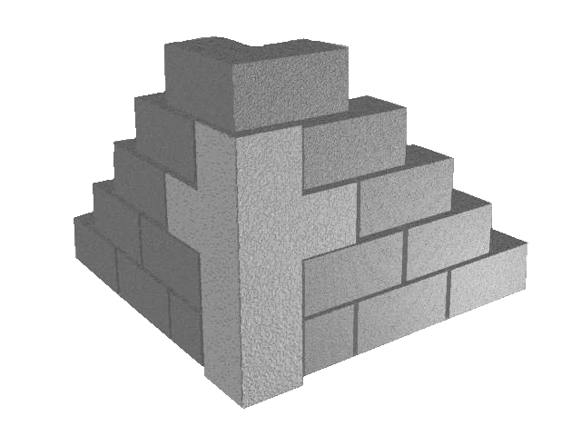
❖ A sinful past & a beautiful future
❖ Forgiveness & accountability
❖ Broken people & a holy God
❖ Different cultures & classes
❖ Husband & a wife
❖ Parent & child
❖ Hope & hard work
Notes:
Things going in different direction.
Two things not like each other

Slide 18
1 Peter 1:17-18
“See, I lay a stone in Zion, a chosen and precious cornerstone, and the one who trusts in him [Jesus] will never be put to shame.” ⁷ Now to you who believe, this stone is precious. But to those who do not believe, “The stone the builders [families] rejected has become the cornerstone [for families that believe in Him],”
Notes:
Every marriage problem is a cornerstone problem
Two different people, stories and passions -
What you won’t do for each other - do for him
When you are suffering - don’t stumble over him - love His way
He can bring you out of darkness - and bring you together

Slide 19
Is Jesus
Precious To Us?
“I tell you the truth, anyone who will not receive the kingdom of God like a little child will never enter it.”
Luke 18:17
Notes:
Do you have to follow Jesus - or do you get to?
Did he take all your shame - pay the price | so you can forgive
Give you a new spirit instead of a temporary circumstance
Suffering and all faling apart - start like a child with Jesus again
Is Jesus precious to your family - “have to go” or “get to go” Have to serve or get to serve - have to pray or get to pray!

Slide 20
What God’s Word is
1:23 “the living and enduring word of God”
1:25 “the word of the Lord stands forever. ”
2:2 “Like newborn babies, crave pure spiritual milk ”
What God’s Word Does
2:3 By obeying it you ”taste that the Lord is good”
2:2 “by it you may grow up in your salvation"
1:22 By obeying it you can love others deeply

Slide 21
Obeying God’s Word
“The Mortar” (Glue)
Jesus
The Cornerstone
Notes:
The way grow and build up our marriage
Not by getting my way, not by getting your way, choosing his way
(conflict resolution) - if we obey / purify, love, experience

Slide 22
Is God’s Word
Oxygen To Us?
“ Man shall not live by bread alone, but by every word that comes from the mouth of God.”
Matthew 4:4
Notes:
If oxygen leaves you would - you would stop
Pleasure - do we still focus and follow (Busy)
Pain - do we still focus and follow
Do we push away God’s Word for sports, people
How do we turn to it in good times and bad

Slide 23
Loving God’s People
1:22 “you have sincere love for your brothers ”
1:22 “love one another deeply, from the heart. ”
2:10 “now you are the people of God”
What Loving God’s People Does
2:10 You are no longer isolated from mercy & grace
2:9 deepens your belonging & identity
2:5 builds you up together in strength
Notes:
CONSUMER VS. COMMITTED

Slide 24
Loving God’s People
“Living Stones”
Obeying God’s Word
“The Mortar”
Jesus
The Cornerstone
Notes:
We build our family by loving God’s people
This is how the God’s Kingdom & The Kingdom of This World are different

Slide 25
“The Kingdom Paradox”
When you give God’s way
You receive more.
When you focus the family on loving God’s people, you love each other more.
Notes:
Your sinful nature would rather you do something impure and sinful to avoid
pain in order to “feel” better now, but be worse and weaker later.
Not bitter and controlling
Not bitter and revenge or retaliation that feels better
Family

Slide 26
Are God’s People
Loved By Us?
“A new command I give you: Love one another. As I have loved you, so you must love one another.”
John 13:34

Slide 27
Our Family Will Heal, Grow & Win When:
JESUS IS PRECIOUS TO US
HIS WORD IS OXYGEN TO US
HIS PEOPLE ARE LOVED BY US
Notes:
This is a different way

