Slide 1
A New Year To Bring Us Closer To The One Thing That Never Changes

Slide 2
You have made known to me the path of life; You will fill me with joy in Your Presence, with eternal pleasures at Your right hand. Psalm 16:11

Slide 3
Knowing about someone is not the same as being with someone
Notes:
Even knowing that someone loves you is not the same as being in their presence and them expressing that love

Slide 4
Create in me a clean heart, O God, And renew a steadfast spirit within me. Do not cast me away from Your Presence, And do not take Your Holy Spirit from me. Psalm 51:10-11

Slide 5
The Holy Spirit is God’s personal and transforming presence with you
Notes:
Even knowing that someone loves you is not the same as being in their presence and them expressing that love

Slide 6
But I tell you the truth: It is for your good that I am going away. Unless I go away, The Counselor [The Holy Spirit] will not come to you; but if I go, I will send Him to you. John 16:7

Slide 7
And with that Jesus breathed on them and said, “Receive the Holy Spirit.” John 20:22

Slide 8
There is nothing more important than SEEKING HIS PRESENCE
Notes:
Even knowing that someone loves you is not the same as being in their presence and them expressing that love

Slide 9
In my former book [the Gospel of Luke], Theophilus, I wrote about all that Jesus began to do and to teach until the day he was taken up to heaven, after giving instructions through the Holy Spirit to the apostles he had chosen. After his suffering [and death on The Cross], showed himself to these men and gave many convincing proofs that he was alive. Acts 1:1-3a

Slide 10
He appeared to them over a period of forty days and spoke about the kingdom of God. On one occasion, while he was eating with them, he gave them this command: “Do not leave Jerusalem, but wait for the gift my Father promised, which you have heard me speak about. For John baptized with water, but in a few days you will be baptized with the Holy Spirit.” Acts 1:3b-5

Slide 11
So when they met together, they asked him, “Lord, are you at this time going to restore the kingdom to Israel?” Jesus said to them: “It is not for you to know the times or dates the Father has set by his own authority. But you will receive power when the Holy Spirit comes on you; and you will be my witnesses in Jerusalem, and in all Judea and Samaria, and to the ends of the earth.” Acts 1:6-8

Slide 12
“Jesus gave them this command: ‘Do not leave Jerusalem, but wait for the gift my Father promised, which you have heard me speak about. For John baptized with water, but in a few days you will be baptized with the Holy Spirit.’” Acts 1:5

Slide 13
TO WAIT FOR HIS PRESENCE INCLUDES: Finding A Place To Be Together “Do not leave Jerusalem, but wait”
Notes:
(how his holiness is accomplished through unholy but repentant people who get together)
If you don’t have a place – you don’t have a priority)
Everything that is important to you, you have a place for (home and church)

Slide 14
TO WAIT FOR HIS PRESENCE INCLUDES: The Promises From His Word “but wait for the gift my Father promised, which you have heard me speak about.”
Notes:
(how his holiness is accomplished through unholy but repentant people who get together)
If you don’t have a place – you don’t have a priority)
Everything that is important to you, you have a place for (home and church)

Slide 15
INTRODUCTION TO THE HOLY SPIRIT with Pastor Shawn Five Wednesdays, 7-8:15p Jan 26– Feb 23 Indicate online or connection card in seat pocket in front of you
Notes:
Anything we have is either clutter or constipation

Slide 16
TO WAIT FOR HIS PRESENCE INCLUDES: Purifying Yourself Of Sinful Idols “For John baptized with water, but in a few days you will be baptized with the Holy Spirit.”
Notes:
(how his holiness is accomplished through unholy but repentant people who get together)
If you don’t have a place – you don’t have a priority)
Everything that is important to you, you have a place for (home and church)

Slide 17
15 DAYS OF WORSHIP & WAITING A time to fast from the idol of this world and feast on His Presence Starting Sunday, January 9 through January 23 Online devotional & worship studying Acts 1:1-2:4
Notes:
Anything we have is either clutter or constipation

Slide 18
TO WAIT FOR HIS PRESENCE INCLUDES: Surrendering Your Preconceived Ideas “So when they met together, they asked Jesus, ‘Lord, are you at this time going to restore the kingdom to Israel?”
Notes:
(how his holiness is accomplished through unholy but repentant people who get together)
If you don’t have a place – you don’t have a priority)
Everything that is important to you, you have a place for (home and church)

Slide 19
15 DAYS OF WORSHIP & WAITING January 9 - 23 - Finding A Place Together - The Promises Of His Word - Purifying Ourselves Of Idols - Surrendering Preconceived Ideas
Notes:
Anything we have is either clutter or constipation

Slide 20
But you will receive power when the Holy Spirit comes on you; and you will be my witnesses in Jerusalem, and in all Judea and Samaria, and to the ends of the earth.” Acts 1:8

Slide 21
Blessing Our Board Of Supervisors This Wednesday, Jan 5, 6p (5:45p) May our consistent obedience to pray for and give thanks for our leaders be a powerful witness and work of Jesus Public Meeting Room: 10001 Iron Bridge Rd, Chesterfield 23238
Notes:
Anything we have is either clutter or constipation

Slide 22
Gathering Together In Person & Online M-F (9-23) 8a zoom @ cornerstone.ag W (5,12) Noon Time Prayer Sa (15,22) 9a Elder Led Prayer W (12) 7pm Worship & Waiting W (19) 7p Spanish Worship & Waiting
Notes:
Anything we have is either clutter or constipation

Slide 23
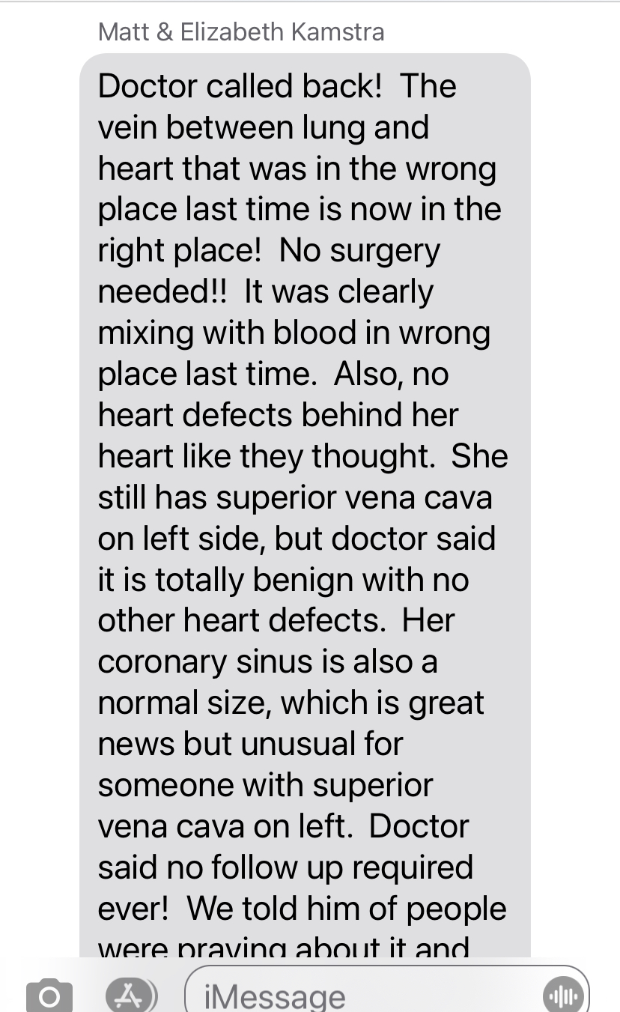
But you will receive power when the Holy Spirit comes on you; and you will be my witnesses in Jerusalem, and in all Judea and Samaria, and to the ends of the earth.” Acts 1:8

Slide 24
15 DAYS OF WORSHIP & WAITING - A Place Together - The Promises Of His Word - Purifying Ourselves Of Idols - Surrendering Preconceived Ideas “You will seek me and find me when you seek me with all your heart. I will be found by you,’ declares the Lord” – Jeremiah 29:13-14
Notes:
Anything we have is either clutter or constipation

