Slide 1
We see a church filled
with mobilized members
who love helping others
follow Jesus together
Cornerstone Vision Statement

Slide 2
Between my current confusion
and my kingdom calling
is God’s loving process

Slide 3
STEP 1
Real surrender to God
“I am the Lord’s servant,” Mary answered. “May it be to me as you have said.”
(Luke 1:38)

Slide 4
STEP 2
TIME OF TESTING
“Because Joseph her husband was a righteous man and did not want to expose her to public disgrace, he had in mind to divorce her quietly.” (Mt 1:19)

Slide 5
STEP 3
LEARNING TO LOVE IN FAMILY
“When Joseph woke up, he did what the angel of the Lord had commanded him and took Mary home as his wife.”
(Mt 1:24)

Slide 6
STEP 4
UNRECOGNIZED PREPARTIONS
And Mary said: “My soul glorifies the Lord and my spirit rejoices in God my Savior, for he has been mindful of the humble state of his servant.” (Lk 1:46-48)

Slide 7
STEP 5
SERVING ANOTHER’S VISION
“Mary stayed with Elizabeth for about three months and then returned home.”
(Lk 1:56)

Slide 8
MOBILIZED MEMBERS
Maria Rodriguez: Hispanic Ministry Leader
Margo Rees: Lydia House Intl., Founder
Doug Wheeling: Project Hope, Co-Founder
Laura Burke: CRC, President

Slide 9
My Mission Work
CHRIST
Español
English
CRISTO

Slide 10
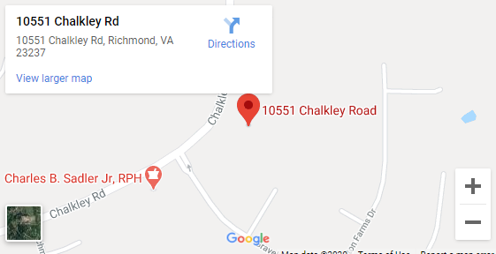
Where I Serve

Slide 11
How To Pray And Connect…
Listen Everywhere
Monthly Spanish Worship Service
Spanish Small Groups

Slide 12
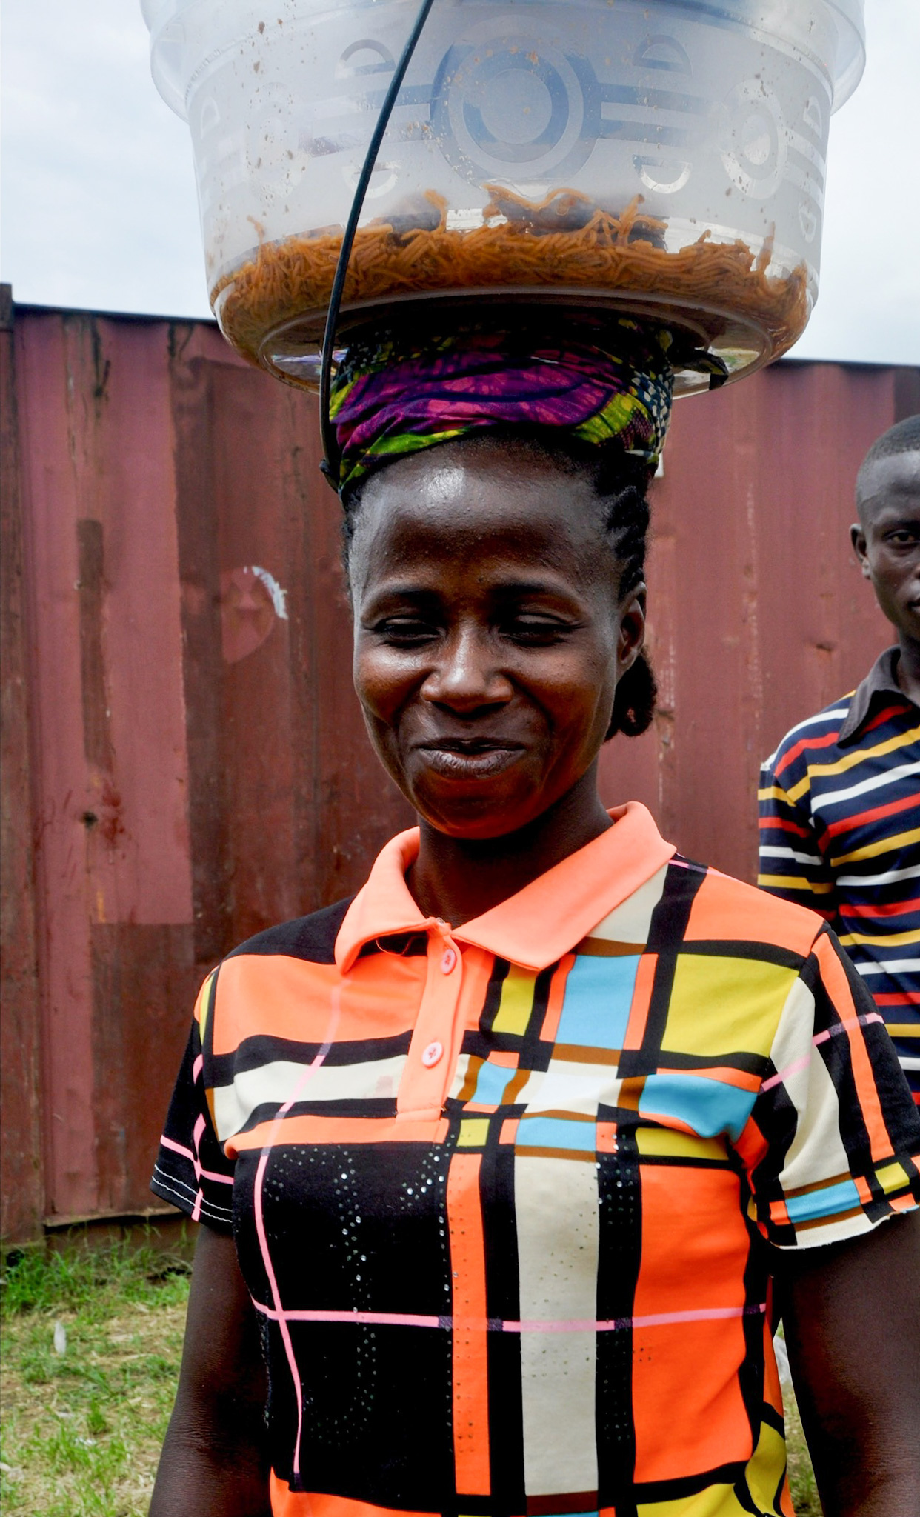
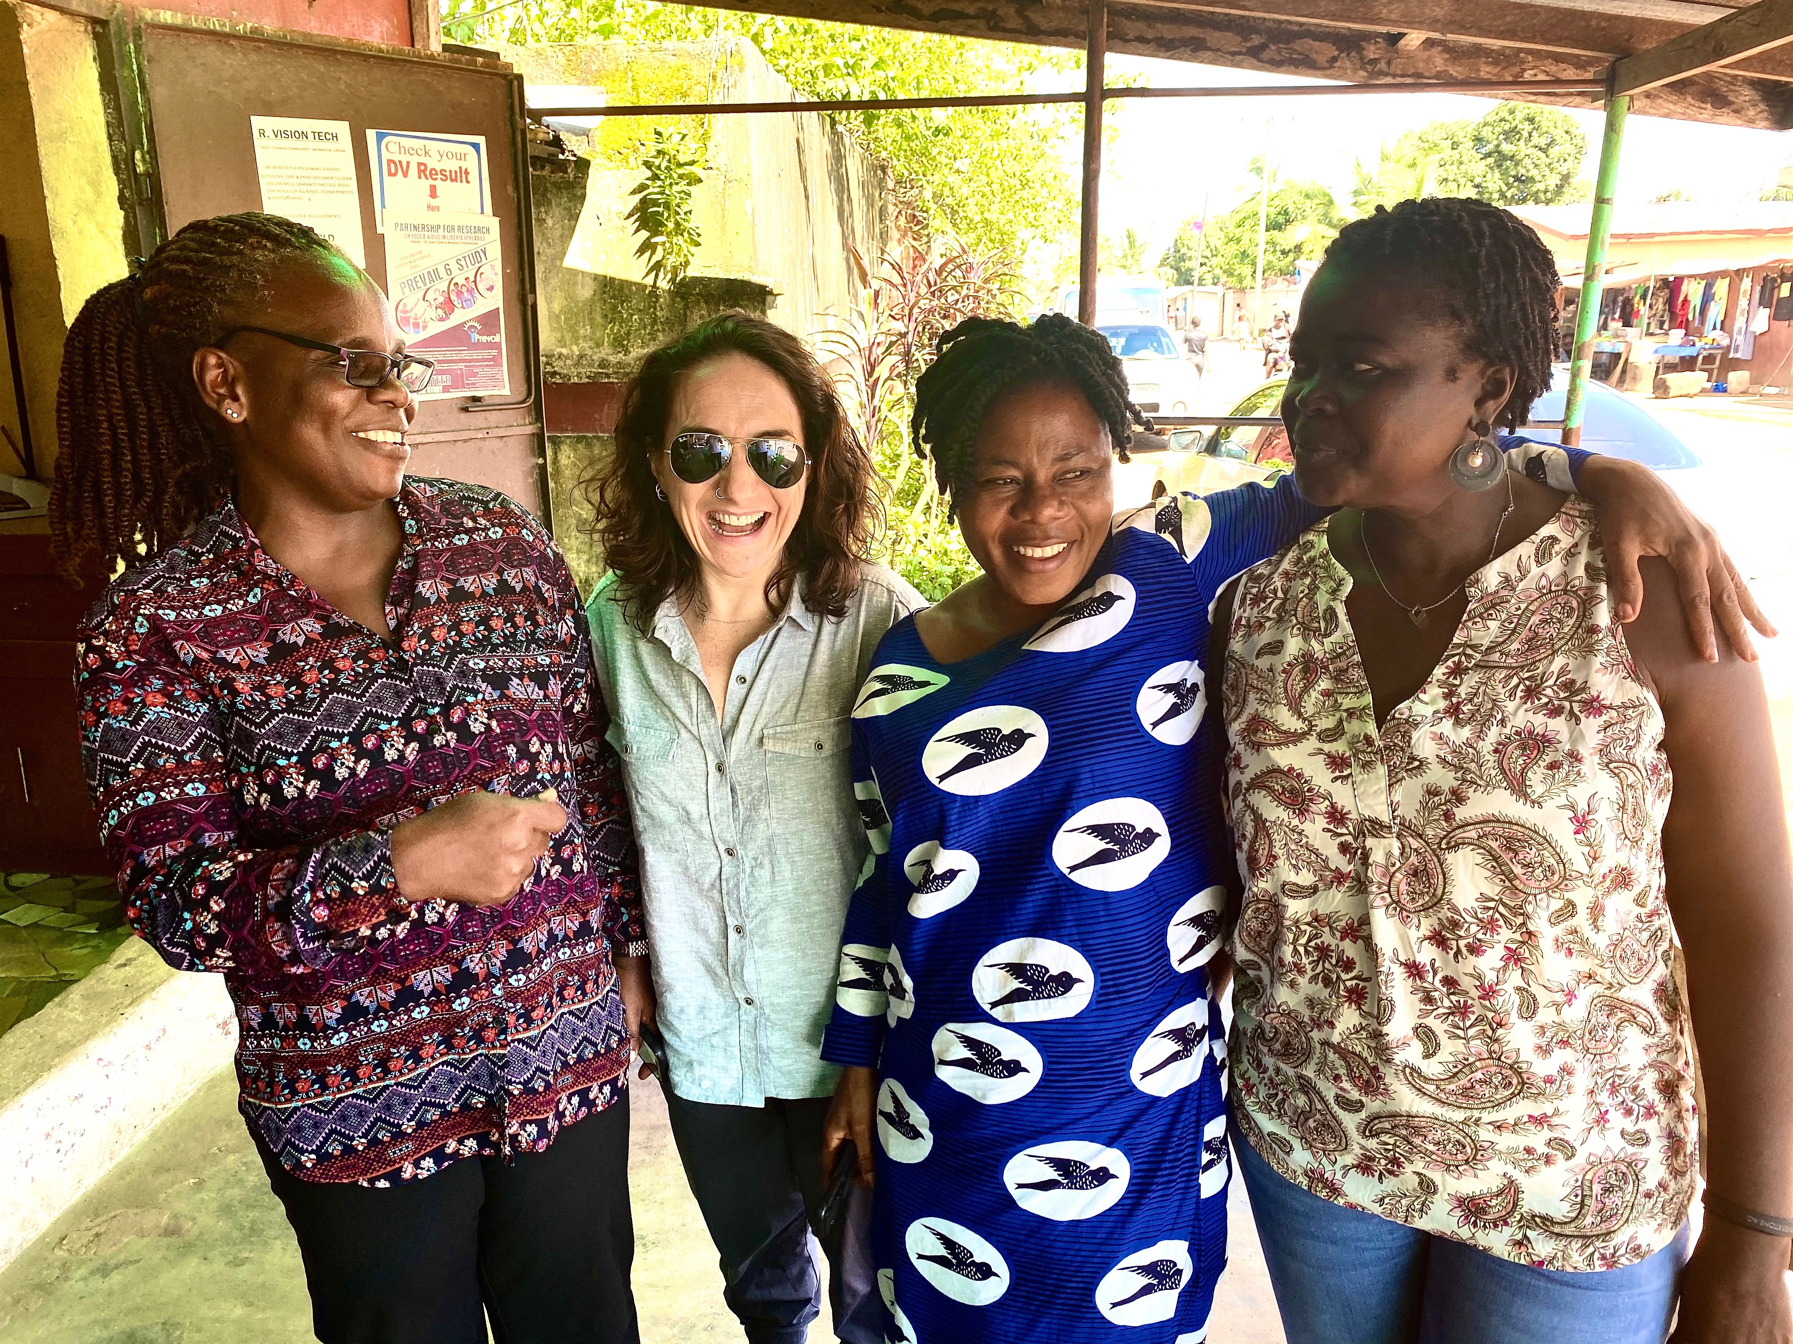
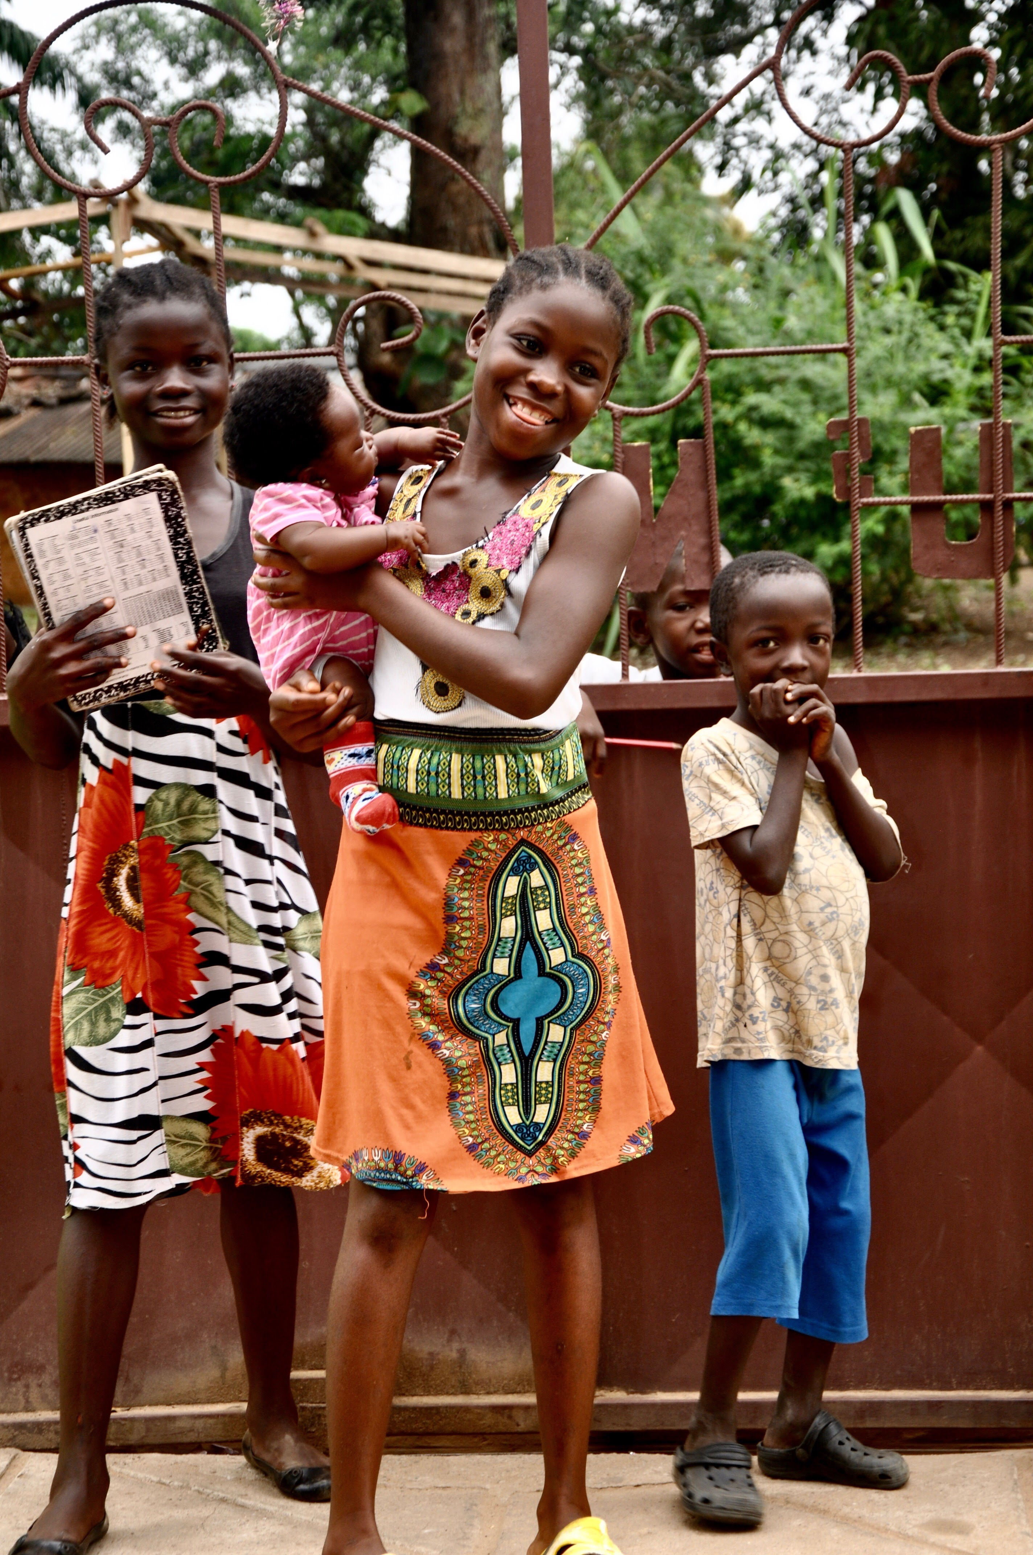
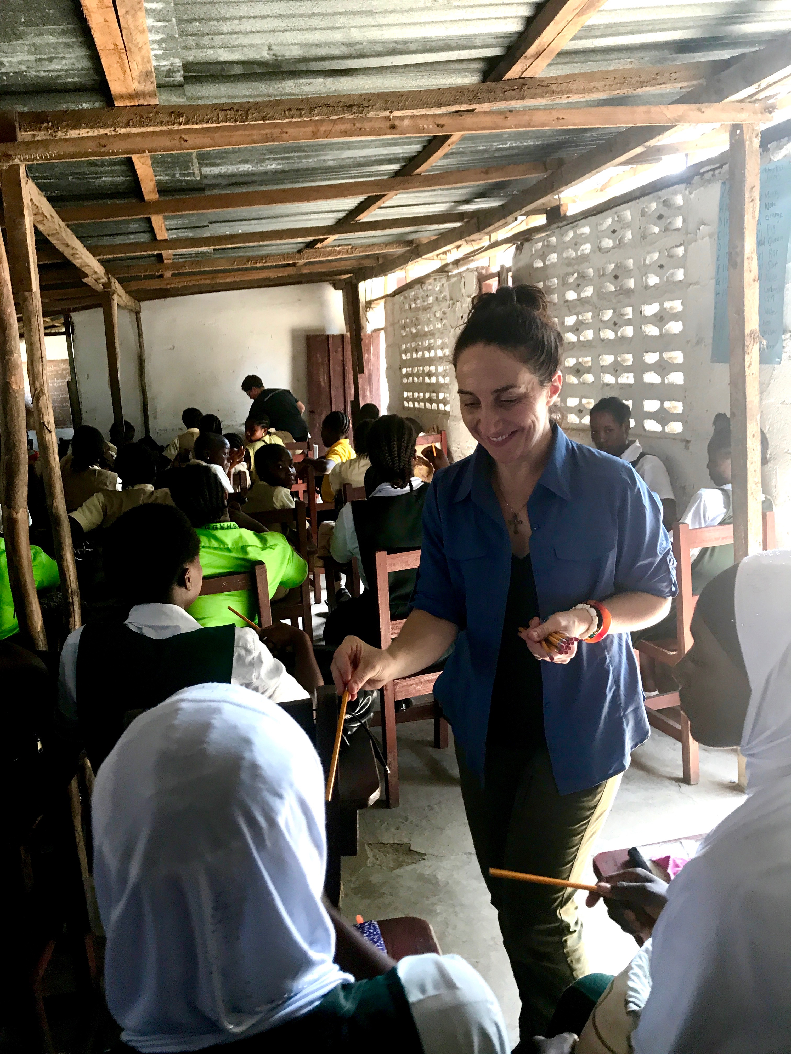
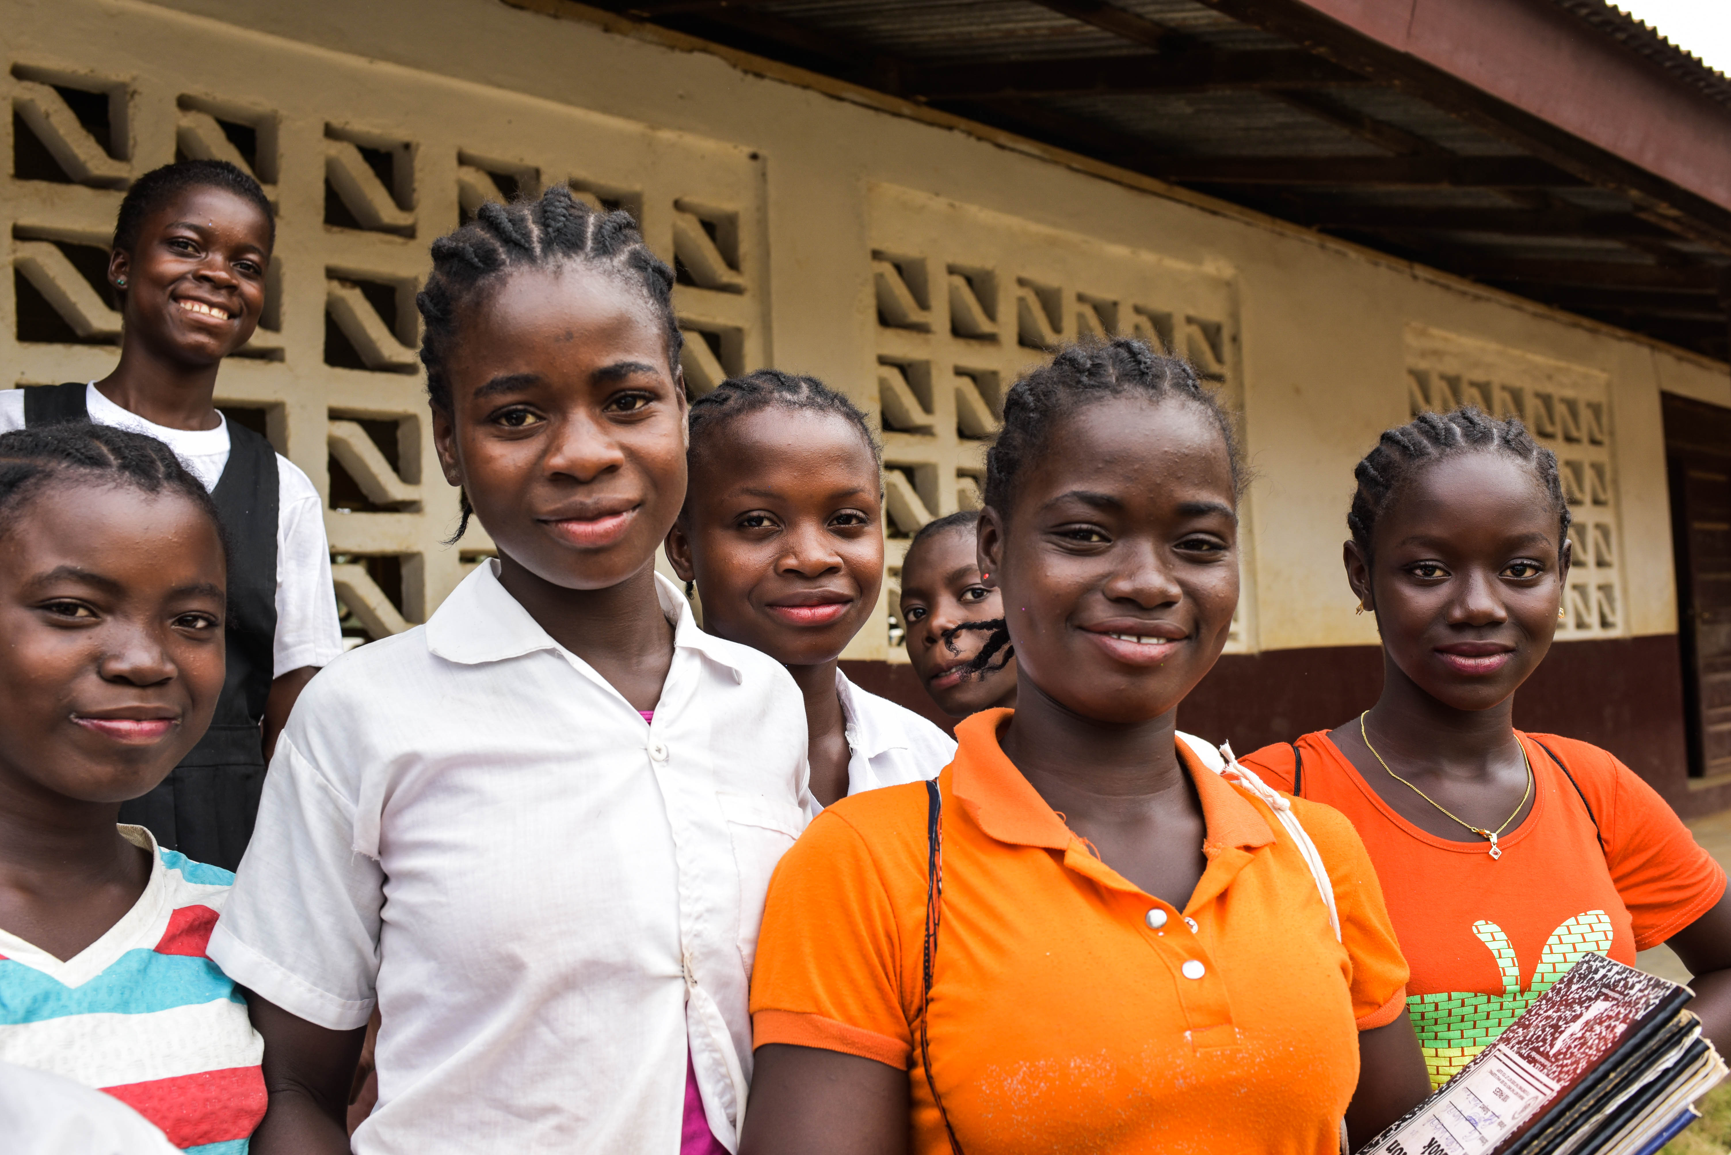
Speak out | Rise up | Lead on

Slide 13
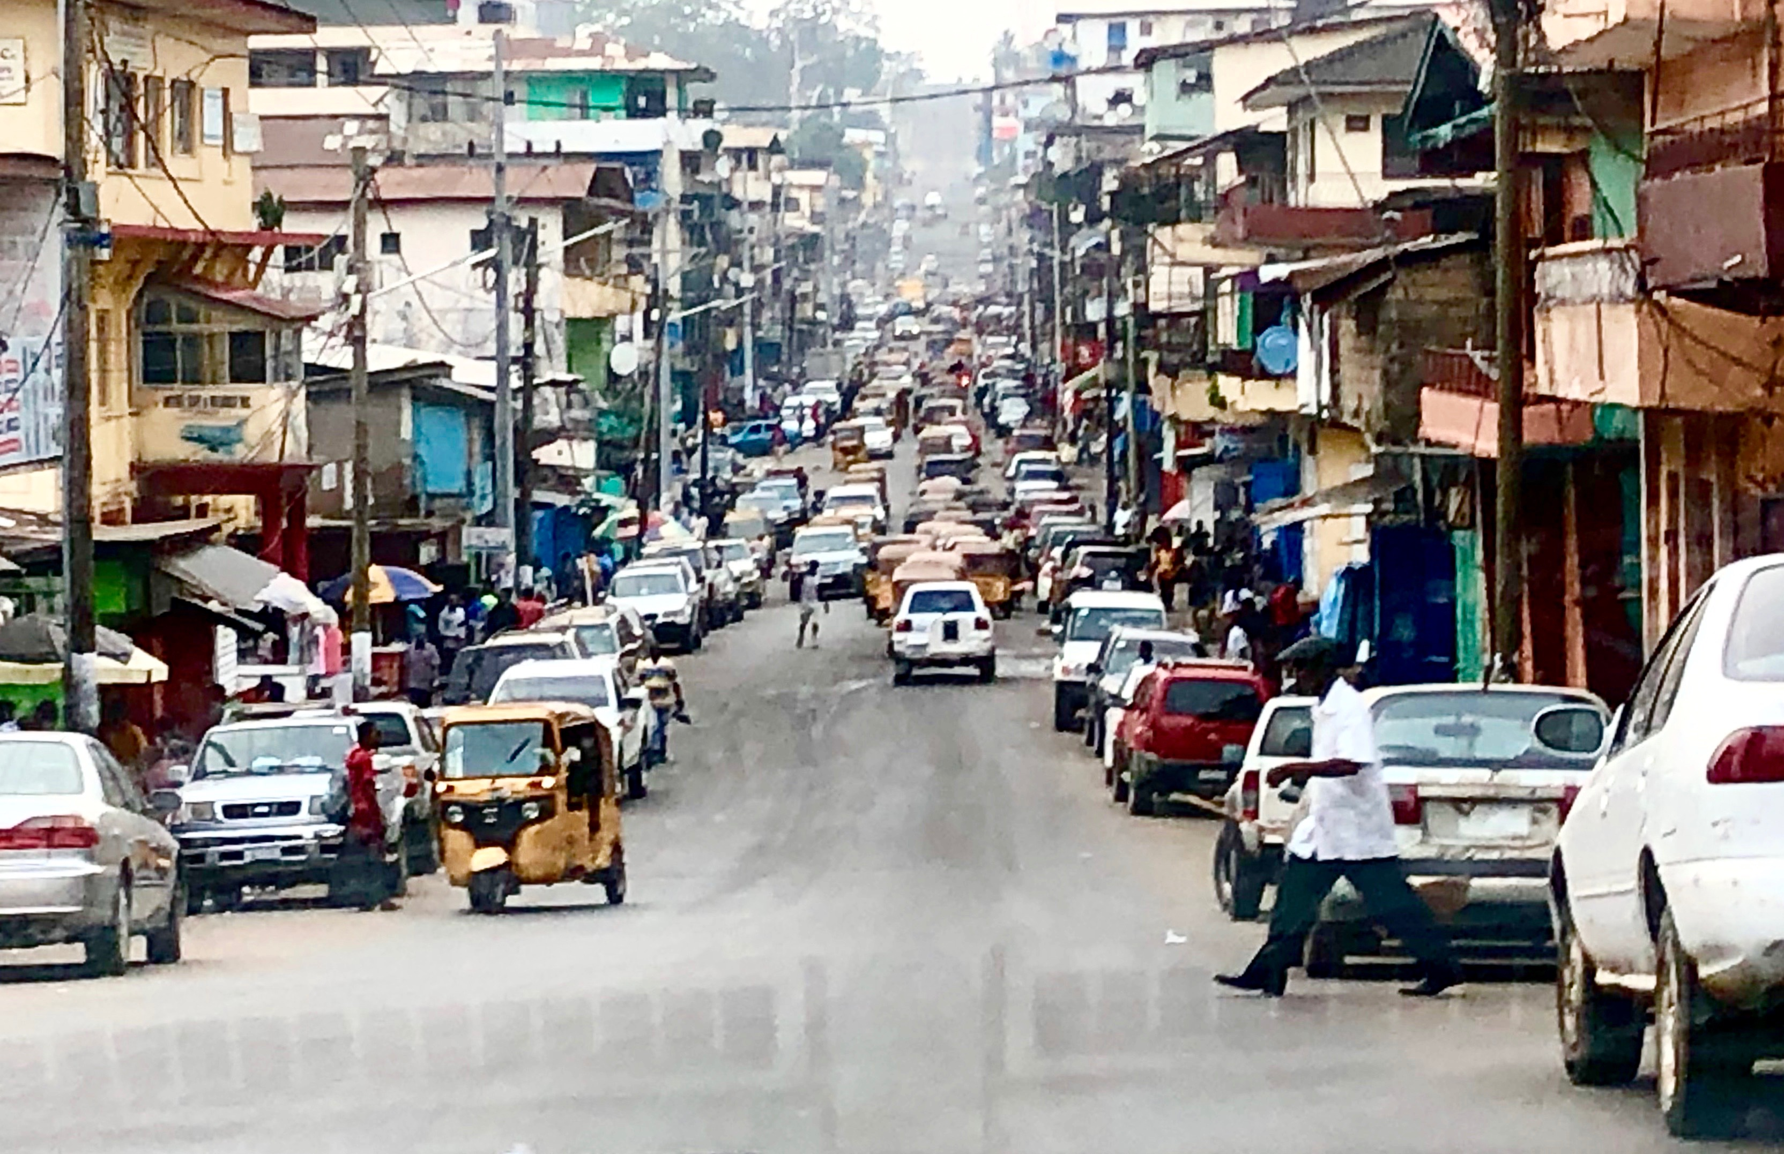
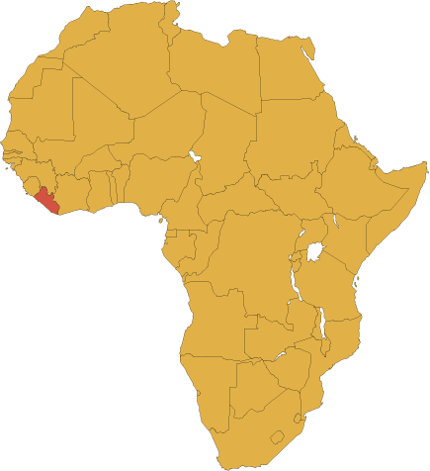
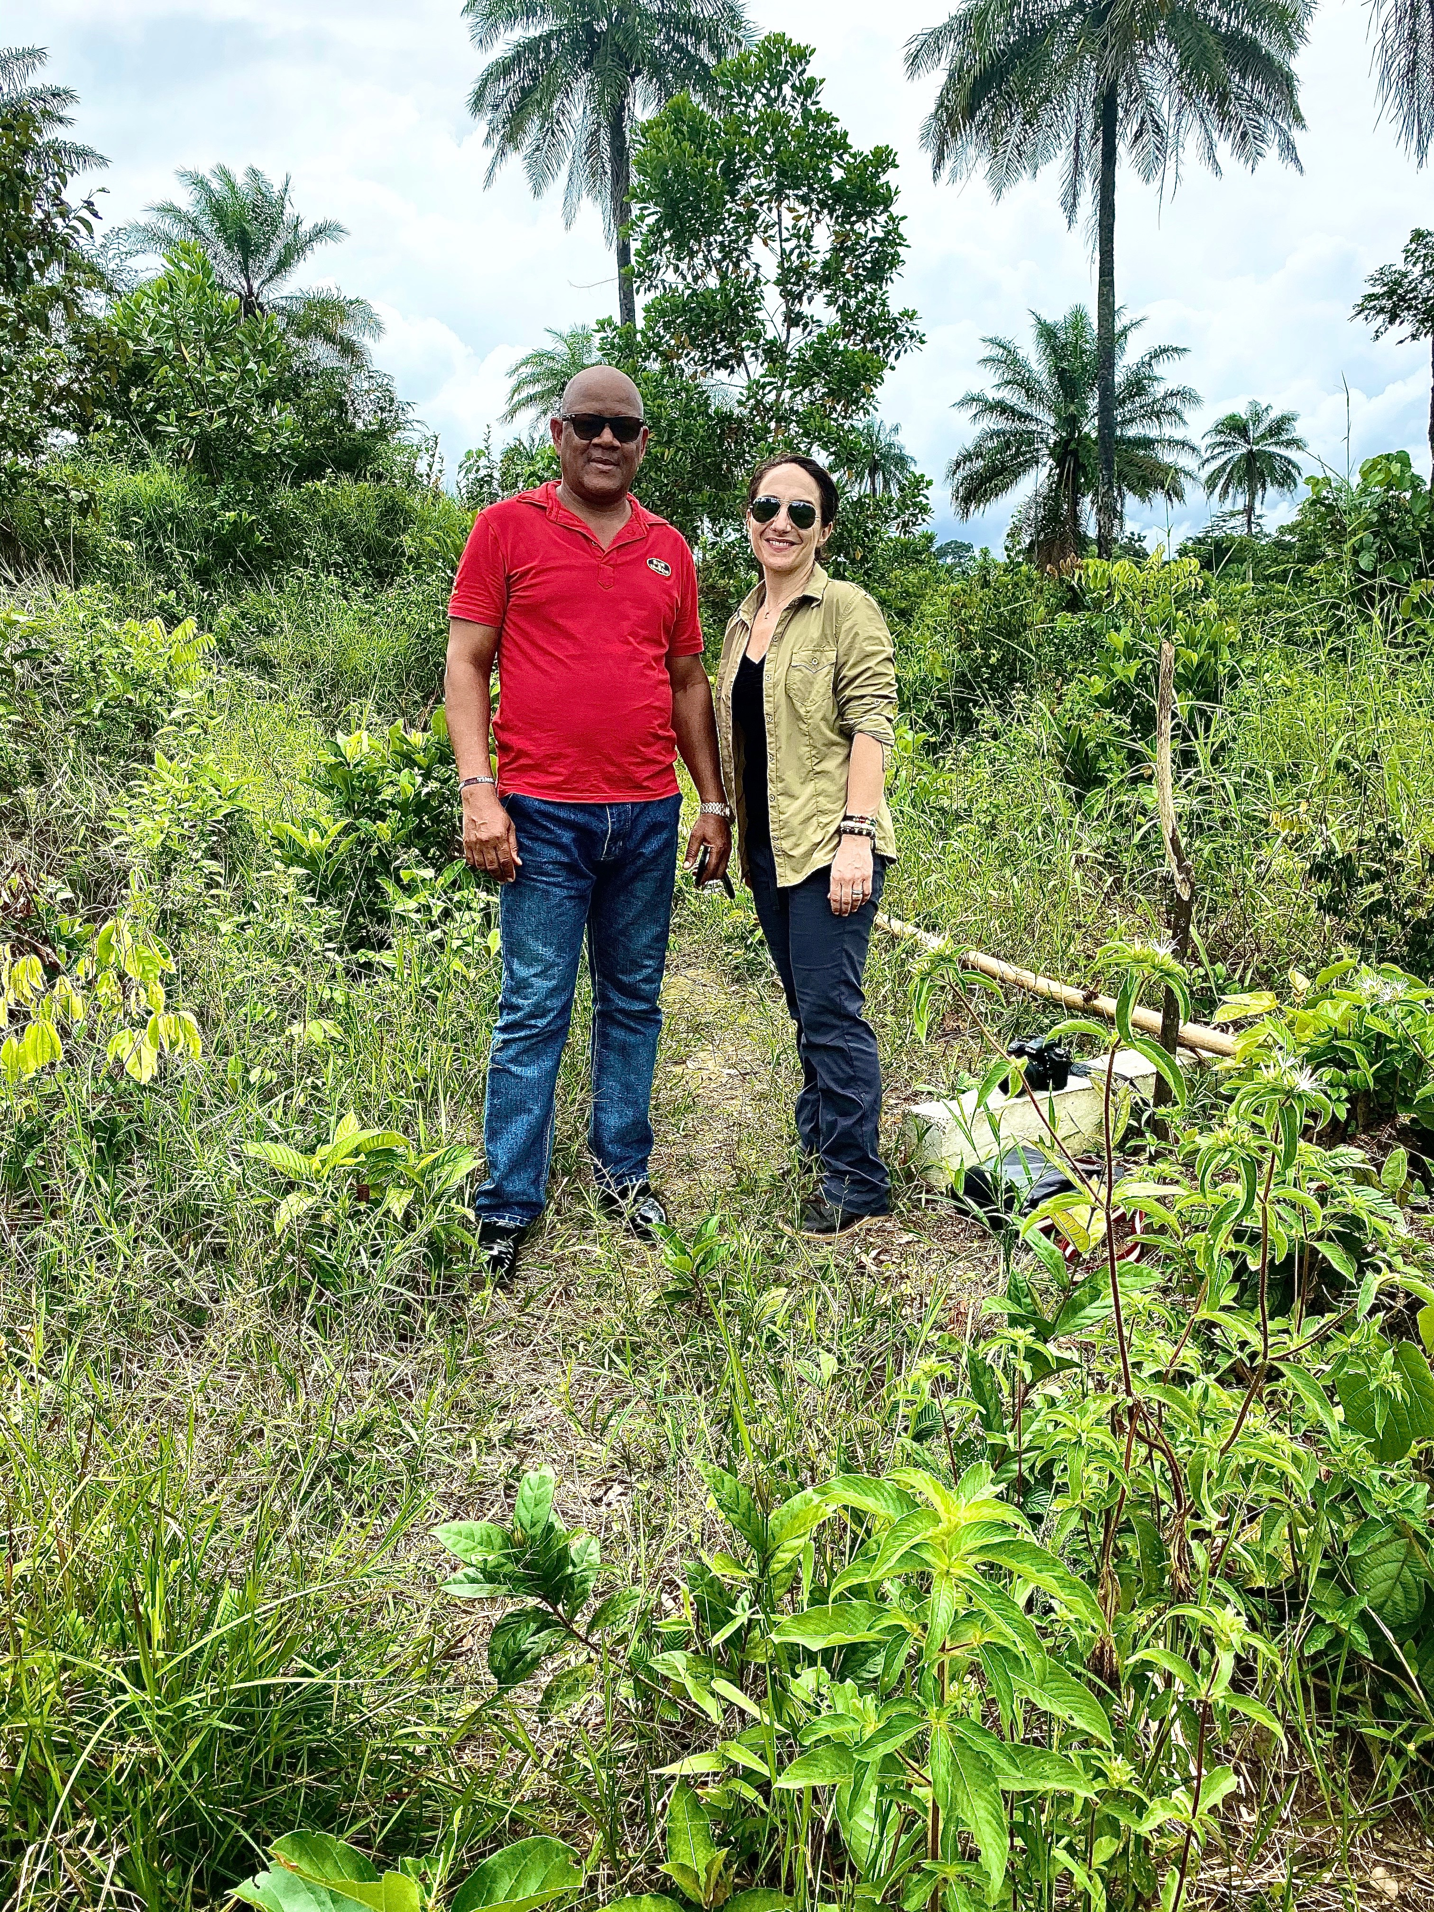
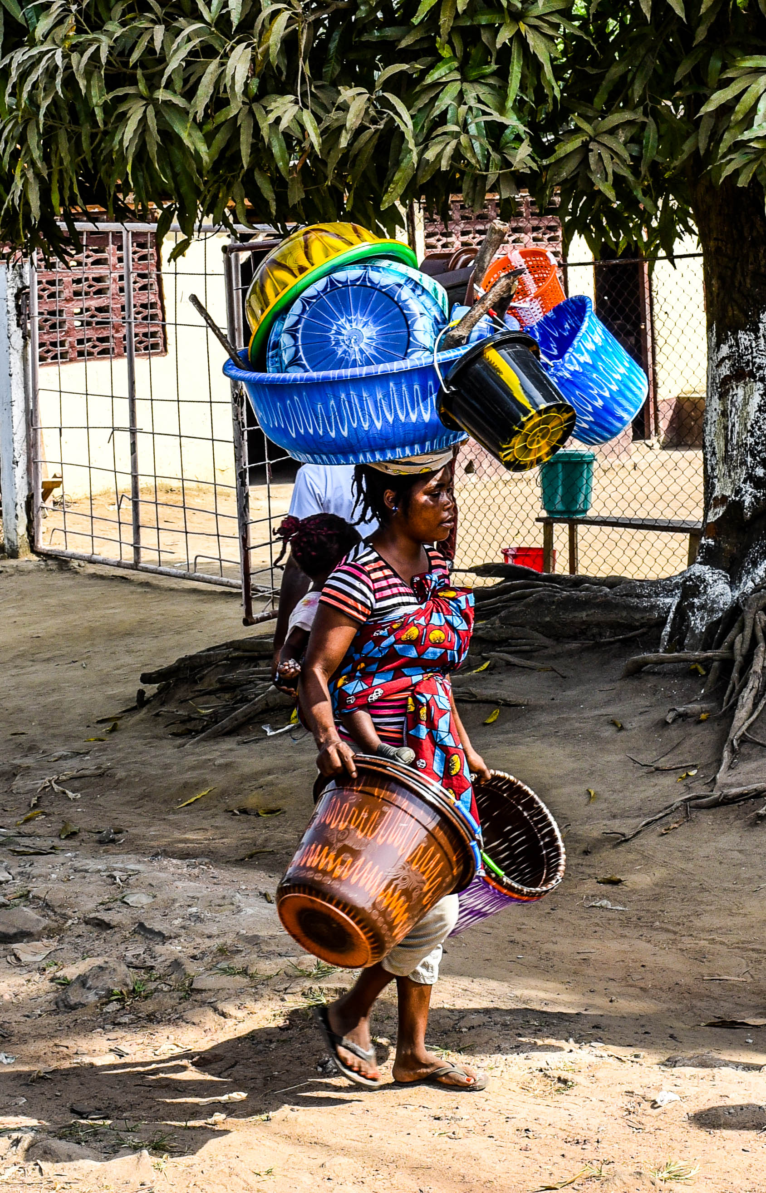
LIBERIA
IN 2020, LIBERIA was ranked
THE POOREST COUNTRY IN THE WORLD
- World Population Review

Slide 14
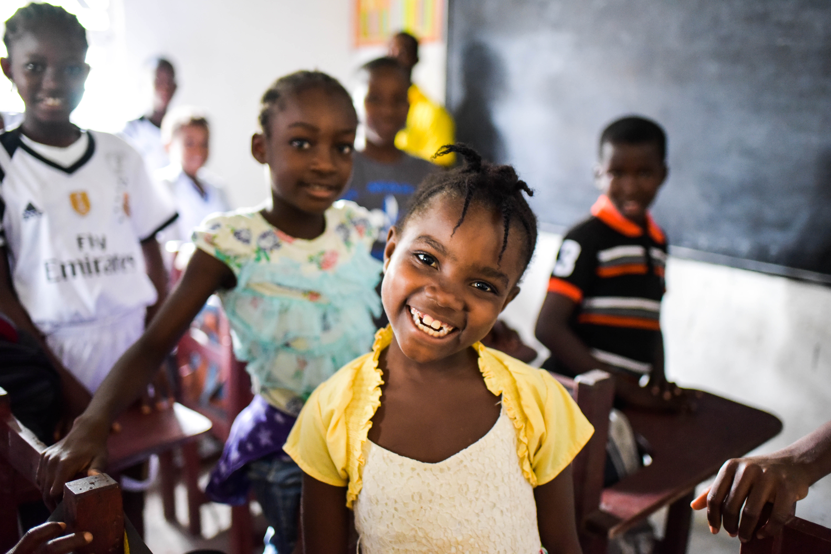
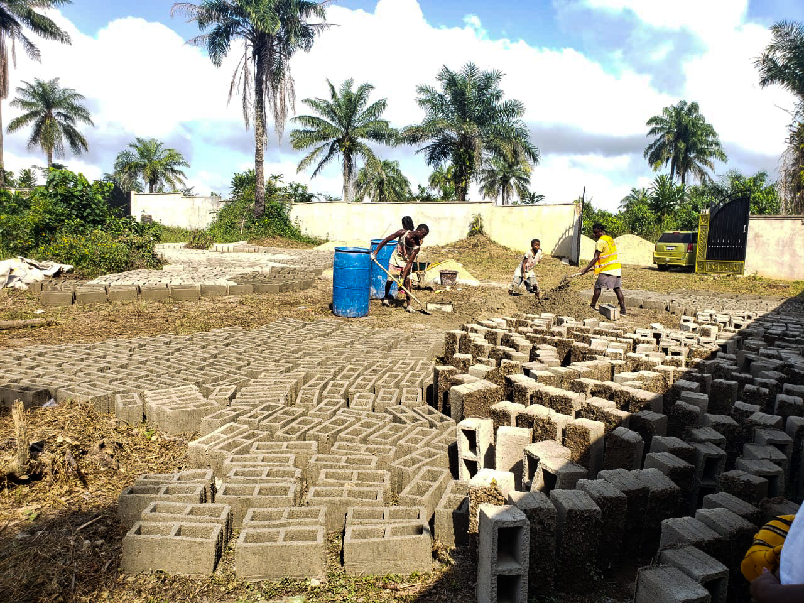
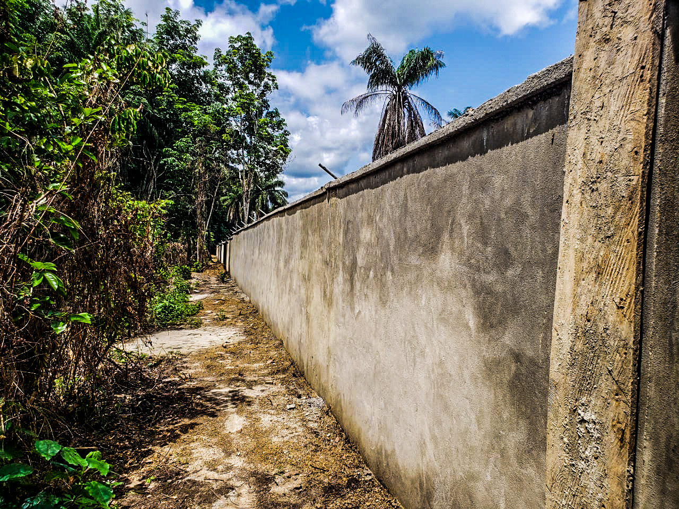
the women + girls of Liberia
our Liberian partners
the construction project + funding
Pray
Give
www.LydiaHouseInternational.org
or: Text “LYDIAHOUSE” to 44-321

Slide 15
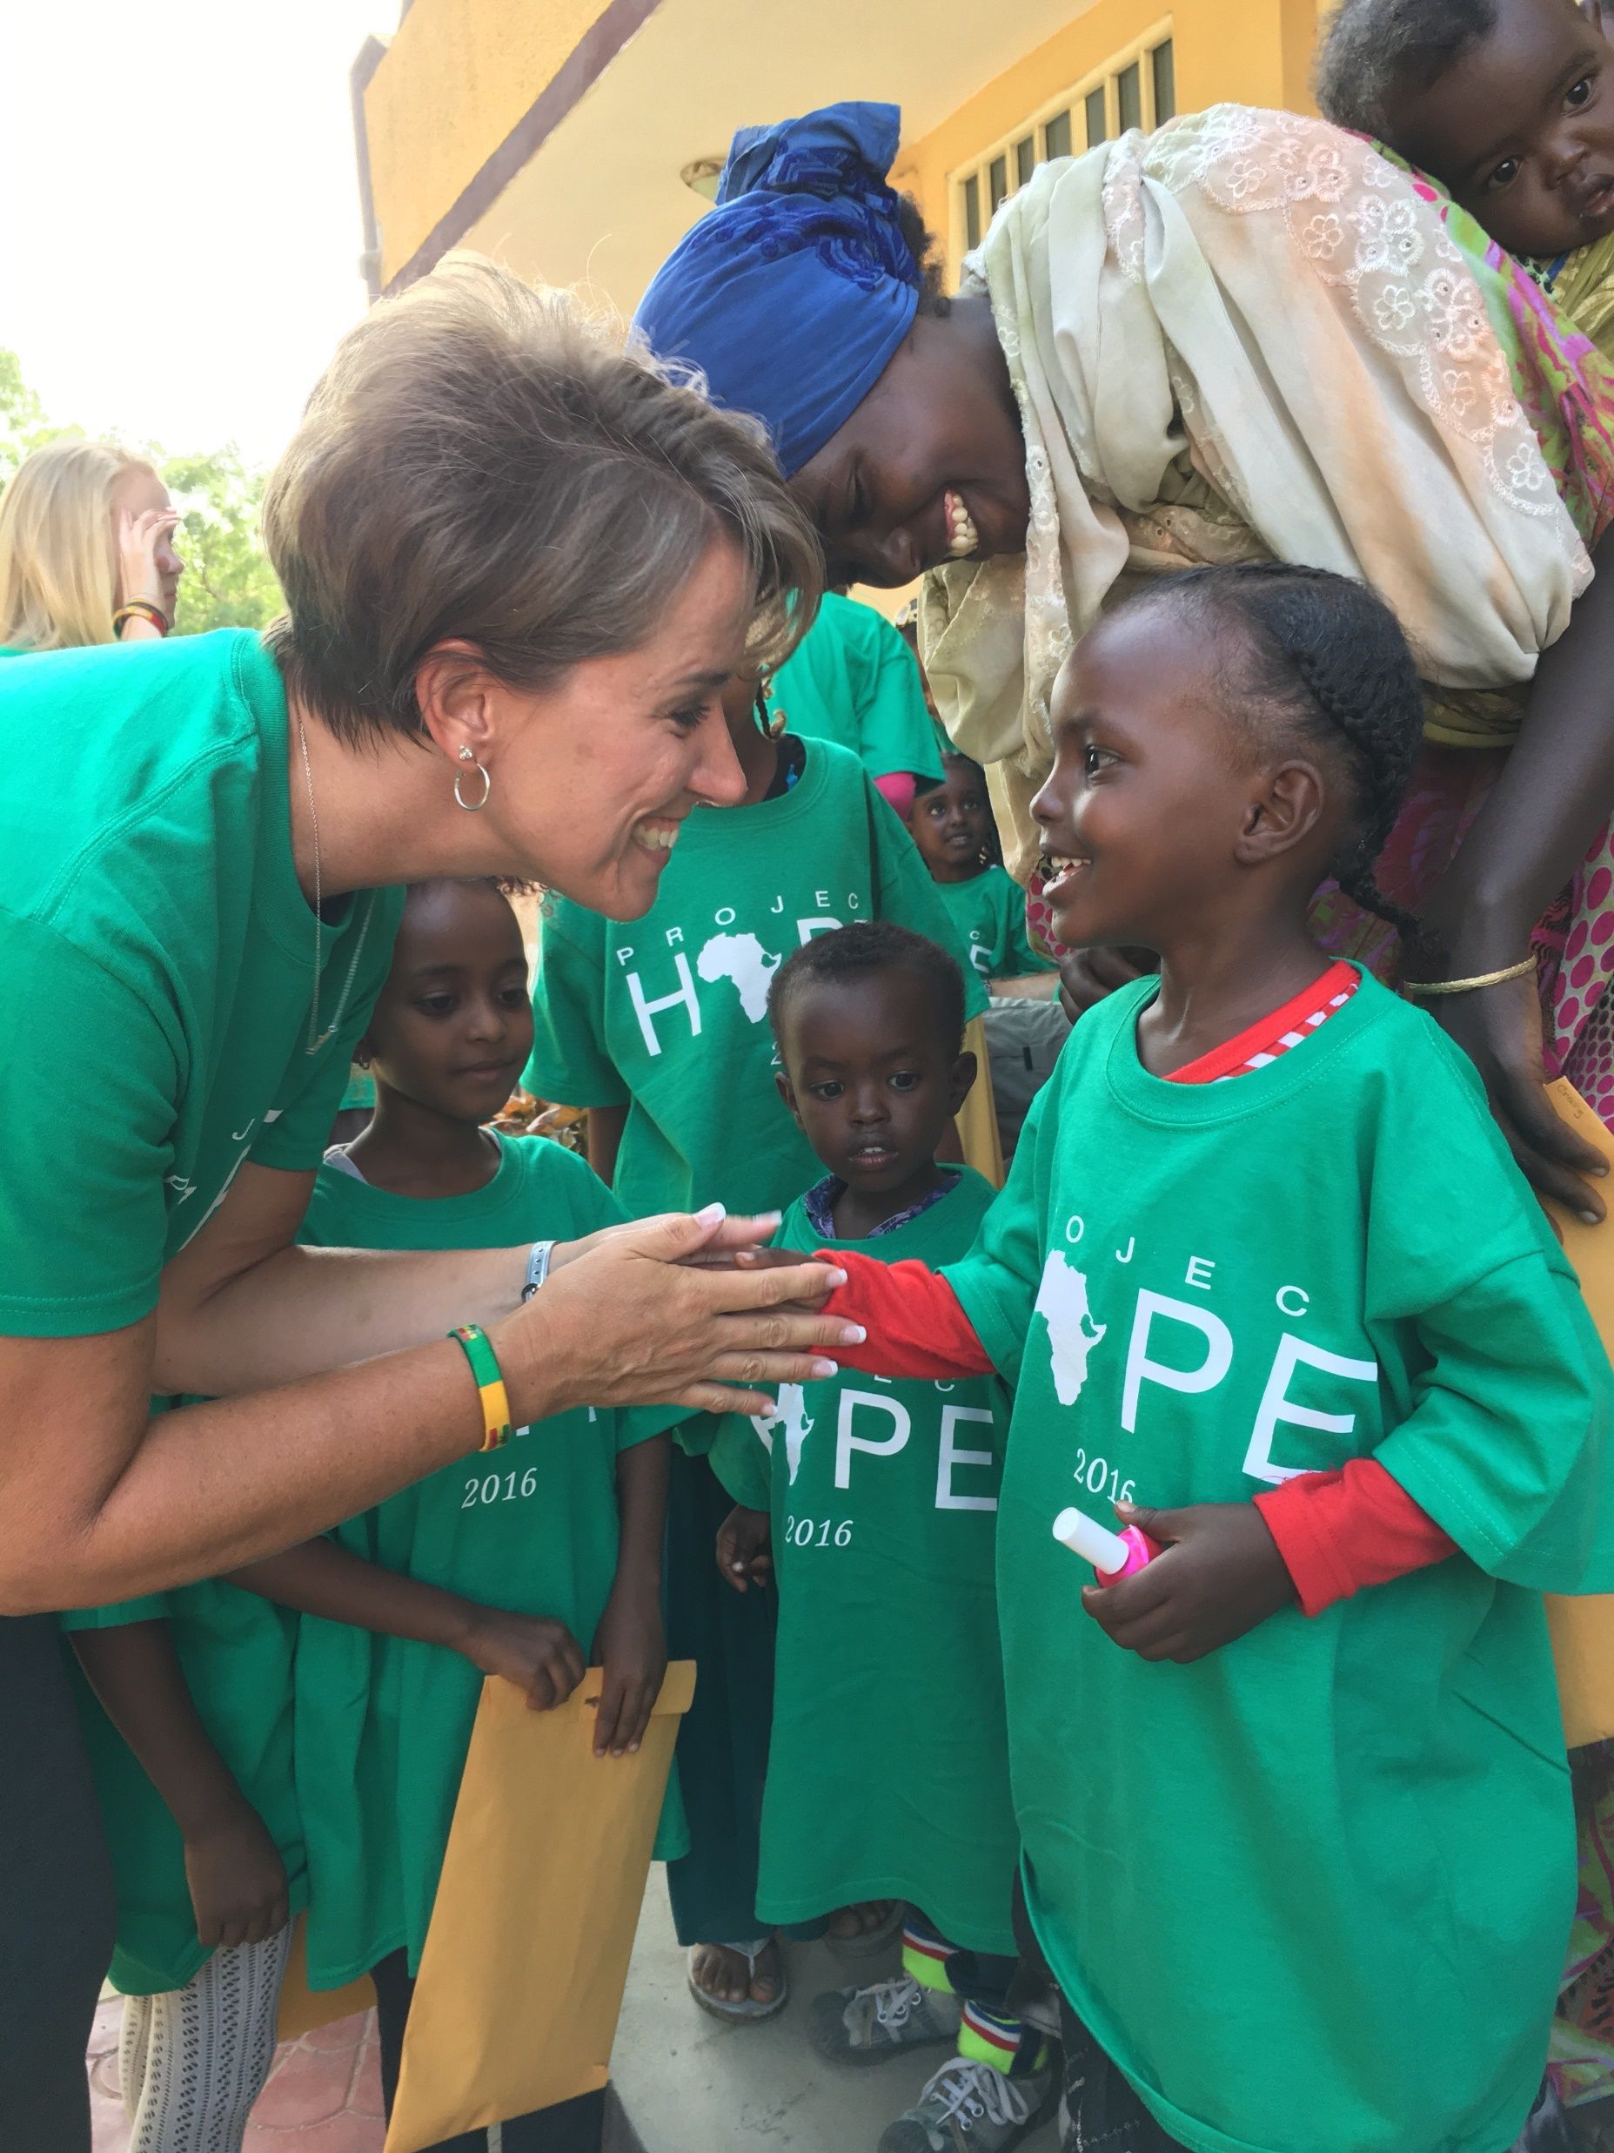
Health Car
Project Hope
A Witness Of Jesus Among The Unreached or Under-Reached Muslim World
H ealth Clinic
O rphan Sponsorship
P rimary Education
E conomic Development

Slide 16
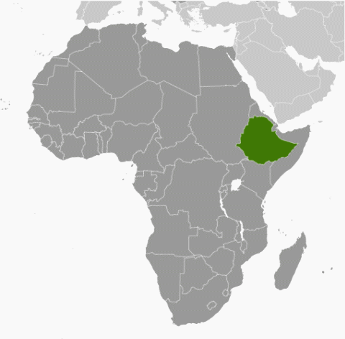
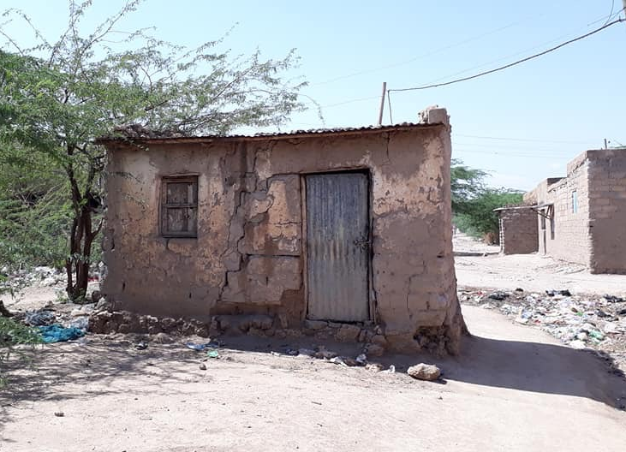
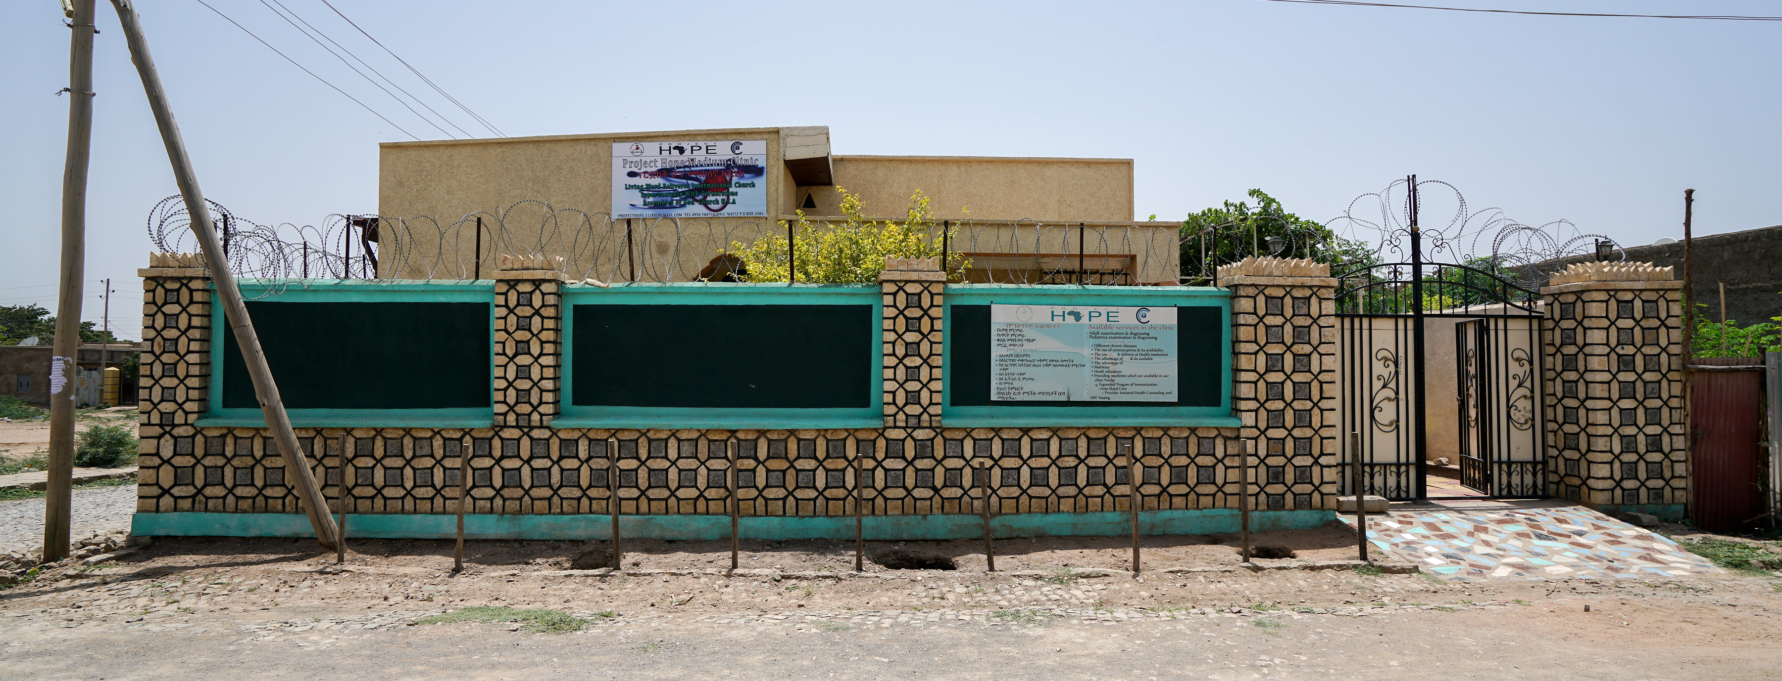

Slide 17
CONNECT & PRAY
Give To Church Christmas Offering
Learn More About Summer Trip
Become a prayer partner

Slide 18
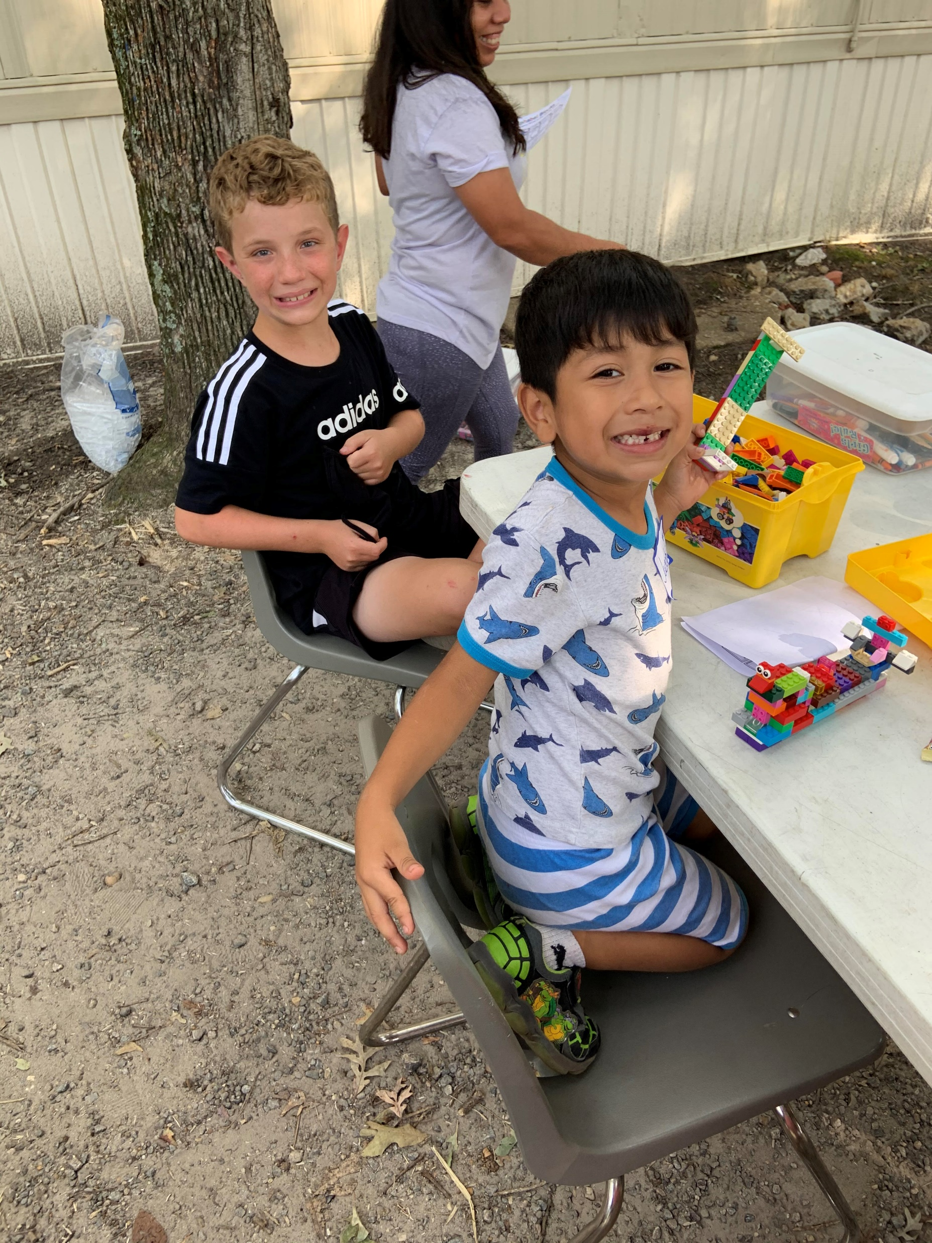
Cornerstone Revitalization Center
Loving and serving children well to reach entire families for Jesus
Notes:
Hispanic ministry and bringing the Hispanic culture and community together with the other cultures and people of cornerstone to show God’s greatness

Slide 19
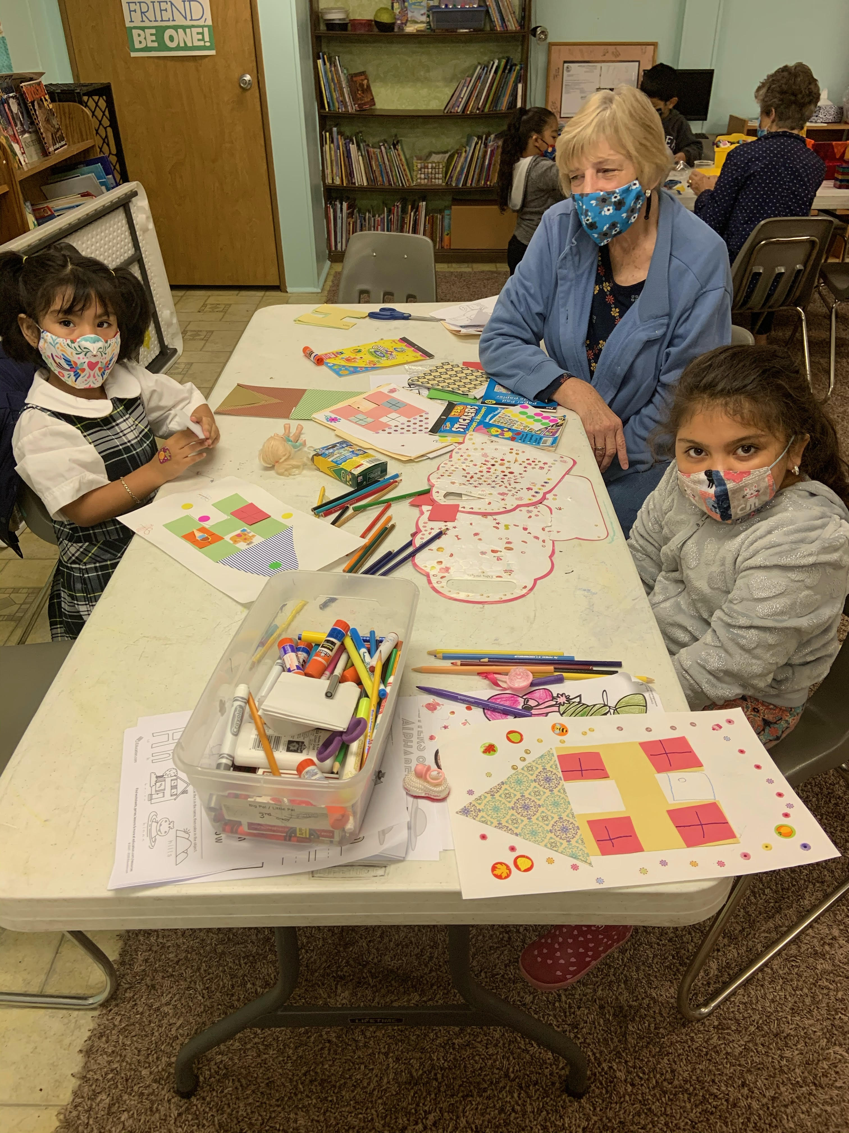
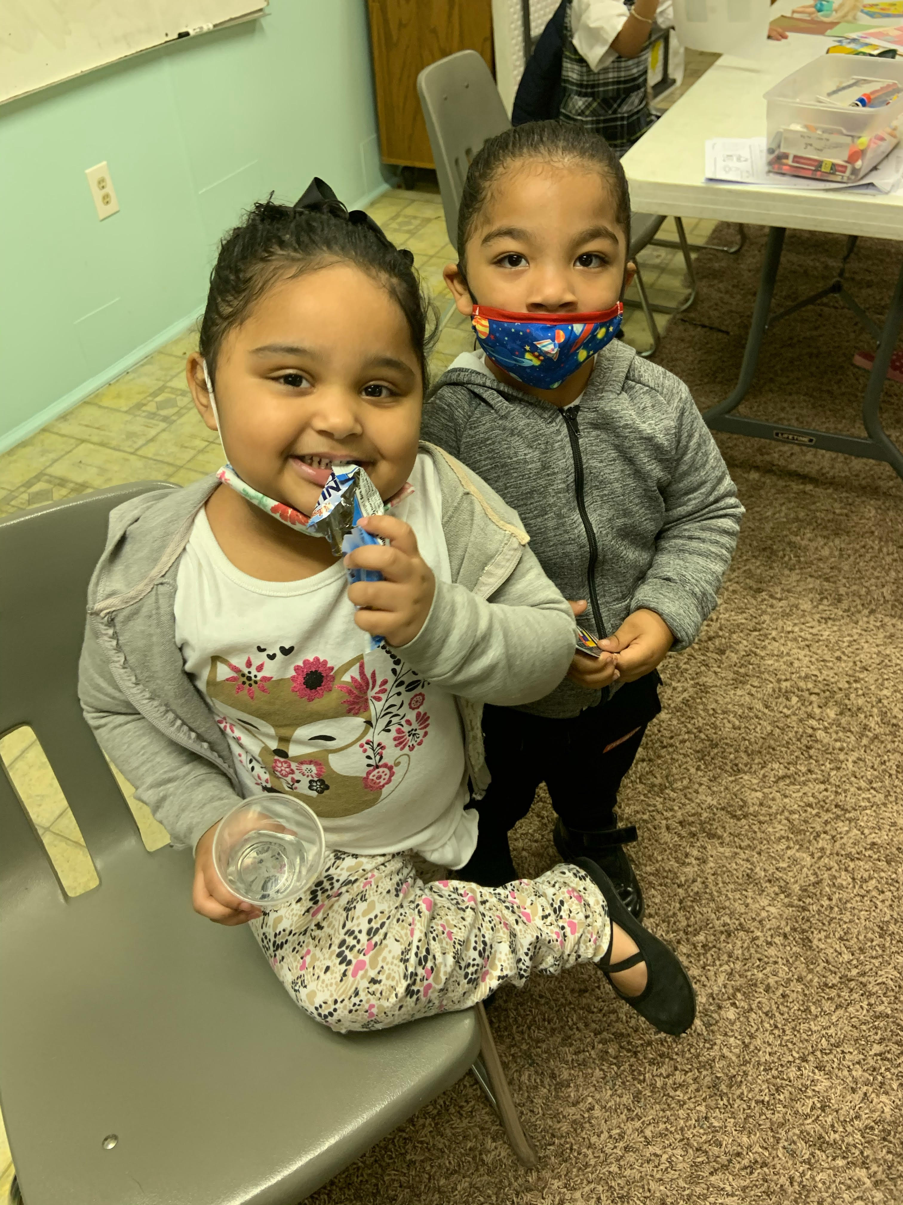
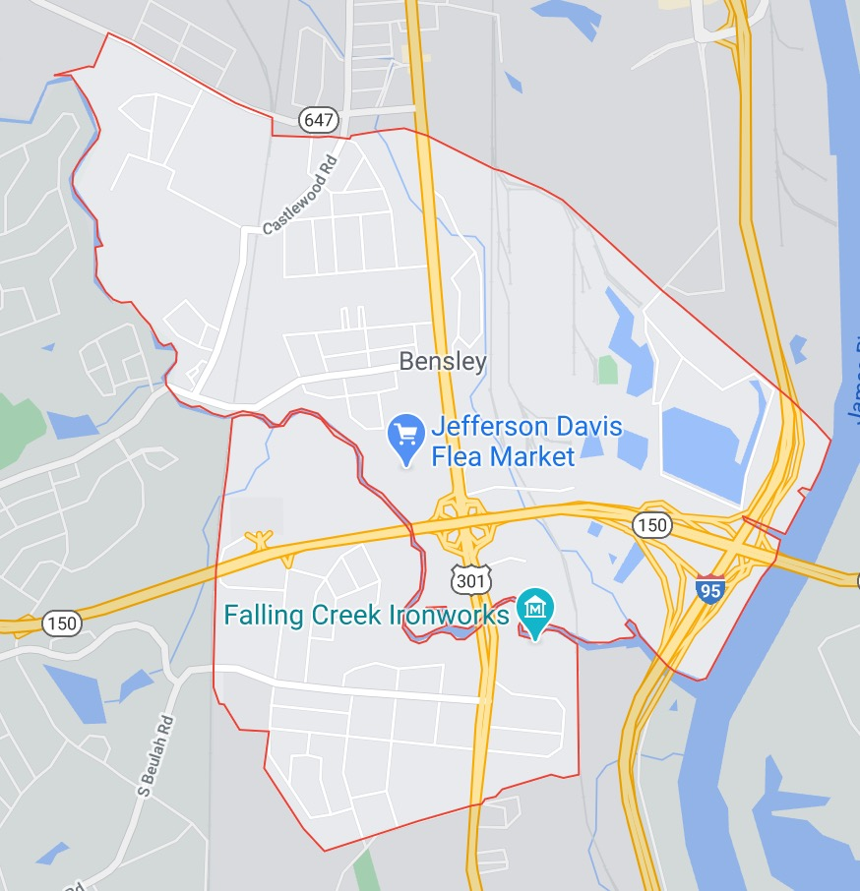
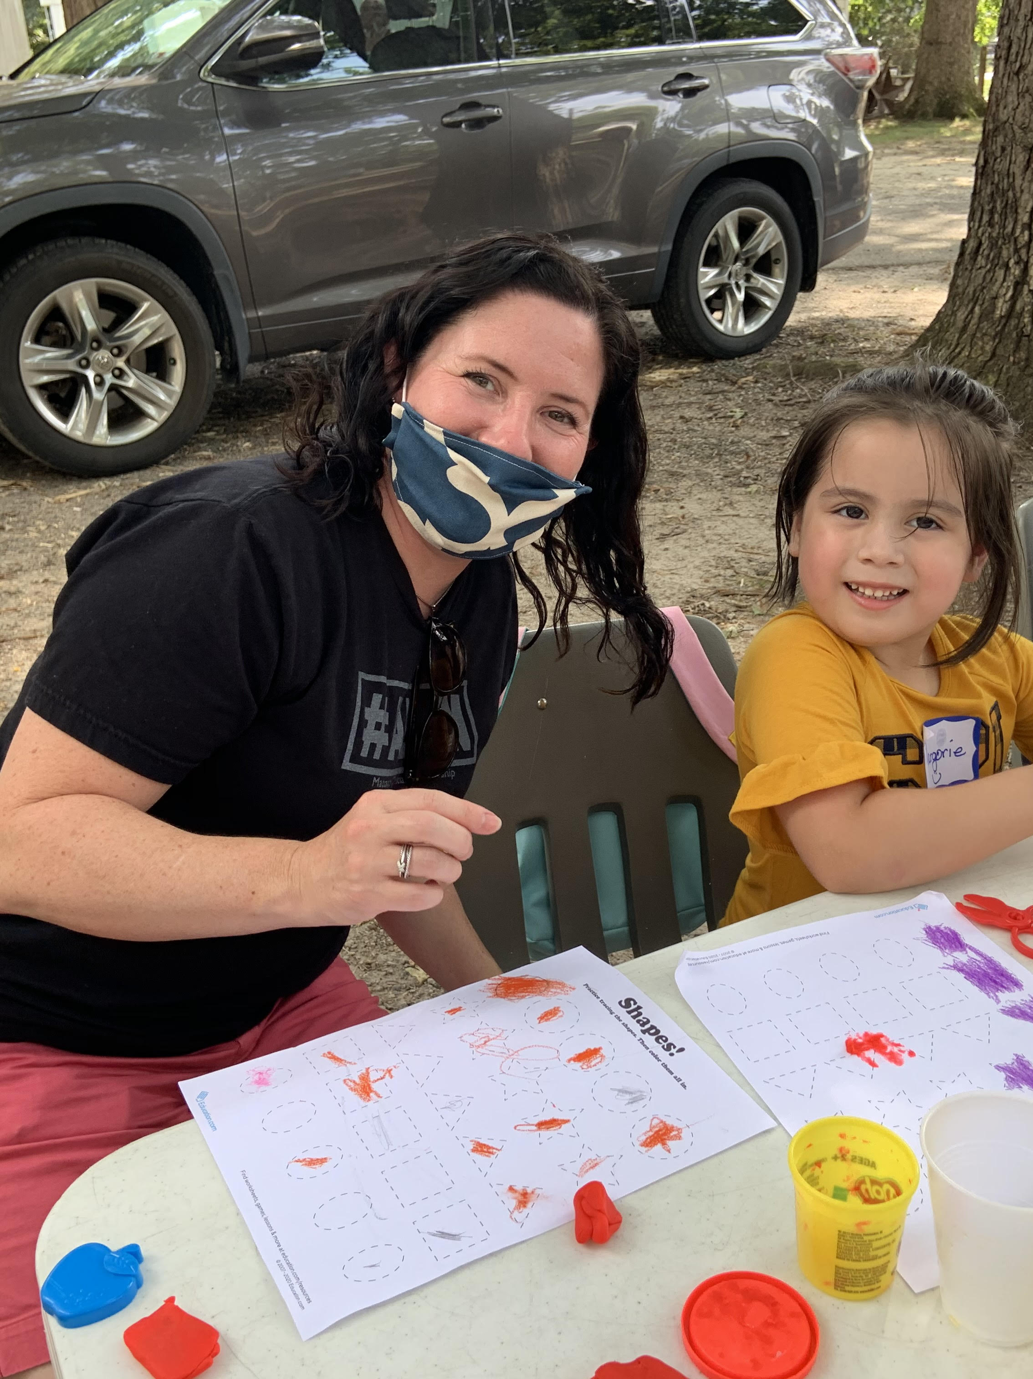
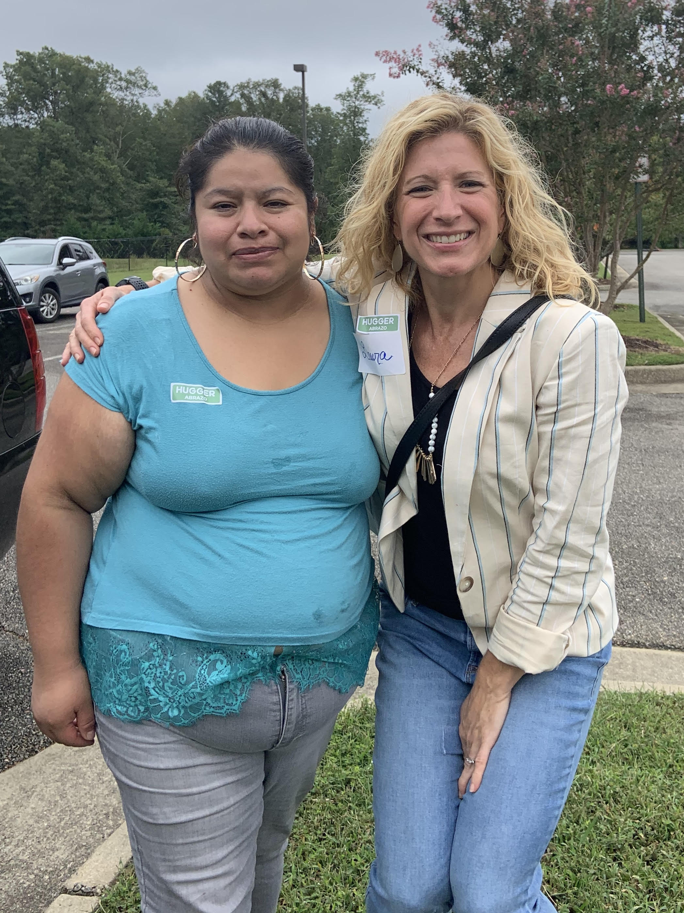
Notes:
At Cornerstone
Every Sunday: Spanish translation and fellowship
Monthly Hispanic Healing Service (3rd Friday)
Upcoming marriage home groups
Small groups during the semester
New Year’s eve

Slide 20
CONNECT & PRAY
Donate items for Christmas store
Work a shift to set up and run the store
Help with Big Pal/Little Pal Christmas parties
Join in on the neighborhood Christmas caroling night December 20th
Pray for the children and families we are serving
Notes:
At Cornerstone
Every Sunday: Spanish translation and fellowship
Monthly Hispanic Healing Service (3rd Friday)
Upcoming marriage home groups
Small groups during the semester
New Year’s eve

Slide 21
Panel Question
Which step
was the hardest for you? (or)
Which step changed your life the most?
PROCESS
OF MOBILIZATION
1. Real Surrender
2. Time of Testing
3. Learning to Love In Family
4. Unrecognized Preparation
5. Serving Another’s Vision

Slide 22
Final Question
What would you say to the Christian who knows they have a call from God but doesn’t know what to do or doesn’t feel qualified?
PROCESS
OF MOBILIZATION
1. Real Surrender
2. Time of Testing
3. Learning to Love In Family
4. Unrecognized Preparation
5. Serving Another’s Vision

