Slide 1
Notes:
-Jesus has resurrected! Now what???
-WE GO! (turn to your neighbor…)
-Introduce new series
-Why Let’s Go? (Great Comm.)
-51% of church goers aren’t aware of GC

Slide 2
THE GREAT COMMISSION | MATTHEW 28:18-20 NLT
¹⁸ Jesus came and told his disciples, “I have been given all authority in heaven and on earth. ¹⁹ Therefore, go and make disciples of all the nations, baptizing them in the name of the Father and the Son and the Holy Spirit.
Notes:
-Comm.: a group of people officially
charged with a particular function.
-God has equipped each believer with unique
gifts, talents, and abilities to fulfill the great commission.
-Clergy may have training to preach, but
all believers can use their gifts to follow G.C.
-G.C. was more effective the disciples changed.

Slide 3
THE GREAT COMMISSION | MATTHEW 28:18-20 NLT
²⁰ Teach these new disciples to obey all the commands I have given you. And be sure of this: I am with you always, even to the end of the age.”
Notes:
-Comm.: a group of people officially
charged with a particular function.
-God has equipped each believer with unique
gifts, talents, and abilities to fulfill the great commission.
-Clergy may have training to preach, but
all believers can use their gifts to follow G.C.
-G.C. was more effective the disciples changed.

Slide 4
LET’S GO CHANGE
Notes:
-New believer, know that it would
be more beneficial if you helped yourself
before you reach out to help others.
-If we don't change first, nobody else will
go and change.
-Hard to go tell it on the mountain if you
haven’t been telling it to yourself in the valley.

Slide 5
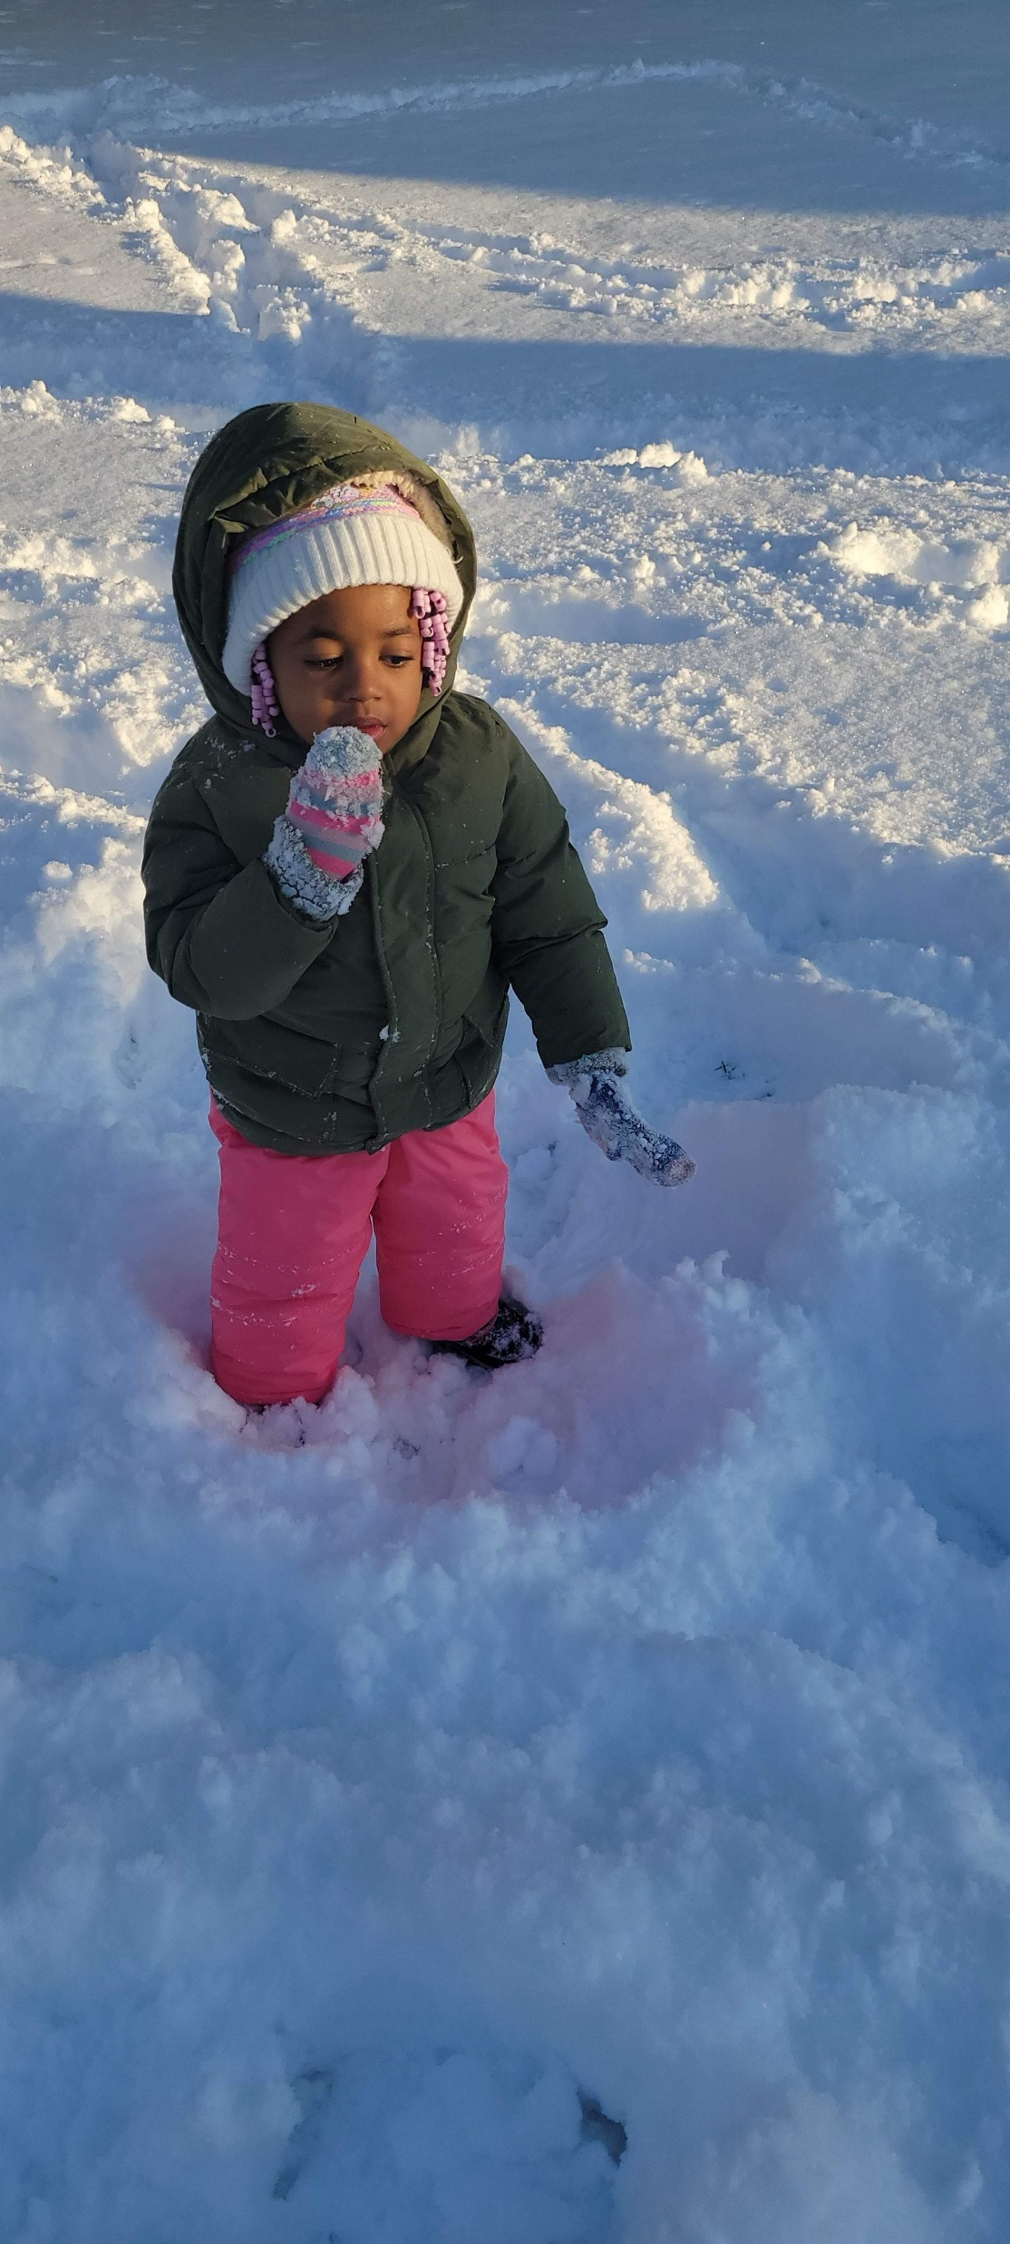
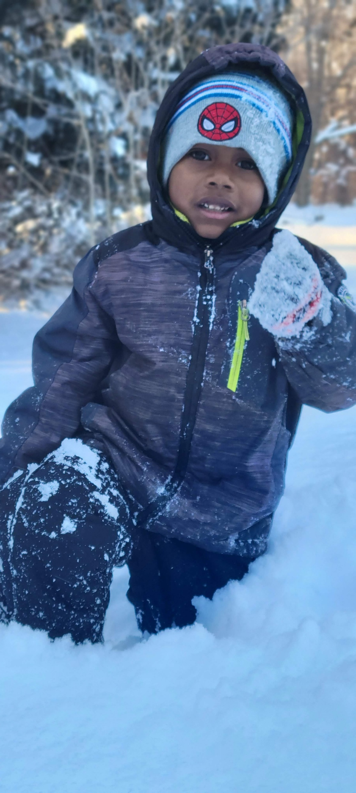
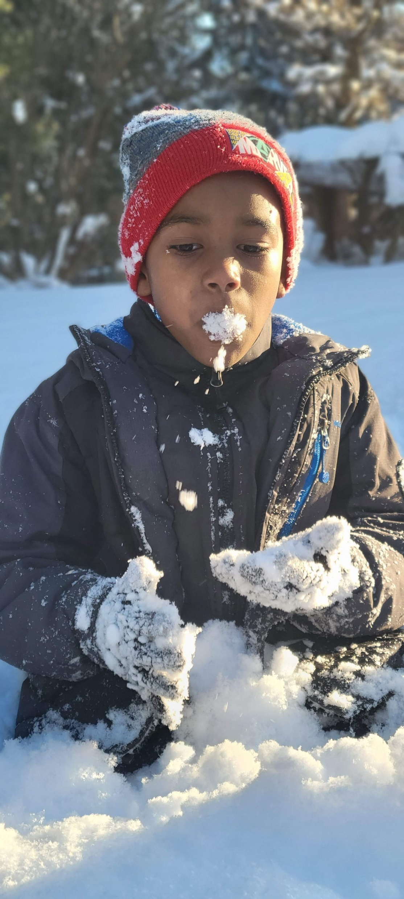
Notes:
-Snow is a gift and great.
-BUT they couldn’t go outside with the
same clothes on.
-To be apart of it, they had to change clothes
-God blessed us with something great and
beautiful in the G.C./change to be apart
-Col. 3:9-10—take off old and put on new

Slide 6
ACTS 2:37-47 NLT
Notes:
-Repent; to think differently or afterwards
that is to reconsider
-“True repentance is permanent, painful,
and profitable. -John Blanchard”
-“Repentance is a continual spring, where
the waters of godly sorrows are always
flowing.” -Thomas Brooks

Slide 7
Notes:
-GC is all about going making disciples
but when we take action and go repent
and change, we see God’s magnificent work
bc we’re more equipped to make disciples.
-What happens when we change?
-10 things that happen when we change

Slide 8
WHEN WE GO AND CHANGE
V41: THEY WERE BAPTIZED
V41: THEY GREW NUMERICALLY (3K)
V42: THEY DEVOTED THEMSELVES TO THE WORD OF GOD AND STARTED GOING TO CHURCH.
V43: THEY NOW POSSESS THE FEAR OF THE LORD
V43: THEY SAW MIRACLES AND SIGNS
Notes:
v41:…(we did BAPTISMS
last week and doing it again April 21st)
V42: …(WELCOME LUNCH)

Slide 9
WHEN WE GO AND CHANGE
V44: THEY HAD PEACE WITH ONE ANOTHER
V45: THEY WERE MORE GENEROUS
V46: WORSHIPPED EVERYDAY TOGETHER
V46: THEY FELLOWSHIPPED TOGETHER OUTSIDE OF CHURCH.
V47: AND THE LORD ADDED MORE EVERY DAY.
Notes:
-v44:…(they understand who the real enemy is.
-When you understand who your true enemy
is, you have more peace with people
-v46:…small groups

Slide 10
WHEN WE GO AND CHANGE
44: THEY HAD PEACE WITH ONE ANOTHER
V45: THEY WERE MORE GENEROUS
V46: WORSHIPPED EVERYDAY TOGETHER
V46: THEY FELLOWSHIPPED TOGETHER OUTSIDE OF CHURCH.
V47: AND THE LORD ADDED MORE EVERY DAY.
Notes:
-What is the one thing in your life right now
that if it was blotted out, you would be
dancing like David in between every single pew?
-I want to remind you that its possible!
-Its possible to overcome that sin, to go and change
-When you do, the GC becomes active and you
and I become dangerous to the power of darkness!

Slide 11
WHEN WE DON’T CHANGE
Notes:
-Matthew 22:10-13/ Wedding Feast Parable
-Some people want more from Jesus but haven’t
changed because they like what they
already have one.
-Some people want to do more for Jesus
but haven’t changed
-Col 3:9-10/take off and put on new

Slide 12
GO QUESTIONS
Notes:
-We don’t want you to just come and hear
a sermon, but to go and be a sermon.
-Not a sermon series, but an action series!
-To make sure that we are all truly taking
action, we will display one question on
the screen and next steps from our church.

Slide 13
GO QUESTIONS
What’s the best change you’ve made in the last 6 months?
Which next steps will you commit to of the follow three?
-Welcome lunch | Right after second service
-Water Baptism| April 21
-First 15 in the morning
Notes:
-You will discuss it with the two to three
people that you are sitting next to.
-This is your go group for the series!
-Address guest and introverts
-Address online viewers
-Take 3 minutes to discuss and we
Will conclude service.

Slide 14
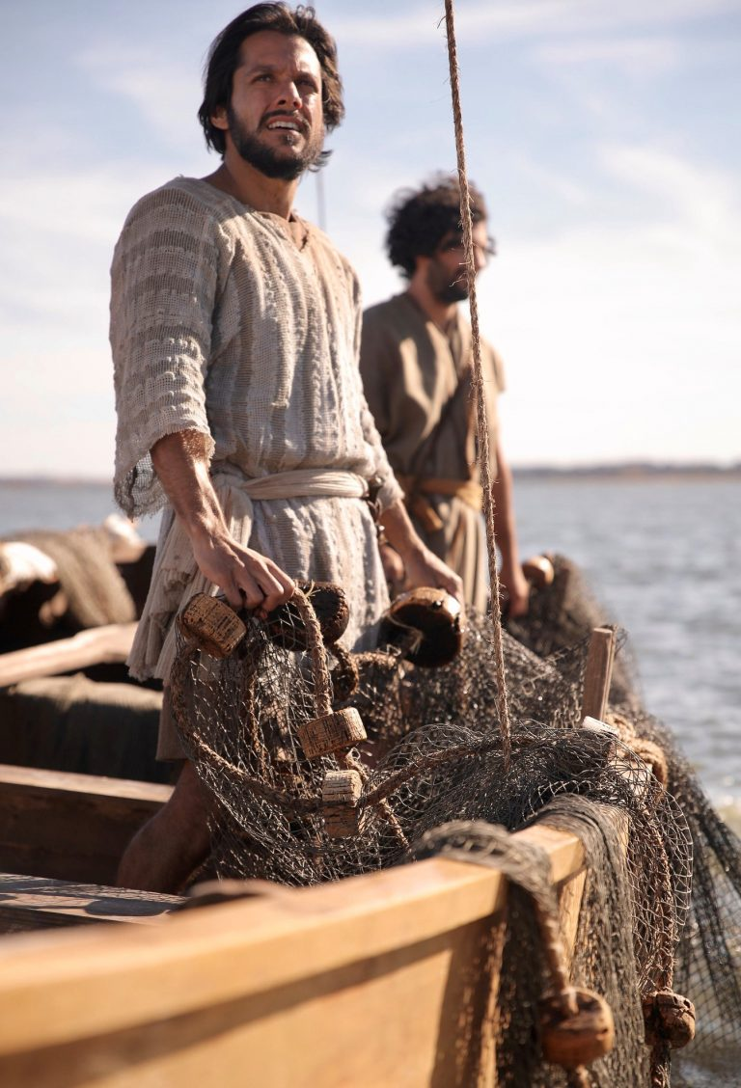
Notes:
-Story of Gabe not liking peter/Bible Bully
-He didn’t die a disciple. He didn’t die Simon
-He died an apostle. He died Peter.
He was changed!) Paul too…
-how will you change today? -Peter is the hope for you and I today
-Church family, LET’S GO CHANGE!

Slide 15
Notes:
-GC is all about going making disciples
but when we take action and go repent
and change, we see God’s magnificent work
bc we’re more equipped to make disciples.
-What happens when we change?
-10 things that happen when we change

