Slide 1
Mark 14:1-10 | Great For King Jesus
Notes:
Have you ever felt like you weren’t important? That your life is too messed up, too small or too busy to make a difference.
Do you feel too old, too young, too poor? Not ready, not good enough
You can be great for King Jesus today
Mark 14:1-11

Slide 2
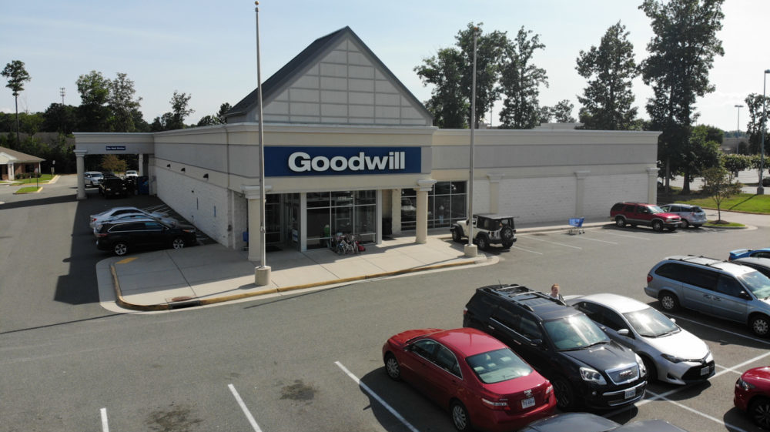
Notes:
It was a thrift store like this in Austin Texas
That five years ago, Laura Young walked in and saw this.

Slide 3
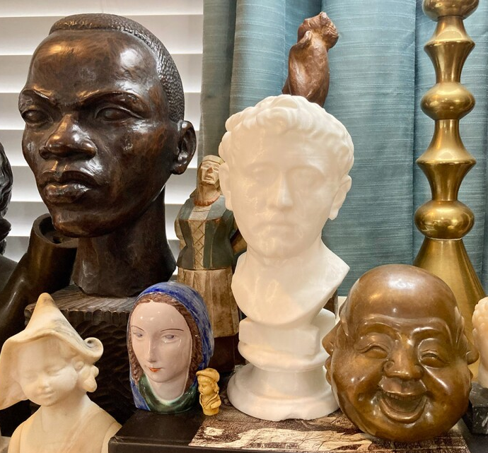
Notes:
That white statude in the center
It has been there a while in the thirst store
Many people had seen it and bought something else
After all - who wanted to pay 34.99 when you get a shirt for 50cents?
But Laura noticed it was different

Slide 4
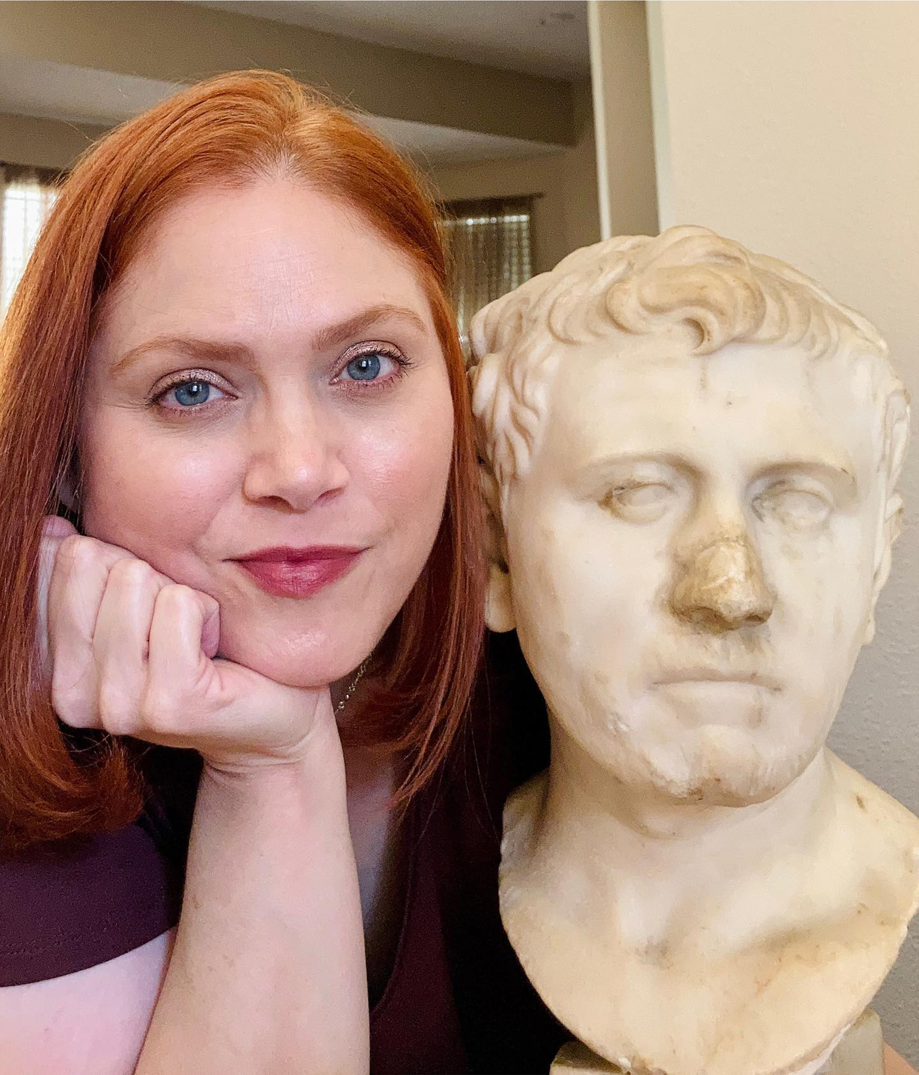
Notes:
So she paid the $35 And brought it home
Sure enough - that overlooked statue was priceless bust from the first century
She saw what no one else say - paid what no one else would pay
AND HER LIFE CHANGED
That’s what happens when you see what no one else sees & pay . . .

Slide 5
“The beginning of the gospel about Jesus Christ, the Son of God.
Mark 1:1
Christ/Messiah = “The Anointed King”
Notes:
That is what Mark is trying to get us to see
He wants us to see Jesus - the King - anointed of God
In the middle of a world with lots of other things to worship.
He’s inviting us to see what no one else sees and pay what no one else will pay
SO OUR LIVES WILL BE FOREVER CHANGED!

Slide 6
Mark is inviting us to see what the world does not: Jesus is God’s King sent to save us. And this king brings a kingdom that will deliver us from the sin, anxiety, fear, bitterness and strife of this world.
Notes:
The problem is - as we see in Mark
Almost no one else sees who He is
And all the time Jesus is saying - believe in me
Stop worshiping what this world worships!
We saw that last week

Slide 7
Mark 13 | God’s Kingdom Won’t Waste Your Life
“For whoever wants to save his life will lose it, but whoever loses his life for Me and for The Gospel will save it. What good is it for a man to gain the whole world, yet lose his soul?”
Mark 8:35-36
Notes:
Jesus is saying don’t waste your life on what isn’t going to last
But most people then and now don’t see what Jesus is worth
So we come to Mark 14 - and sure enough . . .

Slide 8
Mark 14 | Not everyone sees the worth of this king
“the Passover and the Feast of Unleavened Bread were only two days away, and the chief priests and the teachers of the law were looking for some sly way to arrest Jesus and kill him. “But not during the Feast,” they said, “or the people may riot.”
Mark 14:1-2

Slide 9
Mark 14 | One woman see how much Jesus is worth
“While Jesus was in Bethany, reclining at the table in the home of a man known as Simon the Leper, a woman came with an alabaster jar of very expensive perfume, made of pure nard. She broke the jar and poured the perfume on his head. ”
Mark 14:3

Slide 10
“Then Mary took about a pint of pure nard, an expensive perfume; she poured it on Jesus’ feet and wiped his feet with her hair. And the house was filled with the fragrance of the perfume.”
John 12:3 (Mark 14:3)

Slide 11
Spikenard
rare & expensive perfume from India
It was her savings, her future.
A year’s salary.
She gave it all.

Slide 12
Mark 14 | Even those closest to Jesus lost focus
“Some of those present were saying indignantly to one another, “Why this waste of perfume? It could have been sold for more than a year’s wages and the money given to the poor.” And they rebuked her harshly. ”
Mark 14:4-5
Notes:
Listen to these next words of jesus

Slide 13
“Leave her alone,” said Jesus. “Why are you bothering her? She has done a beautiful thing to Me. The poor you will always have with you . . .but you will not always have Me. She did what she could. She poured perfume on My body beforehand to prepare for my burial. I tell you the truth, wherever the gospel is preached throughout the world, what she has done will also be told, in memory of her.”

Slide 14
GREAT FOR JESUS, THE KING
It wasn't the person with the biggest testimony, but the one who gave (wasted) the most for Jesus
Notes:
On a trip with high school students last week
We came back to this - view from my front door
That Friday -

Slide 15
ARE YOU GREAT FOR JESUS, THE KING?
When is the last time someone looked at your life - saw how much you love, give, and serve Jesus – and said, “what a waste”?
Notes:
After all He has done for you
Are you great for him?
Are you willing to lose friends, career, power, money?

Slide 16
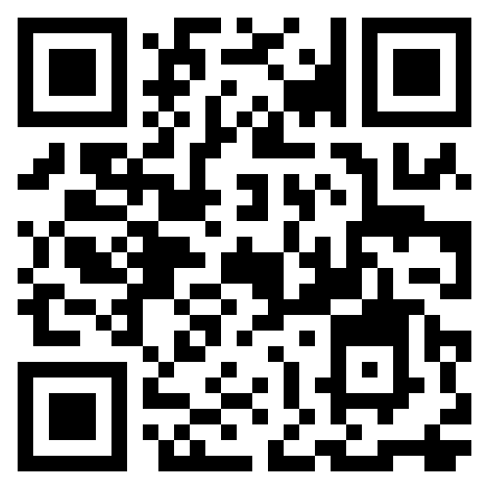
Your
Somebody
&
Testimony
For Easter Sunday
Notes:
Lose

Slide 18
GREAT FOR JESUS, THE KING
It wasn't the person who was always right, but the one who loved Him even when He didn’t meet her expectations
Notes:
So many times Jesus didn’t live up Mary’s expectations, assumptions
Lazarus - ”If you were here my brother wouldn’t have died”
Went into Jerusalem - triumphant - He wasn’t taking over
Mary knew it - still loved him
So want to ask you

Slide 19
ARE YOU GREAT FOR JESUS, THE KING?
Are you entitled or in love with Jesus?
Notes:
You will give God the greatest glory when you worship him
After He didn’t do what you want
Exact opposite of Judas- next verses
Instead Mary accepted and loved - gave!

Slide 20
Your
Somebody
&
Testimony
For Easter Sunday
Notes:
In the middle of the hardship - love him then

Slide 21
ARE YOU GREAT FOR JESUS, THE KING?
Are you entitled or in love with Jesus?
After knowing what Jesus did for you: why not you & why not now?
Notes:
Doug story

Slide 22
GREAT FOR JESUS, THE KING
It wasn't the person who knew the most, but the one who knew only one thing that she couldn't let go of
Notes:
Mary isn’t like the chief priest & Scribes
Not like the disciples - mount of transfiguration/upper room
She just knows what mark said. - he;s the anointed one
So he anoints him!

Slide 23
ARE YOU GREAT FOR JESUS, THE KING?
Are you focused on doing something great for Jesus, or, Jesus doing something great for you?
Notes:
You don’t need to know a lot
Just that He is the one
Jesus is betrayed - and the smell of his anointing is there
He is arrested - he is beaten - Mark 15:61 - are you the anointed one
(no matter if no one else ever knows) Why - he did it for you- communion

Slide 24
Your
Somebody
&
Testimony
For Easter Sunday
Notes:
Keep the right fire buring
See the big picture
Don’t waste your life, your health, talent, love
Today
March 31 - testimonies & baptism
Worried about fire - jumpin the water!

Slide 25
https://youtu.be/4Uo2QjR0Vbg?si=iFHRhBMeG6_eo6eT
Pour My Love On You \ UpperRoom \ Lyric Video

