Slide 1


Slide 2
Jesus came to set us free!
It’s time to stop letting money
trouble and defeat us!
The Practical Wisdom & Purpose Of Budgeting
Notes:
Impossible promises
Possible steps

Slide 3
“Jesus sat down near the collection box in the Temple and watched as the crowds dropped in their money. Many rich people put in large amounts. Then a poor widow came and dropped in two small coins.”
Mark 12 :41-42

Slide 4
Jesus called his disciples to him and said, “I tell you the truth, this poor widow has given more than all the others who are making contributions. For they gave a tiny part of their surplus, but she,
poor as she is, has given everything she had to live on.”
Mark 12:43-44

Slide 5
Most People Are Not Free!
40% Rely on credit cards to pay monthly expense
49% Finances cause stress or anxiety
51% Don’t have at least $1,000 emergency fund
51% Difficulty paying bills in past 3 months
64% Monthly rent is a consistent challenge
The number one reason why couples fight!

Slide 6
“No one can serve two masters. Either he will hate the one and love the other, or he will be devoted to the one and despise the other. You cannot serve both God and Money. . . your heavenly Father knows [what you need]. But seek first His Kingdom and His righteousness, and all these things will be given to you as well.”
Matthew 6:24,32-33

Slide 7
Kingdom Of God | Kingdom Of This World | Kingdom Of Satan
Gives Life | Empty | Takes Life [Death]
Holy Spirit | Sinful Flesh | Unclean Spirits
Freedom | Control | Slavery
Truth | Appearances | Lies
Abundance | Scarcity | Debt
Give | Hoard | Steal
Abundance | Scarcity | Debt
Servant | Master | Idol

Slide 8
The Truth
Money is a servant not a master.
And not your servant, God’s servant.
A budget is how we tell
God’s servants what to do.

Slide 9
LIES OF THIS WORLD
Getting out of debt is impossible
Having a budget limits your freedom
You don’t need financial unity with your spouse
“Do not conform any longer to the pattern of this world, but be transformed by the renewing of your mind. Romans 12:2

Slide 10
Choices To Seek First The Kingdom
1. Declare your king: what Kingdom are you living for?
2. Look at reality: current financial reality - fear not!
3. Get wisdom: know “The 7 Baby Steps"
4. Talk to God (Ultimate Reality): get His direction
5. Make your budget: based on reality & trust in God
6. Track & manage: monthly (give it 90 days)
7. Grow closer to Jesus: watch what He does!

Slide 11
Choice 2: Look At Current Reality
Aiming for A “Zero Balance Budget”
Every dollar is working every day for God’s plan
Income - Stewardship - Expenses = $0
Paycheck Side Job Other Income | Tithing Debt/Savings God Goals | Necessities Useful Wants Miscellaneous

Slide 12
Choice 2: Look At Current Reality
Aiming for a “Zero Balance Budget”
Income - Stewardship - Expenses = $0
Paycheck Side Job Other Income | Tithing Debt/Savings God Goals | Necessities Useful Wants Miscellaneous
Income - Tithe - Necessities = Reality

Slide 13
C3: Get Wisdom - Seven Baby Steps
Where am I in the steps towards God’s freedom?
Create an emergency fund of $1,000
Pay off all debt (except house) with debt snowball
Save 3-6 months of expenses
Invest 15% of income into retirement
Save for children’s college fund
Pay off your home early
Build wealth to give generously

Slide 14
Choice 4: Talk To God
Lord Jesus, what should my goals be with Your money (servants)?
Short Term (1-12 months)
Long Term (1-5 years)

Slide 15
Choice 5: Make Your Budget
In faith, wisdom and obedience,
tell your money what God wants you to accomplish!

Slide 16
Simple
Simple Budget Example

Slide 17
C6: Track & Manage Your Budget
Seeking God first means
staying connected to reality!
- Track your expenses daily/weekly
- Use “EveryDollar” Software & Phone App (free)
- Adjust the budget before the next month
- Give it 3 months to see it start to change everything
Notes:
Like Jesus in the wilderness
Satan loves to use money to get us to forsake God
Rich young ruler seemed great in the world -because of money
Jesus offered him a chance to take a great step of faith
To becom truly great - he thought like kingdom of this world

Slide 18
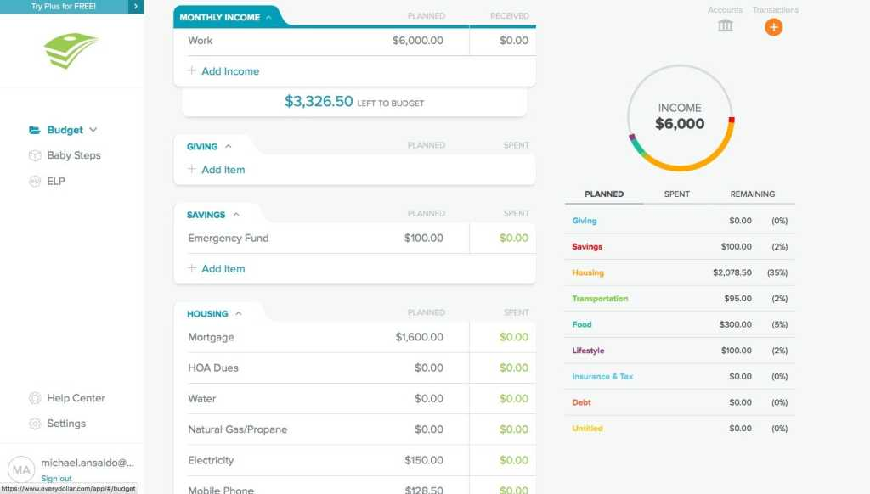
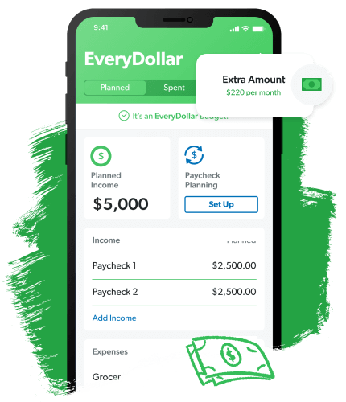

Slide 19
C7: Grow Closer To Jesus & Watch!
“No one can serve two masters. Either he will hate the one and love the other, or he will be devoted to the one and despise the other. You cannot serve both God and Money. . . your heavenly Father knows [what you need]. But seek first his kingdom and his righteousness, and all these things will be given to you as well.”
- Matthew 6:24,32-33
Notes:
Like Jesus in the wilderness
Satan loves to use money to get us to forsake God
Rich young ruler seemed great in the world -because of money
Jesus offered him a chance to take a great step of faith
To becom truly great - he thought like kingdom of this world

Slide 20

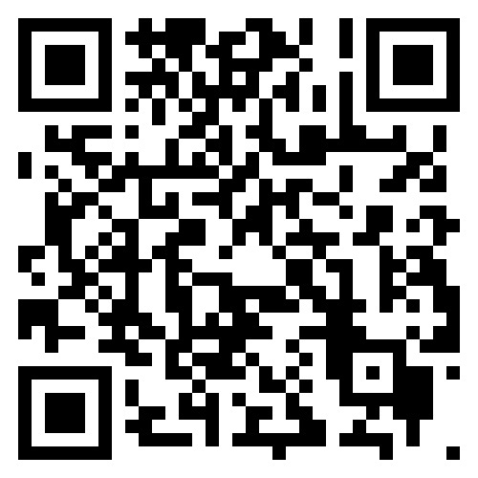
Cornerstone.ag/
kingdomchallenge
You’re not alone as you take a great step of faith
TITHE FOR THE NEXT 90 DAYS
Trust in God’s Kingdom not money

Slide 21
Choices To Seek First The Kingdom
1. Declare your king: what Kingdom are you living for?
2. Look at reality: current financial reality - fear not!
3. Get wisdom: know “The 7 Baby Steps"
4. Talk to God (Ultimate Reality): get His direction
5. Make your budget: based on reality & trust in God
6. Track & manage: monthly (it will take 90 days)
7. Grow closer to Jesus: watch what He does!

