Slide 1
Notes:
Finishing up an important section (see notes)
Disciples - what is greatness / how do you live a great life
Last week - marriage
What it means to take a great step of faith
Greatness of God you long for - requires great step of faith

Slide 2
Greatness takes
great steps of faith
Notes:
”Everything great it uphill”
Best parts of your life took steps of faith
Easiest parts of your life never do
Last week talked about marriage
Best part of my life - took faith -pic

Slide 3
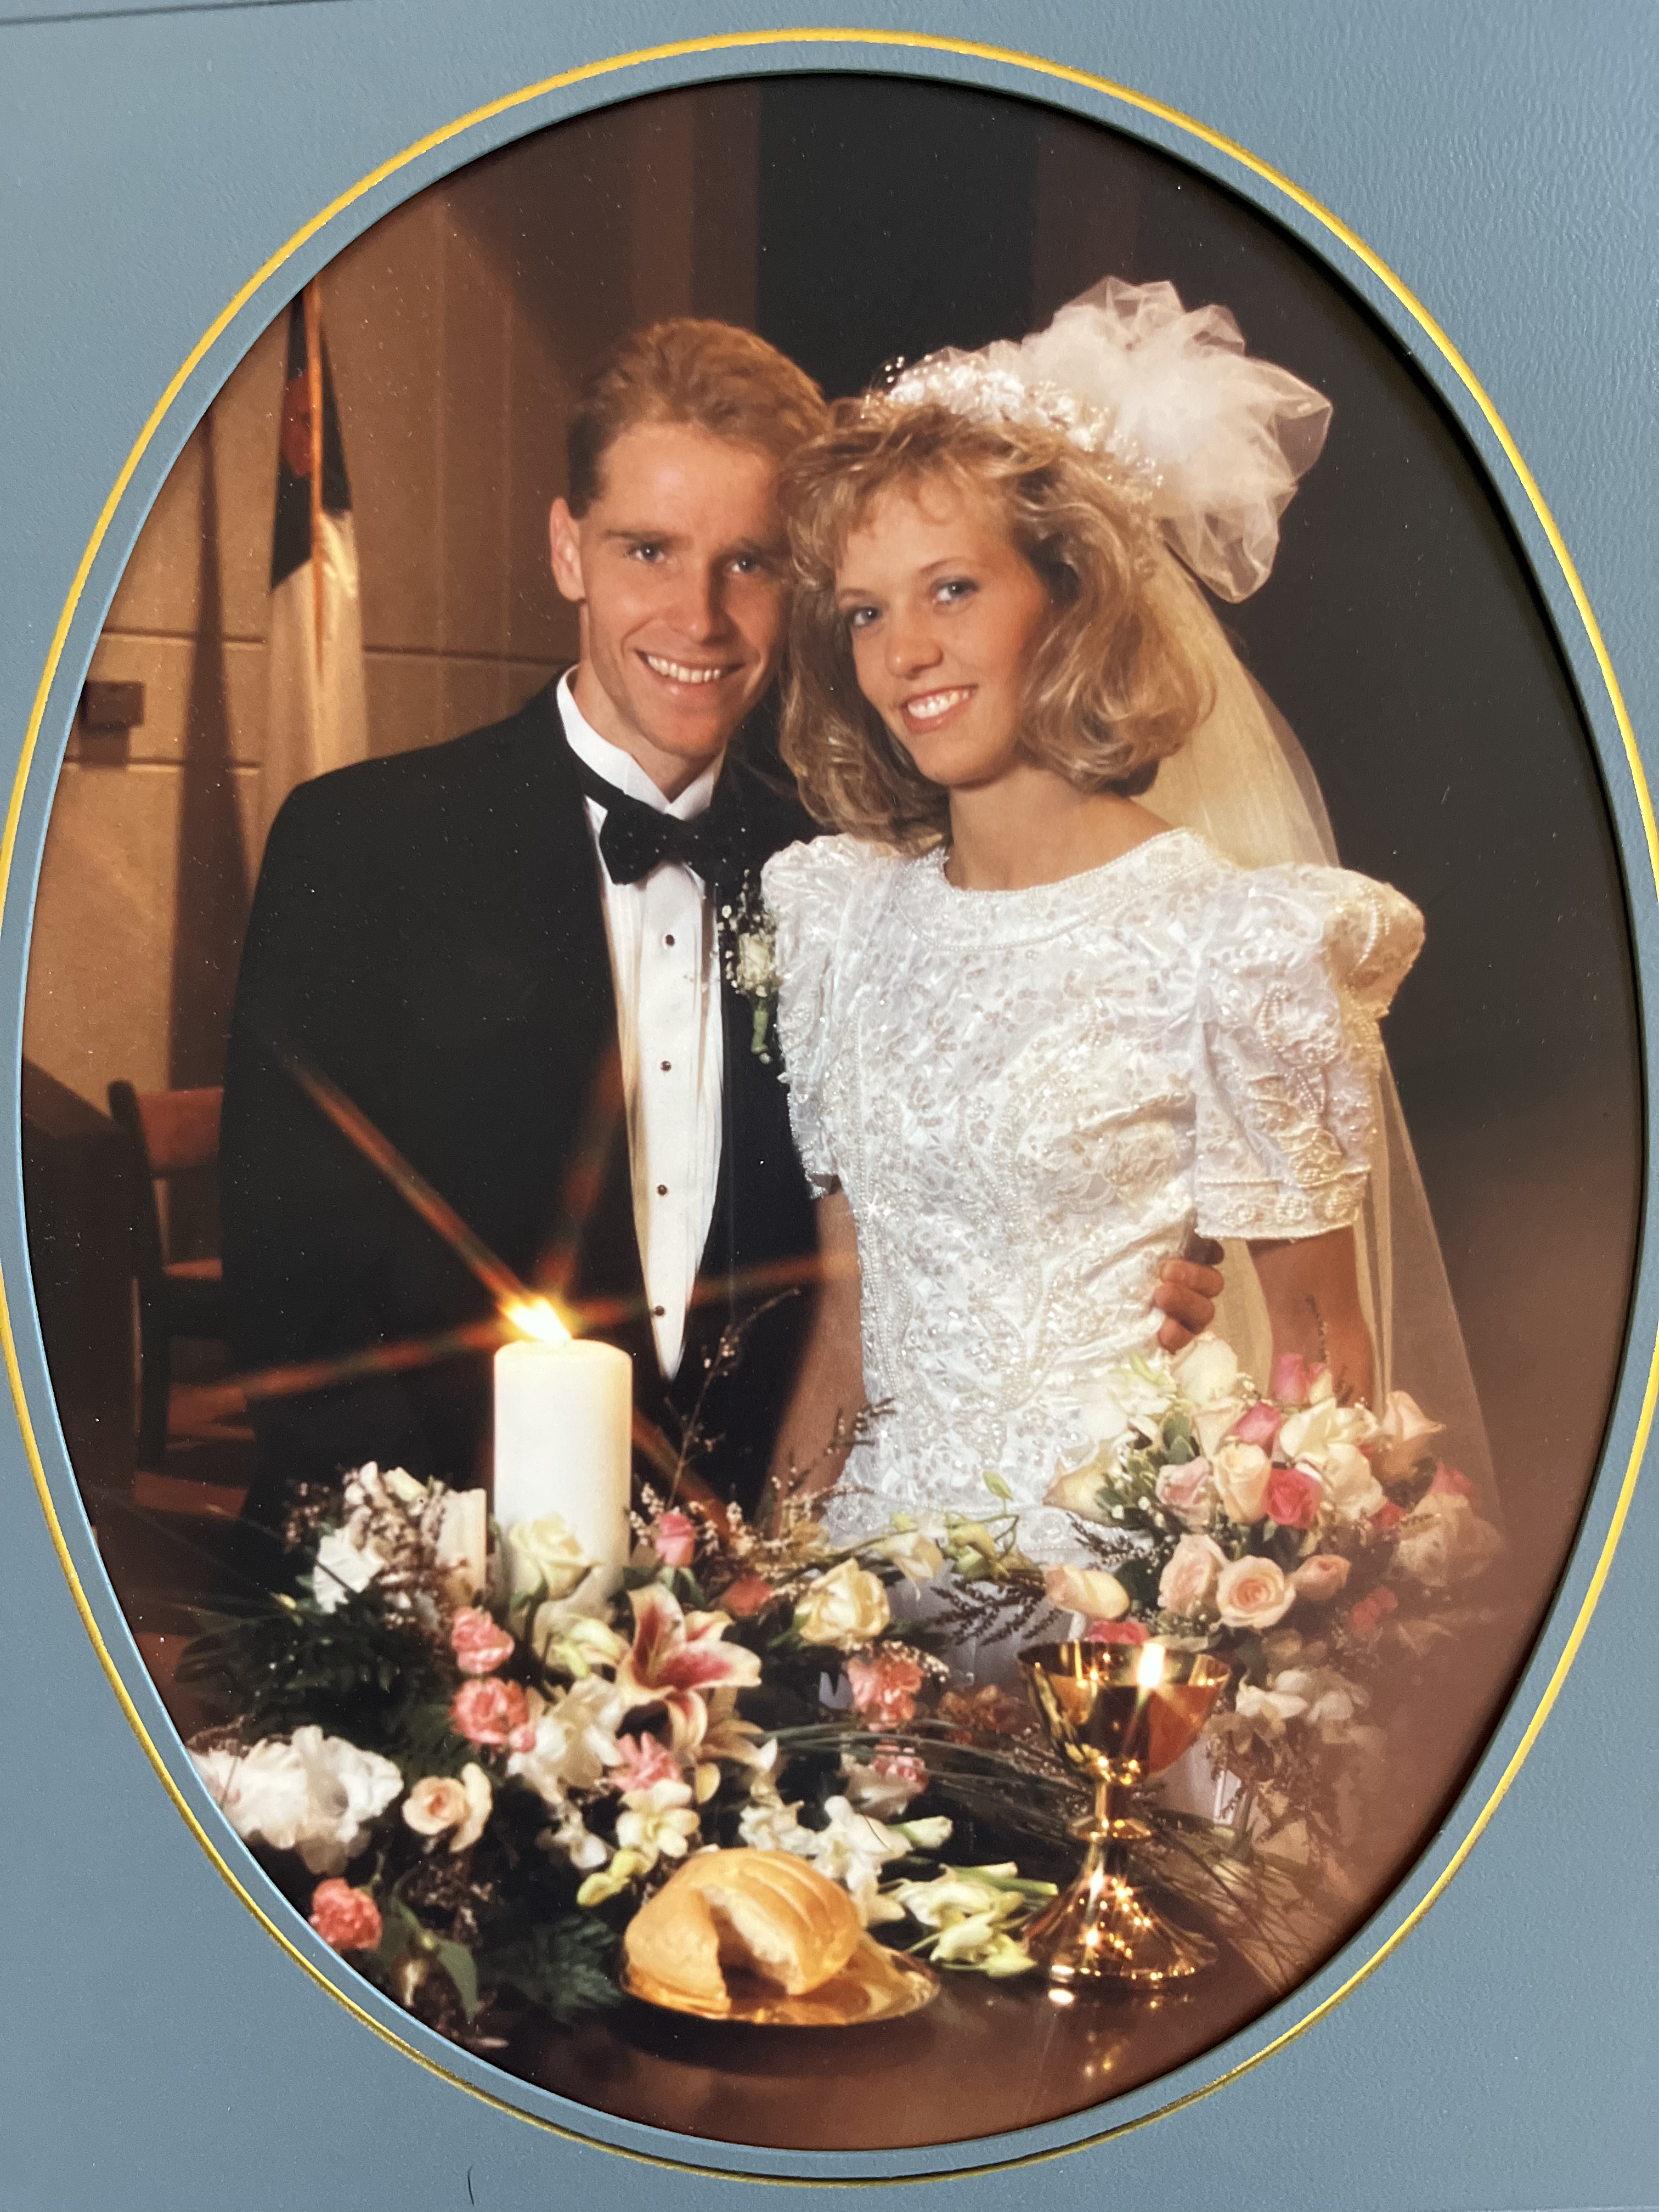
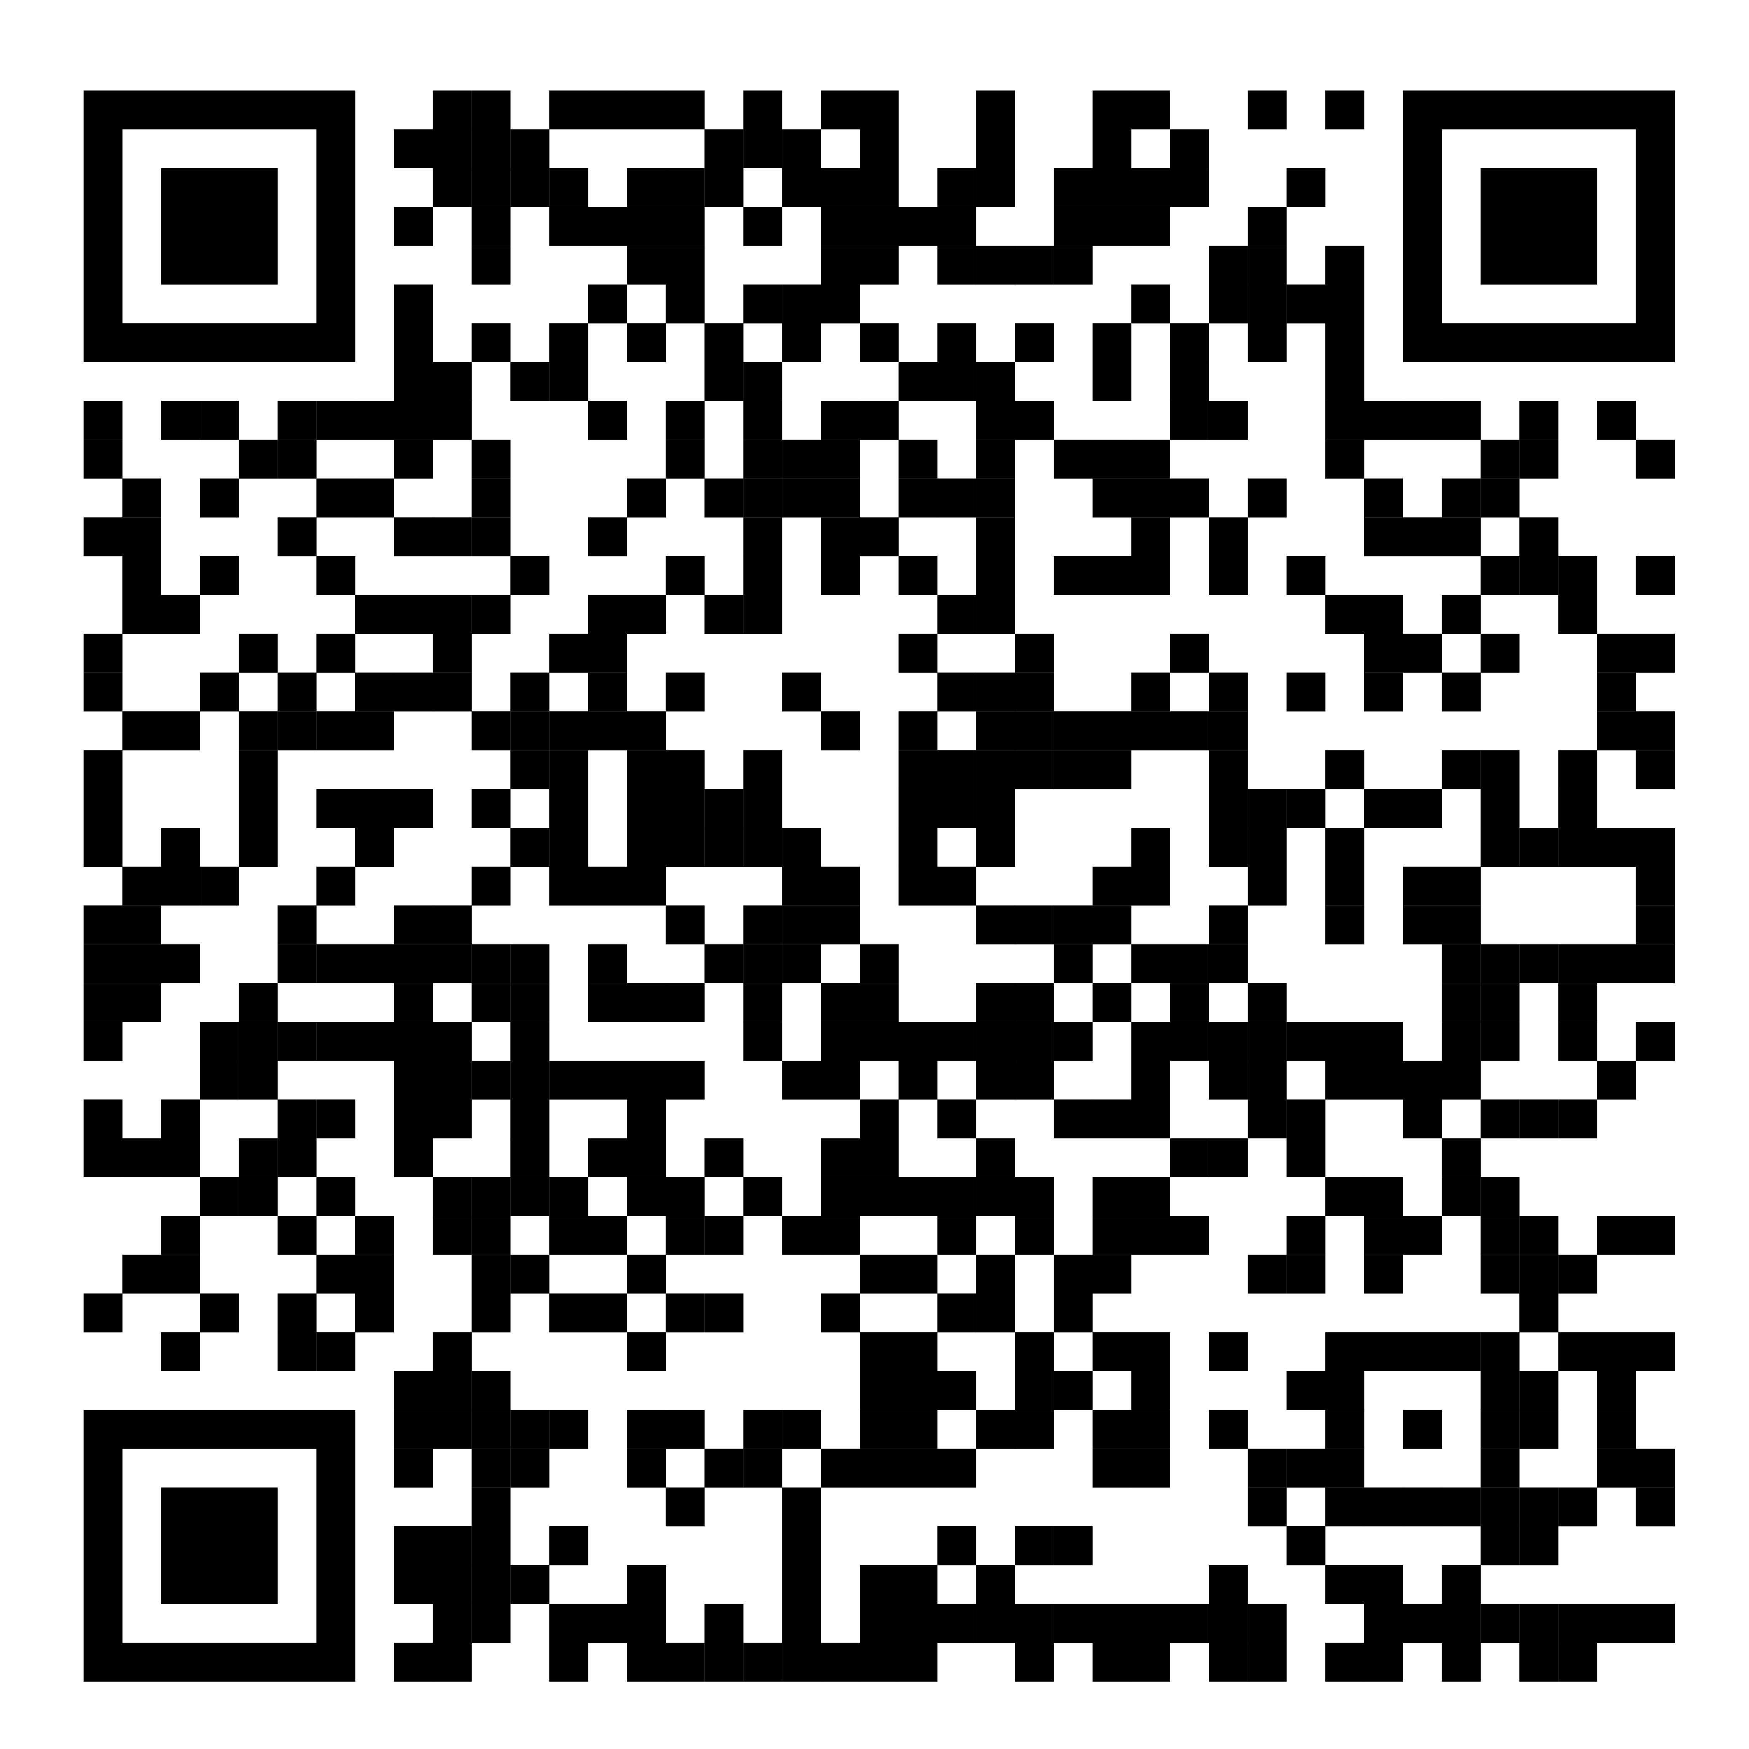
Marriage
Conference
March 1-2
Notes:
Story of step of faith
Greatest part of my life - hoped it would come easy
Tried dropping hints / good look
So many time hoping she would just choose me
Finally had to take a great step of faith . . .

Slide 4
Greatness takes
great steps of faith
That means you have to
let go of something
you want to trust and control
Notes:
Jesus time and time again
- repent and follow me
Today, Mk 10:17 Jesus invites great step
In area that Jesus talked about more than anything but kingdom
Money. - rich young ruler - great step - see what he does

Slide 5
So. As Jesus started on his way, a man ran up to him and fell on his knees before him. “Good teacher,” he asked, “what must I do to inherit eternal life?” ¹⁸ “Why do you call me good?” Jesus answered. “No one is good—except God alone.
Mark 10:17-18

Slide 6
¹⁹ You know the commandments: ‘Do not murder, do not commit adultery, do not steal, do not give false testimony, do not defraud, honor your father and mother.’” ²⁰ “Teacher,” he declared, “all these I have kept since I was a boy.”
Mark 10:19-20

Slide 7
²¹ Jesus looked at him and loved him. “One thing you lack,” he said. “Go [right now], sell everything you have and give to the poor, and you will have treasure in heaven. Then come, follow me.” ²² At this the man’s face fell. He walked away sad, because he had great wealth.
Mark 10:21-22

Slide 8
²³ Jesus looked around and said to his disciples, “How hard it is for the rich to enter the kingdom of God!” ²⁴ The disciples were amazed at his words. But Jesus said again, “Children, how hard it is to enter the kingdom of God! ²⁵ It is easier for a camel to go through the eye of a needle than for a rich man to enter the kingdom of God.”
Mark 10:23-25

Slide 9
²⁶ The disciples were even more amazed, and said to each other, “Who then can be saved?” ²⁷ Jesus looked at them and said, “With man this is impossible, but not with God; all things are possible with God.” ²⁸ Peter said to him, “We have left everything to follow you!”
Mark 10:26-28

Slide 10
²⁹ “I tell you the truth,” Jesus replied, “no one who has left home or brothers or sisters or mother or father or children or fields for me and the gospel ³⁰ will fail to receive a hundred times as much in this present age (homes, brothers, sisters, mothers, children and fields—and with them, persecutions) and in the age to come, eternal life. ³¹ But many who are first will be last, and the last first.”
- Mark 10:29-31
Notes:
man had what the world thought was great - money
Jesus wanted him to have a great life
Offered him a great step of faith
What do we notice from this passage
4 for 2024

Slide 11
1
There is a BIG difference
between treating Jesus like a
good teacher versus your great God
Notes:
Come to jesus, “good teacher”
Jesus - drops hint - God
We are most tempted to do - treat as teacher

Slide 12
Following Jesus as Teacher
Jesus improves “my” life and
helps me to succeed (be first) in this world
Following Jesus as God
Jesus requires I surrender “my” life and
calls me to look like a failure (last) in this world
Notes:
In the end there is one difference
Idol - Jesus can be teacher

Slide 13
“You can believe in God yet still trust something else for your real significance, security and happiness – which means that “something else” is actually your god, or in the terms of the Bible, it’s your idol. And until you “put away your idols” (Judges 10:10-18) you will never be free from the slavery and power of this world.”
Tim Keller, “God’s Wisdom For Navigating Life

Slide 14
“There are excessive emotions surrounding things you make your idol. You trust your idol more than anything else in daily life, whether it is your career, wealth, spouse, children, or some romantic relationship. You will be inordinately shaken, anxious, angry, despondent if anything threatens your idol. And that idol clouds your judgement and distorts your vision. It’s how you justify yourself and find peace.”
Notes:
This ruler wanted Jesus to be his teacher
While money was his idol
Jesus invited him to greatness
AND HE BECAME SAD
Why - #2

Slide 15
2
There is a BIG difference
between popular church teaching about money and what Jesus taught
Notes:
Prosperity Gospel
God loves me so I have things
This world is empty
Jesus teaching is different
Spoke on it more than anything but the kingdom

Slide 16
“No one can serve two masters. Either he will hate the one and love the other, or he will be devoted to the one and despise the other. You cannot serve both God and Money. . . your heavenly Father knows [what you need]. But seek first his kingdom and his righteousness, and all these things will be given to you as well.
Matthew 6:24, 32-33
Notes:
Money is essential and is separate from following Jesus.
Jesus loves me by blessing me with more money
Money is insignificant compared to all God can do.
Jesus loves me by setting me free from its slavery.

Slide 17
Money In Each Kingdom
God’s Kingdom:
God’s servant for some things
World’s Kingdom:
Your master to gain everything
Satan’s Kingdom:
Satan’s best deceiver to steal eternal things
Notes:
Like Jesus in the wilderness
Satan loves to use money to get us to forsake God
Rich young ruler seemed great in the world -because of money
Jesus offered him a chance to take a great step of faith
To becom truly great - he thought like kingdom of this world

Slide 18
3
There is a BIG difference
between pleasing someone and loving someone

Slide 19
²¹ Jesus looked at him and loved him. “One thing you lack,” he said. “Go [right now], sell everything you have and give to the poor, and you will have treasure in heaven. Then come, follow me.”
Mark 10:21-22
Notes:
Pleasing -we do what they want / Love - God wants
Today - God wants to love you / but not please you (your idols)
Will you give your first and best to God
Bible - first represents the rest /
Give your first - giving everything

Slide 20
THINK KINGDOM
B
ring the first to Jesus
I
incline your heart to His will
G
ive to those Jesus is reaching
Notes:
“The first . . .belongs to Me.” - Exodus 23:2
“Honor the Lord with your wealth, with the firstfruits of all your crops” - Proverbs 2:9

Slide 21
Return to Me, and I will return to you,” says the Lord Almighty. “But you ask, ‘How are we to return?’ “Will a man rob God? Yet you rob Me. “But you ask, ‘How do we rob You?’ “In tithes and offerings. . . Bring the whole tithe into the storehouse . . .
Malachi 3:7-9
Notes:
Pleasing -we do what they want / Love - God wants
Today - God wants to love you / but not please you (your idols)
Will you give your first and best to God
Bible - first represents the rest /
Give your first - giving everything

Slide 22
“’Test Me in this [take a great step of faith],’ says the Lord Almighty, “and see if I will not throw open the floodgates of heaven and pour out so much blessing that you will not have room enough for it. I will prevent pests from devouring your crops . . .”
Malachi 3:10-11
Notes:
Pleasing -we do what they want / Love - God wants
Today - God wants to love you / but not please you (your idols)
Will you give your first and best to God
Bible - first represents the rest /
Give your first - giving everything

Slide 23
TITHE FOR THE NEXT 90 DAYS
Trust in God’s Kingdom not money
Notes:
Jesus is loving you
Inviting you into greatness
But will you take a great step of faith
In area that is the place that often replaces your faith In God
(yeah that hard - leads to last point)

Slide 24
4
There is a BIG difference
between “knowing” God by yourself & knowing God with others
Notes:
By himself, the rich young ruler thought he was what he needed to be
Soon as he got in relationship with Jesus - he realize there was an idol
Jesus loved him enough to call him to great faith
Small group fair - Jane - we heal together / we surrender together
You haven’t let Jesus talk back to you - through others
{TRACY & THEN JAMES HERE}

