Slide 1
SEEING JESUS NEW
MARK 9:1-13
Notes:
-GREETINGS/ CHRISTMAS & NYE
-BEST GIFT TO ME-AIRTAG WALLET
-I LOVE YOU ALL CSTONE!
-BOLD STATEMENT! 2024 WILL BE
THE BEST YEAR YOU’VE EVER HAD
IF YOU DO THESE 3 THINGS!

Slide 2
MARK 9
THE MOUNT OF TRANSFIGURATION
Notes:
-RECAP MARK 8:27-38
-PETER RECEIVES REVELATION
-PETER GETS REBUKED
-SIX DAYS LATER WE HAVE
TRANSFIG. EXPERIENCE.
-LET’S READ

Slide 3
MARK 9: 1-13 ESV
1 And he said to them, “Truly, I say to you, there are some standing here who will not taste death until they see the kingdom of God after it has come with power.” 2 And after six days Jesus took with him Peter and James and John, and led them up a high mountain by themselves. And he was transfigured before them,

Slide 4
MARK 9: 1-13 ESV
3 and his clothes became radiant, intensely white, as no one on earth could bleach them. 4 And there appeared to them Elijah with Moses, and they were talking with Jesus. 5 And Peter said to Jesus, “Rabbi, it is good that we are here. Let us make three tents, one for you and one for Moses and one for Elijah.”

Slide 5
MARK 9: 1-13 ESV
6 For he did not know what to say, for they were terrified. 7 And a cloud overshadowed them, and a voice came out of the cloud, “This is my beloved Son; listen to him.” 8 And suddenly, looking around, they no longer saw anyone with them but Jesus only.

Slide 6
MARK 9: 1-13 ESV
9 And as they were coming down the mountain, he charged them to tell no one what they had seen, until the Son of Man had risen from the dead. 10 So they kept the matter to themselves, questioning what this rising from the dead might mean. 11 And they asked him, “Why do the scribes say that first Elijah must come?”

Slide 7
MARK 9: 1-13 ESV
12 And he said to them, “Elijah does come first to restore all things. And how is it written of the Son of Man that he should suffer many things and be treated with contempt? 13 But I tell you that Elijah has come, and they did to him whatever they pleased, as it is written of him.”

Slide 8
5 WHY’S OF MARK 9
SHALL NOT TASTE DEATH VS. 1
MOSES & ELIJAH VS. 4 (LATER)
JESUS’S CONVO WITH M&E (L9:31)
TELL NO ONE THE VISION VS. 9-10
ELIJAH MUST COME VS. 11-13
Notes:
JESUS’S CONVO WITH M&E (L9:31)
(JESUS’ NEVER TALKED ABOUT HIS
CRUCIFIXION WITHOUT TALKING
ABOUT HIS RESURRECTION!
-BOLD STATEMENT- 2024 WILL BE THE
BEST YEAR YOU’VE EVER HAD IF
YOU DO 3 THINGS.

Slide 9
WE CONSIDER OTHERS MORE THAN OURSELVES (VS. 2)
Mark 9:2 And after six days Jesus took with him Peter and James and John, and led them up a high mountain by themselves.
Notes:
-JC prayed by himself often
-JC tired of disciples in mark8
-JC rebuked peter
-yet he still took the 3
-stayed until next day (L9:37)
-Mount Hermon or Tabor

Slide 10
PHIL 2:3-5 ESV
3 Do nothing from selfish ambition or conceit, but in humility count others more significant than yourselves. 4 Let each of you look not only to his own interests, but also to the interests of others. 5 Have this mind among yourselves, which is yours in Christ Jesus,
Notes:
-JC considered these 3 and carried
them with him to witness some-
thing so glorious.
-PERSONAL-take time to pray
for people and counsel and check in.
-Take the focus off of your problems

Slide 11

Notes:
3 PEOPLE YOU’RE PRAYING FOR
3 PEOPLE YOU’RE DISCPLPING
3 PEOPLE YOU’RE INSPIRED BY
STAFF JOKE- ARM-PITTING
-JC ARM-PITTED JAMES JOHN
& PETER. WHY? TO SHOW THEM
HIS GLORY!!!

Slide 12
IF WE SEEK HIS GLORY (VS. 2-3)
Mark 9:2-3 And he was transfigured before them, 3 and his clothes became radiant, intensely white, as no one on earth could bleach them.
Notes:
TRANSFIGURED-METAMORPHOO-
WHICH MEANS: TRANSFORMED
-TRANSFIG. HAD NEVER BEEN DONE
-TRANSFIG. WAS SO AMAZING.
-A GLIMPSE OF WHO WE WILL
SEE IN HEAVEN.

Slide 13
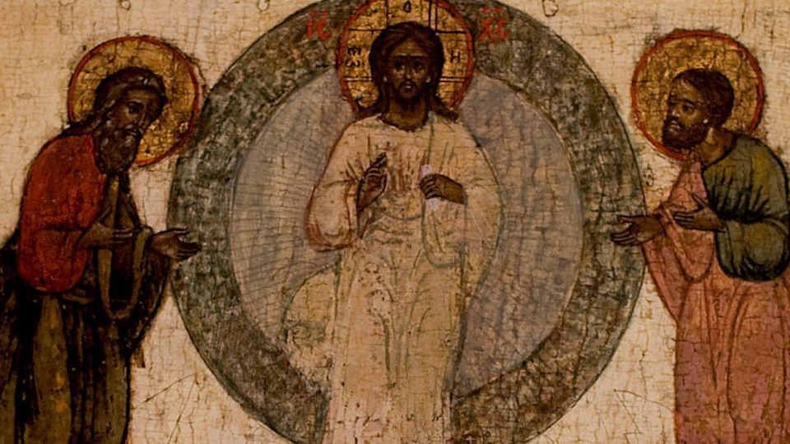
MOSES & ELIJAH
Notes:
MOSES-LAW/ELIJAH-PROHPETS
-FASTED 40 DAYS
-MYSTERIOUS ENDINGS
-ASSOCIATED W/REV 11
-HAD MOUNTAIN TOP EXPEREICES
-ELIJAH’S WAS DIFFERENT THAN
MOSES’ EXPERIENCES.

Slide 14
MOSES & ELIJAH
Notes:
-MOSES’S REQUEST-“SHOW ME
YOUR GLORY” EXODUS 33:18
-WHY DO I NEED TO SEEK THE
GLORY OF GOD?
-THE CLOSER WE GET TO HIS GLORY,
THE CLOSER WE GET TO HIS PRESENCE..
“DON’T ASK FOR MY GLORY UNLESS…”

Slide 15
MOSES & ELIJAH
Notes:
-4TH OF JULY STORY
-JAMES 4:8 DRAW NEAR TO GOD, AND
HE WILL DRAW NEAR TO YOU…
-MOSES WAS CLOSE, ELIJAH WAS CLOSE,
P-J-J WAS CLOSE.
-TRANSFIG. WAS IMPORTANT TO PETER!

Slide 16
2 PETER 1:16-18 ESV
16 For we did not follow cleverly devised myths when we made known to you the power and coming of our Lord Jesus Christ, but we were eyewitnesses of his majesty. 17 For when he received honor and glory from God the Father, and the voice was borne to him by the Majestic Glory, "This is my beloved Son, with whom I am well pleased," 18 we ourselves heard this very voice borne from heaven, for we were with him on the holy mountain.
Notes:
-YOU SHOULD KNOW THAT JESUS WANTS
TO REVEAL HIS GLORY (JOHN 17:24)
-IF ITS ONE THING I KNOW AS A CHRISTIAN,
ITS THAT WHEN I GET CLOSER TO CHRIST,
HE SPEAKS. BUT WHEN HE SPEAKS, WE HAVE
TO LISTEN TO HIM!!!

Slide 17
LISTEN TO HIM (JESUS) (VS. 7)
Mark 9:7 And a cloud overshadowed them, and a voice came out of the cloud, “This is my beloved Son; listen to him.”
Notes:
-we must mark
& listen to the words
of our Lord Jesus.
-some of us are of the faith
and some not.
-which is why the next verse is
important.

Slide 18
MARK 8:38 ESV
38 For whoever is ashamed of me and of my words in this adulterous and sinful generation, of him will the Son of Man also be ashamed when he comes in the glory of his Father with the holy angels."
Notes:
-my family and I celebrate on December 31
the life of a phenomenal woman
who walked this earth for a
short 62 years, and that was
my grandmother Joanne.
…she just wanted us to listen to her.
this is the gospel & heart of God

Slide 19
LISTEN TO HIM (JESUS) (VS. 7)
MARK 9:7 And a cloud overshadowed them, and a voice came out of the cloud, “This is my beloved Son; listen to him.”
Notes:
-GOD WANTS US TO LISTEN TO THE
WORDS AND TEACHINGS OF JESUS.
-WHY? IF NOT THEN YOURE LIVING A
LIFE THAT IS IN THE MIDST OF STEAKING
KILLING AND DESTROYING, BUT IF DO
LISTEN, YOU WILL EXPEREINCE LIFE,
AND LIFE MORE ABUNDANTLY.

Slide 20
SEEKING JESUS NEW IN 2024
WHAT
HOW
CONSIDER OTHERS BEFORE YOUR OWNSELVES
SEEK HIS GLORY
LISTEN TO HIM
3-3-3.
IN WHAT WAYS WILL I GO HIGHER AND CLOSER TO SEE GOD’S GLORY?
WHO AM I LISTENING TO MORE? AM I ASHAMED? WHAT ARE THE TEACHING OF CHRIST?
Notes:
-SALV. PRAYER (MARK 8)
-YOU DON’T HAVE TO BE ASHAMED
ANYMORE.
-HE WANTS TO LOVE YOU AND
SHOW YOU HIS GLORY.
AND WE WANT TO ACCEPT YOU
INTO THE FAMILY!

Slide 21
SEEKING
JESUS
NEW
IN 2024
Notes:
-PRAY AND TRUST GOD
-HE WILL ANSWER IF YOU
INQUIRE TO HIM.
-CONCLUDE

