Slide 1
And Everything Changes!
Luke 2:10-14

Slide 2
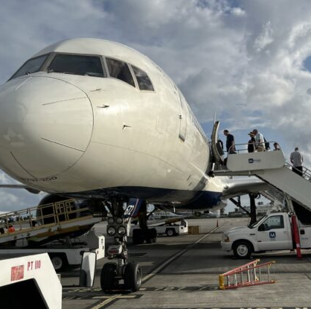
I want to “turn left!”

Slide 3
“Mary and Joseph lived in an oppressive society. They were heavily taxed by local and faraway rulers who, some scholars believe, demanded as much as 50% to 60% of what the common people grew and owned. Most peasants, like Mary & Joseph lived a precarious existence where 10% at the top controlled virtually everything. . . . Scholars speculate that Joseph moved to Nazareth to find work after he or his family could not economically survive in Bethlehem in previous years” Dr. Meier, author of “A Marginal Jew”

Slide 4
“It’s clear that Herod was brutal. Jesus was born into essentially a third-world context under a military dictatorship. It was a society where everyone was coerced. The whole concept of civil rights did not exist. If Herod wanted to do away with you, he could slit the throat of anybody he wanted – and he often did. . . Then consider the Romans, who crucified as many as 2,000 in one place to quell the all too common revolts of the day. . . Jesus’ world was a place of violence, oppression and poverty.” Dr. Douglas Oakman, Pacific Lutheran Univ.

Slide 5
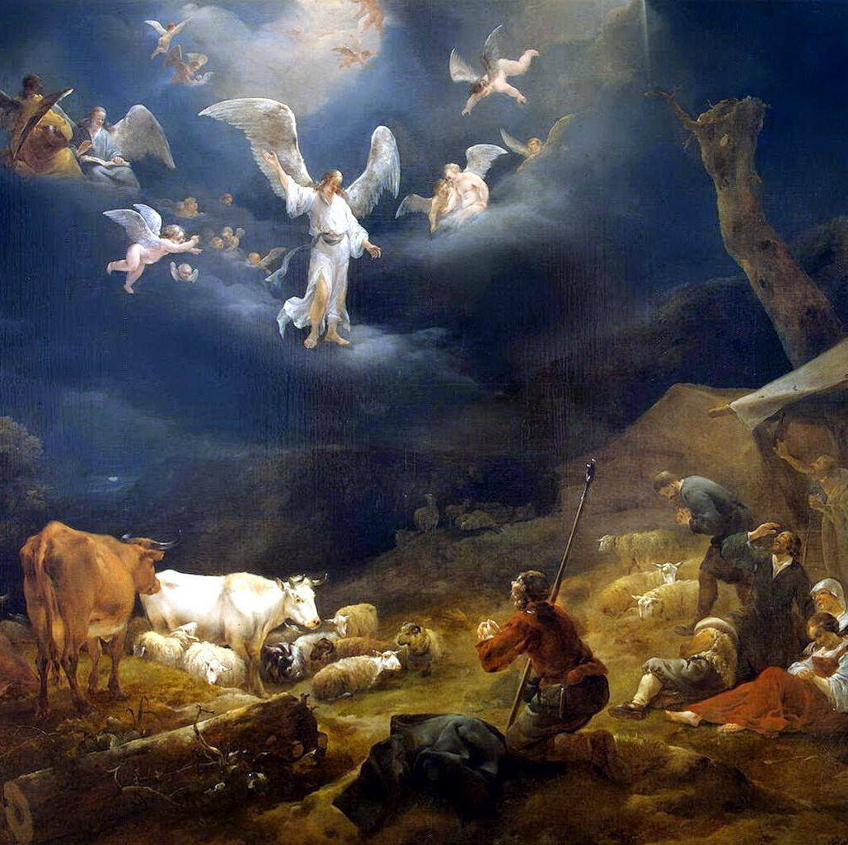
But the angel said to the shepherds, “Do not be afraid. I bring you good news of great joy that will be for all the people. Today in the town of David a Savior has been born to you; he is Christ the Lord.
Luke 2:10-11

Slide 6
This will be a sign to you: You will find a baby wrapped in cloths and lying in a manger.” Suddenly a great company of the heavenly host appeared with the angel, praising God and saying, “Glory to God in the highest, and on earth peace to men on whom his favor rests.” [Luke 2:13-14]

Slide 7
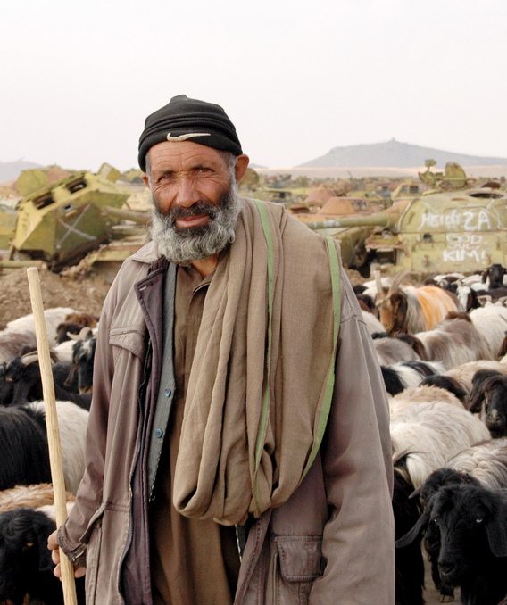
But the messenger of the God of the Universe said to the poor, outcast and unclean shepherds working third shift, “In the middle of the cold and your surviving, do not be afraid. I bring you good news of great joy that will be for all the people, even you. Today in the birthplace of the great King David the Savior you so desperately need has been born to you; he is God’s Anointed King and the Lord over all who was promised from David’s line.

Slide 8
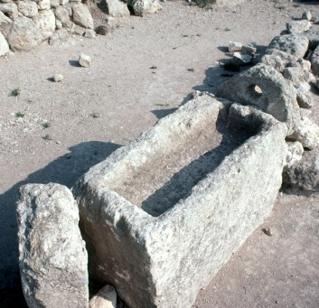
“This will be how you know Him and know He is for you in the cheap seats: You will find this royal baby, not in a palace - not even in a warm home. No, the king of Heaven is living exactly where you are - out in the cold without a home, wrapped in peasants’ cloths to stay warm and lying in an animal’s unclean feeding trough - the ones you work with all the time.”

Slide 9
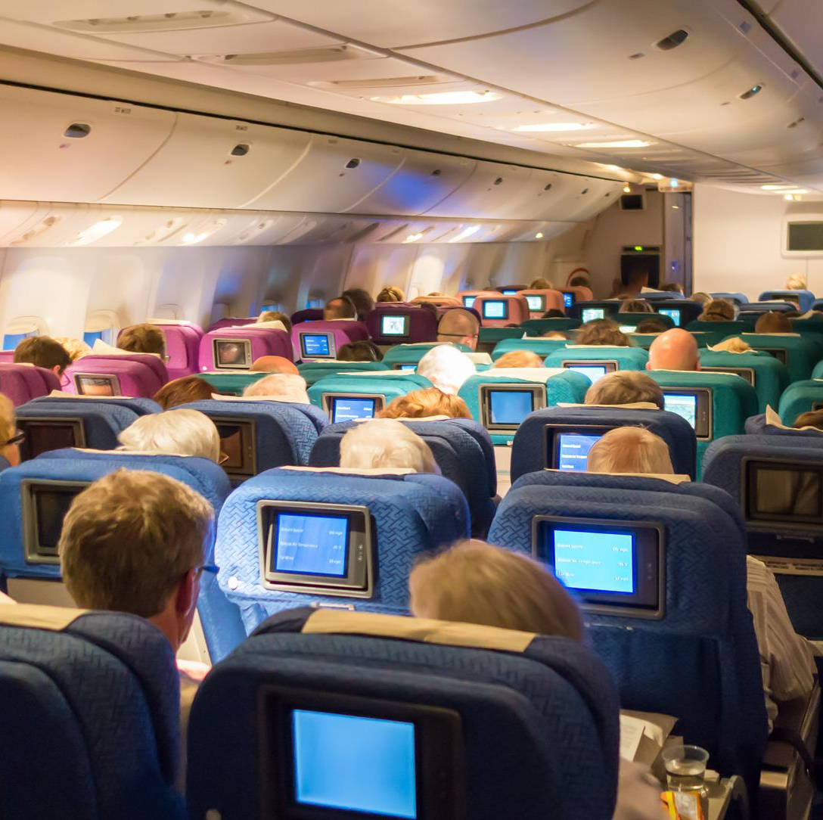
And as the totally confused shepherds were trying to figure out if this made any sense or could possibly be true in the second class world they live in, the overwhelming awe-inspiring army of Heaven appeared with this angel, praising God and celebrating the King’s birth to the forgotten and left behind!

Slide 10
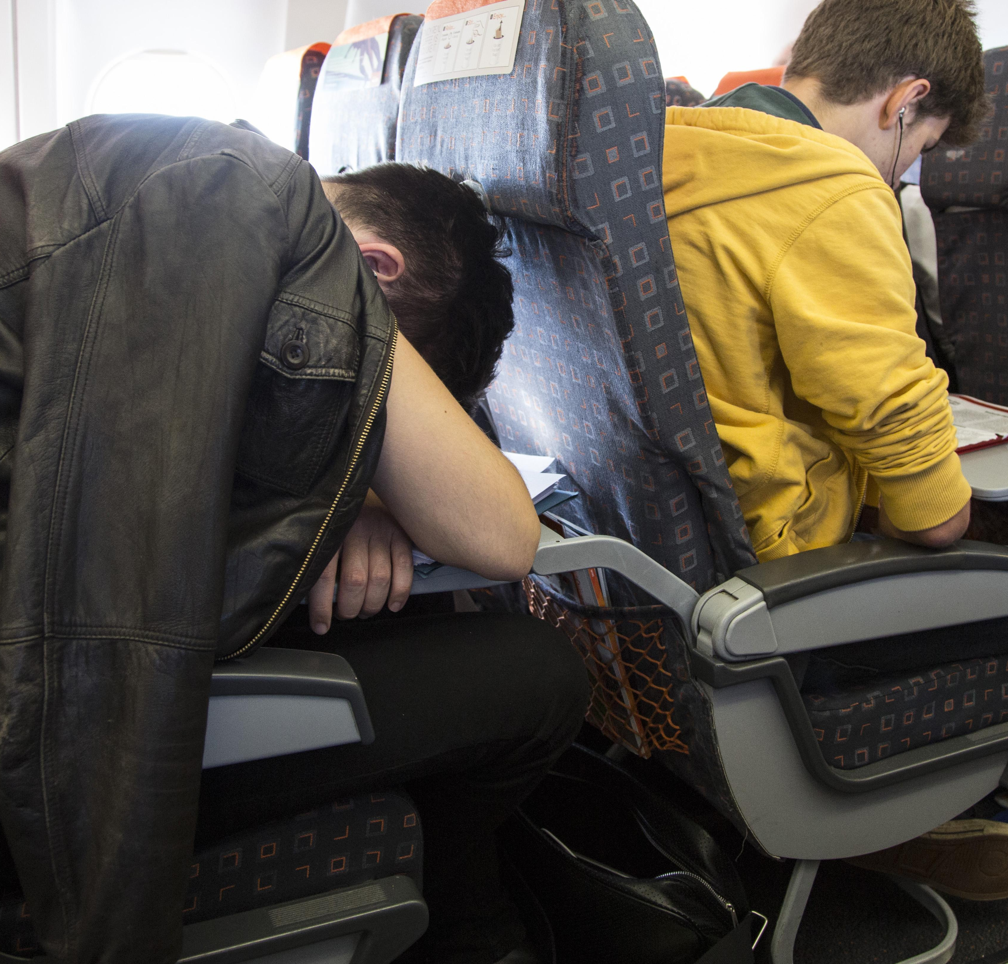
“They celebrated by saying, ‘Glory to God for doing it this way! Give Him Glory in the Highest Heaven for revealing Himself to the lowest and most humble! And praise to God for letting there be peace in the hearts of those on the earth who choose Him! Who have a first class overflowing in their hearts in second class circumstances. That’s something the universe rejoices in!’”

Slide 11
This king doesn’t call you to the front. This king comes with you to the back and makes it the place of greatest glory and life!

Slide 12
Have this mind among yourselves, which is yours in Christ Jesus, ⁶ who, though he was in the form of God, did not count equality with God a thing to be grasped, ⁷ but emptied himself, by taking the form of a servant, being born in the likeness of men. ⁸ And being found in human form, he humbled himself by becoming obedient to the point of death, even death on a cross Philippians 2:5-8

Slide 13
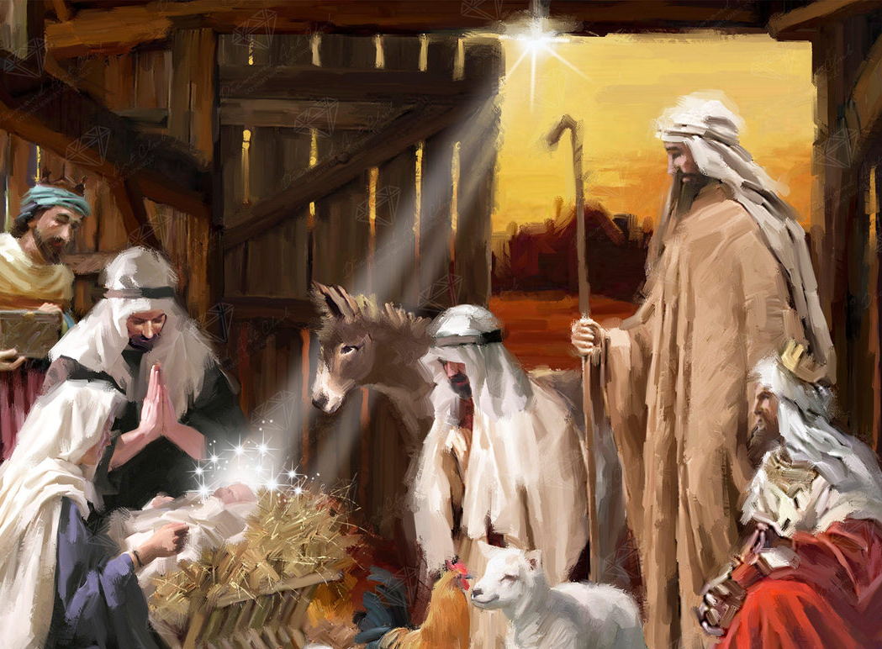
The King’s presence transforms . . . The hardest place to the most glorious. The most forgotten to the most known The powerless to the strongest

Slide 14
For thus says the One who is high and lifted up, who inhabits eternity, whose name is Holy: “I dwell in the high and holy place, and also with him who is of a contrite and lowly spirit, to revive the spirit of the lowly, and to revive the heart of the contrite. Isaiah 57:15

Slide 15
King Jesus, Thank you for being where I am. Help me to see that You are with me.

