Slide 2
Jesus feeds 5,000 men
Mark 6:30-44

Slide 3
Jesus feeds 5,000 men
Mark 6:30-44
The only miracle recorded in all 4 Gospel accounts
(Mt. 14:13-21 | Luke 9:10-17 | John 6:1-15 )

Slide 4
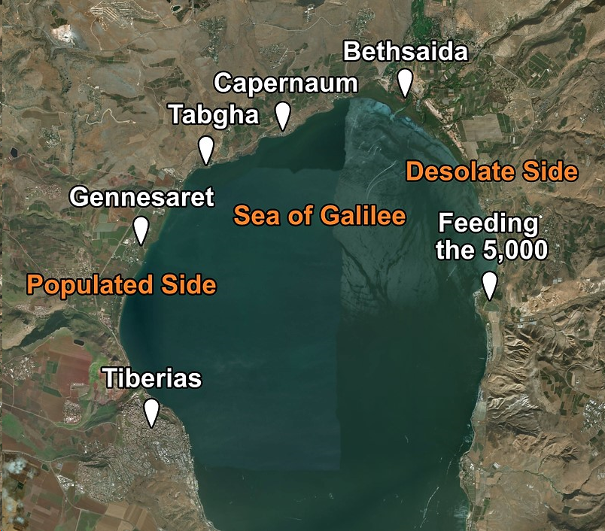

Slide 5
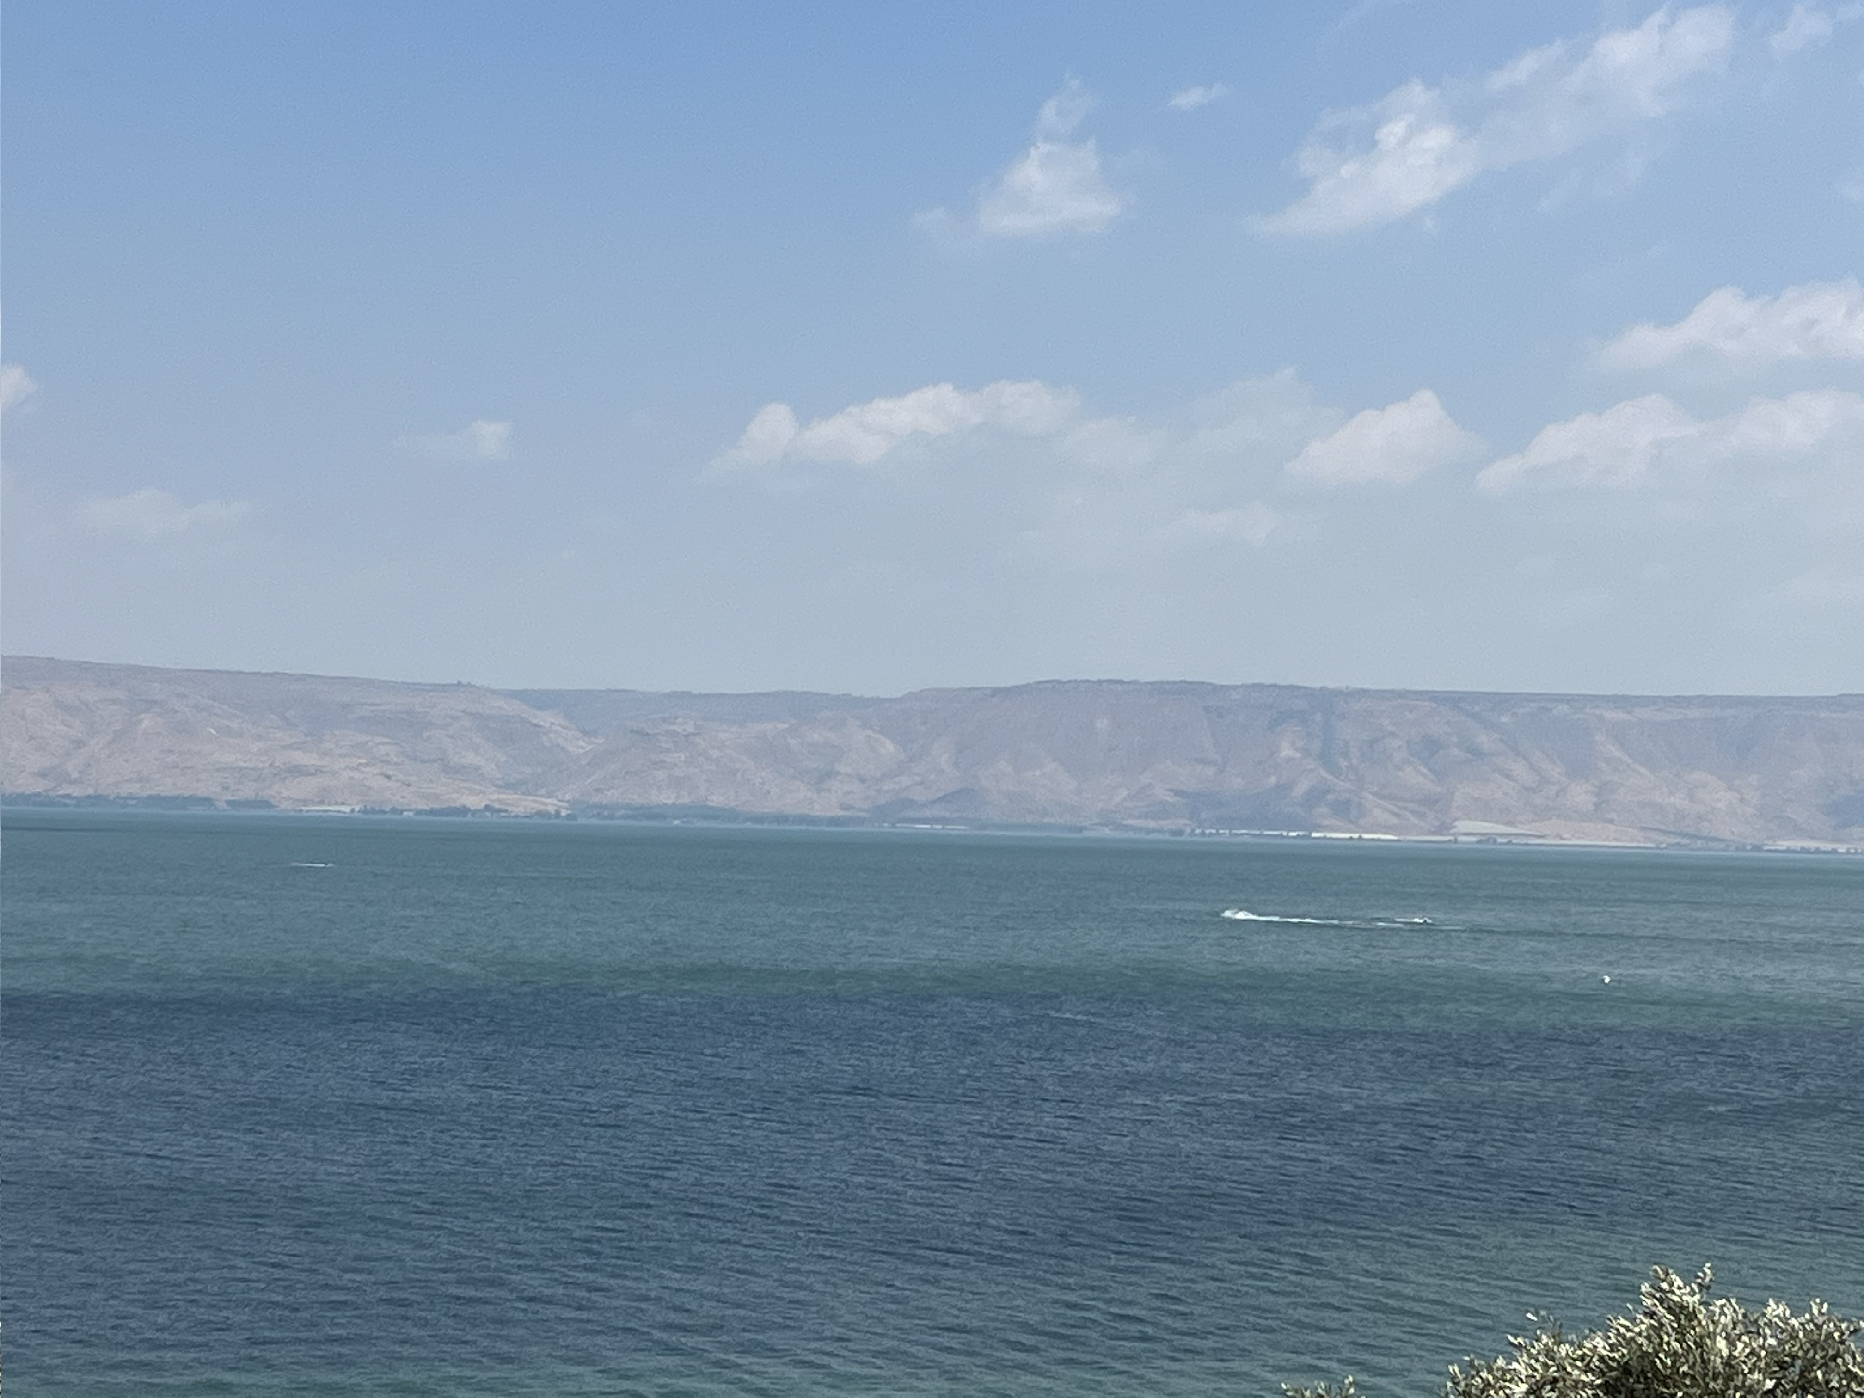

Slide 6
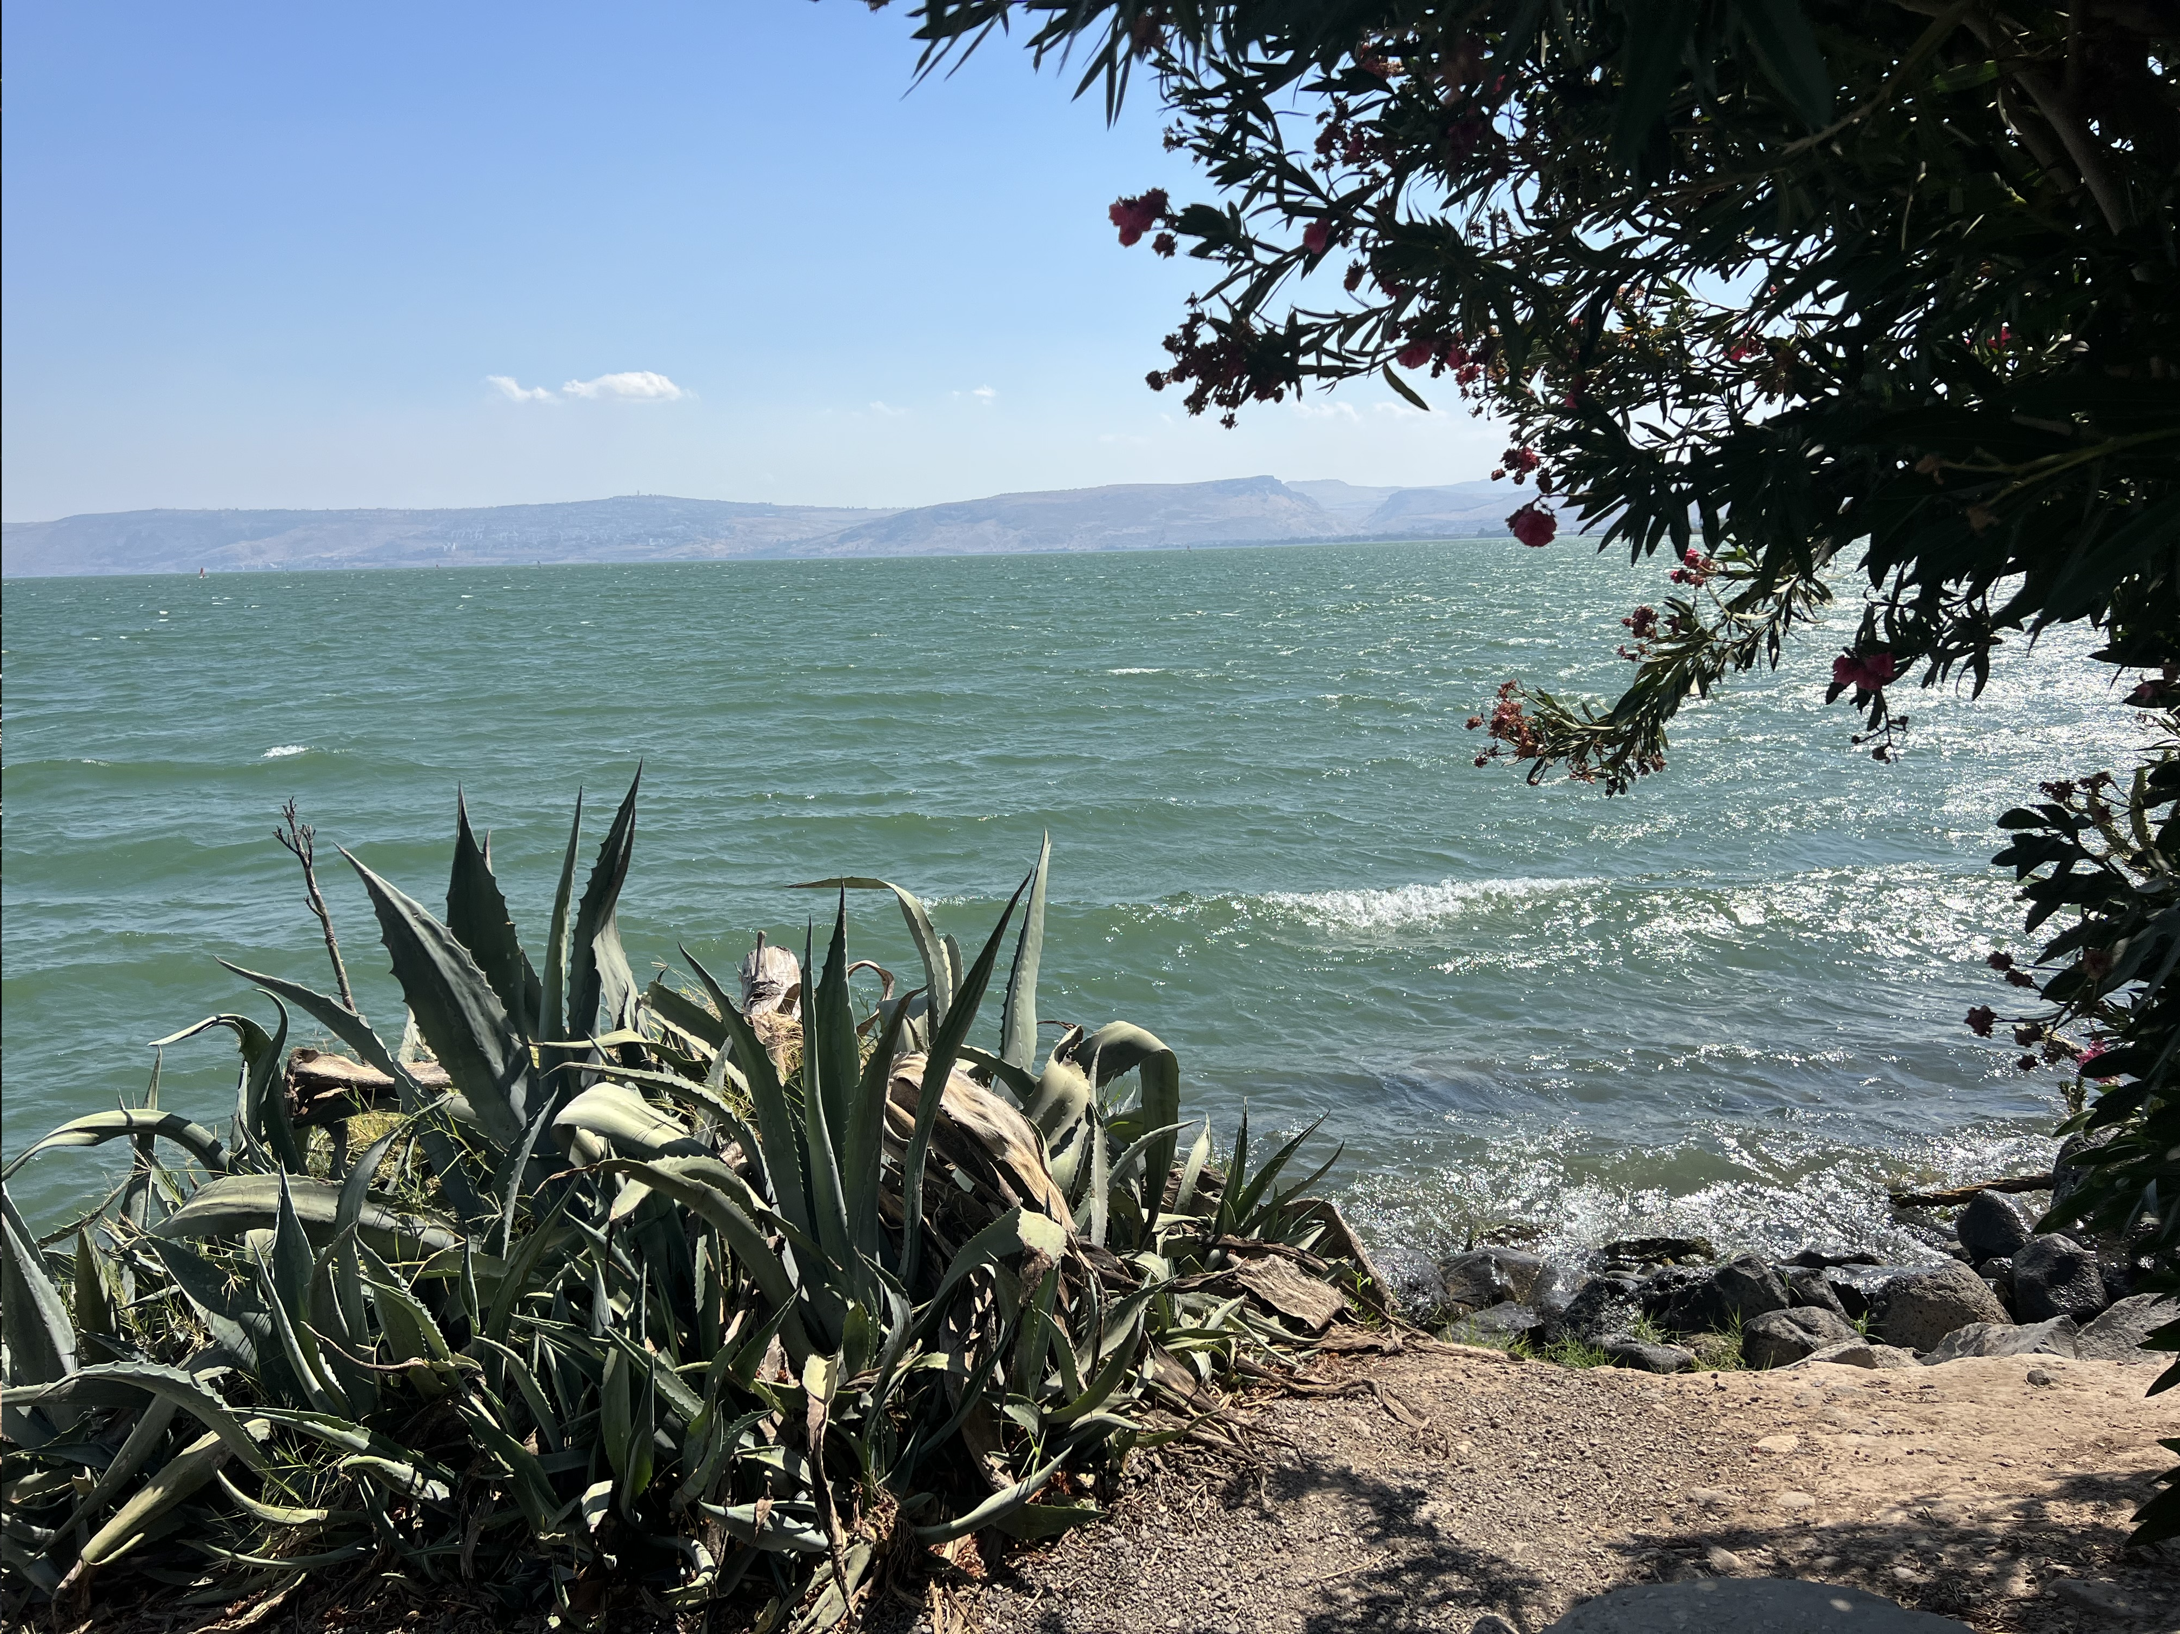

Slide 7
Who’s there and what did they know?

Slide 8
Who’s there and what did they know?
The crowd
- Experiencing Jesus’ compassion, healing, teaching

Slide 9
Who’s there and what did they know?
The crowd
- Experiencing Jesus’ compassion, healing, teaching
The disciples
- awareness of the situation; world’s focus

Slide 10
Who’s there and what did they know?
The crowd
- Experiencing Jesus’ compassion, healing, teaching
The disciples
- awareness of the situation; world’s focus
The little boy
- 2 fish and 5 loaves in his lunch bag

Slide 11
Who’s there and what did they know?
The crowd
- Experiencing Jesus’ compassion, healing, teaching
The disciples
- awareness of the situation; world’s focus
The little boy
- 2 fish and 5 loaves in his lunch bag
Jesus
- “He already knew what he was going to do”

Slide 12
Feeding Of 5000 | Thinking During Great Need
JESUS
THE DISCIPLES
Kingdom Of God | Kingdom Of This World | Kingdom Of Satan
Gives Life | Empty | Takes Life [Death]
Holy Spirit | Sinful Flesh | Unclean Spirits
God’s Freedom | My Control [Fear] | Satan’s Slavery
Abundance | Scarcity | Debt
Abundance | Scarcity | Debt
New | Temporary | Old
Give | Hoard | Steal

Slide 13
Feeding Of 5000 | Thinking During Great Need
JESUS
THE DISCIPLES
Kingdom Of God | Kingdom Of This World | Kingdom Of Satan
Gives Life | Empty | Takes Life [Death]
Holy Spirit | Sinful Flesh | Unclean Spirits
God’s Freedom | My Control [Fear] | Satan’s Slavery
Abundance | Scarcity | Debt
Abundance | Scarcity | Debt
New | Temporary | Old
Give | Hoard | Steal
Little Boy

Slide 14
My little “Am I…” statements

Slide 15
My little “Am I…” statements
The crowd
- Seeking Jesus? What did I come to see?

Slide 16
My little “Am I…” statements
The crowd
- Seeking Jesus? What did I come to see?
The disciples
- trying to solve issues in my abilities or in faith in the Lord?

Slide 17
My little “Am I…” statements
The crowd
- Seeking Jesus? What did I come to see?
The disciples
- trying to solve issues in my abilities or in faith in the Lord?
The little boy
- Unaware of what Jesus is going to do through me?

Slide 18
John
John 6:35
“Jesus said to them, ‘I am the bread of life. The one who comes to me will never become hungry, and the one who believes in me will never become thirsty.’”
John 7:38
“Whoever believes in me, as scripture says, rivers of living waters will flow through them.”

Slide 19
The Pathway
Be devoted to God’s Word Discipleship Pathway
Be Devoted to Fellowship Small Groups
Be Active in Corporate Worship and Prayer Sunday Worship | Calls to Prayer
Love Those Different than Yourself Bilingual Ministry | Hospitality
Find Calling and Serve the Kingdom Ministry Teams | Missions
Win the Lost, Especially the Next Generation Kids & Youth Ministry | Personal Witnessing | Outeach

Slide 20
Daily walk

Slide 21
Daily walk
Quiet time in PRAYER, alone, still…
- meditation and a conversation
- thanksgiving first before petitions

Slide 22
Daily walk
Quiet time in PRAYER, alone, still…
- meditation and a conversation
- thanksgiving first before petitions
Word of God…
- go wherever he takes you; read, ponder, reread

Slide 23
Daily walk
Quiet time in PRAYER, alone, still…
- meditation and a conversation
- thanksgiving first before petitions
Word of God…
- go wherever he takes you; read, ponder, reread
Take one small step yielding to the nudge of God

Slide 24
What is the best I have of me, to sacrifice for the greatness of God within me?

Slide 25
What’s in your lunch bag?

Slide 26
What’s in your lunch bag?
Time –
- to seek Jesus, to listen all day; a desire to hear his authority; focused - not aware of hunger (crowd)

Slide 27
What’s in your lunch bag?
Time –
- to seek Jesus, to listen all day; a desire to hear his authority; focused - not aware of hunger (crowd)
Talents –
- skills, knowledge – how do you feed them?; logical, sensible, worldly discernment to situation (disciples)

Slide 28
What’s in your lunch bag?
Time –
- to seek Jesus, to listen all day; a desire to hear his authority; focused - not aware of hunger (crowd)
Talents –
- skills, knowledge – how do you feed them?; logical, sensible, worldly discernment to situation (disciples)
Treasures –
- Do I have enough for me if I give it all away; am I aware of what He can do with what I have (boy)

Slide 29
“Beware of paying to much attention or going back to what you were or what you know how to do when God wants you to be something you’ve never been before”

Slide 30
Things to pray about…

Slide 31
Things to pray about…
Am I seeking him, running after him, am I following? And for what? “He had compassion on them, healed them, welcomed them, taught them about the Kingdom of God”

Slide 32
Things to pray about…
Am I seeking him, running after him, am I following? And for what? “He had compassion on them, healed them, welcomed them, taught them about the Kingdom of God”
Am I thinking, solving, striving to do life logically, common sensibly, worldly? Where do you get your truth from?

Slide 33
Things to pray about…
Am I seeking him, running after him, am I following? And for what? “He had compassion on them, healed them, welcomed them, taught them about the Kingdom of God”
Am I thinking, solving, striving to do life logically, common sensibly, worldly? Where do you get your truth from?
What’s in your lunch bag, freely given to the Lord, that he will do the impossible through you?

Slide 34
