Slide 1
Notes:
-GET EXCITED
-INTRODUCE YOURSELF
-THANK ALL VETERANS (DAD)
-YOUNG ADULT SHOUT OUT

Slide 2
Mission of Healing
Notes:
-KNOW: JESUS IS ON MISSION TO HEAL
-DO: BELIEVE WITH CHILD-LIKE FAITH
THAT JESUS WANTS TO.
-WHEN TALKING ABOUT HEALING
WE HAVE TO DISCUSS GODS
SOVEREIGNTY AND THE ISSUE
OF WHAT IF HE DOESN’T…

Slide 3
Four Ways Jesus Gives us Victory
[1] endure sickness for a time
for a greater purpose (maturity or ministry)
[2] live in a disability
to show true life & defeat lies of this world
[3] use sickness to bring us home:
completed His purpose & time for reward
[4] remove sickness as a sign
of His Gospel and power
Notes:
-RECAP P.S. SERMON (SOVEREIGN)
-7 CERTANTIES OF BIB. HEALING
-YOUR GREATEST PHYS. NEED IS NOT
YOUR GREATEST NEED; ITS FORGIVE-
NESS AND DELIVERANCE (MAR 2:5-11)

Slide 4
Four Ways Jesus Gives us Victory
[1] endure sickness for a time
for a greater purpose (maturity or ministry)
[2] live in a disability
to show true life & defeat lies of this world
[3] use sickness to bring us home:
completed His purpose & time for reward
[4] remove sickness as a sign
of His Gospel and power
Notes:
-I WANT TO SPEAK TO GODS
SOVERIGNTY.
-2 HEALINGS
-1 ATTEMPT TO HEAL
-TODAY, I WANT TO PUT A FOCUS
ON #4 REMOVING/HEALING.

Slide 5
MARK 5:21-42
Notes:
PRAY

Slide 6
WHO IS JAIRUS?
²³ Then came one of the rulers of the synagogue, Jairus by name, and seeing him, he fell at his feet ²³ and implored him earnestly, saying, “My little daughter is at the point of death. Come and lay your hands on her, so that she may be made well and live.” ²⁴ And he went with him.
Mark 5:23-24
Notes:
-WHO IS JAIRUS?
-RULER OF THE SYNAGOGUE
-HUSBAND (BELIEVED TO)
-MOST IMPORT., FATHER

Slide 7
WHO IS WOMAN W/ ISSUE OF BLOOD?
²⁶ and who had suffered much under many physicians, and had spent all that she had, and was no better but rather grew worse.
Mark 5:26
Notes:
-SUFFERED DIFF. PROCEDURES
-NO MONEY (NO INSURANCE)
-PAIN GOT WORSE WITH TIME.
-HERMORPHAGE/BLOOD ISSUE
-LEV 15:27/WASH THEIRSELVES
& CLOTHES & CONSIDERED
UNCLEAN UNTIL EVENING.

Slide 8
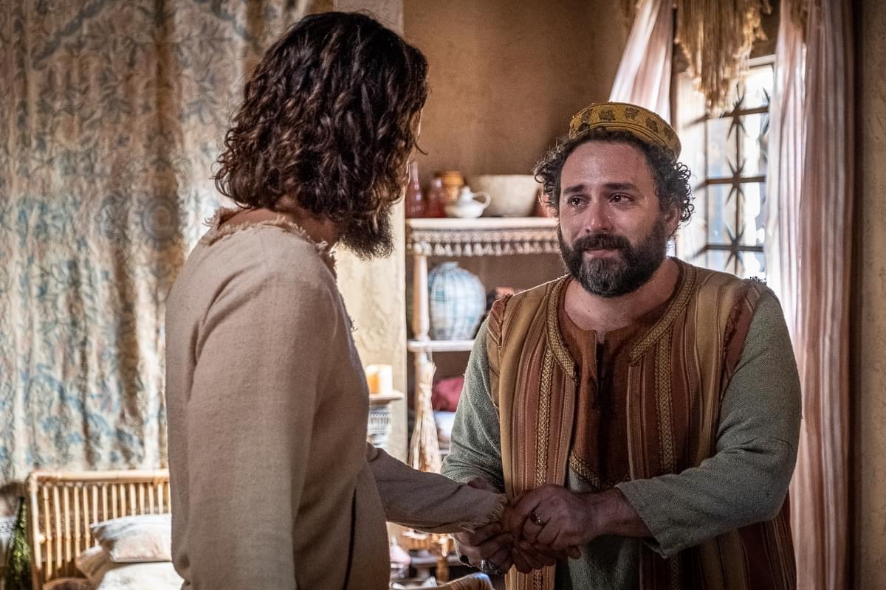
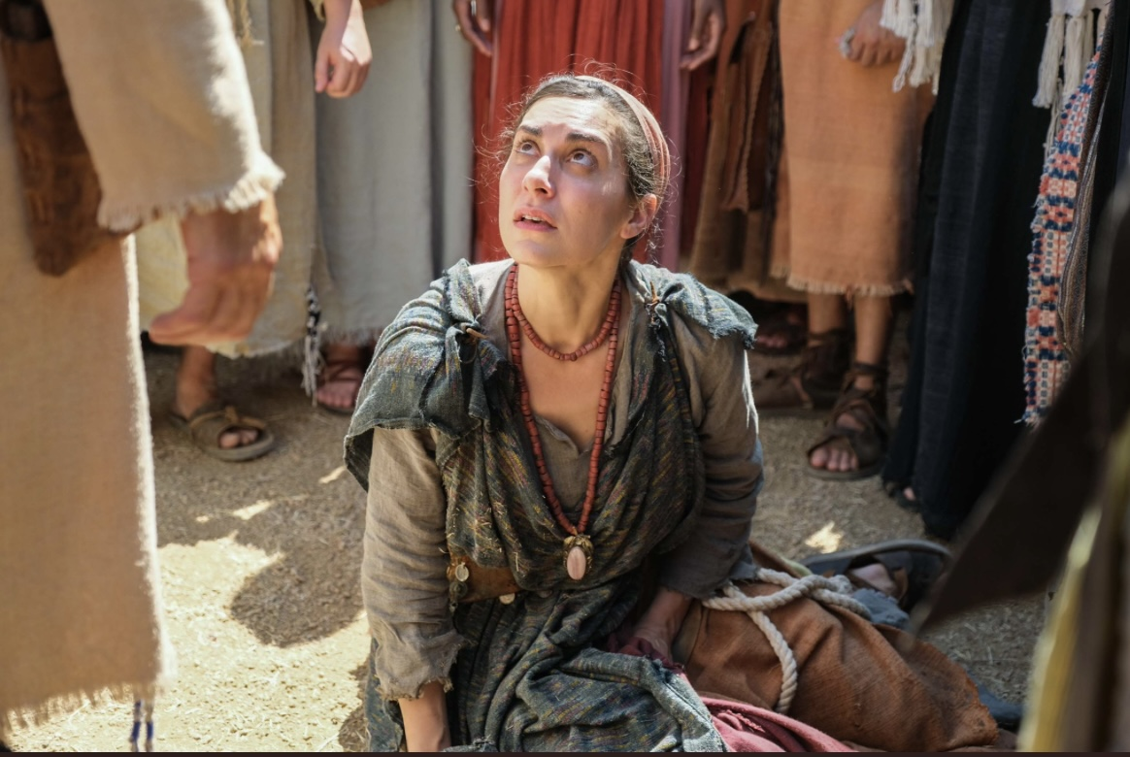
JAIRUS & WOMAN W/ ISSUE OF BLOOD
Notes:
-MISSION-DESPITE COMM.
STATUS AS RULER, HE HUMBLED
HIMSELF AND BELIEVED.
-MISSION- DESPITE FAILURE AND
RISK TO MAKE PEOPLE UNCLEAN,
SHE BELIEVED. (CANT BE IN PUBLIC)
-LETS CHANGE NAME

Slide 9
JAIRUS & VERONICA
Notes:
-REMEMBER OBJECTIVE!
-KNOW: JESUS IS ON MISSION TO HEAL
-DO: BELIEVE WITH CHILD-LIKE FAITH
THAT JESUS WANTS TO.
- THERE IS A PROBLEM THAT’S
OPPOSING US!

Slide 10
“Where there is a need for healing, there’s a desire to doubt”
Notes:
-THIS IS THE PROBLEM!
-LETS LOOK AT VERSES
TO SEE THE PROBLEM IN
BOTH CHARACTERS

Slide 11
VS. 26 Veronica’s Doubt
VS. 35 Jairus’ Daughter Dies
VS. 36 But overhearing what they said, Jesus said to the ruler of the synagogue, “Do not fear, only believe.”
Notes:
-VS. 26/ 12Y OR 4380 DAYS
-ALL REMEDIES, NO MONEY,
NO BETTER.
VS. 35/ CROWD SLOWED JESUS
DOWN (FRUSTRATED FATHER)
-IN VS. 36 THE SOLUTION
-HOW CAN WE BE LIKE J&V??

Slide 12
IMAGINATION

Slide 13
IMAGINATION
THE ACTION OF FORMING NEW IDEAS OR IMAGES OR CONCEPTS OF EXTERNAL OBJECTS NOT PRESENT TO THE SENSES.
Notes:
-HEBREW 11:1 DEFINTION
-ONE OF THE BEST GIFTS GOD
GAVE US IS THE GIFT OF IMAGE.
-TO THINK AND CREATE WITH
MENTAL PICTURE.

Slide 14
Notes:
-IMAGINATION OF KIDS
-NOTHING BECOMES REALITY
UNLESS SOMEONE THINKS OF IT.
-STEVE JOBS-97.7 MILLION PHONES
-WRIGHT BROTHERS-5K AIRLINES
-GWC-94% AMERICANS HAVE PB

Slide 15
MARK 11:23-23 ESV
²³ Truly, I say to you, whoever says to this mountain, ‘Be taken up and thrown into the sea,’ and does not doubt in his heart, but believes that what he says will come to pass, it will be done for him. ²⁴ Therefore I tell you, whatever you ask in prayer, believe that you have received it, and it will be yours.
Notes:
-DO WE STILL BELIEVE THIS
TODAY? IF NOT WHY?
-WHEN DID YOUR FAITH
DECREASE? THIS IS WHO WE ARE
-THIS IS WHO J & V WAS!

Slide 16
MARK 11:23-24 ESV
²³ Truly, I say to you, whoever says to this mountain, ‘Be taken up and thrown into the sea,’ and does not doubt in his heart, but believes that what he says will come to pass, it will be done for him. ²⁴ Therefore I tell you, whatever you ask in prayer, believe that you have received it, and it will be yours.
Notes:
-CAN WE DO BAD WITH OUR IMAGEI.?
-YES! THAT’S WHY PHIL 4:8
-QUOTE EPH 3:20

Slide 17
THE POWER OF THE IMAGINABLE BELIEVER
+
THE POWER OF OUR INCREDIBLE JESUS
=
ADVANCEMENT OF THE KINGDOM OF GOD
Notes:
-I HAVE AN IMAGE IN MY HEAD OF
YOU HEALED/THAT’S WHY I CAN
PRAY WITH ENERGY! (IMAGI. IS GAS)
-THAT’S WHY I BELIEVE FOR:
-BROKEN LEG, BAD VIRUS
-CANCER, MARITAL ISSUES

Slide 18
THE POWER OF THE IMAGINABLE BELIEVER
Mark 5:23 and implored him earnestly, saying, “My little daughter is at the point of death. Come and lay your hands on her, so that she may be made well and live.” ²⁴ And he went with him.
Mark 5:28-29 For she said, “If I touch even his garments, I will be made well.” ²⁹ And immediately the flow of blood dried up,
Notes:
-J NEVER MET JESUS BUT HAD
AN IMAGE THAT ACTIVATED
HIS FAITH TO GO TO JESUS.
-V WASN’T SUPPOSE TO BE
THERE OR ATTEMPT TO TOUCH.
-HER DETERM AND PERSIST.
AND IMAGI. PUSHED HER TO BELIEVE

Slide 19
THE POWER OF OUR INCREDIBLE JESUS
John 11:6 So, when he heard that Lazarus was ill, he stayed two days longer in the place where he was.
Mark 5:30 And Jesus, perceiving in himself that power had gone out from him, immediately turned about in the crowd and said, “Who touched my garments?”
Notes:
-NEVER LATE, ALWAYS ON TIME.
-JES. IS NOT ON TIME, TIME IS ON HIM.
-JESUS PROVED THAT HE WAS/IS
LORD OVER TIME, DEATH, SICKNESS
-JESUS SPOKE WORD OF HEALING 3 TIMES
-PROVED NO MATTER HOW, HES ON MISS. -MALACHI 4:2 “HEALING IN HIS WINGS”

Slide 20
THE POWER OF THE IMAGINABLE BELIEVER
+
THE POWER OF OUR INCREDIBLE JESUS
=
ADVANCEMENT OF THE KINGDOM OF GOD
Notes:
-MISSION OF HEALING:
-OUR JOB IS TO IMAGINE
AND BELIEVE. HIS IS JOB IS
TO HEAL.
-THE WORLD GIVES
REMEDIES BUT JESUS
GIVES THE CURE.

Slide 21
Luke 8:40 KJV
And it came to pass, that, when Jesus was returned, the people gladly received him: for they were all waiting for him.
Notes:
-DIFFERENT GOSPEL BUT
SAME STORY (MARK5:21)
-THIS IS HOW WE KNOW THE
KINGDOM OF GOD IS ADVANCING
-WHY? BECAUSE PEOPLE BELIEVED
HIM FOR HEALING AND HE DID IT.

Slide 22
Notes:
-HAVE I GIVEN UP ON THE
MISSION OF PRAYING FOR
SOMEONE TO BE HEALED?
-HAVE I GIVEN UP ON MYSELF?
-DO I STILL BELIEVE THAT JESUS
IS ON MISSION TODAY TO HEAL?
-INVITE TEAM, ALTAR CALL, BE BOLD

