Slide 2
One day Jesus came from Nazareth in Galilee, and John baptized him in the Jordan River.
Mark 1:9(NLT)

Slide 3
As Jesus came up out of the water, he saw the heavens splitting apart and the Holy Spirit descending on him[a] like a dove. And a voice from heaven said, “You are my dearly loved Son, and you bring me great joy.”
Mark 1: 10-11 (NLT)

Slide 4
…, “You are my dearly loved Son, and you bring me great joy.”
Mark 1:9 NLT(New Living Translations)

Slide 5
Let love be without dissimulation(Genuine). Abhor that which is evil; cleave to that which is good.
Romans 12:9(KJV)

Slide 8
And I am convinced that nothing can ever separate us from God’s love. Neither death nor life, neither angels nor demons,[a] neither our fears for today nor our worries about tomorrow—not even the powers of hell can separate us from God’s love. No power in the sky above or in the earth below—indeed, nothing in all creation will ever be able to separate us from the love of God that is revealed in Christ Jesus our Lord.
Romans:8:38-39(NLT)

Slide 9
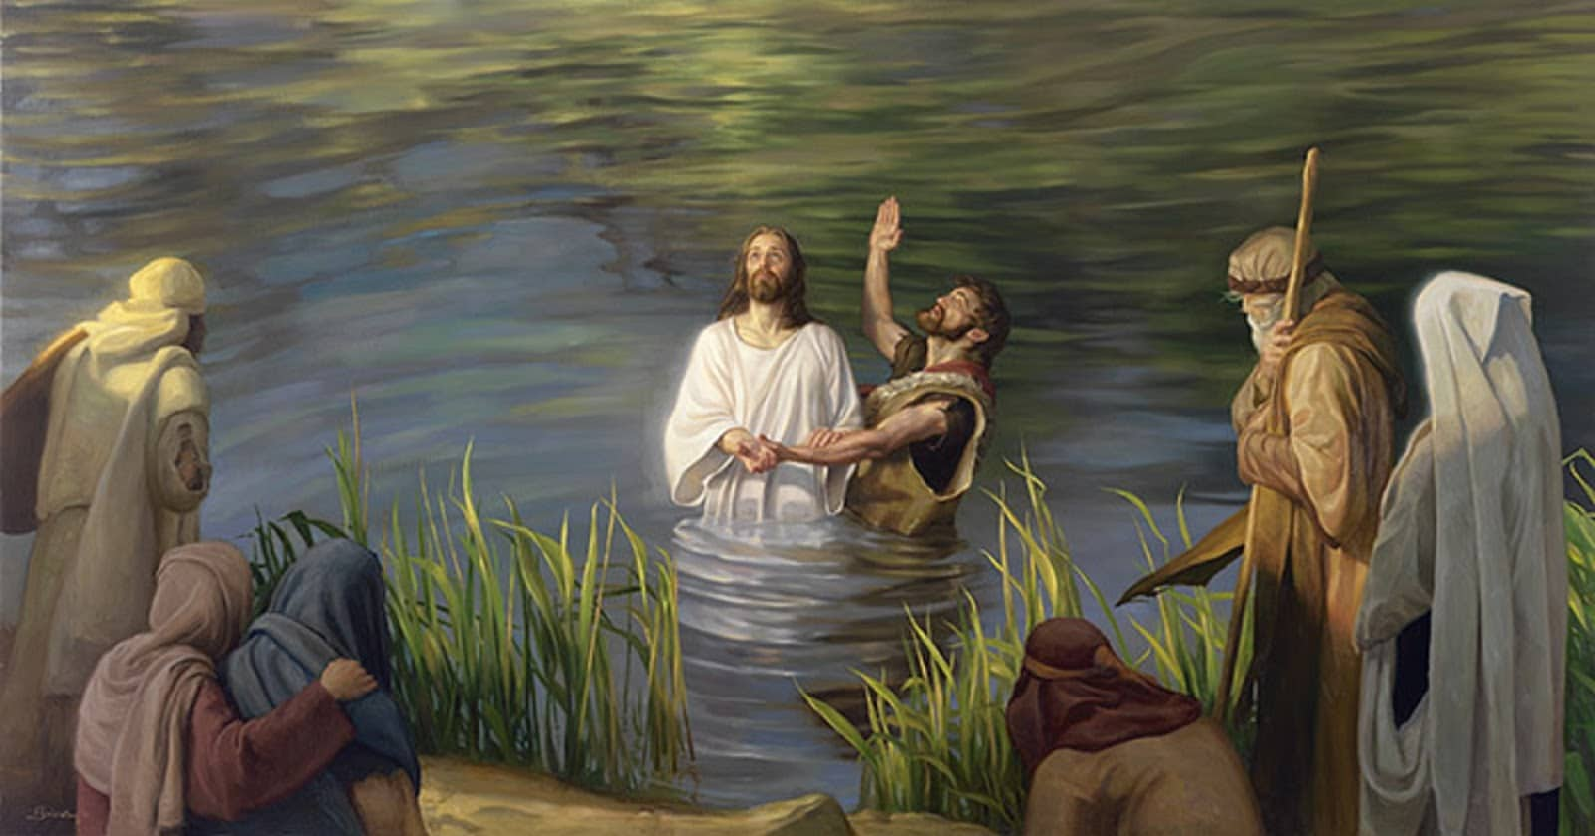
9 At that time Jesus came from Nazareth in Galilee and was baptized by John in the Jordan.

Slide 10
submission
“Abba, Father,”[g] he cried out, “everything is possible for you. Please take this cup of suffering away from me. Yet I want your will to be done, not mine.”
Mark 14:36 (NLT)

Slide 11
After the wise men were gone, an angel of the Lord appeared to Joseph in a dream. “Get up! Flee to Egypt with the child and his mother,” the angel said. “Stay there until I tell you to return, because Herod is going to search for the child to kill him.”
Matthew 2:13 (NTL)

Slide 12
42 “Father, if you are willing, please take this cup of suffering away from me. Yet I want your will to be done, not mine.” 43 Then an angel from heaven appeared and strengthened him.
Luke 22:42-43 (NLT)
The Spirit then compelled Jesus to go into the wilderness, 13 where he was tempted by Satan for forty days. He was out among the wild animals, and angels took care of him.
Mark 1:13(NLT)

Slide 13
As Jesus came up out of the water, he saw the heavens splitting apart and the Holy Spirit descending on him[a] like a dove. And a voice from heaven said, “You are my dearly loved Son, and you bring me great joy.”
Mark 1: 10-11 (NLT)

Slide 14
Submission to God:
1-Pleases God.
2-Bring the manifestation of the Holy Spirit.
3-Opens the heavens for US.

