Slide 1
Looking at the Scoreboard
Acts 26
Notes:
A key word through this reset – has been focus
Let’s read Paul’s story in Acts 26 and remember what to focus on
Paul on trial again as a prisoner – Acts 25:23
He walks in with chains. 2 years of being on trial for his life.

Slide 2
“I [Jesus] have appeared to you to appoint you as a servant and as a witness…
I am sending you to them ¹⁸ to open their eyes and turn them from darkness to light, and from the power of Satan to God, so that they may receive forgiveness of sins and a place among those who are sanctified by faith in Me.’
[Acts 26:17-18, NIV]
Notes:
Acts 26:1-3, 9f

Slide 3
²⁸ Then Agrippa said to Paul, “Do you think that in such a short time you can persuade me to be a Christian?”
²⁹ Paul replied, “Short time or long—I pray God that not only you but all who are listening to me today may become what I am, except for these chains.”
[Acts 26:28-29, NIV]
Notes:
Comsewogue | sophomore | new tea,
Team pics coming | working out
First game | hair, uniform, cheerleaders
Only one problem . . .

Slide 4
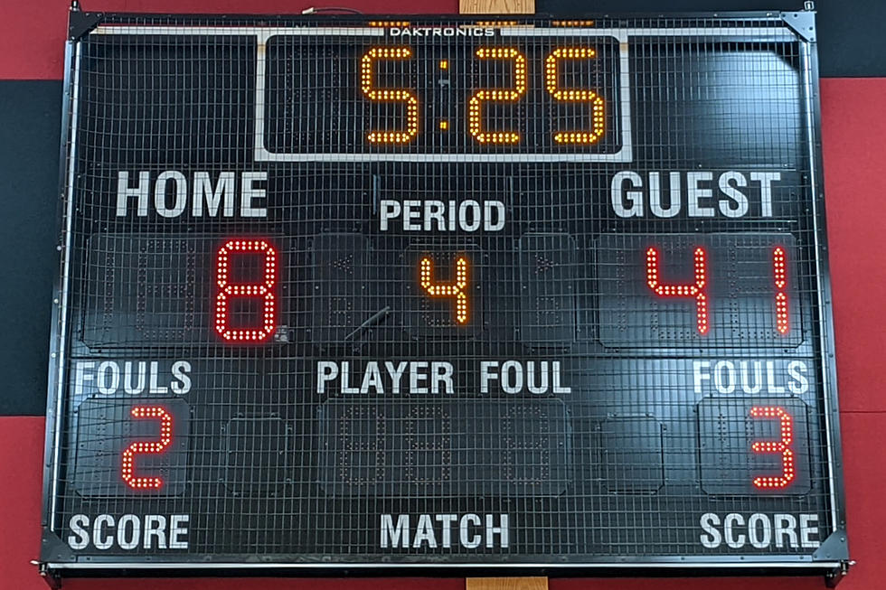
Notes:
Coach | time out | didn’t mention how we looked
We’re losing | reset | new play | its about winning
It’s not about what the fans are saying
It’s about the scoreboard
[slide]

Slide 5
It doesn’t matter
how you look or feel,
what matters is the score!
Notes:
Paul & King Agrippa & officials – pomp & prisoner
They wear jewelry, he wears chains.
He’s looking at scoreboard (heavenly vision) (v19)
Two teams: Not jews/gentiles, Israel/rome
Prisoner/prominent, gov’t/people, poor/rich
Its this . . .

Slide 6
I am sending you
to open their eyes and turn them from
darkness to light
Satan’s power to God’s power
condemnation to forgiveness
rejection to belonging
fear to faith
[Acts 26:17-18, NIV]
Notes:
It’s Darkness vs light | hell v heaven [list]
His whole life – paul is looking at the scoreboard
If one person doesn’t know
Paul doesn’t care about the uniform, the fans, the appearances
He’s the prisoner. They are the powerful – (v28&29)

Slide 7
Regardless of these chains
(circumstances & appearances)
I know the game,
whose team I’m on,
and what’s the win.
Become “what I am.”
[Acts 26:28-29, NIV]
Notes:
Become like me
Find life
Open your eyes – realize the game!
Don’t lose

Slide 8
I have fought the good fight, I have finished the race, I have kept the faith. ⁸ Now there is in store for me the crown of righteousness, which the Lord, the righteous Judge, will award to me on that day
[2 Timothy 4:7-8]
Notes:
Paul’s looking at the scoreboard not the circumstances
Few years later – he will write
I kept my eyes on the scoreboard
How about you?

Slide 9
Notes:
Are you paying attention to the scoreboard?
For yourself, your family, your workplace, our community
YOU: right there – called screen time | late a night
YOUR FAMILY: look at calendar, look at love, does everyone know him?
YOUR WORKPLACE: so busy living in your title – missing your identity

Slide 10
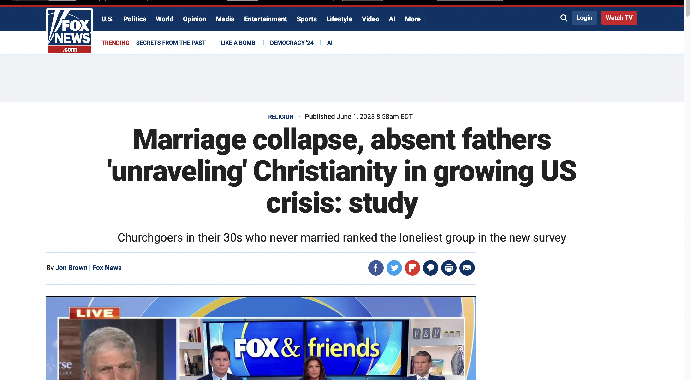
Notes:
our community? |10 miles | 30 churches | 20k unchurched
Are we looking at the scoreboard?
Drive Chester: how many new CBD, bars or other places of addiction
Our schools and the need for mentors and healing
How about our church? Not about #’s? Not what Jesus said?

Slide 11
Jesus replied: “A certain man was preparing a great banquet and invited many guests. ¹⁷ At the time of the banquet he sent his servant to tell those who had been invited, ‘Come, for everything is now ready.’
¹⁸ “But they all alike began to make excuses. …²¹ “The servant came back and reported this to his master.
[Luke 14:16-21, NIV]

Slide 12
Then the owner of the house became angry and ordered his servant, ‘Go out quickly into the streets and alleys of the town and bring in the poor, the crippled, the blind and the lame.’ ²² “ ‘Sir,’ the servant said, ‘what you ordered has been done, but there is still room.’
²³ “Then the master told his servant, ‘Go out to the roads and country lanes and make them come in, so that my house will be full.
[Luke 14:121-23, NIV]
Notes:
Church isn’t about church – about people God loves
Never judge based on our numbers
Look at the scoreboard – his house should be full
Look at your work – pain, complaining, depression all normal
Paul didn’t think so. Neither did Jesus . . .

Slide 13
Jesus was looking at the scoreboard
Let us fix our eyes on Jesus, the author and perfecter of our faith, who for the joy set before him endured the cross, scorning its shame, and sat down at the right hand of the throne of God.
[Hebrews 12:2, NIV]
Notes:
Do we want to look at what they really looked like? He did not look good, did not feel good, crowd said he losing
He was winning the most important game – for our souls
He was winning for your family
Are you looking at the scoreboard today – what matters?

Slide 14
Look at the scoreboard
Take this time out.
Change the play.
Notes:
Prayer: 15 days – you are here
Different at home & at work – write it down
Church leaders – about to make sure running right play
Community – Sept 3 – invites | Prayer team | poster team | all invite
Communion Than time to change the play What will you different?

