Slide 2
Have you ever noticed how great breathing is?

Slide 3
Everybody has their own cure for hiccups.
- Holding your breath.
- Drinking something.
- Pulling on their
tongues.

Slide 4
On the count of three:
Breathe in,
hold it,
and then breathe out.

Slide 5
Today, You may be celebrating, exhaling songs of praise, because you have been raised up today, seated with Christ in His manifest glory!

Slide 6
You were once lost, without mercy, an outsider in your community, in your family, without a people.
But now, your lungs
are bursting with worship
like someone who jumps into the rushing James, you are immersed in the cool, refreshing mercy of God!

Slide 7
You have
received mercy!
You are now part
of God’s people.

Slide 8
Hoy, puedes estar celebrando, exhalando cánticos de alabanza, porque has sido levantado ¡Hoy estás sentado con Cristo en su gloria!

Slide 9
Una vez estuviste perdido, sin compasión, un extranjero en su comunidad, en su familia, sin pueblo.
¡Pero ahora, sus pulmones están a rebosar de adoración, como alguien que se lanza al rio James,
estás inmerso en la refrescante misericordia de Dios!

Slide 10
¡Has recibido misericordia!
Ahora eres parte del pueblo de Dios.

Slide 11
Let today
be a hiccup.
Deja que hoy
sea un hipo.

Slide 12
What good is it, my brothers and sisters, if someone claims to have faith but has no deeds? Can such faith save them? Suppose a brother or a sister is without clothes and daily food.
James 2.14-15 (ESV)

Slide 13
If one of you says to them, “Go in peace; keep warm and well fed,” but does nothing about their physical needs, what good is it? In the same way, faith by itself, if it is not accompanied by action, is dead.
James 2.16-17 (ESV)

Slide 14
But someone will say, “You have faith; I have deeds.”
Show me your faith without deeds, and I will show you my faith by my deeds. You believe that there is one God. Good! Even the demons believe that—and shudder.
James 2.18-19 (ESV)

Slide 15
You foolish person, do you want evidence that faith without deeds is useless? Was not our father Abraham considered righteous for what he did when he offered his son Isaac on the altar? You see that his faith and his actions were working together, and his faith was made complete by what he did.
James 2.20-22 (ESV)

Slide 16
And the scripture was fulfilled that says, “Abraham believed God, and it was credited to him as righteousness,” and he was called God’s friend. You see that a person is considered righteous by what they do and not by faith alone.
James 2.23-24 (ESV)

Slide 17
In the same way, was not even Rahab the prostitute considered righteous for what she did when she gave lodging to the spies and sent them off in a different direction? As the body without the spirit is dead, so faith without deeds is dead.
James 2.25-26 (ESV)

Slide 18
James has been addressing the favoritism staining the churches across the Roman Empire.
Instead of acts of mercy to the hurting, the marginalized, the outcast, the people have been ingratiating themselves to the rich!

Slide 19
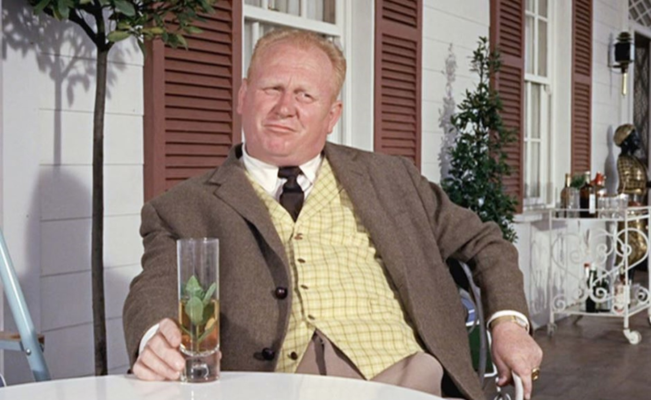

Slide 20
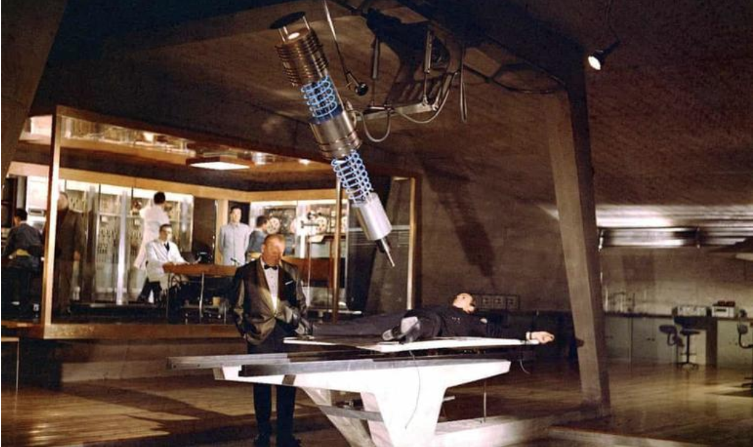
James 5.6
(Fleming International Version)

Slide 21
Do we become fixated on breathing in,
we forget that’s only half of the process?

Slide 22
We breathe in God’s mercy, and we hold our breath, hoarding it for ourselves.
We breathe in God’s blessings, and we say, “let the super rich take care of the world’s injustices.”

Slide 23
We breathe in God’s Word, but we forget to breathe it back out into the world.
We breathe in faith, but we fail to breathe out acts of mercy.

Slide 24
and then the world hiccups

Slide 25
How can we breathe in God’s mercy and breathe out hatred, division and contention?
¿Cómo podemos inspirar la misericordia de Dios y exhalar el odio, la división y la contención?

Slide 26
Rahab

Slide 27
For years, Rahab heard stories about the God of Israel (Judges 2.9-11).

Slide 28
Our acts of mercy, the works that prove our faith, are like air exhaled from lungs that have breathed in the pure oxygen of God’s grace.

Slide 29
God wants more for you than hollow faith. He wants more than empty tears and wishful thinking.

Slide 30
Abraham

Slide 31
Our actions,
our acts of mercy,
show our righteousness
to the world.

Slide 32
Abraham and Rahab

Slide 33
Will you risk to hope?
Will you act in faith?
Will you put your faith into practice, trusting the God?

Slide 34
Deja que hoy sea un hipo.
Contenga la respiración.
Beber algo.
Aguanta tu lengua.

Slide 35
Let today be a hiccup.
Hold your breath.
Drink something.
Maybe even pull on your tongue.

