Slide 1
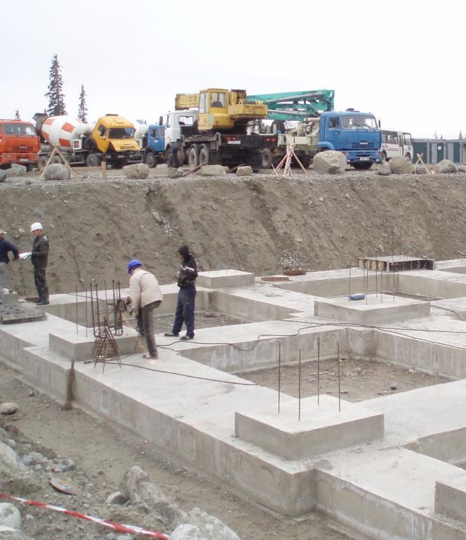
Foundation
the core load-bearing part of a building, usually underground.
the church of the living God, the pillar and foundation of the truth. 1 Ti 3:15
Notes:
No matter how the building goes – the foundation has to stay the same

Slide 2
THE PROBLEM
Most people hope that God will make their lives better but never change to follow God’s plan to use the church as the foundation for that better life

Slide 3
Pattern Of Jesus
Practices Of Church
Daily Relationship With God 1. Daily Habits
A Passion for God’s House 2. Sunday Worship
A Small Group to Share Life 3. Small Group
Serving God’s Greater Purpose 4. Serving Team

Slide 6
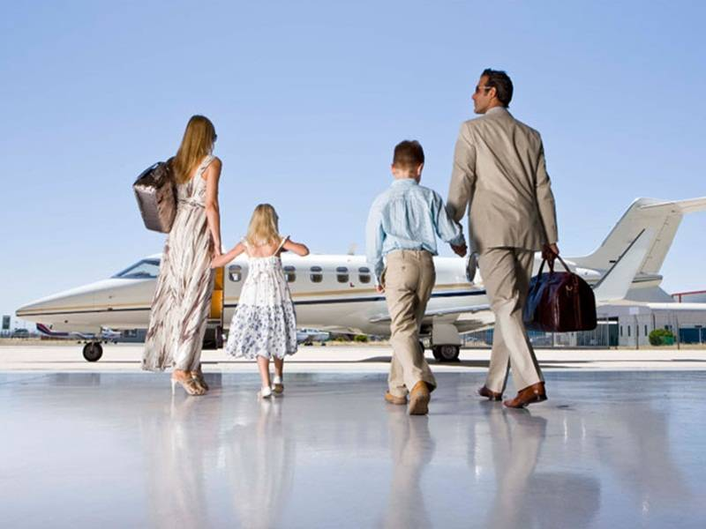

Slide 7
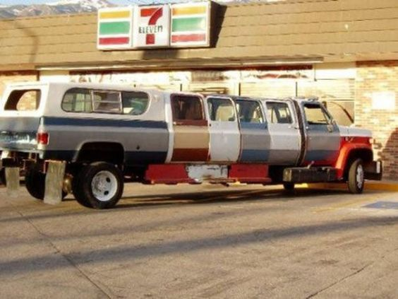

Slide 8
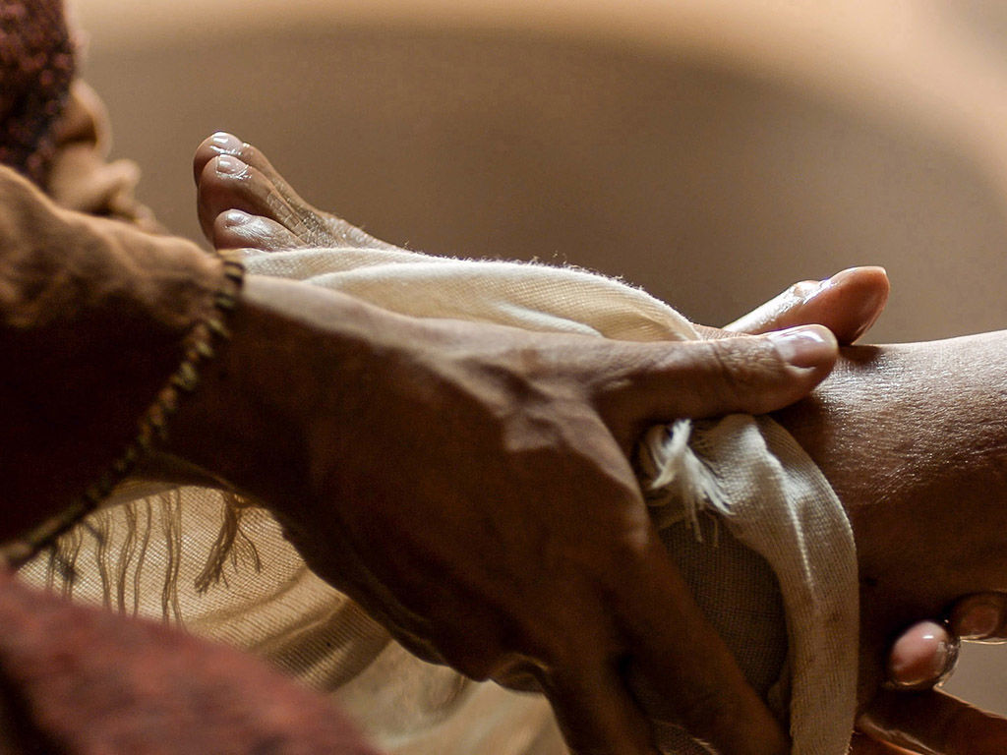

Slide 9
Three reasons why we grow when we serve (and why the local church is all about serving others)

Slide 10
1) Serving God’s greater purpose matures you
Your maturity level is equal to your responsibility level
You can only hold as much blessing as you can be responsible for

Slide 11
Order Matters
‘Well done, my good servant!’ his master replied. ‘Because you have been trustworthy in a very small matter, take charge of ten cities.’ Lk 19:17
First serve: Jesus in you
Second serve: Jesus in your family
Third serve: Jesus in your church
Fourth serve: Jesus in the world
Notes:
If anyone does not provide for his relatives, and especially for his immediate family, he has denied the faith and is worse than an unbeliever. (1 Ti 5:8)

Slide 12
2) Serving God’s greater purpose protects you
Serving God’s greater purposes keeps lesser things from having power over you
God’s great plan for your life will stop growing when you stop serving

Slide 13
3) Serving God’s greater purpose fulfills you
Only Jesus is eternally faithful and full of more than enough for all you need
Serving anything above Jesus will lead to frustration, fatigue and fear

Slide 14
Only Jesus Can Make This Promise
“Give, and it will be given to you. A good measure, pressed down, shaken together and running over, will be poured into your lap. For with the measure you use, it will be measured to you.” - Luke 6:38
Notes:
If anyone does not provide for his relatives, and especially for his immediate family, he has denied the faith and is worse than an unbeliever. (1 Ti 5:8)

Slide 15
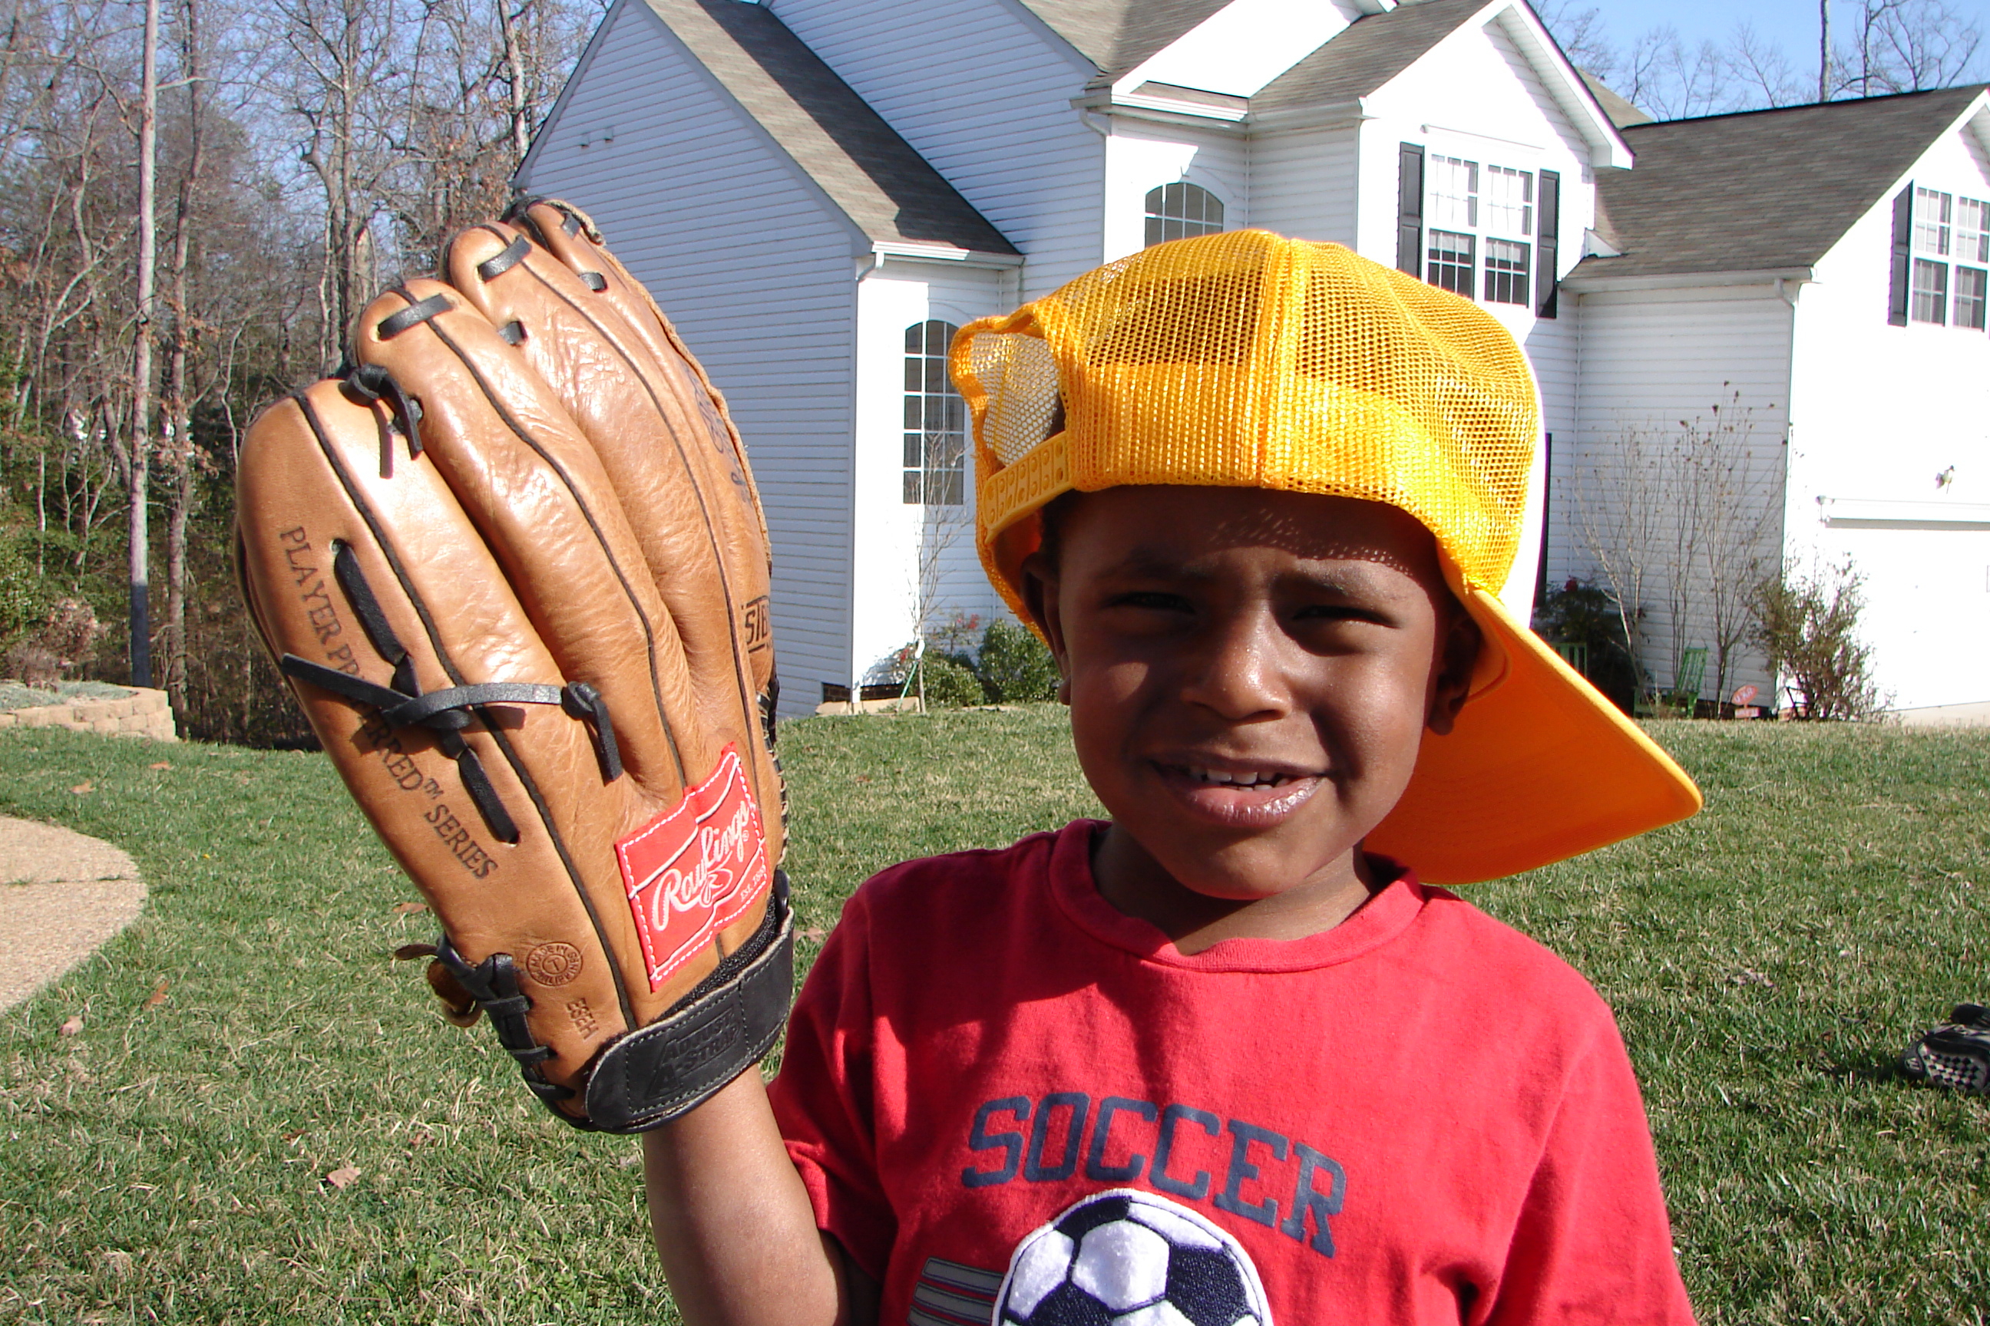

Slide 16
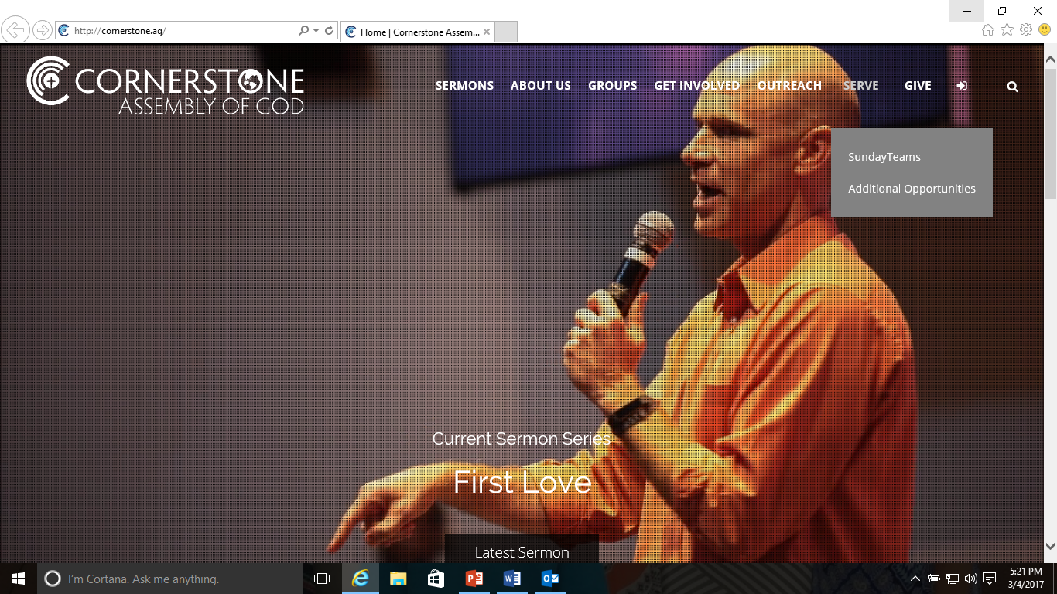

Slide 17
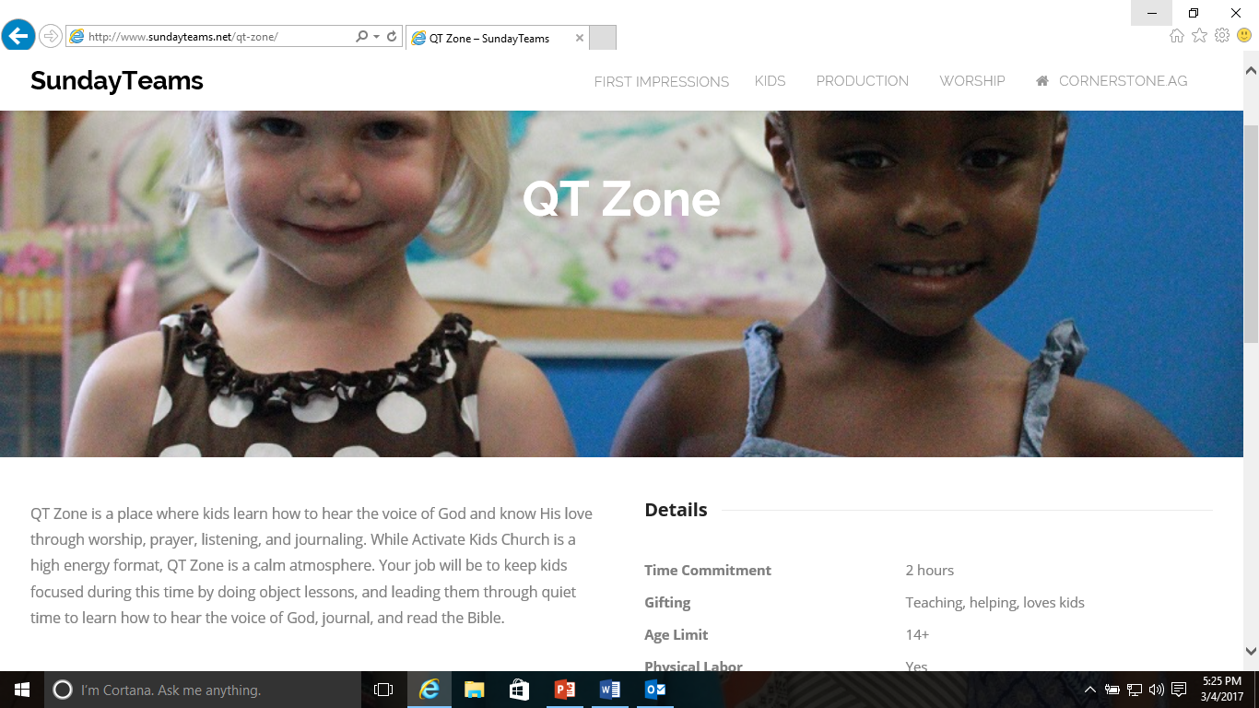

Slide 18
whoever would be great among you must be your servant, ⁴⁴ and whoever would be first among you must be a servant for life of all. ⁴⁵ For even the Son of Man came not to be served but to serve, and to give his life as a ransom for many.”
Mark 10:43-45

