Slide 1
Going from an idea to a lifestyle
Notes:
Luke 18:1-8 - Jesus call not to give up on prayer
[READ]
In this parable – Jesus recognizes its common to give up in prayer
And that’s why we are commiting this year to PRAYfirst
Before I start my day I will . . .. PRAYfirst
Before I send the text out of frustration, I will . . . PRAYfirst
Before I go into that work meeting or classroom, I will . . . PRAYfirst
We made this call, last Sunday . . .
Going from an idea to a lifestyle can take work
Great kick off (continues today)

Slide 2
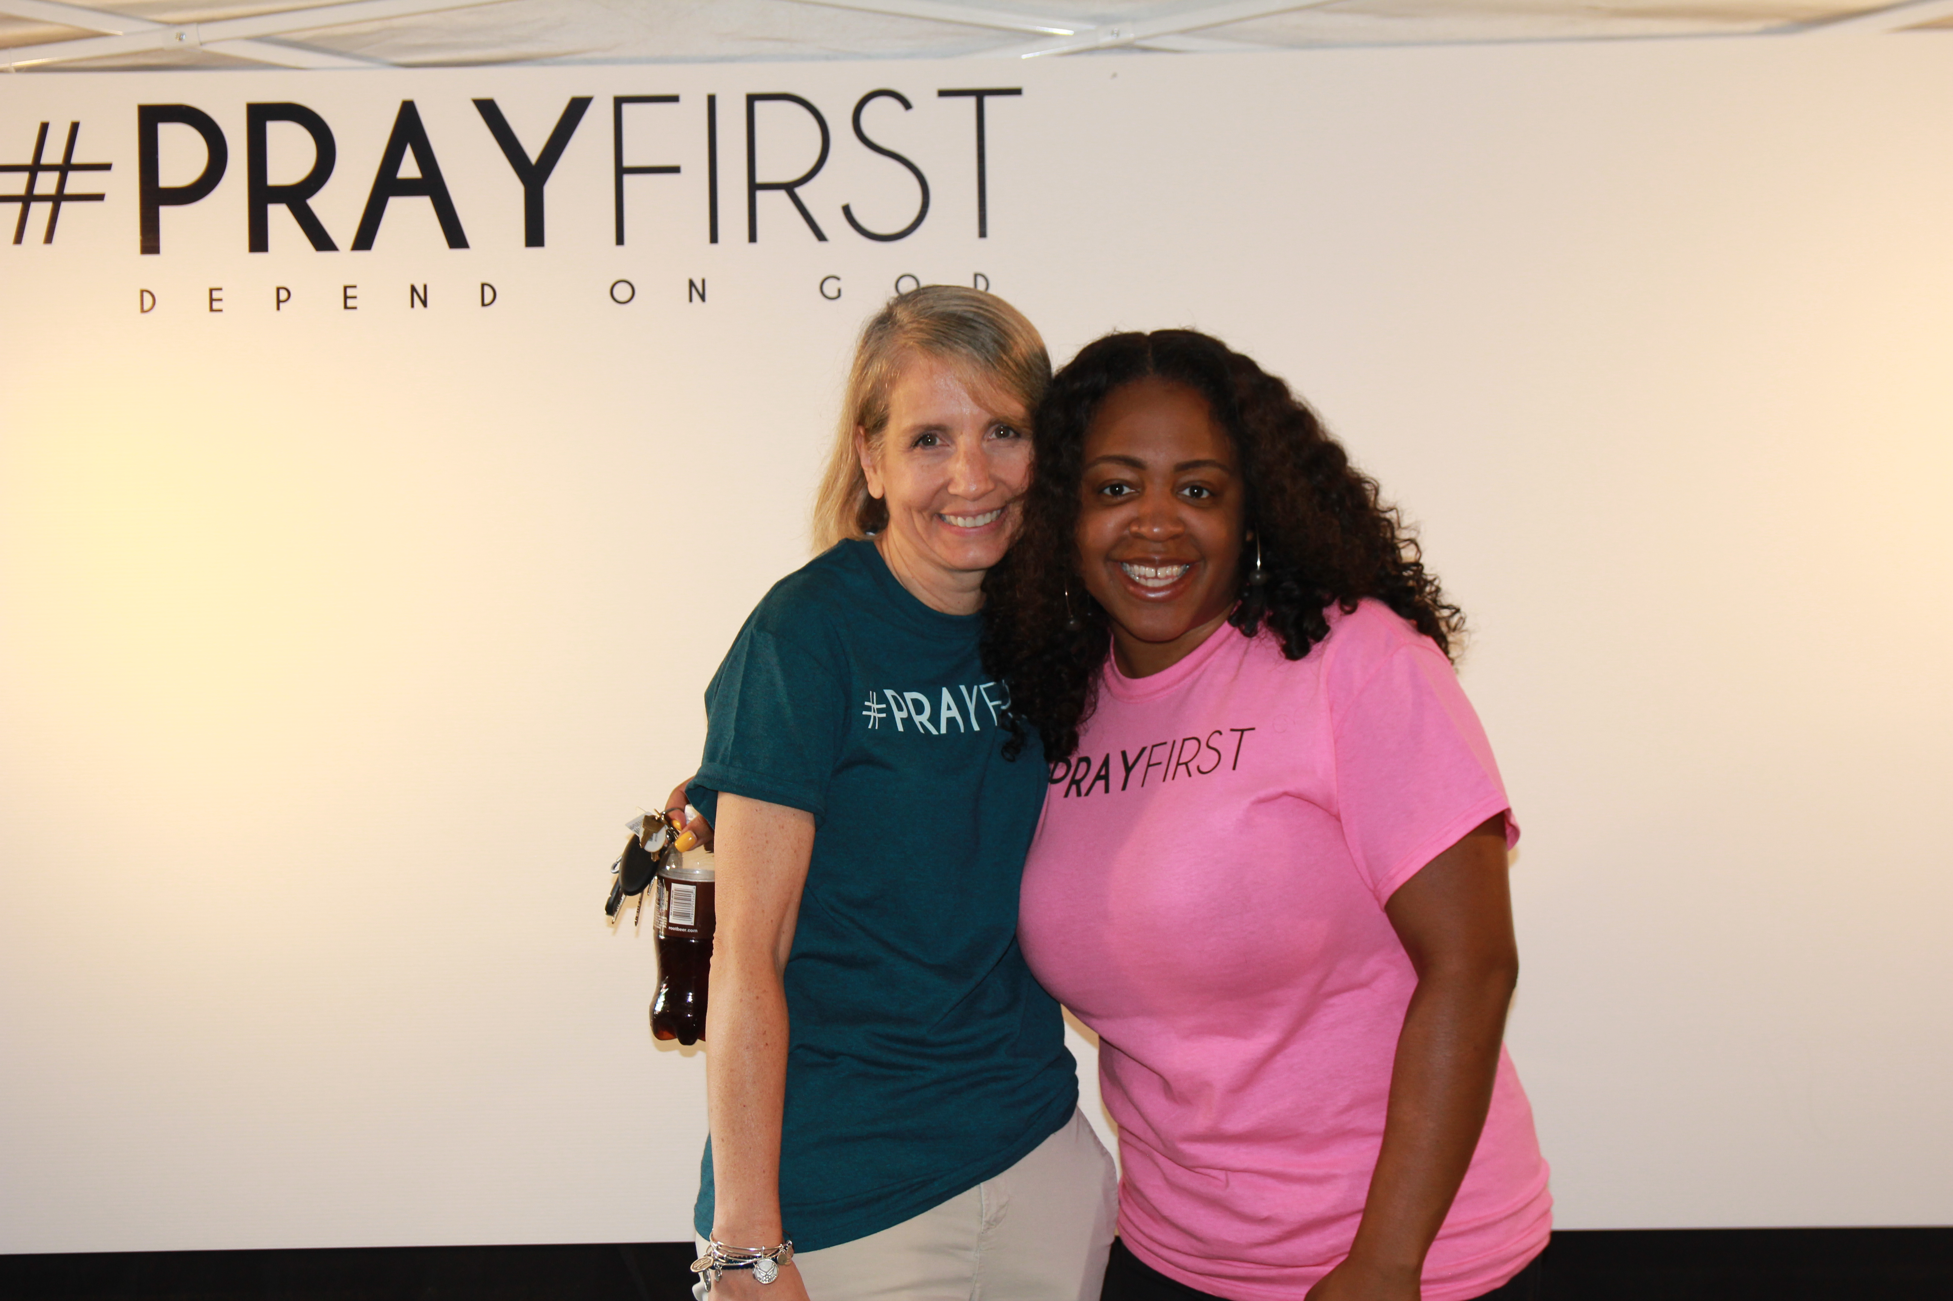
Notes:
As church family & Friends God spoke to so many of us that - we’re going to pray first
We got some tshirts, bands –took some pictures
If you didn’t do it – right after service today
So many are saying how much they need to hear this – that we need to PRAYfirst
We need to PRAYfirst as a family

Slide 3
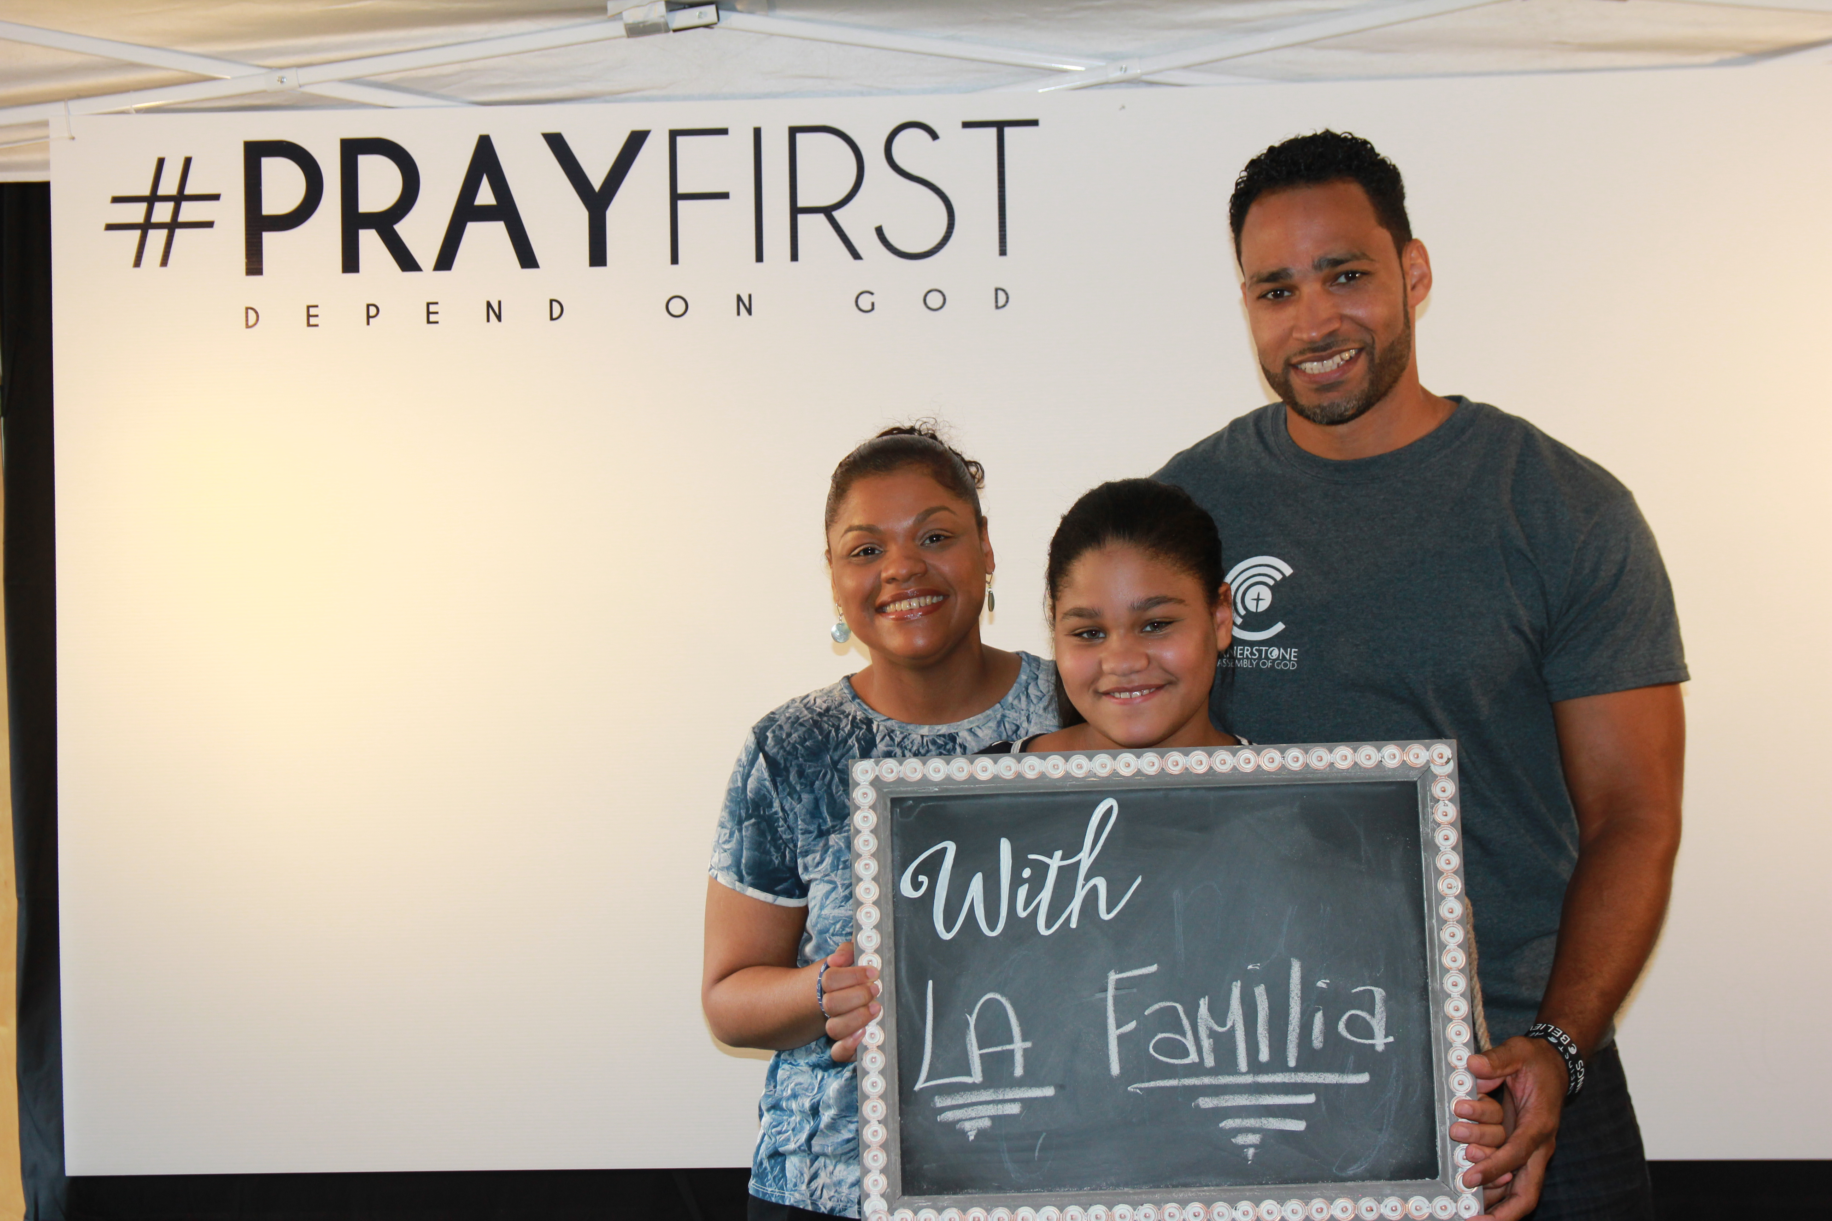
Notes:
Or as a familia

Slide 4
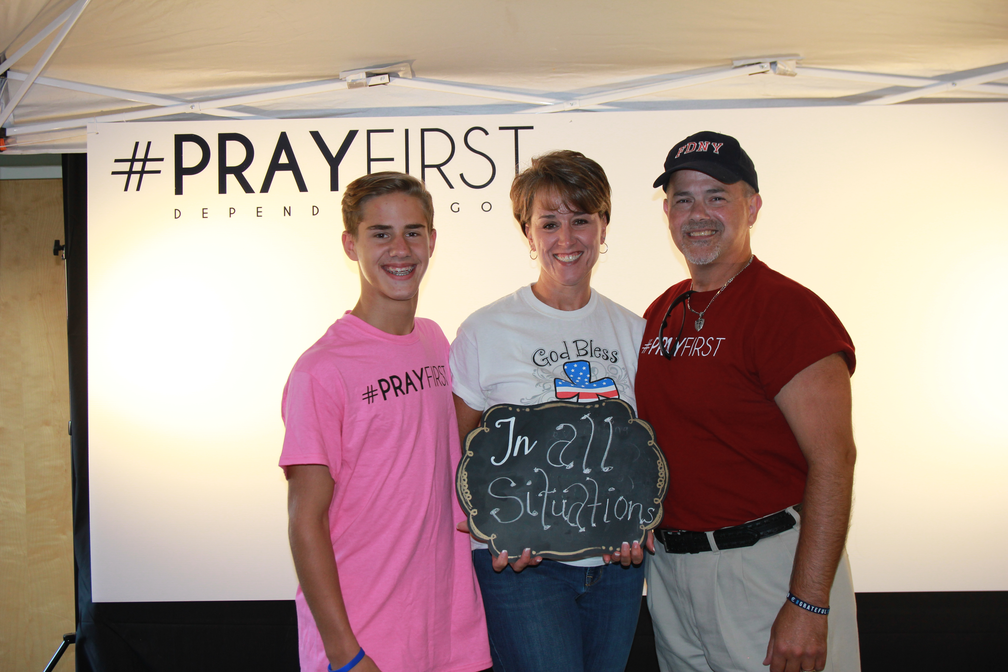
Notes:
We need to pray first as parents and children / youth and adults
BUT . . .

Slide 5
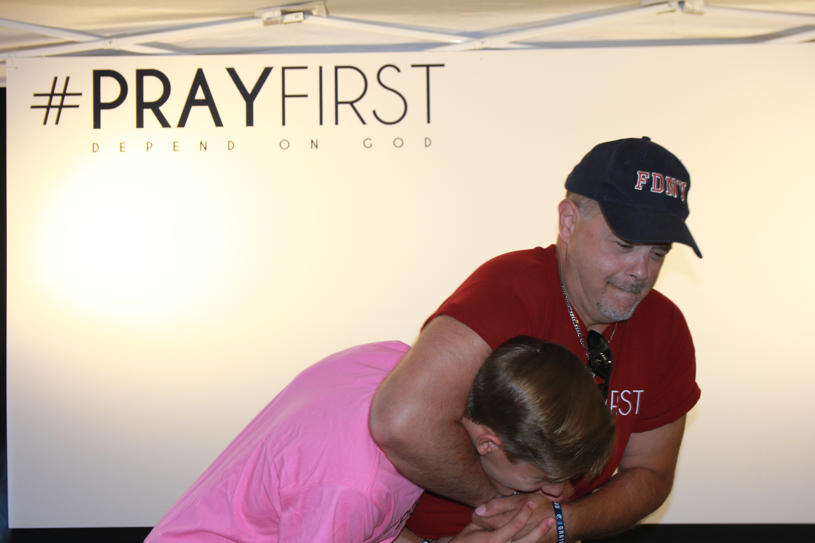
Notes:
Let’s be careful as parents – we don’t try to get our kids to prayfirst the wrong way
This is probably not how we are going to get our kids to take the idea of prayfirst and turn it into a lifestyle
So how do we do it?

Slide 6
Going from an idea to a lifestyle
Notes:
How do we go from an idea to a lifestyle
The answer is – we start thinking practically about and with an open heart to God
When most of us want to bring something into our lives, we tend to track it
For example (raise your hand if):
You’ve got a fantasy football team – I bet you’re tracking it
Fitbit or phone app for exercise
Phone app tracks your bank acct
Get an email or catalog for your favorite store – track sales and new mrechandise
Have ever tracked your calories
Think about all the things we track:
Our calories, blood sugar, cholesterol
Our favorite artist on twitter or spotfy
Your favorite team or political candidate
Why we do this?

Slide 7
In life . . .
We track what we treasure
We create a pattern in our days & weeks (lifestyle) for what we want or need the most
Notes:
For an idea to become a lifestyle
We track it and build tangible ways to increase it
Not true – I don’t get to do what I want – doing things for everyone else
Why is that your pattern – because you want to please everyone else above all

Slide 8
My lifestyle is getting exactly what I designed it to get.
If I don’t like what I am getting? I should change my lifestyle (patterns).
Notes:
The world may have hurt and deceived you into some destructive pattern
But in Christ – you aren’t powerless.
If want something better in your life – create a life that will get it.
Jesus said this in Matthew 7:17

Slide 9
Matthew 7:17-19
“Likewise every good tree bears good fruit, but a bad tree bears bad fruit. ﻿A good tree cannot bear bad fruit, and a bad tree cannot bear good fruit.
Notes:
What we treasure we track.
We build pattern (lifestyle) that gives us more of what we think we need and want
Where our heart is – that’s what we treasure
So, when we talk about PRAYfirst – sounds like a great idea / an important idea
That prayer is how we depend on God and treasure God
The question is –

Slide 10
How did you do in actually making time to PRAYfirst this past week?
Notes:
Did you get to it?
Did you track it and plan it so you made sure you got to it?
Or was it an idea you hoped you would remember and do?
Did you have a pattern in your days and weeks that gave you more prayer?
And how much better was your day and your attitude when you did it?
Did you PRAYfirst?
If you didn’t there are probably one of three reasons why
[text – so angry at people]
When start off your day talking to people AND THEN talking to God, you end up frustrated and far from both
When you start off your day talking to God AND THEN people, you keep a good attitude and can make a difference
When the idea of PRAYfirst becomes a lifestyle
Powerful things happen
But when the idea of PRAYfirst just stays an idea
Discouragement and defeat set in
So how do make prayer a lifestyle instead of just an idea?
Well first let’s make sure we know what prayer is . . .

Slide 11

Killer “B”s of Prayer. . .
1.“Black eye”
2. Burdened
3. Bitterness
Notes:
These three sting us and keep us away from prayer
1. When you think praying is going to make you look bad to others
Sermon – over 40 abt to play – PRAYfirst
Going to play bball – thought – pray with the guys
(might be weird – if I get mad)
Sure enough – black eye
Why didn’t I – worried about a different black eye (hypocrite)
Why so many – home, work, school – hypocrite
Prayed – rest of the week on point
Busyness – burdened (just get this done)- never ends
- you’re too busy not to pray
- not that complicated
- meeting on Thursday
Bitterness – God hasn’t answered when or how we wanted and we are hurt, afraid, trusting
WE’VE BEEN STUNG BY DISAPPOINTMENT
That’s what Jesus is addressing in Luke 18
Hear the words of Luke 18:1-8
Even those these bees are around trying to keep us from prayer – Jesus says these words

Slide 12
“Then Jesus told his disciples a parable to show them that they should always pray and not give up . . . will not God bring about justice for his chosen ones, who cry out to him day and night? Will He keep putting them off? ﻿I tell you, He will see that they get justice” (Luke 18:1, 17-18)
Notes:
Jesus tells us don’t give up
Make prayer a lifestyle (like me – Luke devotionals)
Don’t give up
It can be more than an idea – it can be your life
Here is why we don’t give up

Slide 13
Revelation 5:8-9
“the four living creatures and the 24 elders fell down before the Lamb. Each one had a harp and they were holding GOLDEN BOWLS full of incense, which are the prayers of the saints. And they sang a new song: “You are worthy to take the scroll and to open its seals [and fulfill God’s will on earth]”
Notes:
Scroll is about God’s will
John in revelations – will needs to be done
There is the Lamb, prayers

Slide 14
Revelation 8:3
“Another angel, who had a golden censer, came and stood at the altar. He was given much incense to offer, with the prayers of all the saints, on the golden altar before the throne.
Notes:
When the scroll is opened and heaven poured on earth
Where does the scripture focus on – prayers
What does god do with prayers

Slide 15
Revelation 8:4
“The smoke of the incense, together with the prayers of the saints, went up before God from the angel’s hand. Then the angel took the censer, filled it with fire from the altar, and hurled it on the earth; and there came peals of thunder, rumblings, flashes of lightning and an earthquake.”
Notes:
Pours the prayers to heaven back on earth
And earth quakes and rumbles and changes
Why expectant about prayer
Why turn it into a lifestyle

Slide 16
God tracks what He treasures. He calls us to a pattern of prayer because it means the most to Him. (2 Chron. 7:14)
Notes:
God chooses to use our prayers to pour out His power

Slide 17
Every possible prayer we pray brings us closer to God’s impossible power being poured out on earth
Notes:
Why PRAYfirst expectantly?
For our life’s legacy (especially in relationship)
Family’s victory – let’s stop worrying and start worshiping
Community’s destiny – complain or pray
Has to start with us as a church

Slide 18
Prayer determines . . .
my life’s legacy
my family’s victory
my community’s destiny
Notes:
Jesus determines all of these and prayer is how I depend on Jesus

Slide 19
Idea to lifestyle as a church
“LET US NOT GIVE UP on the hope we affirm, for God can be trusted to keep his promise. Let us think of ways to motivate one another to acts of love and good works [which certainly includes prayer!]” (Heb. 10:23-24)
Notes:
How do we encourage each other not to give up?

Slide 20
Notes:
We want to track what God treasures
We want to dedicate ouorselves to what God wants us to depend on
We want more of what means the most
Track it / become a lifestyle
Believing God as a church privately and together
We will pray 1,000,000,000 this school year
PRAYfirst Wednesdays – prayer groups
But really – each of us
Praying in unity – doesn’t mean we have to be in the same place all the time
We have the same heart and passion
We are filling up the bowls of heaven in prayer
Starts with each of us getting into a daily commitment
Here is the commitment on your notes and for your connection card

Slide 21
Idea to Lifestyle
With my church family,
I commit to pray ____ minutes a day
I will track what I treasure & need most
Notes:
Going into communion
Remember what Christ has done for us
Do that – than make a commitment to prayer
Before he gave his life – he prayed
He had the pattern ready -

