Slide 1
How do I know who Jesus truly is
Matthew 11:1-6, 16-19
Notes:
This story is about people knowing who Jesus truly is
(v1-6) John the Baptist is a faithful believer
Who has forgotten because of his circumstances and his calling
(v16-19) The crowd is the generation
That wants Jesus to be something he is not
Jesus really has one answer for both of them

Slide 2
SEE WHAT I AM DOING
Matthew 11:4, 19
Notes:
John – has believed, prayed and served – but he’s not sure anymore
This generation – they live in extremes and wonder why Jesus doesn’t follow them
And to both Jesus says this: see what I do
Don’t live in the past,
Don’t look at your present prison
Don’t tell me what I should do
SEE WHAT I AM DOING – AND YOU’lL REMEMBER WHO I AM
And worship and love me like never before

Slide 3
RELIGIOUS MISTAKE #1 JESUS IS ALL ABOUT ME. RESULTING TEMPTATION: CONFUSION (v3) JESUS’ RESPONSE: SEE WHAT I AM DOING IN OTHERS (v4)
Notes:
This was John
If Jesus isn’t giving me victory in my Kingdom calling now, He isn’t good or true.

Slide 4
RELIGIOUS MISTAKE #2 JESUS IS ALL ABOUT THE PAST. RESULTING TEMPTATION: OFFENSE (v6) JESUS’ RESPONSE: JOIN MY NEW WORK THAT REFLECTS MY UNCHANGING HEART (v6)
Notes:
This was John
If Jesus isn’t giving me victory in my Kingdom calling now, He isn’t good or true.

Slide 5
RELIGIOUS MISTAKE #3 JESUS IS ALL ABOUT RIGHT NOW. RESULTING TEMPTATION: DENIAL OR DEFEAT (v17) JESUS’ RESPONSE: ACT OUT MY GOOD NEWS IN A WORLD IN DENIAL OR DEFEAT (v19)
Notes:
This was John
If Jesus isn’t giving me victory in my Kingdom calling now, He isn’t good or true.

Slide 6
SEE WHAT I AM DOING & YOU WILL KNOW WHO I AM
Notes:
John – has believed, prayed and served – but he’s not sure anymore
This generation – they live in extremes and wonder why Jesus doesn’t follow them
And to both Jesus says this: see what I do
Don’t live in the past,
Don’t look at your present prison
Don’t tell me what I should do
SEE WHAT I AM DOING – AND YOU’lL REMEMBER WHO I AM
And worship and love me like never before

Slide 7
JESUS IS CAUSING “the blind receive sight”
Project Hope for muslims

Slide 8
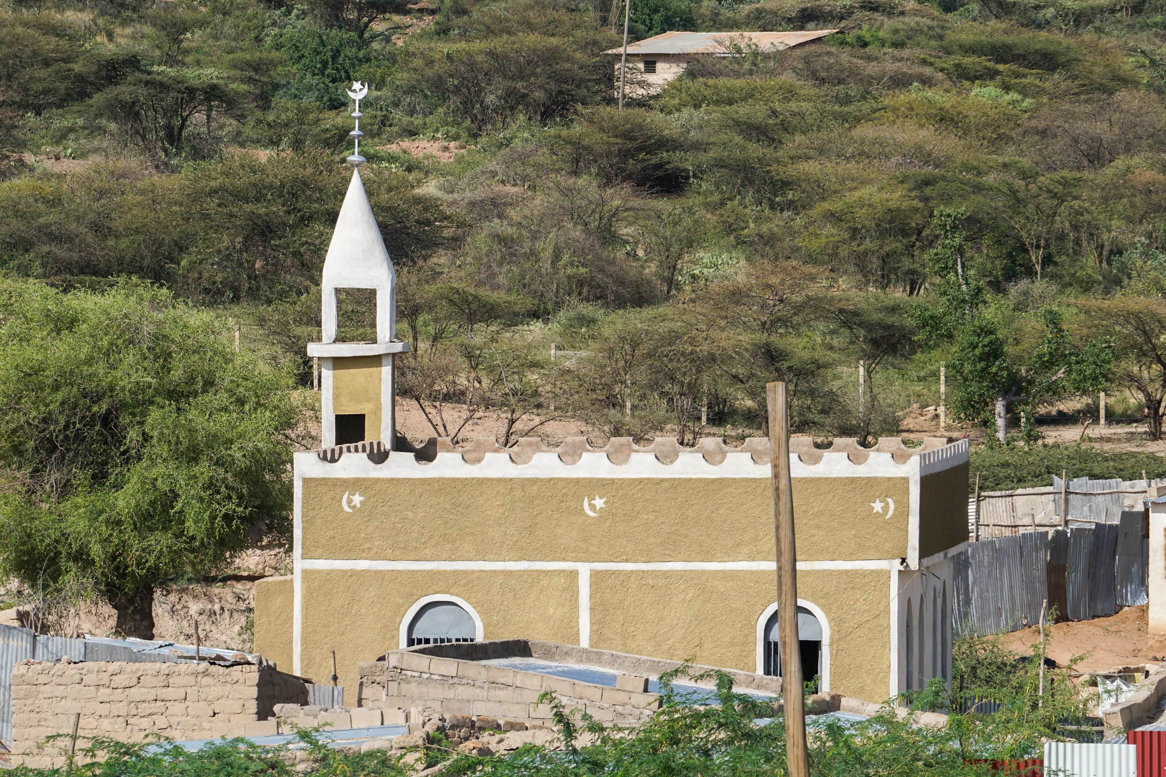

Slide 9
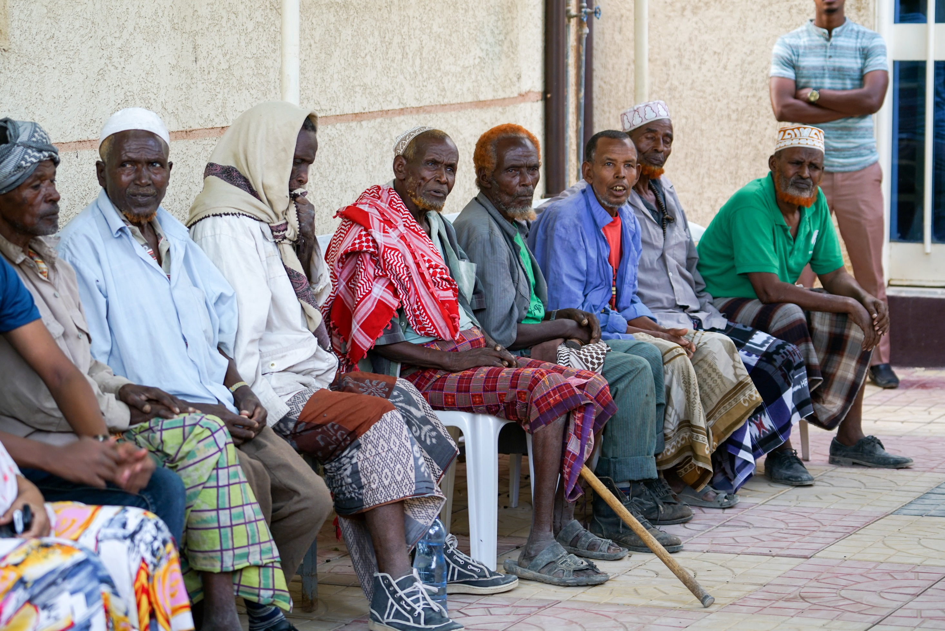

Slide 10
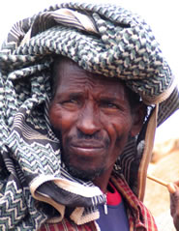
Somali in Ethiopia
Population: 6,606,000
Muslim: 99.86%
Christian: 0.03%
Designation: Unreached

Slide 11
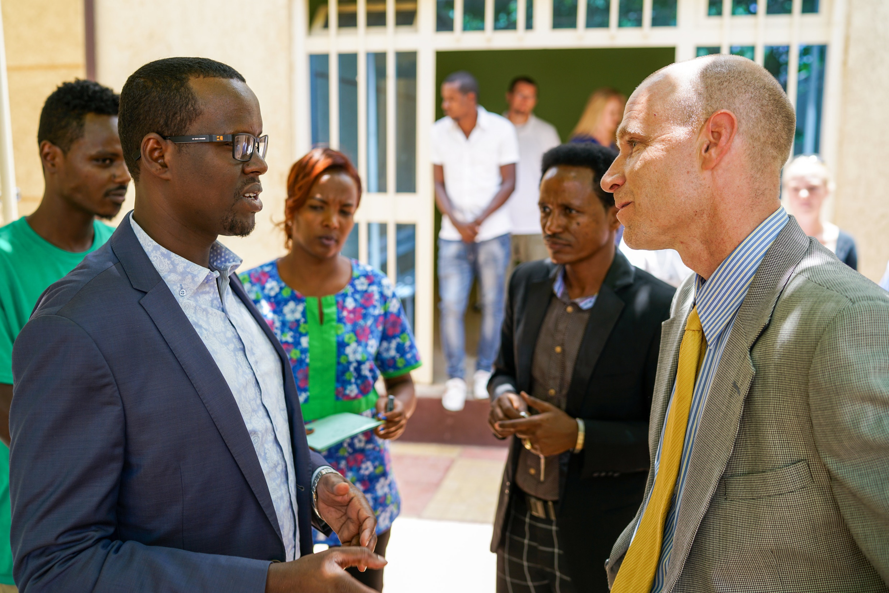

Slide 13
JESUS IS CAUSING “the lame walk”
Project Hope Kids
When you see needy children lifted up and cared for unselfishly, – you know Jesus is the only way, truth & life

Slide 14
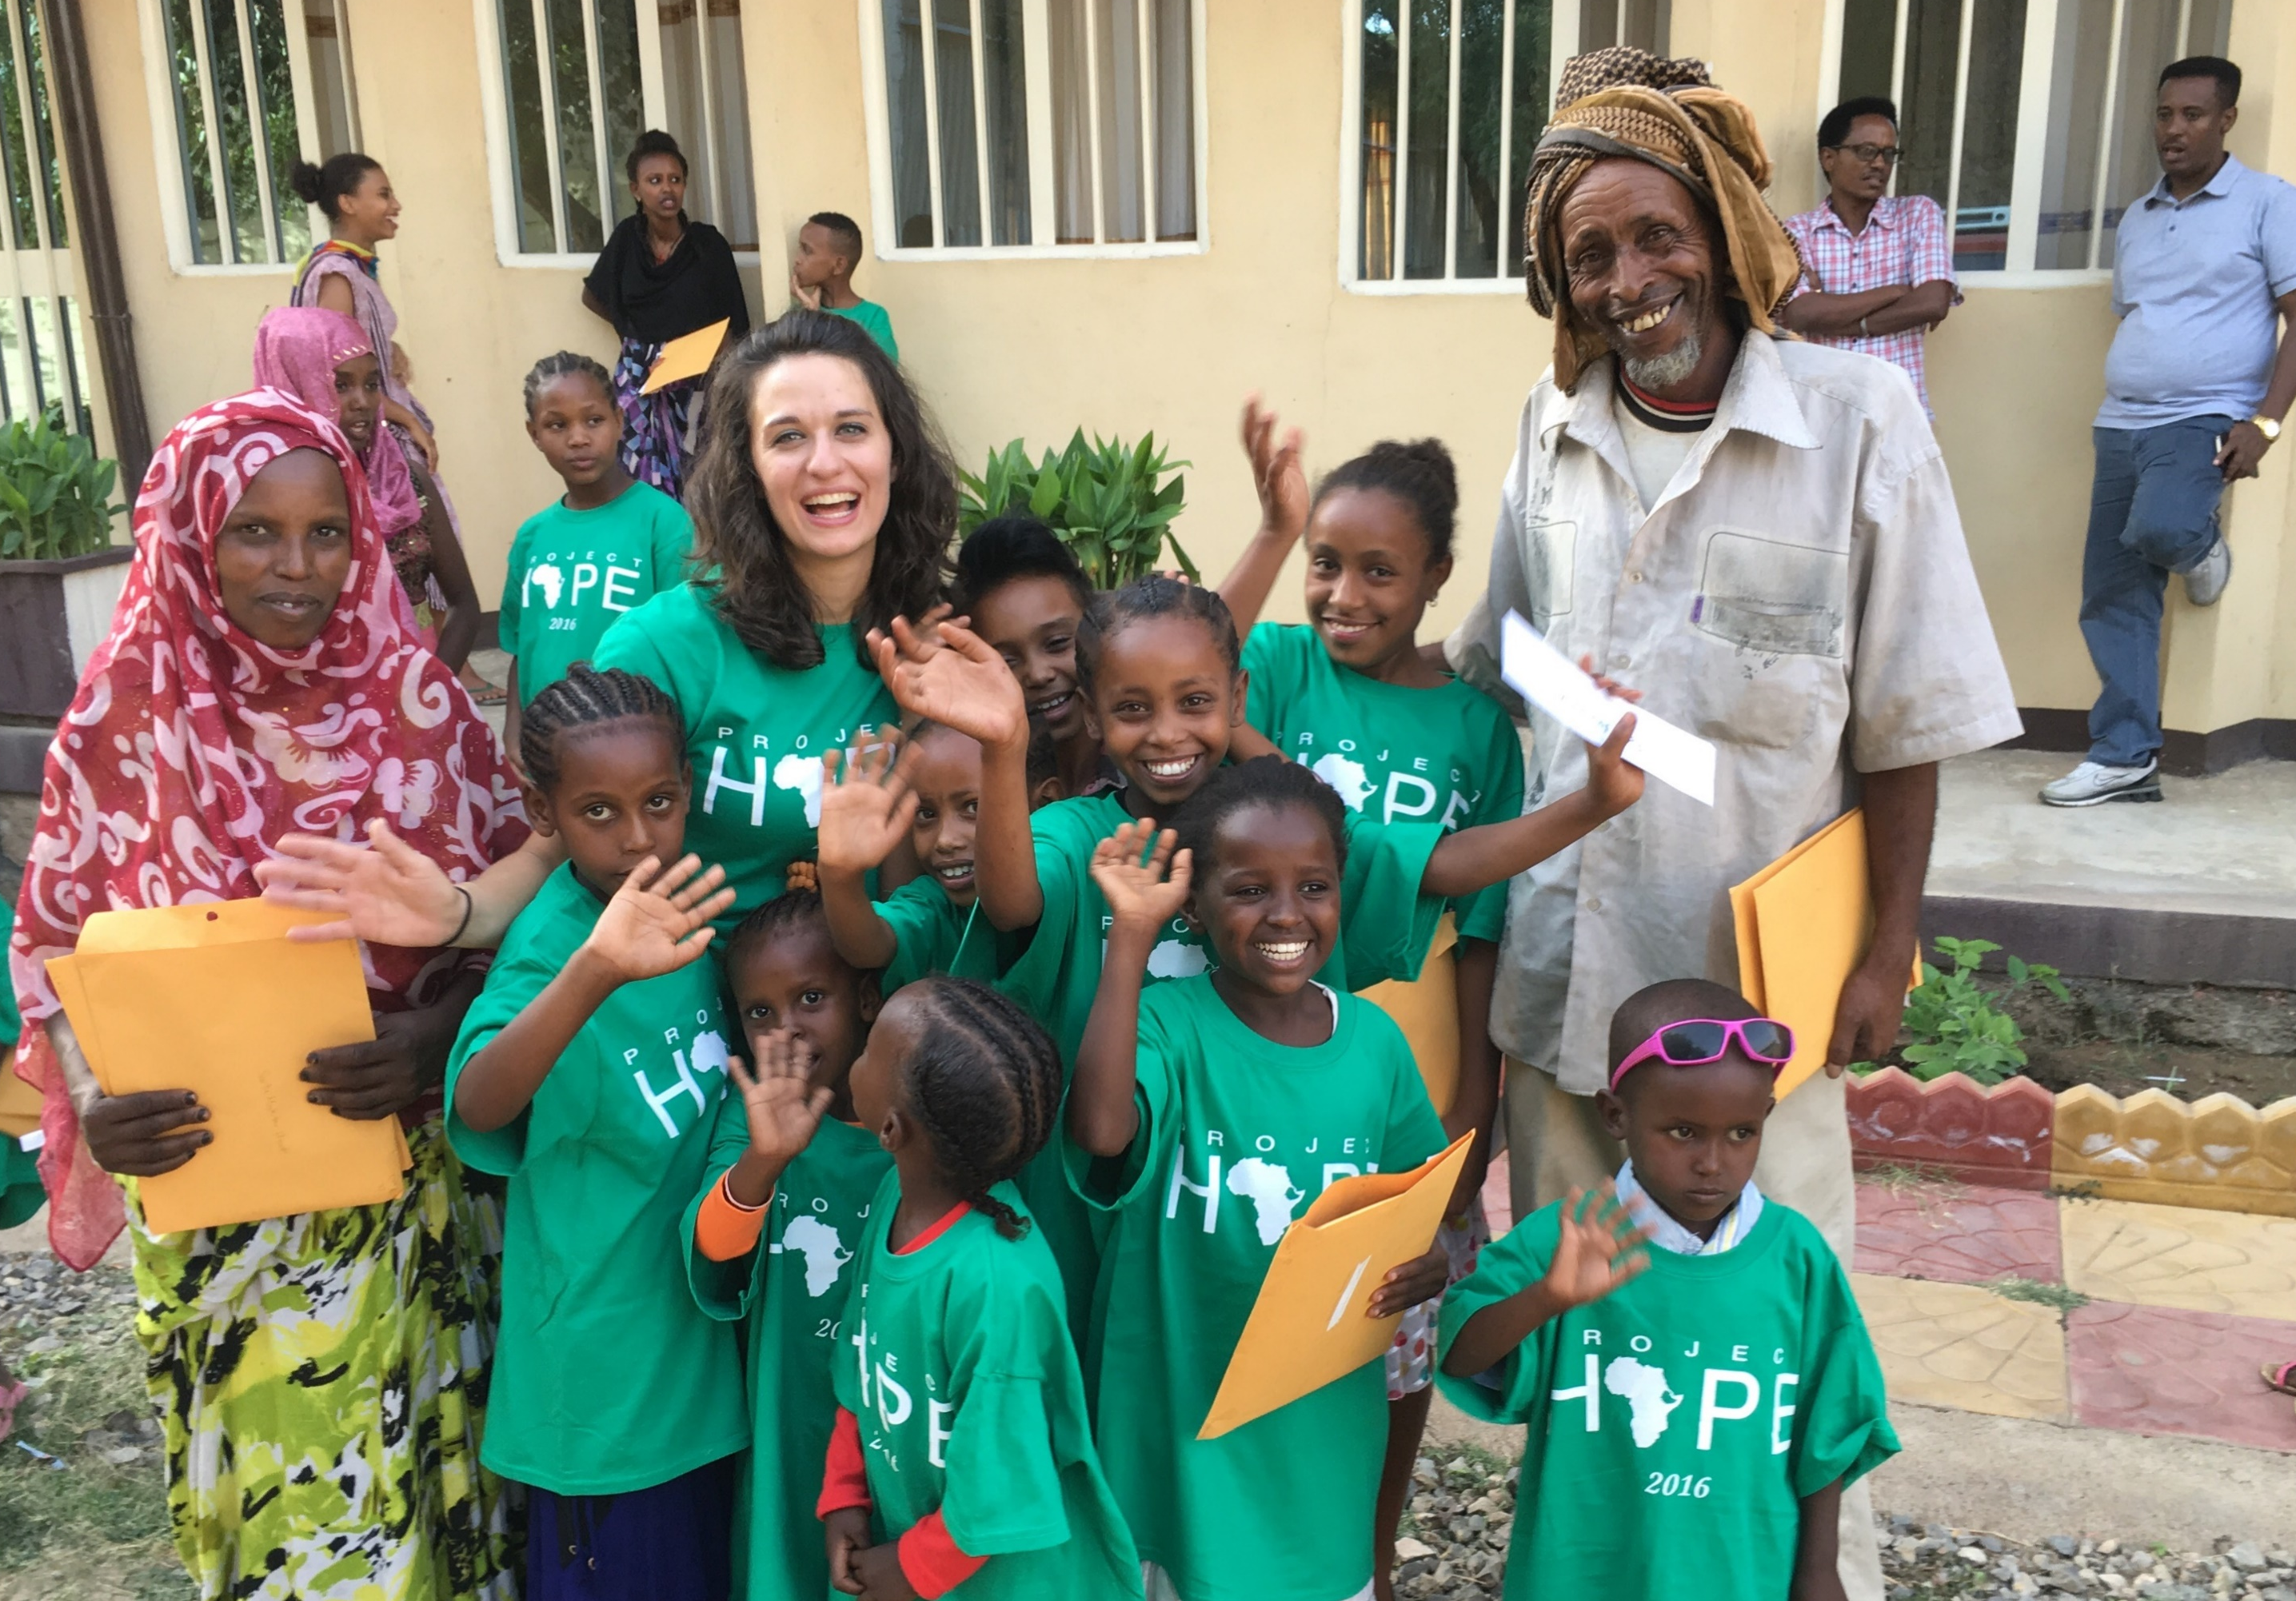

Slide 16
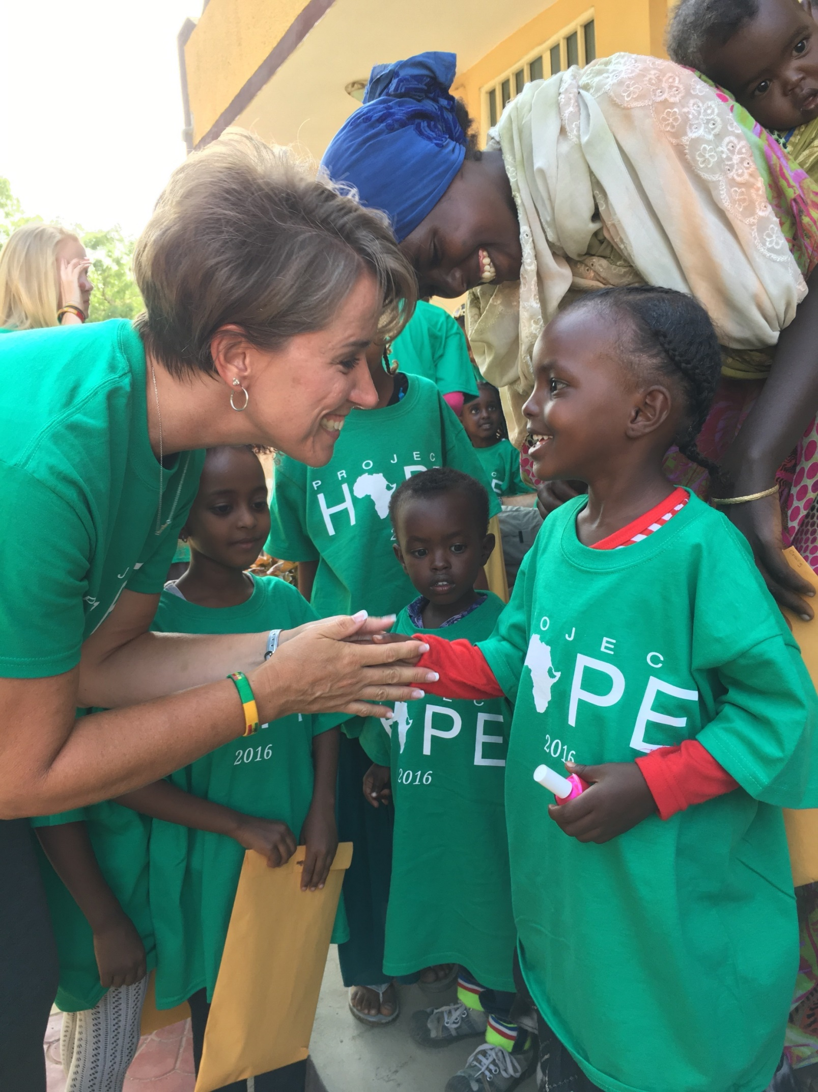

Slide 17
JESUS IS CAUSING “those with leprosy are cured” Project Hope Clinic

Slide 19
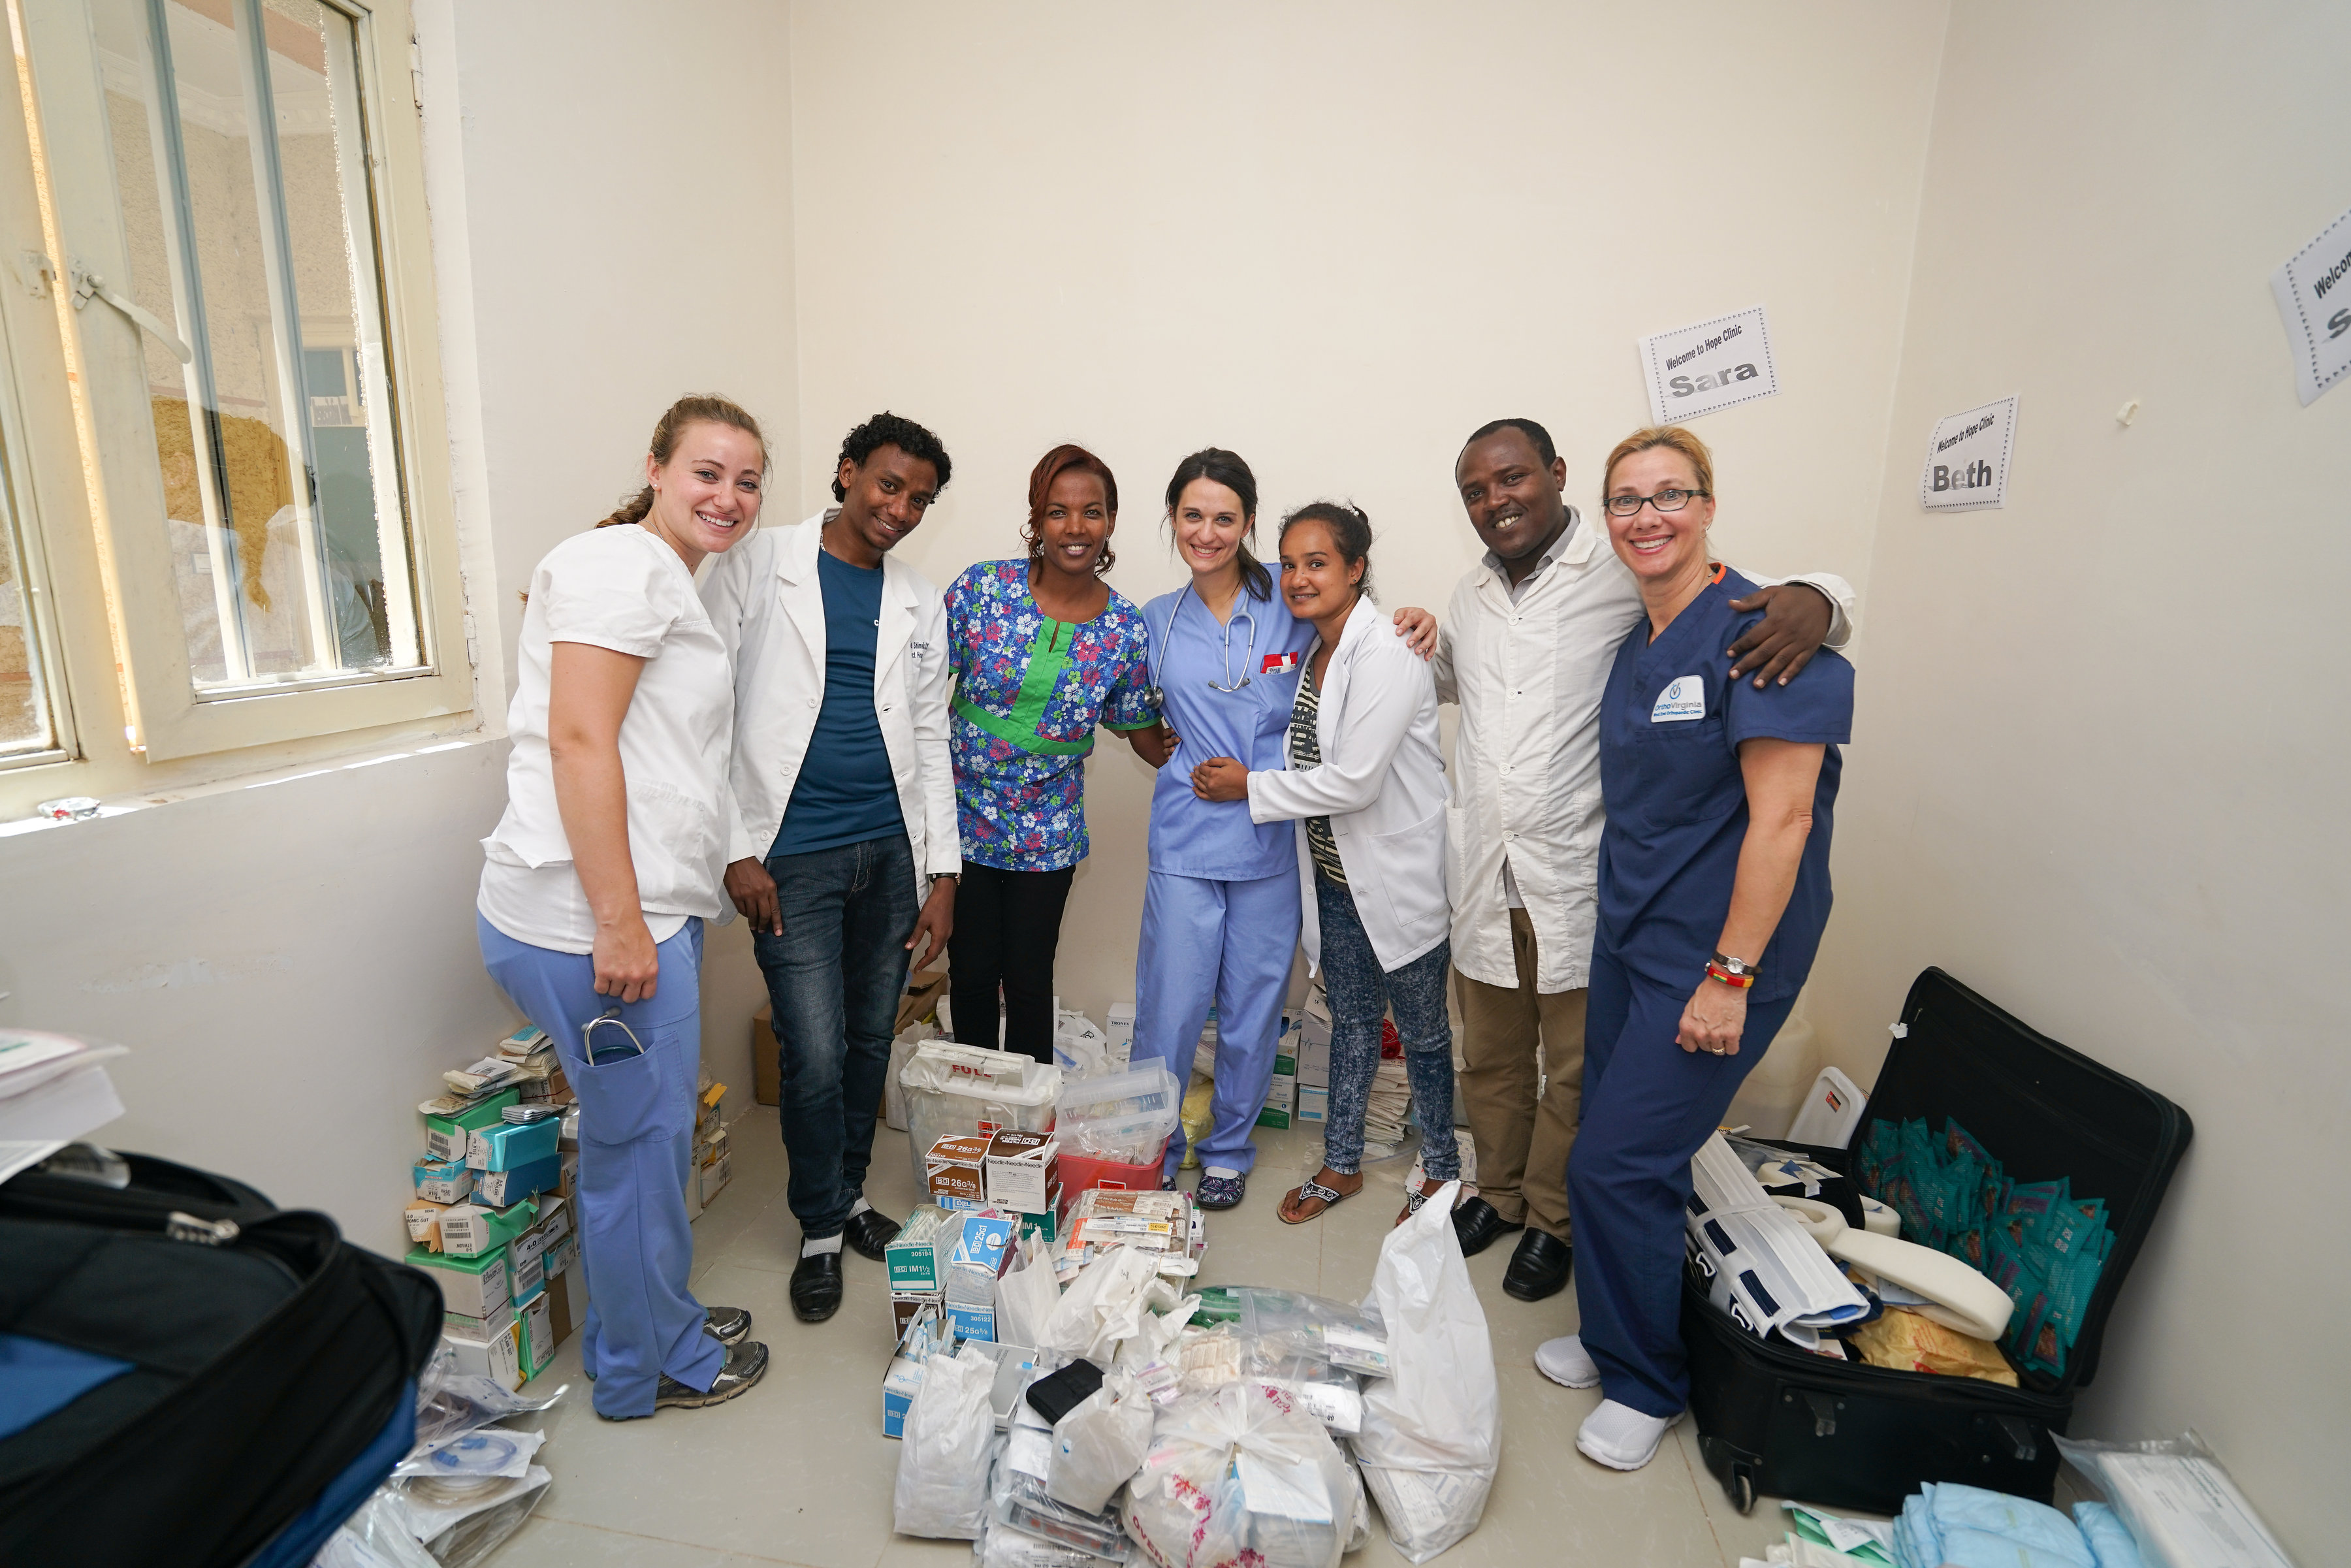

Slide 22
JESUS IS CAUSING “the deaf hear”
“Teaching Hope” English Camps
When you see the next generation building friendships and appreciation where hate is suppose to be – you know Jesus is the only way, truth & life

Slide 24
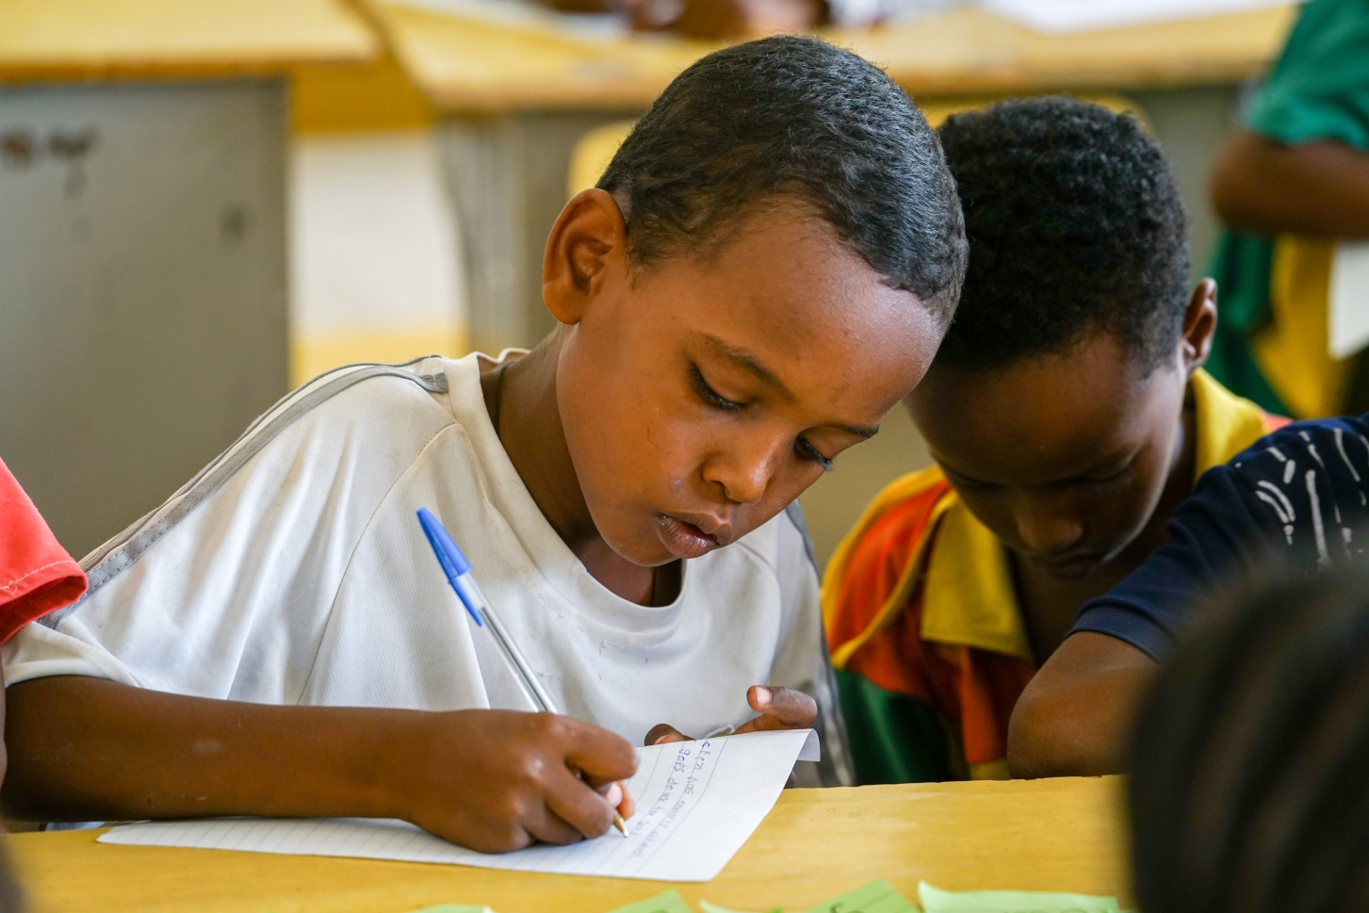
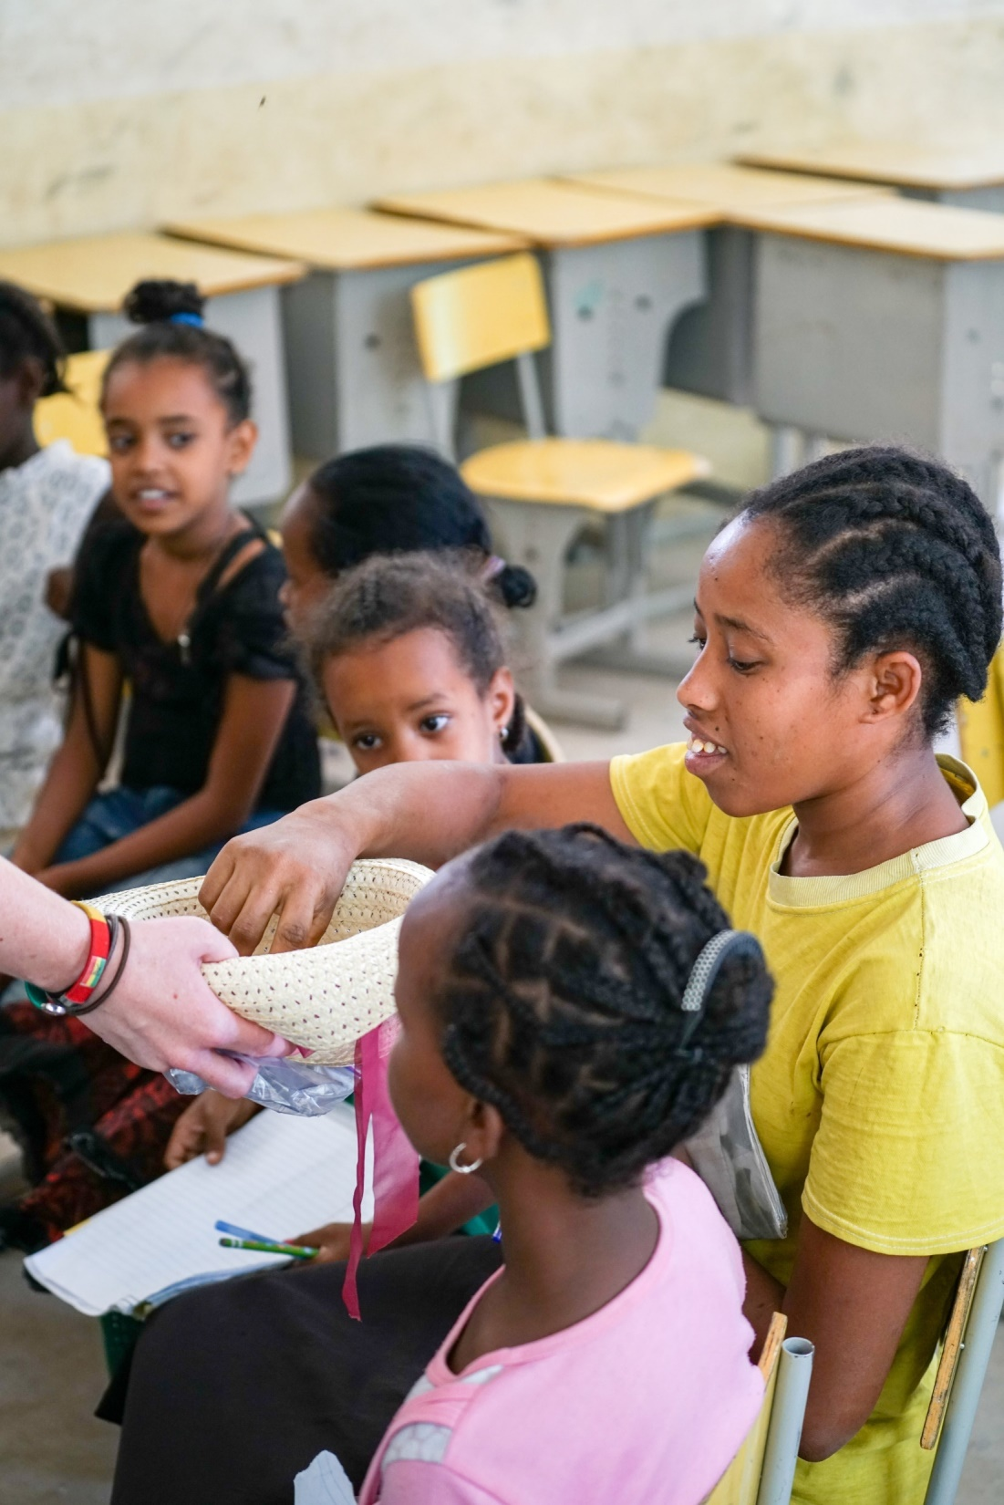

Slide 25
“the deaf hear”

Slide 26
JESUS IS CAUSING “the dead are raised”
Project Hope partner
Living Word Believer’s Intern’l Church
When you see a people poor and persecuted with unexplainable long lasting joy – you know Jesus is the only way, truth & life

Slide 28
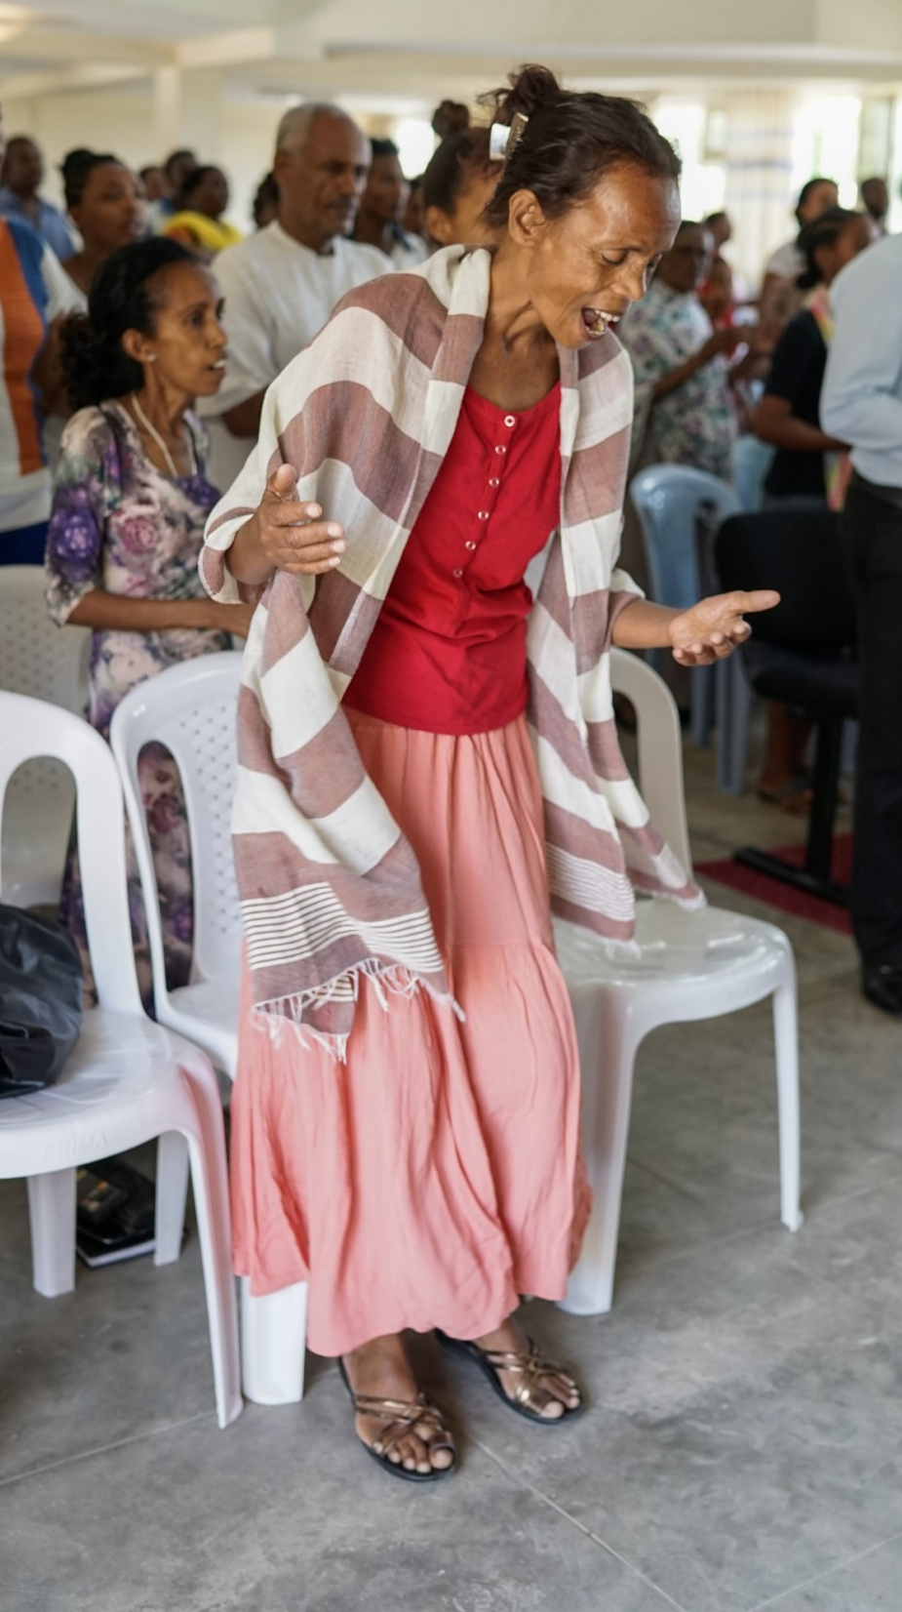

Slide 29
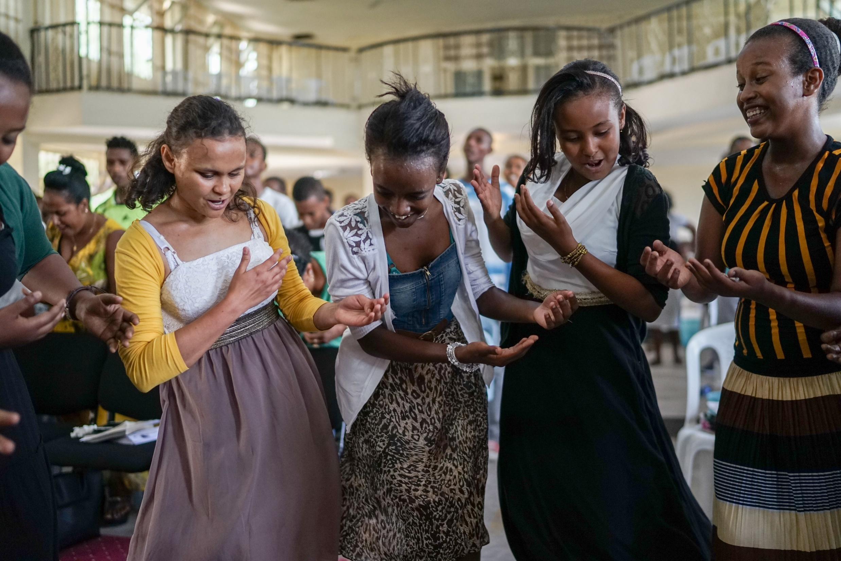

Slide 30
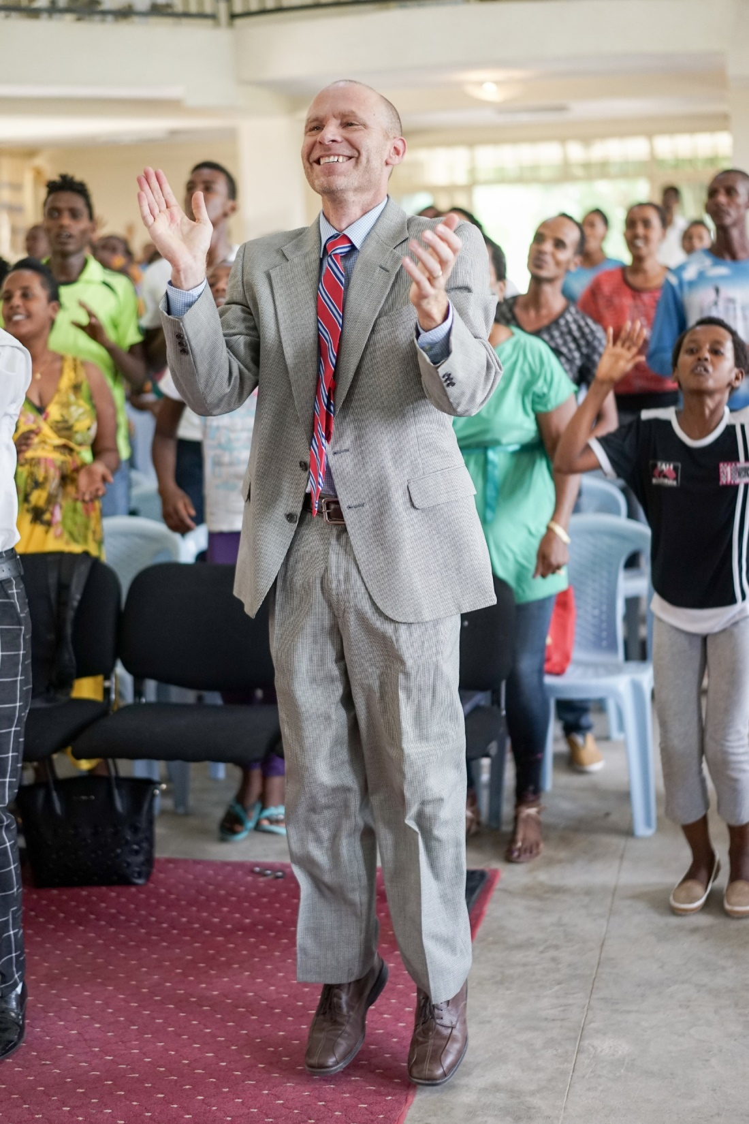
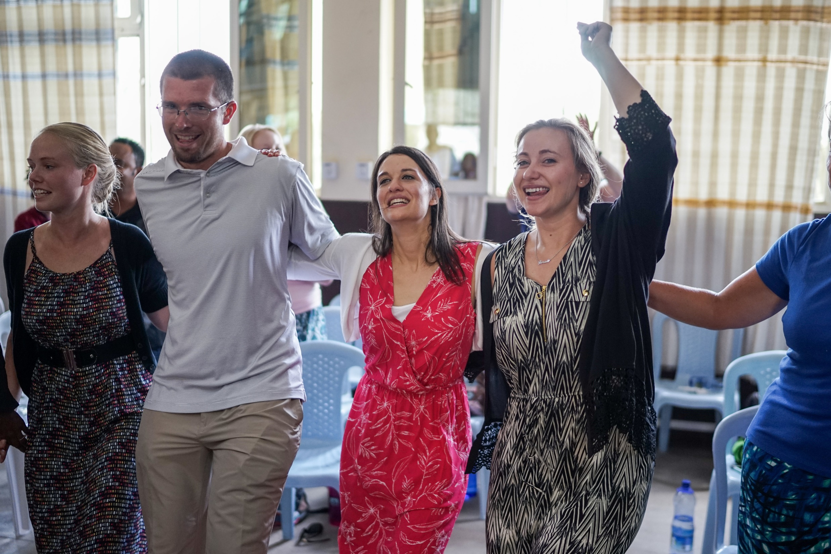

Slide 31
JESUS IS CAUSING “good news is preached to the poor”
When you see people sacrifice for the justice that God wans all – you know Jesus is the only way, truth & life

Slide 33
KNOW HIM AGAIN
SEE WHAT HE IS DOING IN OTHERS
BE A PART OF HIS NEW WORK
BE FILLED WITH GOOD NEWS IN A WORLD THAT WANTS BE IN DENIAL OR BE DEFEATED

