Slide 1
Making Disciples of all Nations

Slide 2
Matthew 28:18-20
“Then Jesus came to them and said, “All authority in heaven and on earth has been given to me. Therefore go and make disciples of all nations, baptizing them in the name of the Father and of the Son and of the Holy Spirit, and teaching them to obey everything I have commanded you. And surely I am with you always, to the very end of the age.”

Slide 3
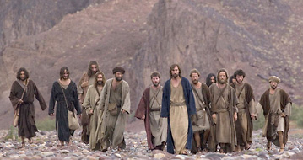

Slide 4
Three R’s of Discipleship
Relationship
Revelation
Response

Slide 5
Basis of Discipleship through the Old Testament
Adam
Abraham
Moses
David

Slide 6
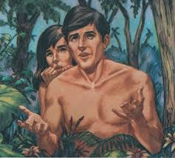
Adam

Slide 7
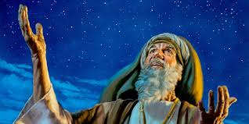
Abraham

Slide 8
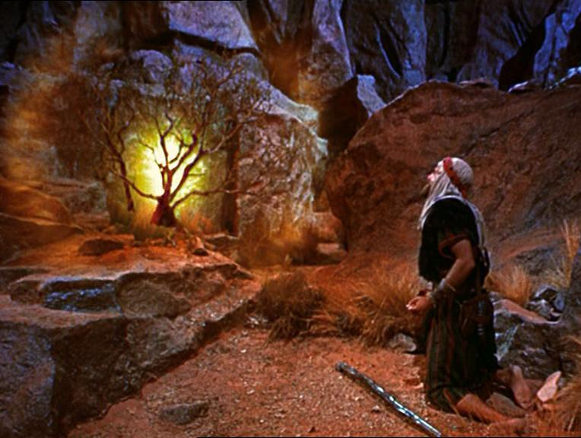
Moses

Slide 9
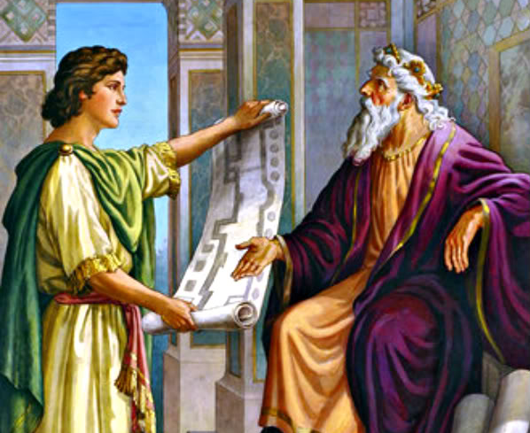
King David &
Solomon

Slide 10
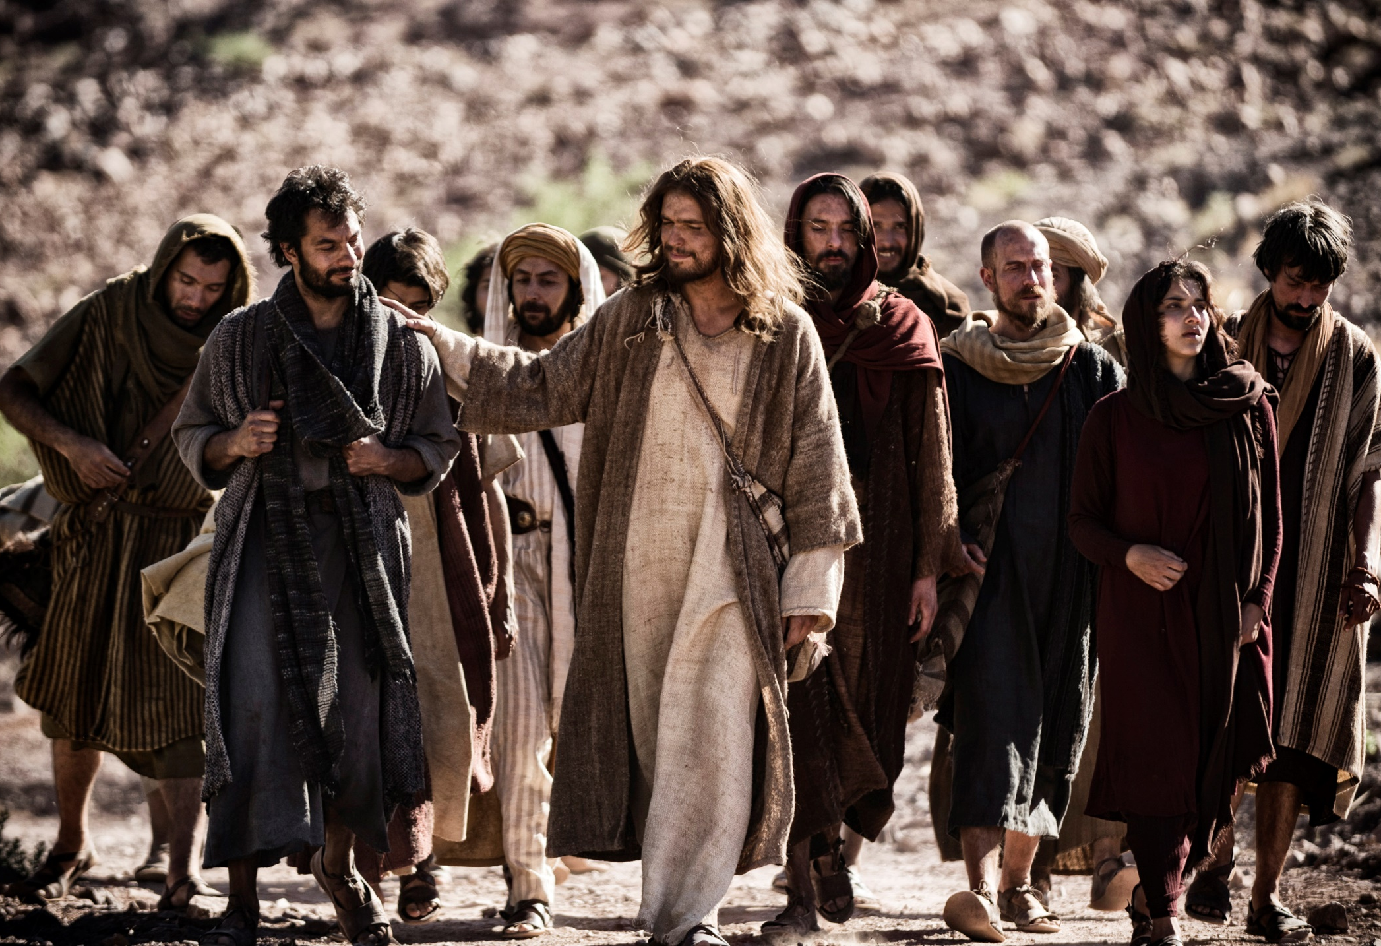
Jesus

Slide 11
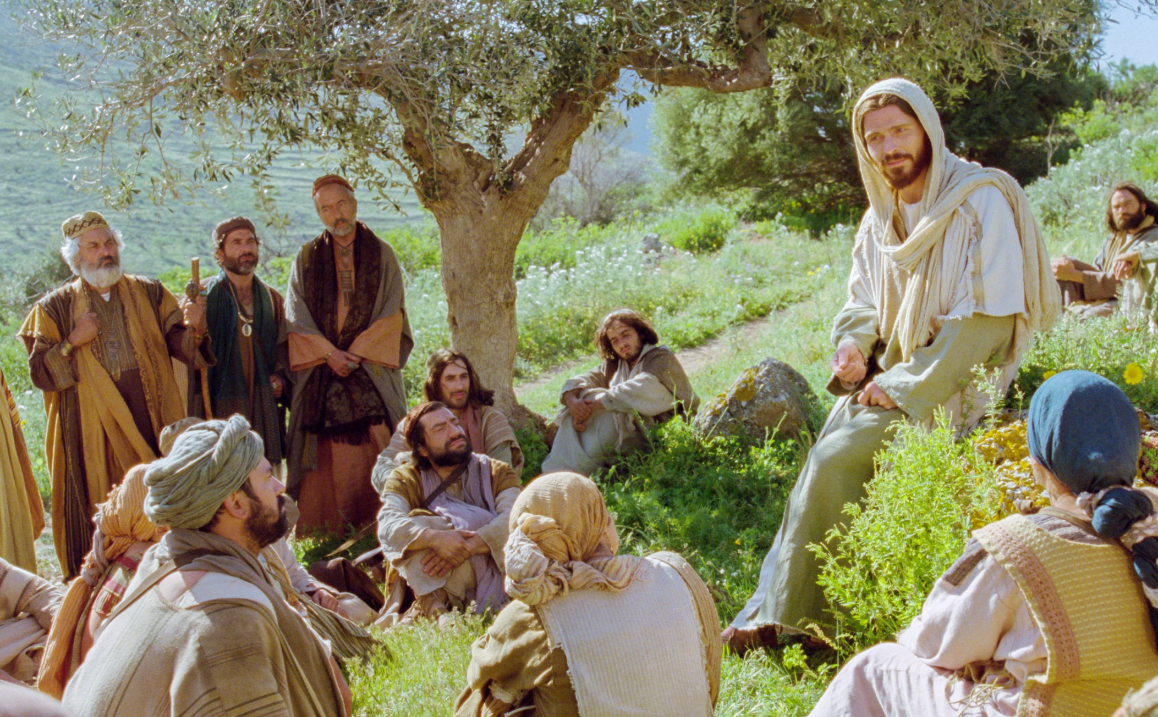
Jesus

Slide 12
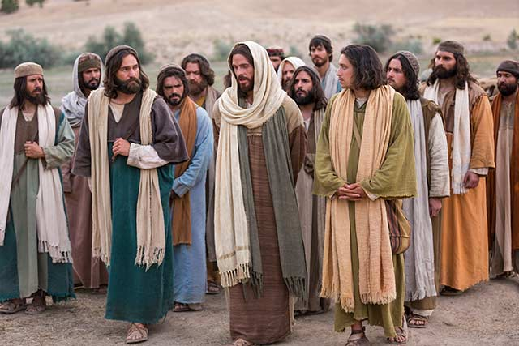
Jesus

Slide 13
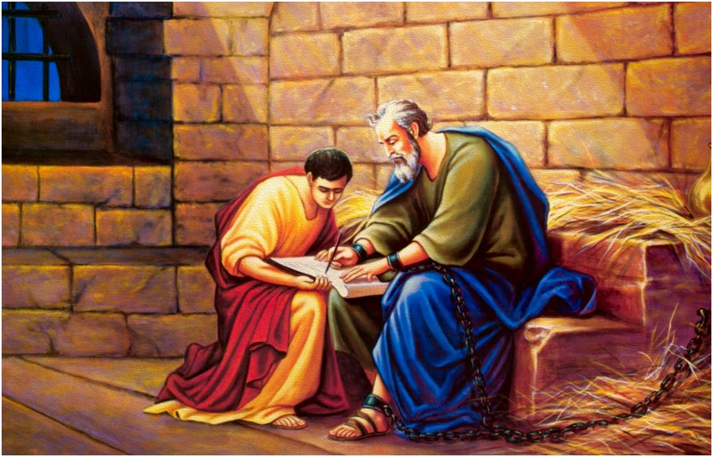
Paul &
Timothy

Slide 14
Making Disciples is about bringing in the harvest
Matthew 9:37-38 “Then he said to his disciples, “The harvest is plentiful but the workers are few. Ask the Lord of the harvest, therefore, to send out workers into his harvest field.”
John 4:35 “Don’t you have a saying, ‘It’s still four months until harvest’? I tell you, open your eyes and look at the fields! They are ripe for harvest.’”

Slide 15
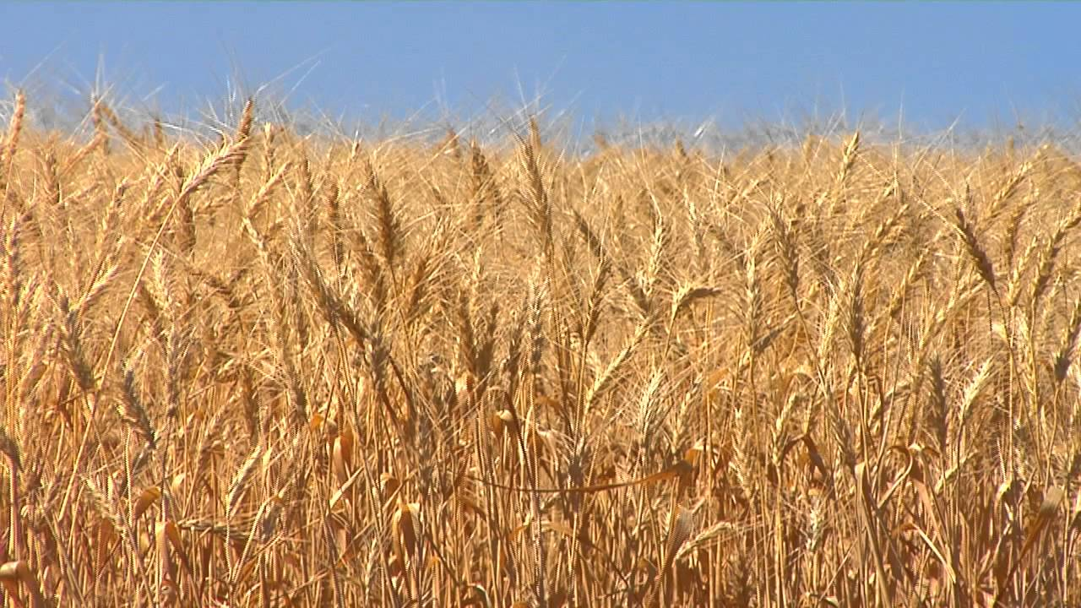

Slide 16
Wanda and I believe in the importance of making disciples wherever we go.

Slide 17
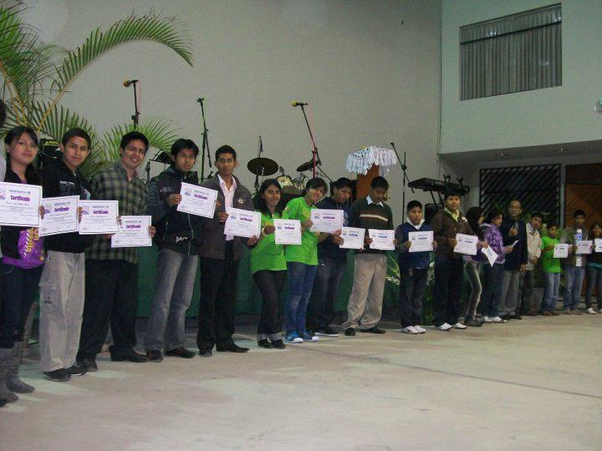
Youth Discipleship Plan
Warriors in Action;
Warriors in Obedience

Slide 18
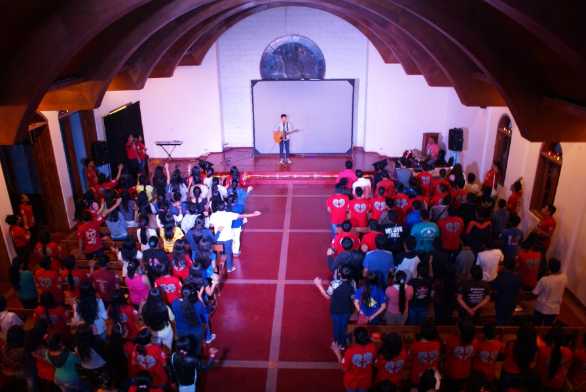
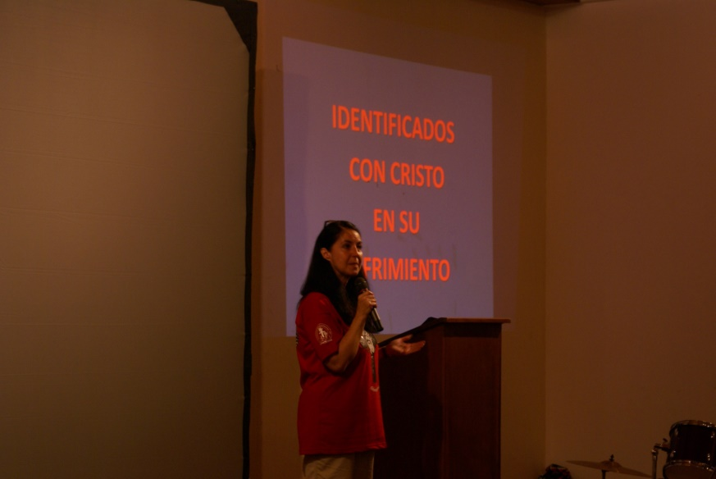
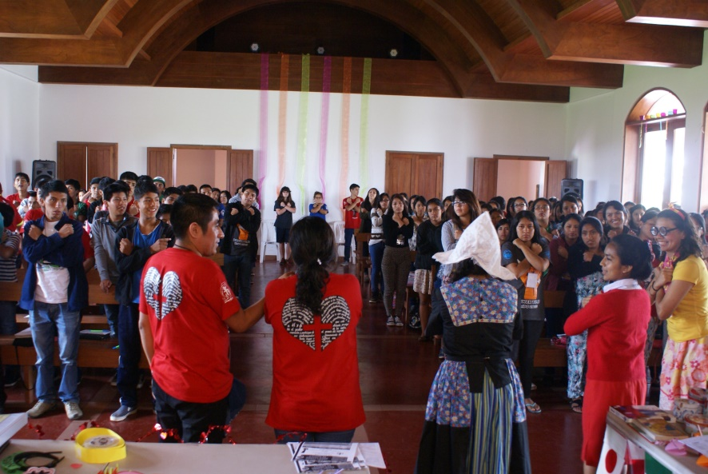
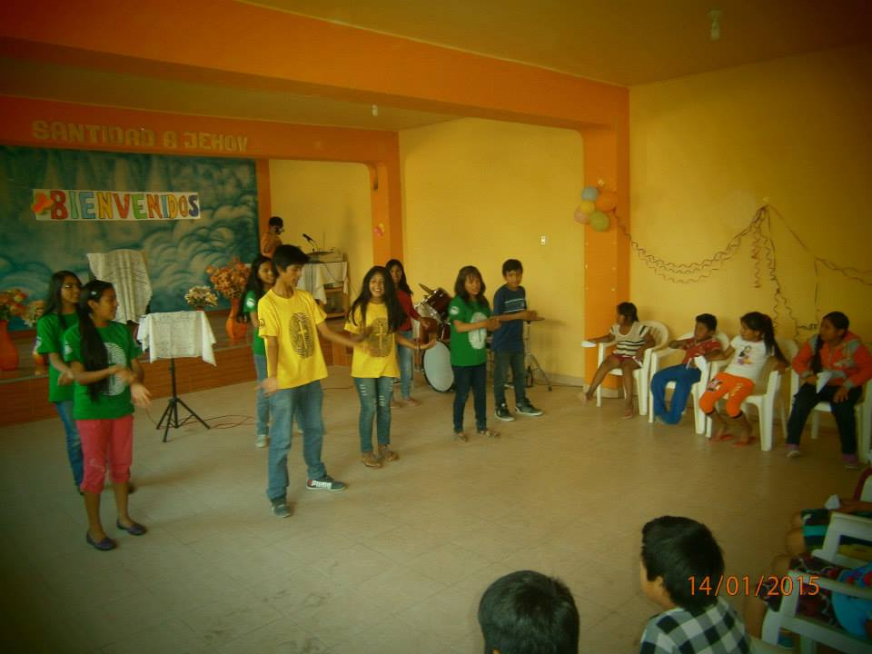
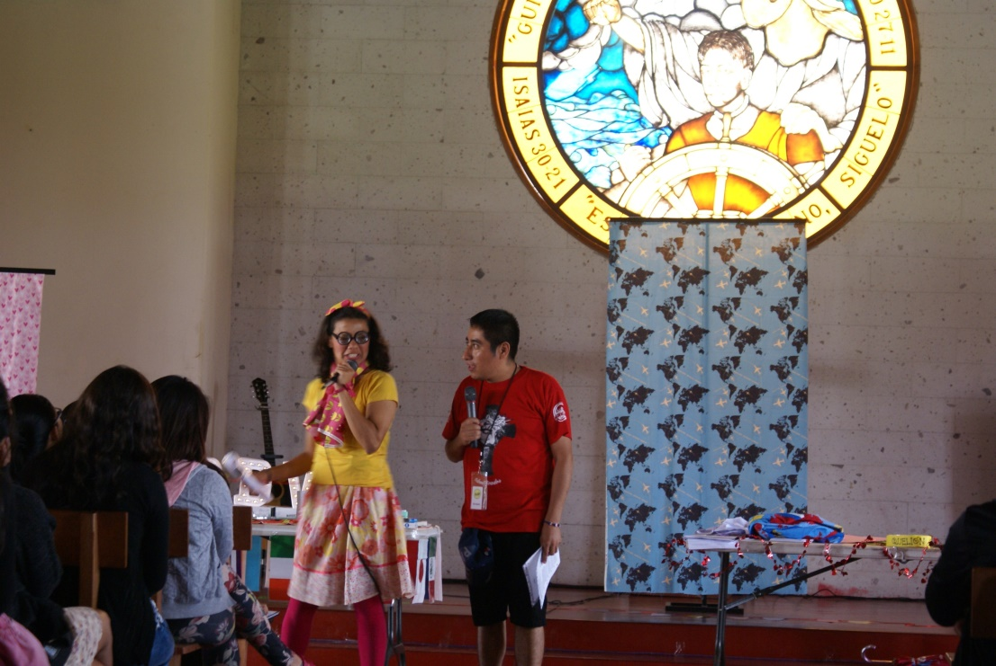
Warriors School
Discipleship Training
School

Slide 19
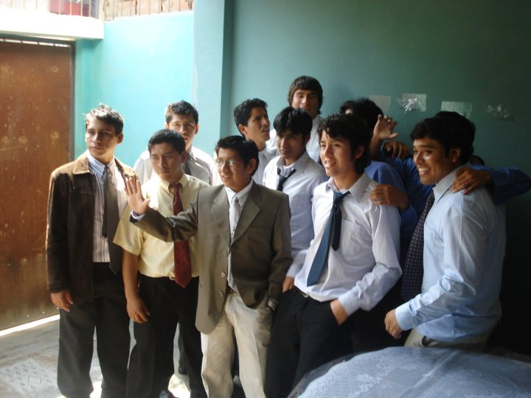
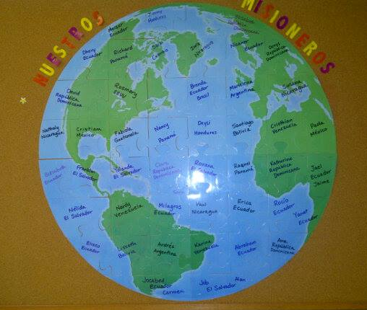
Master’s Commission

Slide 20
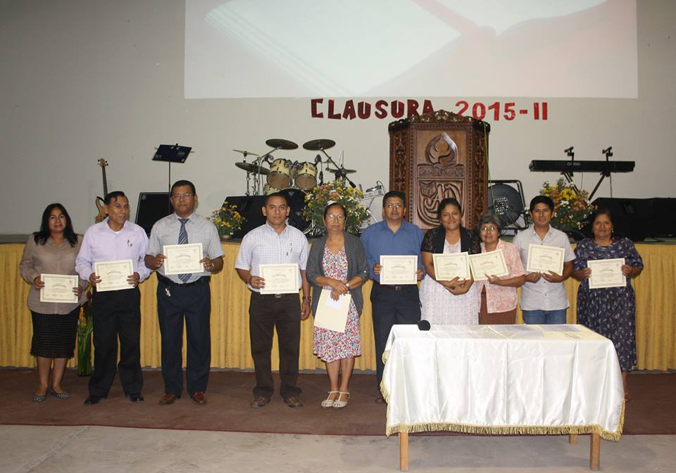
Global University
Discipleship centers
Bible school
University level

Slide 21
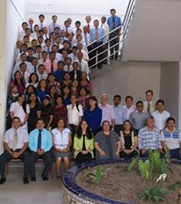
Latin America Advanced School of Theology
Training pastors and leaders

Slide 22
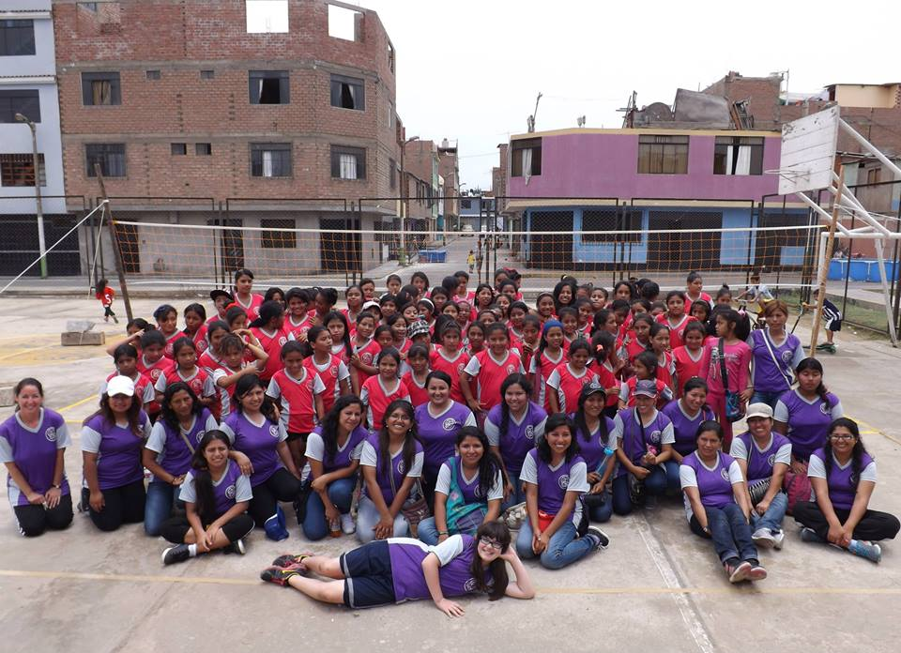
Soccer Salvation Camps
Volleyball & Values Camps

Slide 23
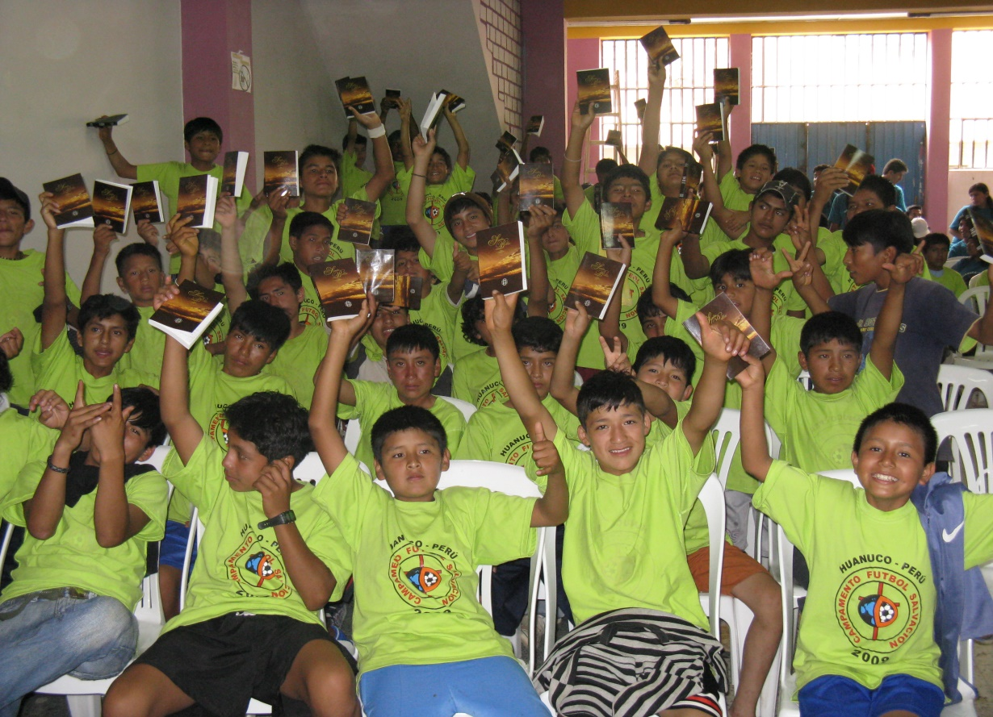
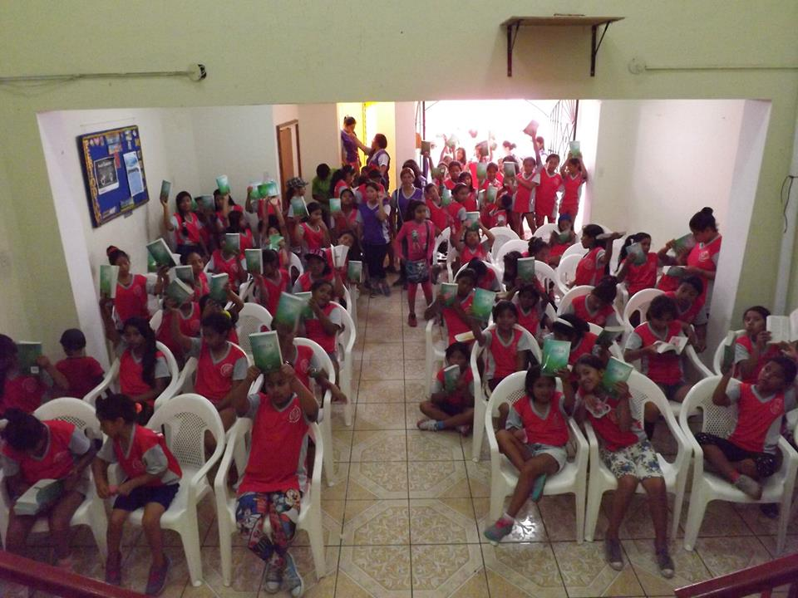
Soccer Salvation Camps
Volleyball & Values Camps

Slide 24
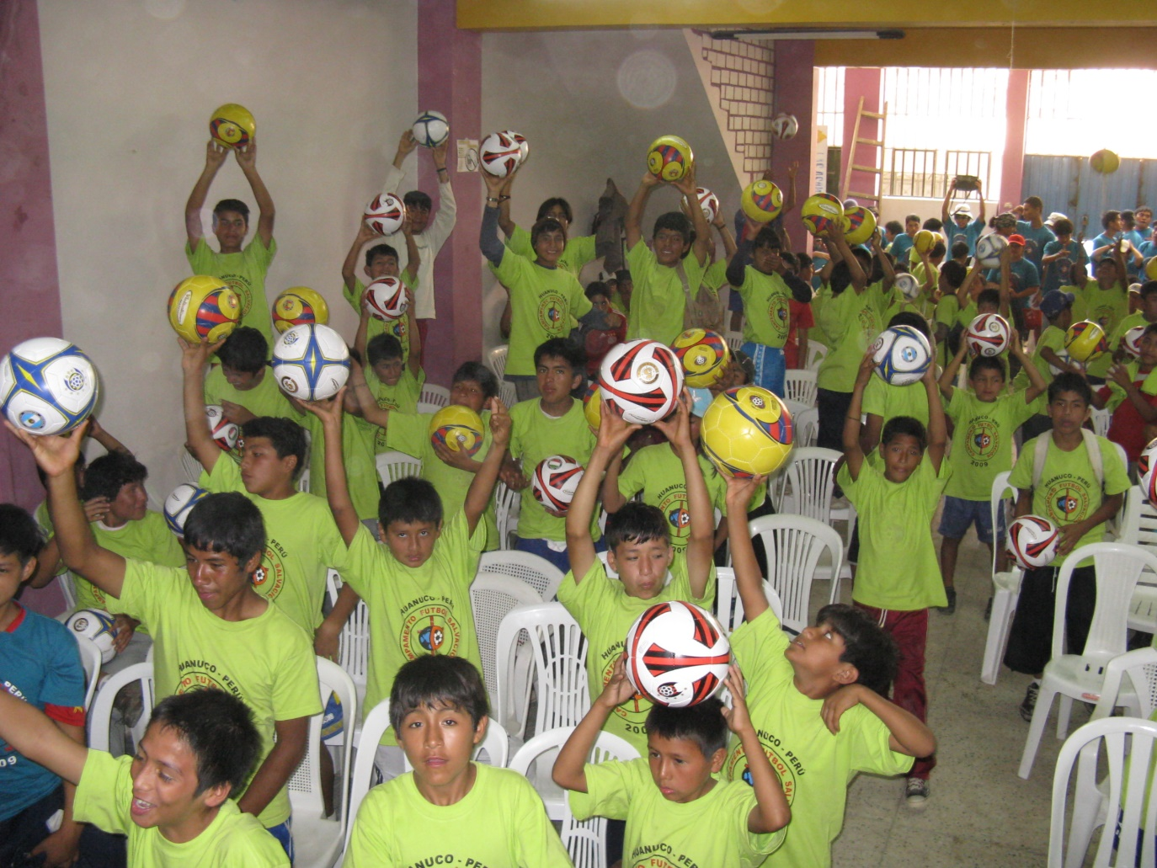
Soccer Salvation Camps
Volleyball & Values Camps

Slide 25
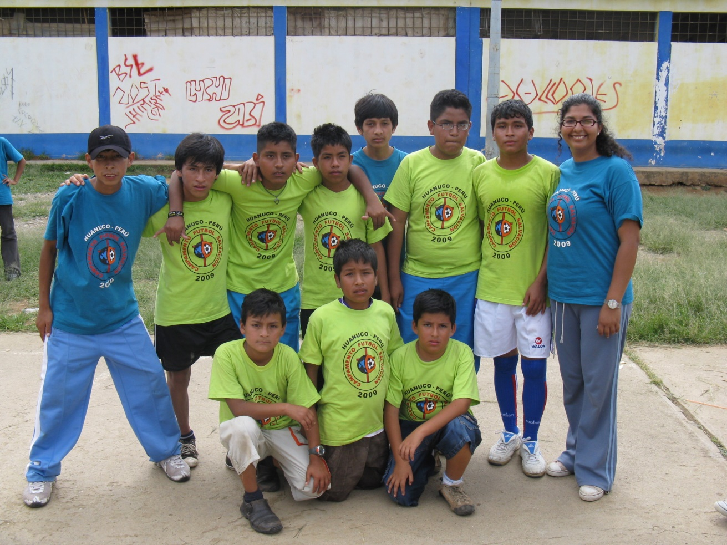
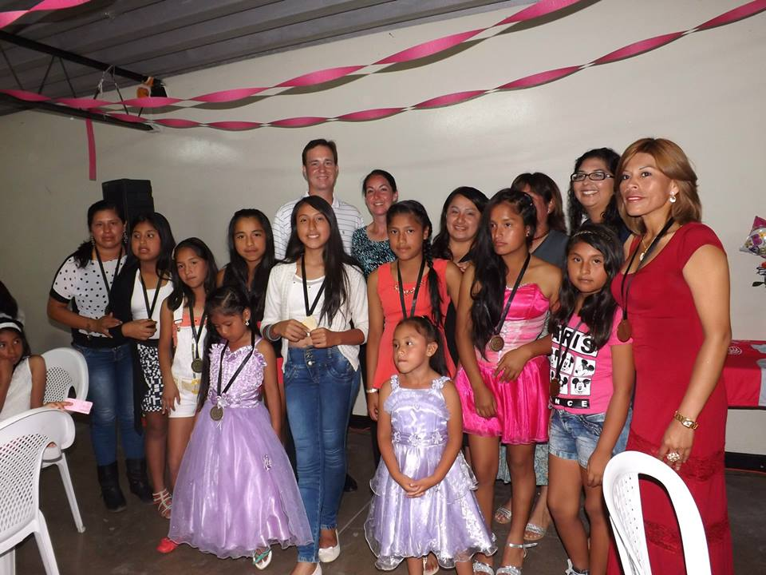
Soccer Salvation Camps
Volleyball & Values Camps

Slide 26
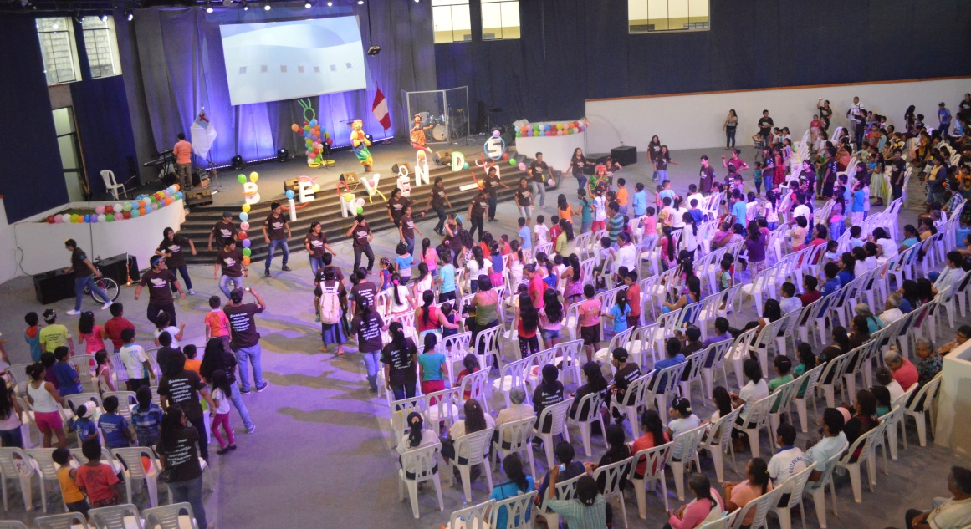
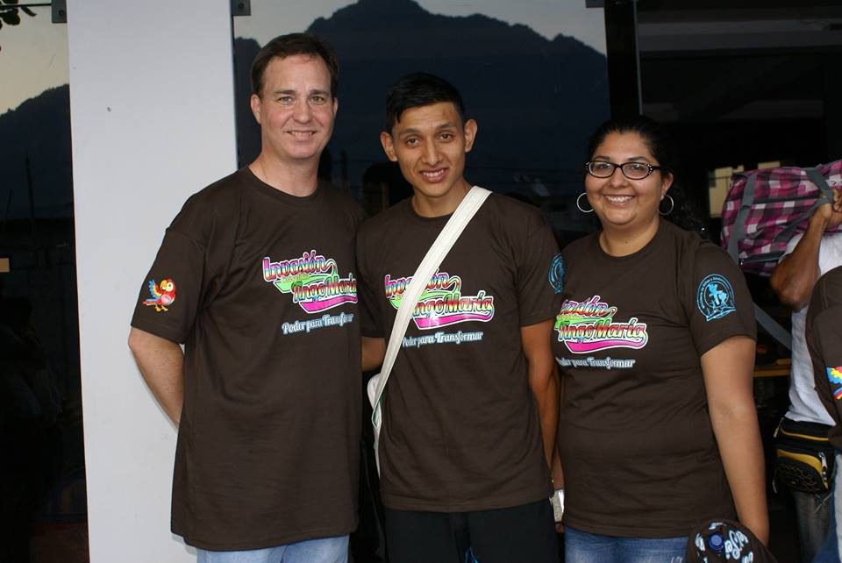
Evangelistic Invasion in Tingo Maria: Johner

Slide 27
We believe that every disciple of Jesus should make other disciples wherever they go.

Slide 28
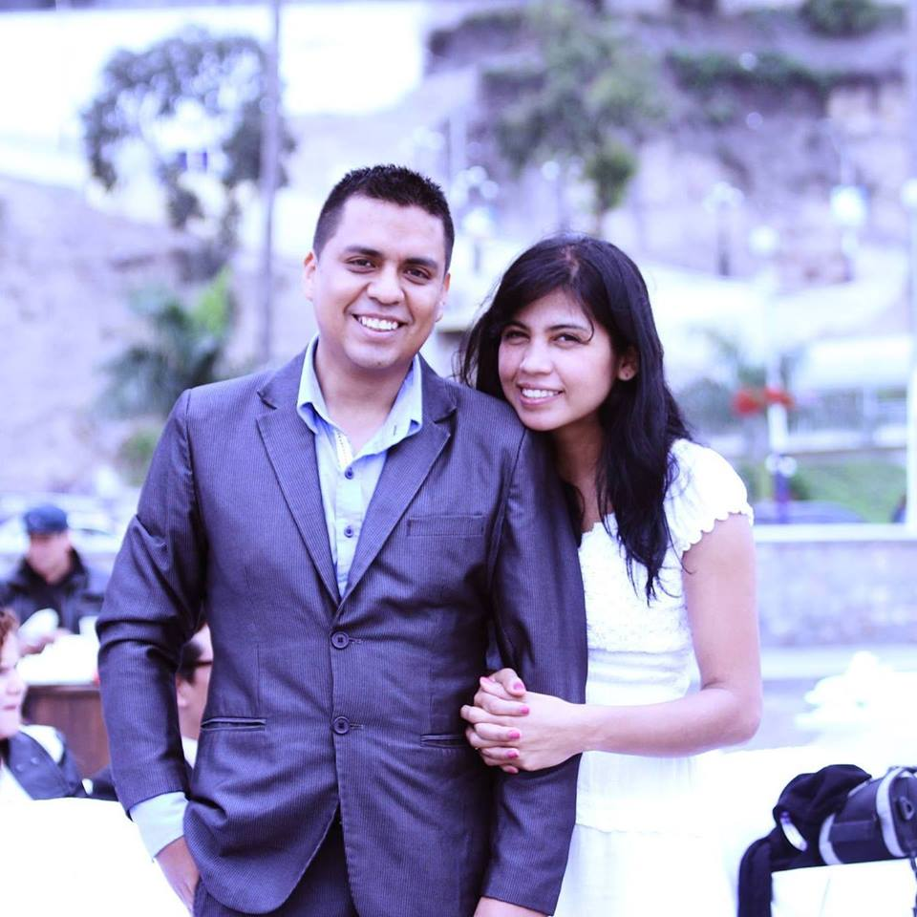
Juan & Gianina Salas

Slide 29
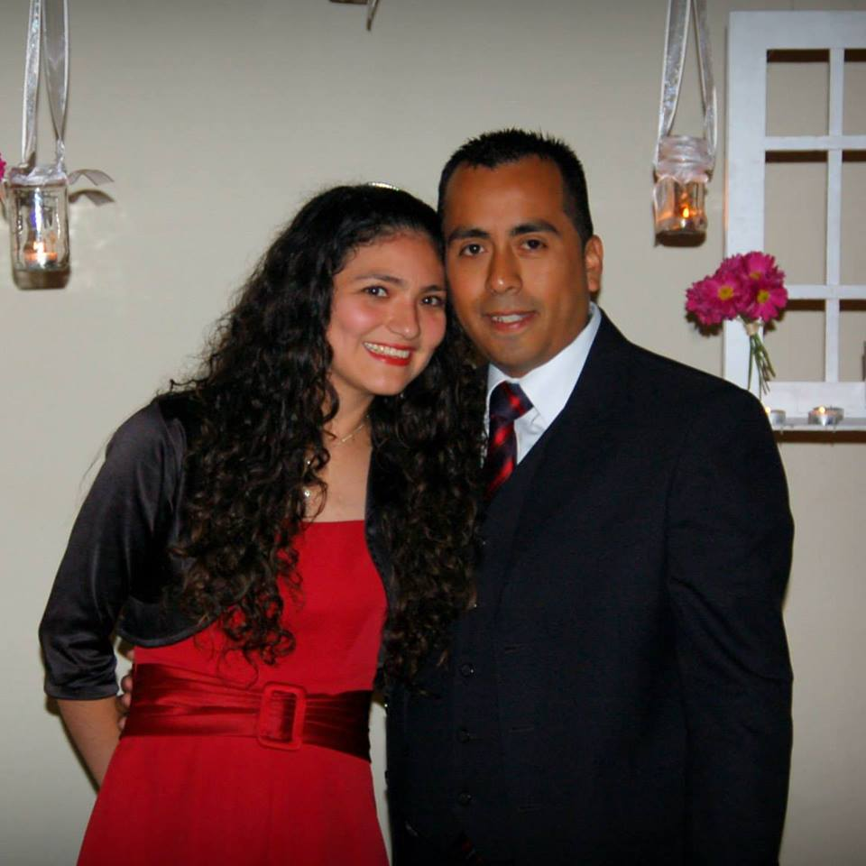
José & Karla Salas

Slide 30
Franklin & Lisseth Medina

Slide 31
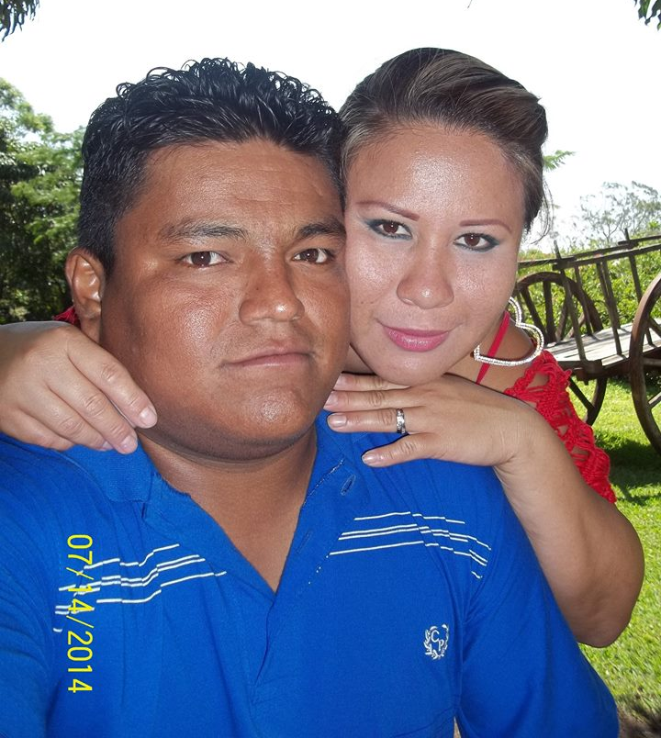
Christian & Kelly Tinedo

Slide 32
Santiago & Carmen Soto

Slide 33
To Further the Process of Making Disciples, Our Desire is to establish a Global University Training Center in Lima.

