Slide 2
Growing Closer To God & One Another This Summer
Deuteronomy 6:4-18
Notes:
Moses – bringing people into a new season

Slide 3
How do I IMPRESS God’s love and law on my children’s hearts?
“Impress them on your children.”
Notes:
Moses – bringing people into a new season

Slide 4
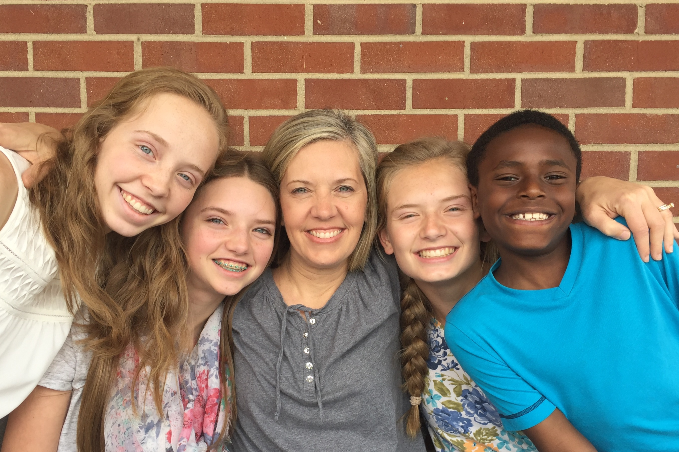

Slide 5
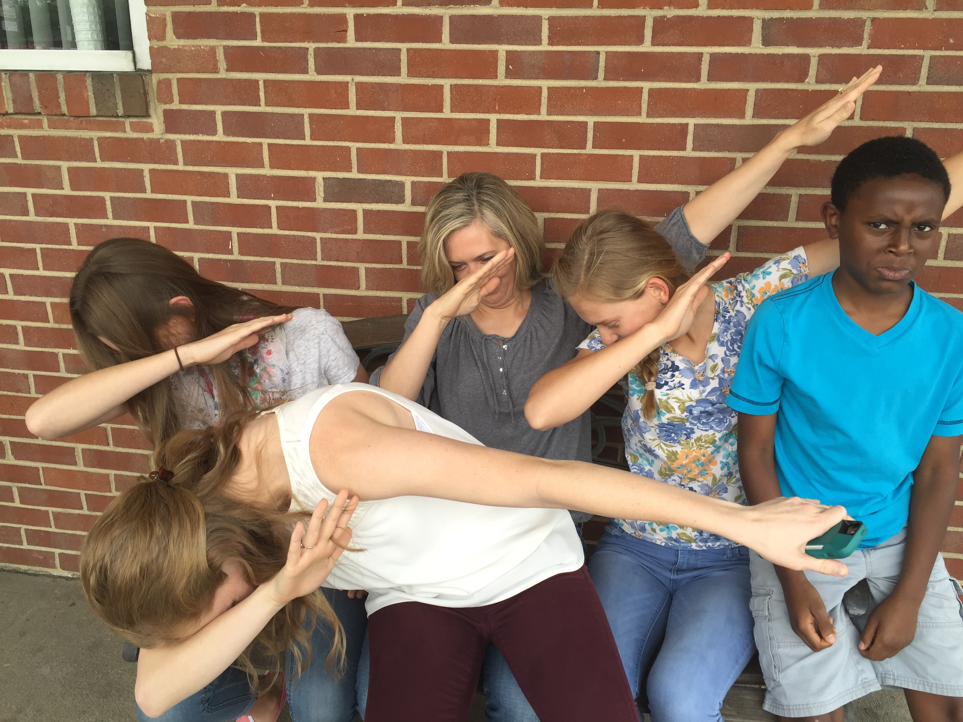

Slide 6
STOP, SEE, CELEBRATE & SEEK . . . THE GOODNESS OF GOD
Notes:
Talk and then panel of parents come and share with you

Slide 7
I. Stop (Selah)
“⁷ Impress them on your children. Talk about them when you sit at home and when you walk along the road, when you lie down and when you get up.”

Slide 8
To “Selah” is to stop to focus and be filled with the one we love and with the truth we confess to live by.

Slide 9
I. STOP (Selah)
Stop to think about . . .
God made us a family
Families are God’s grace to each other
God has good plans for us this summer
Notes:
Live individualistic – tv or ipads
Feeds narcissism
God is a god of family
Grow in family
Go to family

Slide 10
I. STOP (Selah)
Goals & Get-Togethers
What is God’s goal for our family?
What’s God’s goal for you
How do we get together to track it?
Notes:
Biggest fans should be your family
Family time each week
(not church or sports – at home)
Follow Olympics

Slide 11
2. SEE (recognize God’s goodness)
⁸ Tie them as symbols on your hands and bind them on your foreheads. ⁹ Write them on the doorframes of your houses and on your gates.”
Notes:
Something is fixed in your house
To be in house have to see it

Slide 12
2. SEE (recognize God’s goodness)
Stop to think about . . .
Genesis Bible Reading
Summer family book
Notes:
Reading
Chapter
Book

Slide 13
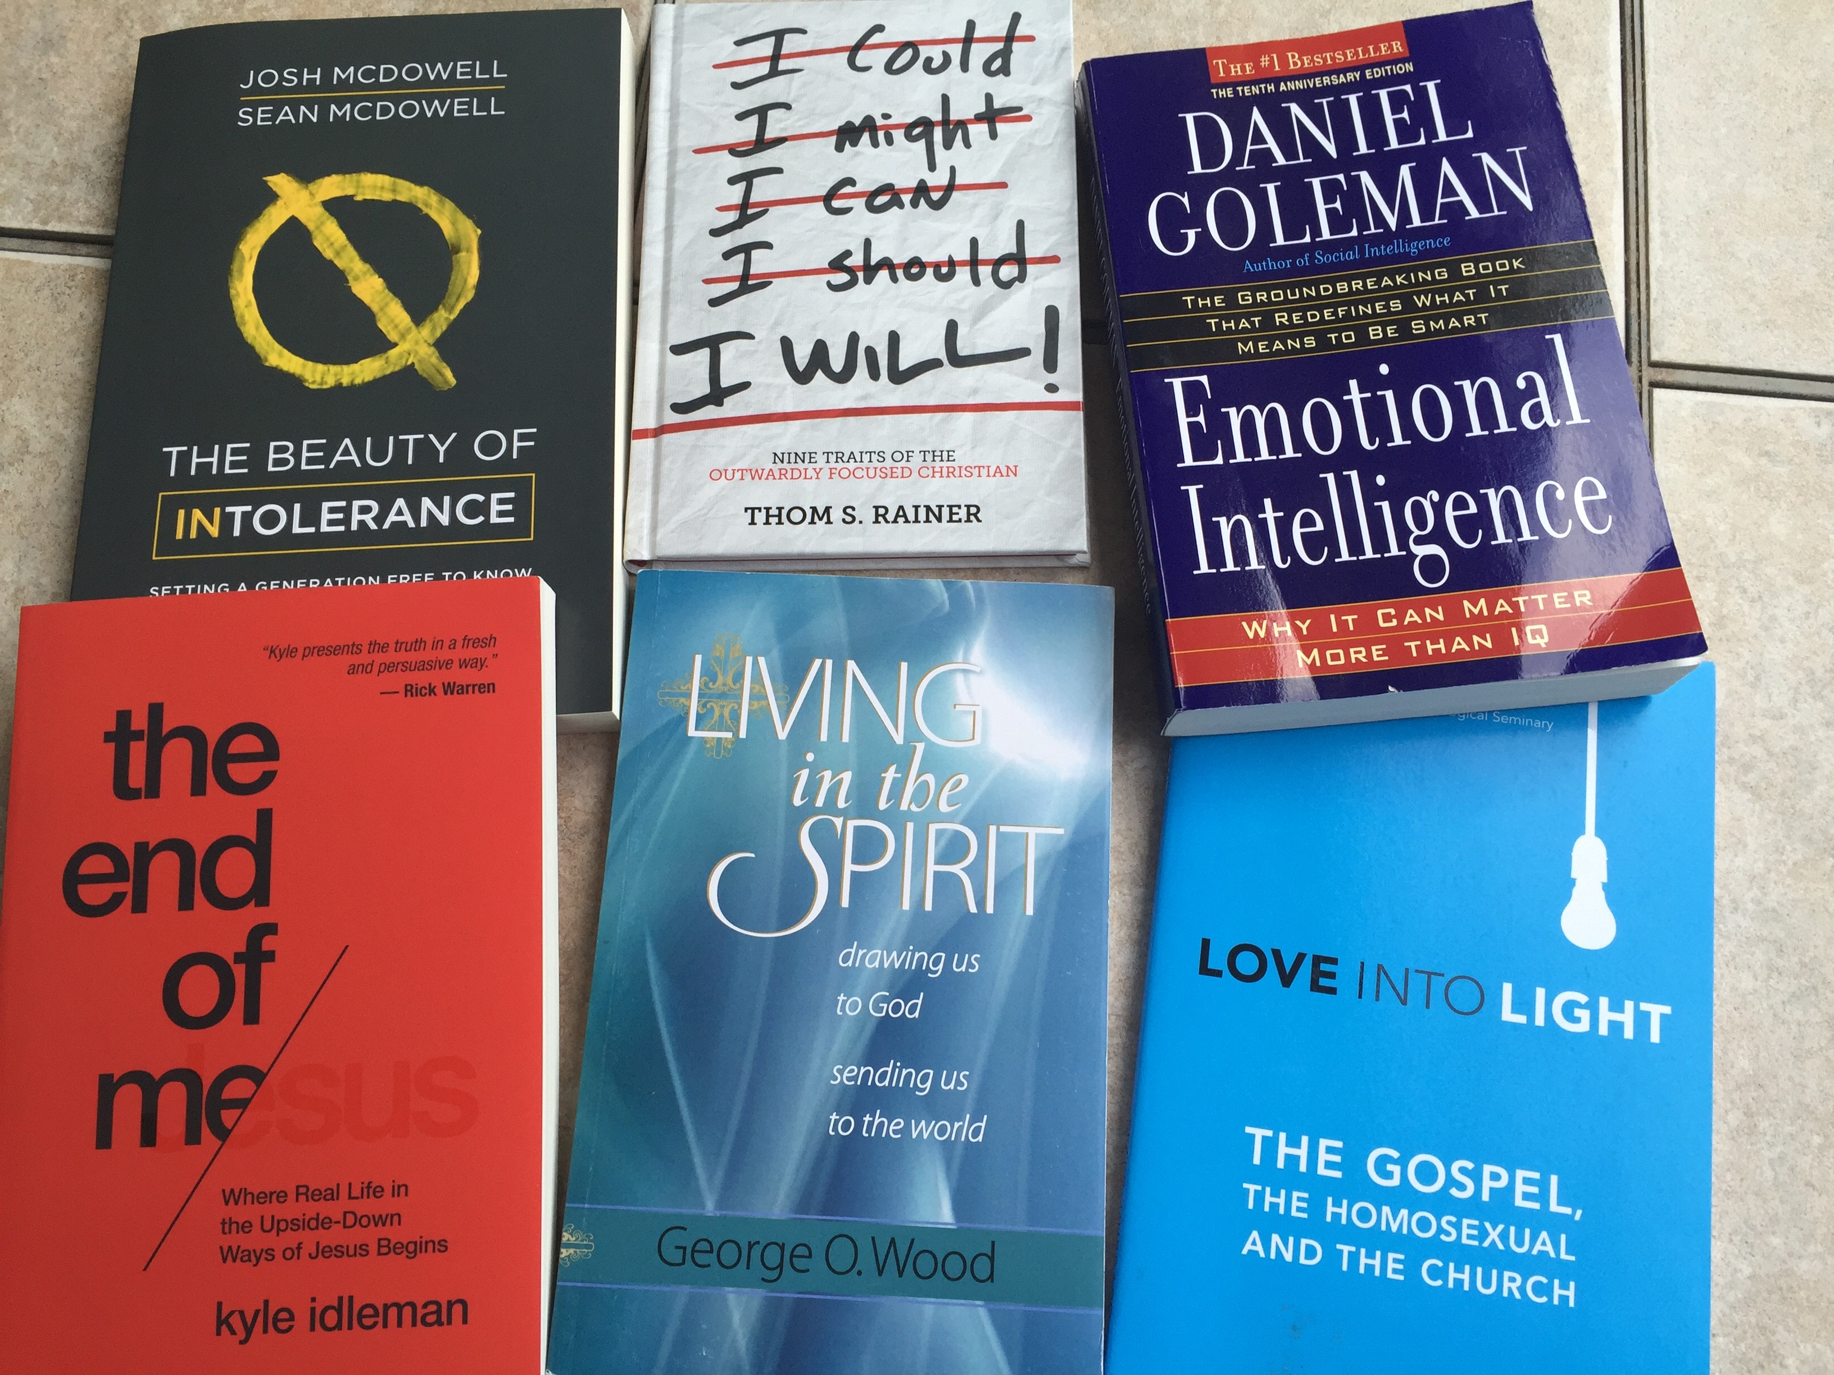

Slide 14
3. CELEBRATE
“be careful that you do not forget the Lord, who brought you out of Egypt, out of the land of slavery” v12
Notes:
God celebrates us
Celebrate each other, friends our family
Celebrate family – vacations

Slide 15
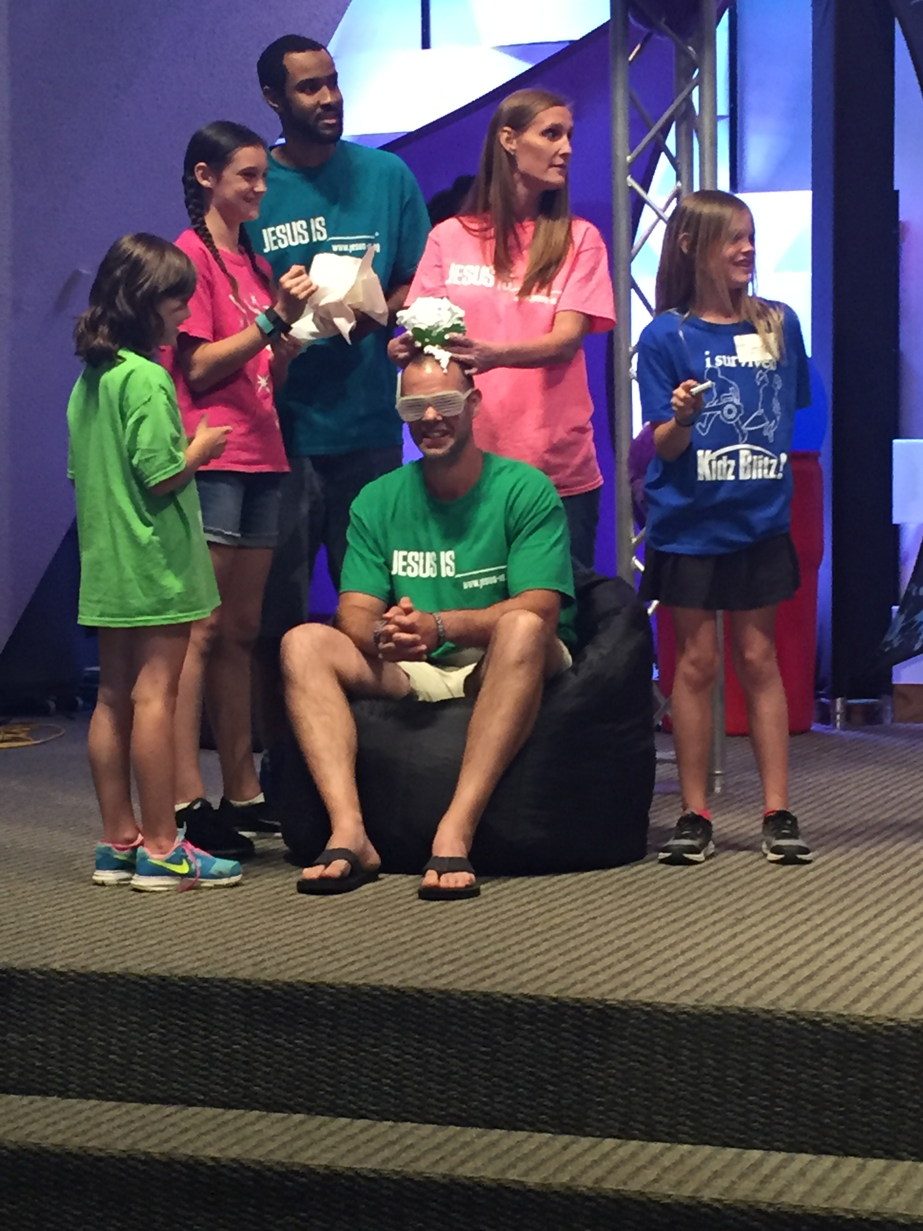
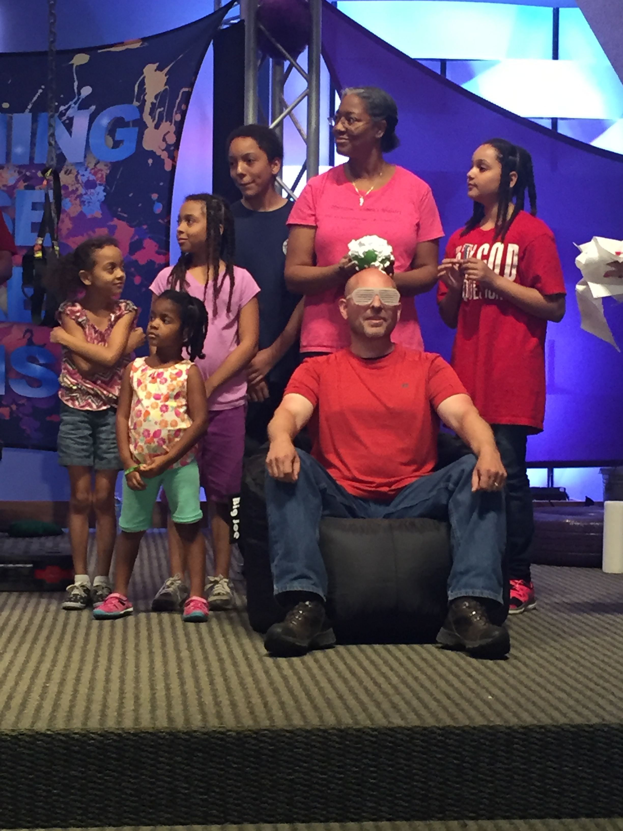

Slide 16
3. CELEBRATE
Stop to think about . . .
Each other
Our family
Our friends
Notes:
Gratitude – encouragement jar
Our family – vacations and get togethers
Having them over

Slide 17
4. SEEK (In trials)
Fear the Lord your God, serve him only . . .14 Do not follow other gods, the gods of the peoples around you; 15. . .. 17 Be sure to keep the commands of the Lord your God”
Notes:
God sings over us
We are meant to sing over him

Slide 18
4. SEEK
Stop to think about . . .
Boundaries
Bad moments
Notes:
Boundaries – tv, media, phone – reasonable, rhytm
Bad moments are most important
Clear
Grace
3. principle

Slide 19
Taught them identity in Christ
Emphasized character over academics
Modeled daily relationship with God
Didn’t avoid tricky subjects
Talked about doubt and struggles to believe & encouraged indiv. thought
Weren’t afraid of science & culture
Notes:
Fuller Youth Institude in 2012 study on Christians college students who kept their faith

Slide 20
Created time & space for conversations
Listened & asked questions (not lecture)
Focused on trusting God instead of obeying rules
Showed grace towards misbehavior
Problems were opportunities to trust God
- Fuller Youth Institute on Christians in College
Notes:
Boundaries – tv, media, phone – reasonable, rhytm
Bad moments are most important
Clear
Grace
3. principle

Slide 21
Make this a summer of helping your children STOP, SEE, CELEBRATE & SEEK the goodness of God

Slide 22
“Do what is right and good in the Lord’s sight, so that it may go well with you and you may go in and take over the good land that the Lord promised on oath to your forefathers, ﻿^{19﻿} thrusting out all your enemies before you, as the Lord said.” [Dt 6:13-19]
Notes:
God sings over us
We are meant to sing over him

