Slide 1
Exodus 6:6-8, NIV
Notes:
Celebrating the good news of Jesus
And how we help each other grow in that
We’ve had over 200 people in life groups and then over 70 adults on Wednesday nights
God brings breakthrough where people join together and trust Him
Looking at the promises of breakthrough for all us
Can help each other in

Slide 2
God’s Four Core Promises
[Exodus 6:6-8] “Therefore, say to the Israelites: ‘I am the Lord, and [1] I will bring you out from under the yoke of the Egyptians. [2] I will free you from being slaves to them...”

Slide 3
“[3] I will redeem you with an outstretched arm and with mighty acts of judgment. [4] I will take you as my own people, and I will be your God. THEN you will know that I am the Lord your God... and I will bring you to the land I promised [for all the world to see]...”

Slide 4
Notes:
God made these promises to people who were
a world away from God’s purpose and plan for their lives!
On handout - scripture
They were slaves and they were supposed to be free
They were hopeless and they were supposed to be givers of hope to the world
They were in a constant pain and God purposed them to be be givers of peace
So God promised to take them on a journey in their heart and in the word
And what God did on the inside would eventually change their outside
Sometimes God did the inside stuff first and sometimes he did the outside stuff first
But here is what God promised to do
Promised to bring them out – no longer be slaves to others or distant from God
Promised to free them – no longer be enslaved to fear and attitudes of the past
Promised to redeem them
When God redeems something – he restores its purpose

Slide 5
God promises the He will . . .
SAVE YOU: change your identity
FREE YOU: change your ability
REDEEM YOU: change your power
FULFILL YOU: change your world
Notes:
These are God’s promises to you and to me
These are God’s promises to get us out of feeling trapped and into freedom
I grew up in Long Island, NY – let me tell you how I felt trapped
You couldn’t get your driver’s license until you were 17
When I was 17, who I was changed
I was legally accepted as a driver.
I was told I was no longer a slave to my parents driving
I didn’t look different.
I just was different – my identity changed. Legally who I was changed
I was different.
But I didn’t have the ability to go any place
I had the authority to go but not able to go
Then my dad got me this – my first car

Slide 6
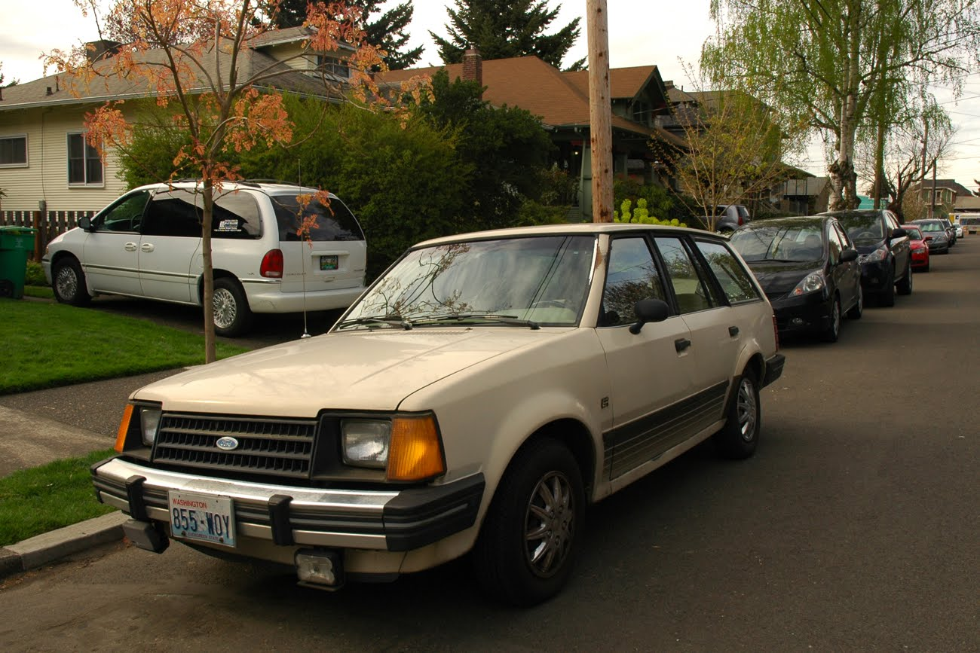
Notes:
A 1980 ford escort station wagon – automatic / cracked windshield / go cart motor
Had to double foot it at stop lights & it shook if I went over 55
I didn’t buy or fix up –my dad did
– it didn’t look like much compared to others
I had the ability to get somewhere new – I was given freedom
Dad – taught me how to have this freedom (DMV, car insurance)
But having the new identity and ability or freedom didn’t matter if I didn’t have the something else
I needed this

Slide 7
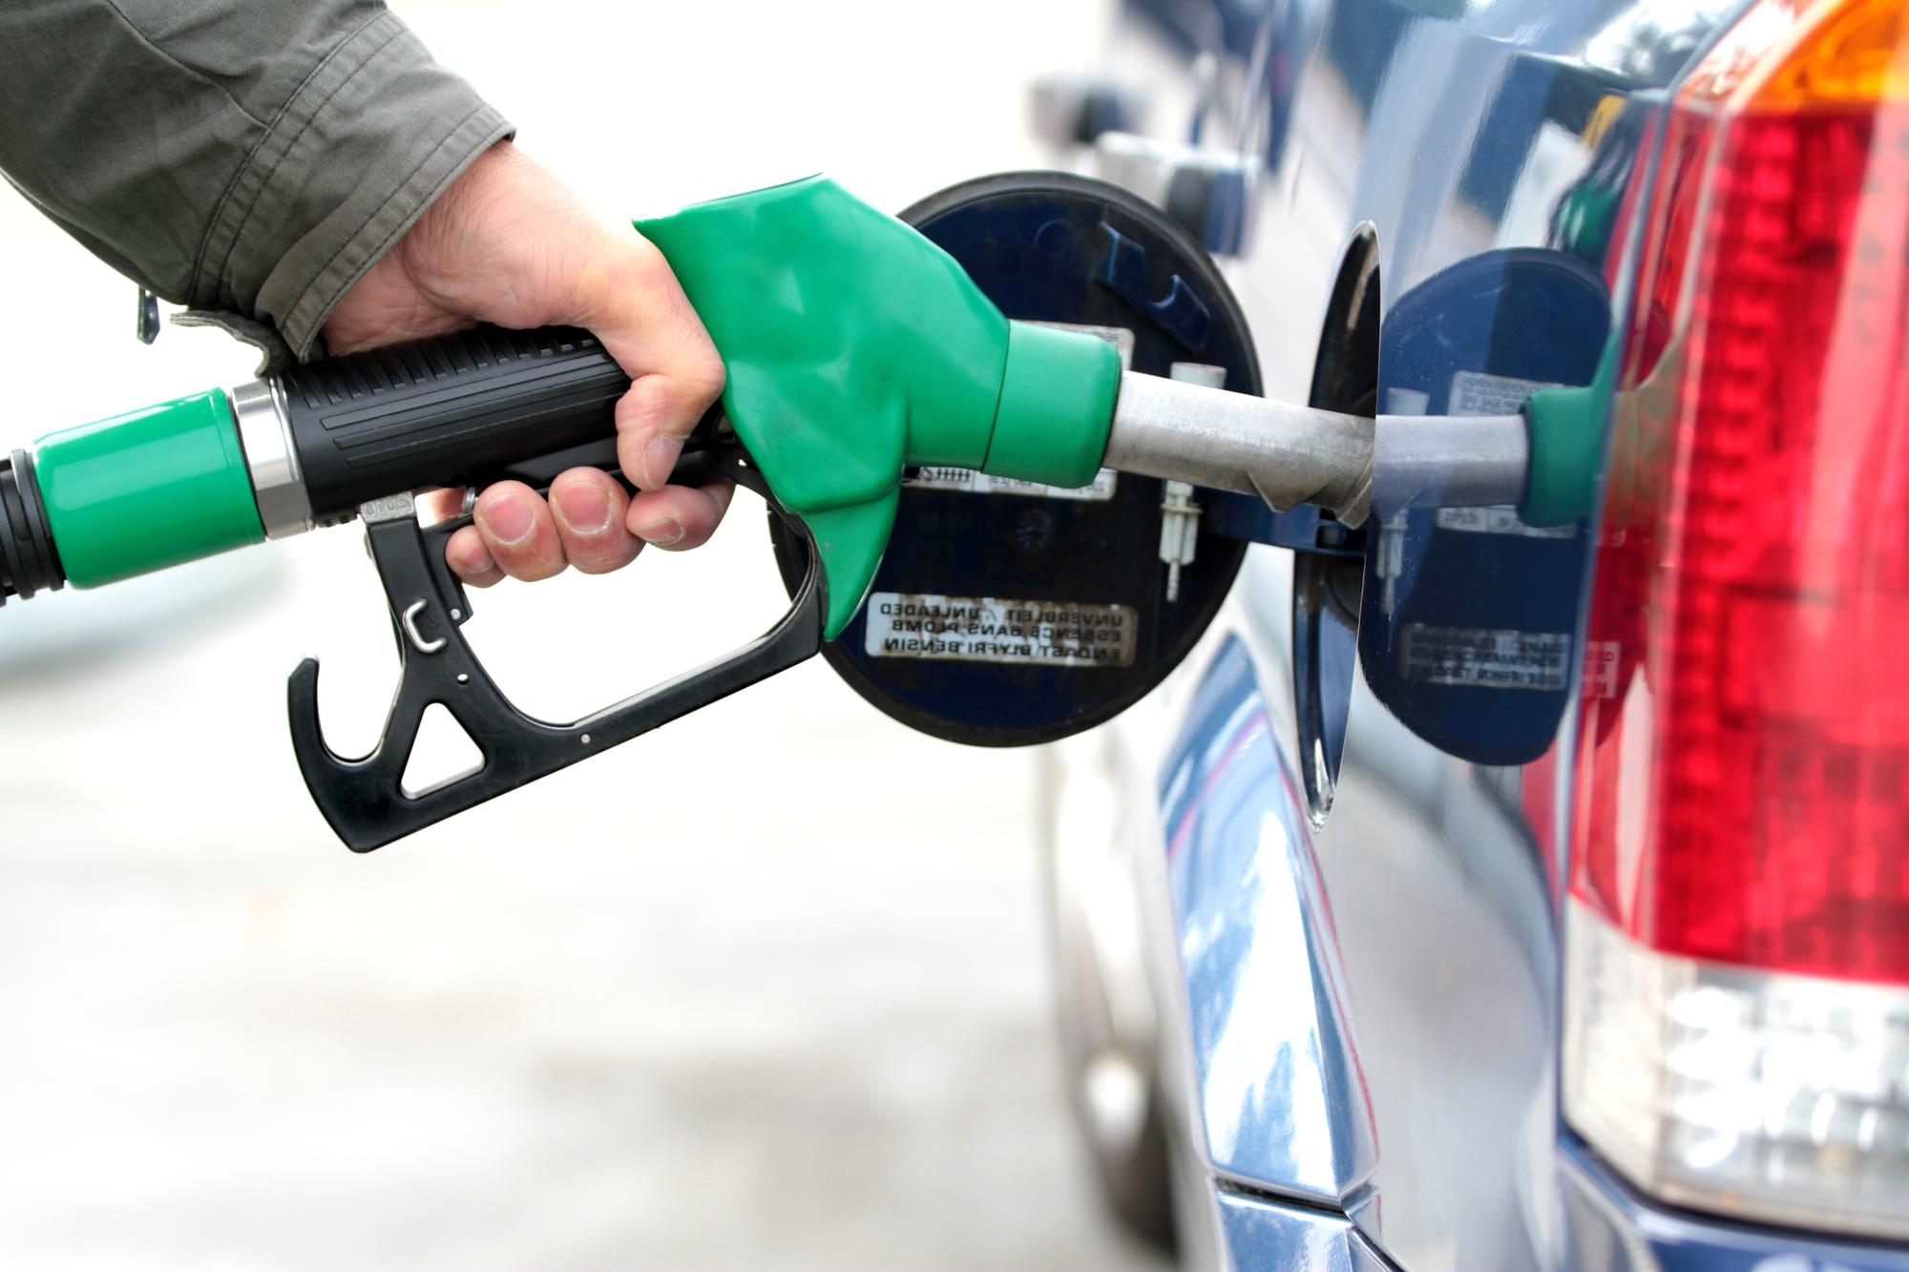
Notes:
I needed this
– I didn’t need just a little
(not if I wanted to get far) / wouldn’t get far with a little
And I didn’t just need it one time
(not if I wanted to do more than visit once or once in awhile)
And so my plans and purposes had to change to this reality.
I had to stay focused on staying filled with power.
If I didn’t (and there were a few times I didn’t)
I’d find myself on the side of the road and in dangerous circumstances
I HAD TO BUILD MY LIFE AROUND STAYING FILLED WITH POWER
WITHOUT IT MY IDENTITY AND MY ABILITY DIDN’T MEAN ANYTHING
And in Exodus 6 – God is telling his people the same thing
He is telling them / he is changing who they are / He is setting free /
I’m going to restore something you’ve lost and were always meant to have
- MY POWER IN YOUR LIVES

Slide 8
[Jer. 29:11] “‘For I know the plans I have for you,’ declares the Lord, ‘plans to prosper you and not to harm you, plans to give you hope and a [victorious] future.’”
Notes:
God has great plans for your life, marriage, family, community
God knows the true life he wants to bring every person
– enslaved and destroyed by their own selfishness, sin and pride
And so he takes us on the same journey he took the isrealites on
And does so with the same promises
It may not literally be from Egypt to Israel
But you can think of it this way

Slide 9
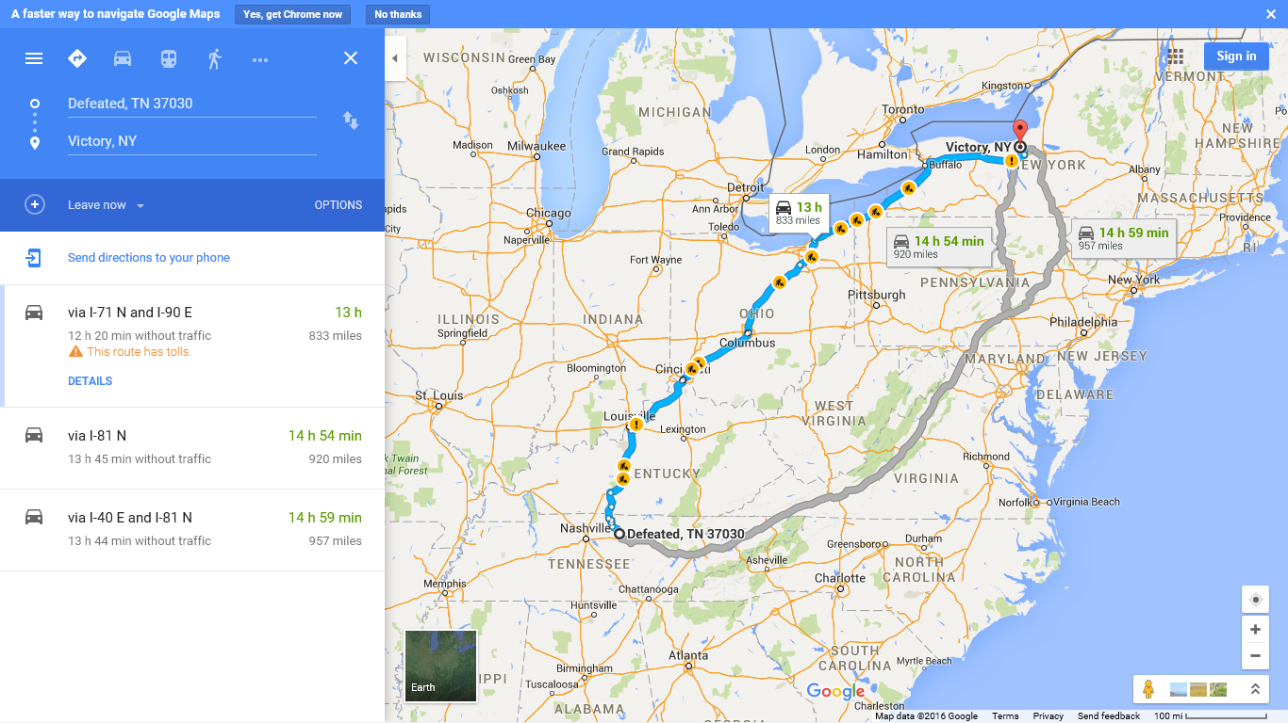
Notes:
God wants to take you from defeated (Tenessess) to victory NY
I have a promise land – a life of victory planned for you
I’ve always had it
Its never not been there for you
Somehow, you, your marriage, your parenting, your career, your lifestyle, your happiness
It all ended up in Defeated, Tennessee
But God still has a purpose and a place for you to get in life
I know how long it will take and what you need
I know the tolls you’ll have to pay
The obstacles and construction of the world and of satan that will stand in your way
And I promise you, I will get you there – not to visit / but to live
I’m going to change your identity – I’m going to make you mine –so you can get out of defeated, TN
I’m going to teach you live differently – I’m going to give you the ability (the car) to get there (may not look like much)
But most of all – you’ve got to have power
And not just a little bit – you’ve got too far to travel to only get a little
And just once – you’ve got to be constantly filled to live in, explore and serve others in victory, NY
And so that’s the third promise – the cup of redemption of the jewish Passover / ex 6

Slide 10
A new identity
plus new freedom
without continuous fresh power
is just a new way
to experience
the same old defeat

Slide 11
“[3] I will redeem you with an outstretched arm and with mighty acts of judgment. . . .THEN you will know that I am the Lord your God... and I will bring you to the land I promised [for all the world to see]...”
Notes:
God knows this so he promises the power to get you to the promise land

Slide 12
God’s Promise
Of Redemption
I will restore My
original purpose and power to your life
for My glory
Notes:
God promises to restore the purpose and power you were always designed and created to live with
SO WHAT HOW DOES THIS PROMISE BECOME A REALITY IN YOUR LIFE
First you have to want him to change your identity and give you the ability
If you want to keep your old life – this won’t work
If you want to be in charge of what parts of your old priorities God has to keep this won’t work
But if you are convinced that you a slave who can’t bring yourself out and doesn’t have the ability to stay out
Than this promise can come true in you life with these three steps
And the verse itself tells us what those three steps are

Slide 13
1. Truly believe God has a great purpose for your life despite your past & problems
[Exodus 6:6] “I will redeem you with an outstretched arm and with mighty acts of judgment
Notes:
No matter your past and problems / you have to have faith in God’s word that says

Slide 14
[Eph. 2:10] “For we are God’s masterpiece. He has created us anew in Christ Jesus, so we can do the good things he planned [purposed] for us long ago.
New Century Version
Notes:
We are his masterpiece – good works – created to be a blessing
We are his sons and daughters / we are royal servants to the world
We are Jesus’ special messengers with his love
Condemnation says – you are a mess and there is no way out
Jesus doesn’t condemn – John 3:17
But he does convict –
Conviction says – I’m a messed up masterpiece with a better purpose
I have a great purpose and I need a great power to get there

Slide 15
[Mt 5:14-16] “You are the light of the world...Neither do people light a lamp and put it under a bowl. Instead they put it on its stand, and it gives light to everyone in the house. ﻿In the same way, let your light shine before men, that they may see your good deeds and praise your Father in heaven.”
Notes:
What did maya angelo say – “You being small does not serve the world”

Slide 16
[2 Co 4:6-7] “For God...made his light shine in our hearts...But we have this treasure in jars of clay to show that this all-surpassing power is from God and not from us.”
Notes:
Your problems that reveal your weaknesses
Are so you can learn to show the world that
By yourself you live in defeat – but with him you live in victory
You are God’s masterpiece – still learning to live out the purpose for which you were made
Your marriage is supposed to be a masterpiece of grace – don’t give up
Your testimony is supposed to be a masteroeice of Grace –
But let me encourage you today – the place of your greatest pain and problems is probably a key part of God’s purpose in your life
Cry – giving a report
Cry –
Why? Talk third point – God’s not the only one with a plan for my life
And Satan’s chief plan is to steal, kill and destroy God’s purpose in my life

Slide 17
2. Be constantly filled with the Holy Spirit
[Exodus 6:6] “I will redeem you with an outstretched arm and with mighty acts of judgment
Notes:
“outretched arm in the Old testemant –was a symbol of God supernatural power overcoming anything on earth
You were made to dwell with God and be close to him
God reaches out – by sending His Holy Spirit to fill you – not a little / not just once – but over and over again
To have the power to see your marriage go form defeat to victory
Your personal life from addiction to freedom
God has always planned to reach out and give you the power to move towards the promise land

Slide 18
[Ezekiel 36:27-28] “ And I will put my Spirit in you and move you to follow my decrees and be careful to keep my laws. ^{﻿28﻿} You will live in the [promised] land”
Notes:
There is power to get you to the promise

Slide 19
[Eph. 3:16] “I pray that out of his glorious riches he may strengthen you with power through his Spirit in your inner being”
[Acts 1:8] “But you will receive power when the Holy Spirit comes on you”
Notes:
There is power to strengthen you – to love and not hate / reconcile / to persevere / to resist temptation
Gasoline for the car
Power for the truth you learn in class or in the small group
But I have to have a “get filled” attitude about life – not just once

Slide 20
[Ephesians 5:17-18] “Don’t act thoughtlessly, but understand what the Lord wants you to do. Don’t be drunk with wine, because that will ruin your life. Instead, be continually filled with the Holy Spirit”
Notes:
Don’t be foolish – no fills up their car only once.
No the further they want to go . . . The more often they have to do what? Get refilled
I can’t just know where the gas station is
I can’t just have a rewards card
I can’t go the gas station once a week and pick up a slurpee and a donut
I’ve got to get filled up
God is ssaying today – take the time

Slide 21
3. Resist Satan’s plan for your life
[Exodus 6:6] “I will redeem you with an outstretched arm and with mighty acts of judgment”
Notes:
To see avenge injustice and destroy enemies

Slide 22
[John 10:10] “‘The thief comes only to steal and kill and destroy; I have come that they may have life, and have it to the full.”

Slide 23
[1 Jn 3:8] “‘The reason the Son of God appeared was to destroy the devil’s work [plan for your life].”

Slide 24
[Jas 4:6-10] “God opposes the proud
but gives grace to the humble.”﻿
﻿Submit yourselves, then, to God. Resist the devil, and he will flee from you...Humble yourselves before the Lord, and he will lift you up.”
﻿

Slide 25
Notes:
Your freedom may look as impressive and powerful as this
You have a great purpse to get to
You’ve got a freedom that God wants to fill with power
Will you take it today
It starts by changing your identity – are you going to God’s or your own
Are you will for the old life to pass?
God has victory – choose today / connection card
Power for the purpose – not even a plan – just the power

Slide 26
[Luke 11:13] “how much more will your heavenly Father give the Holy Spirit to those who ask him”
[Acts 5:32] “We are witnesses of these things and so is the Holy Spirit, who is given by God to those who obey him.”

