Slide 1
Sermon notes in newsletter, p4
Notes:
So excited to see you this morning!
HE IS STILL RISEN! HIS VICTORY WON ON THE CROSS & RESURRECTION – STILL OURS TODAY
This is such an important season for us to be sharing LIFE TOGETHER.
We are seeing God move in new and powerful ways in our community and our church as we have been focusing on new beginnings and new resurrection life.
In our church: many long standing members are having breakthroughs in their relationship with the Lord and in the calling.
Many members starting breakthrough groups in this season: highlighted in your newsletter
Over 35 decisions for Christ in the past three weeks
Today we have eight water baptisms!
- people choosing to follow Christ & begin the new life He promised

Slide 2
Great Commission
“Therefore go and make disciples of all nations, baptizing them in the name of the Father and of the Son and of the Holy Spirit, ﻿and teaching them to obey everything I have commanded you.” (Mt 28:19-20)
Notes:
This is what our church is about
Our job is not just to invite and celebrate new life -
But then we are to teach the entirety of this new life
(not just the beginning but the complete steps of this new life in the spirit)
And that’s we want to do today
Celebrate new beginnings
Teach what that new life is about after baptism
Two reasons:
One of 35 – need this
Been here 35 years – need to remember and refocus
Because nothing is worse than this

Slide 3
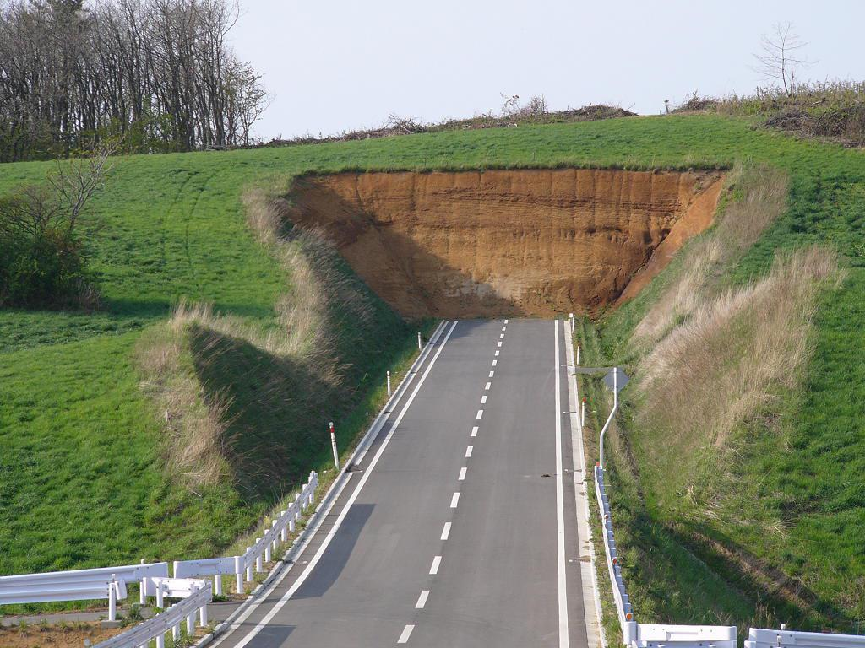
Notes:
Starting something that leads to nowhere
And there is nothing more dangerous than this . . .

Slide 4
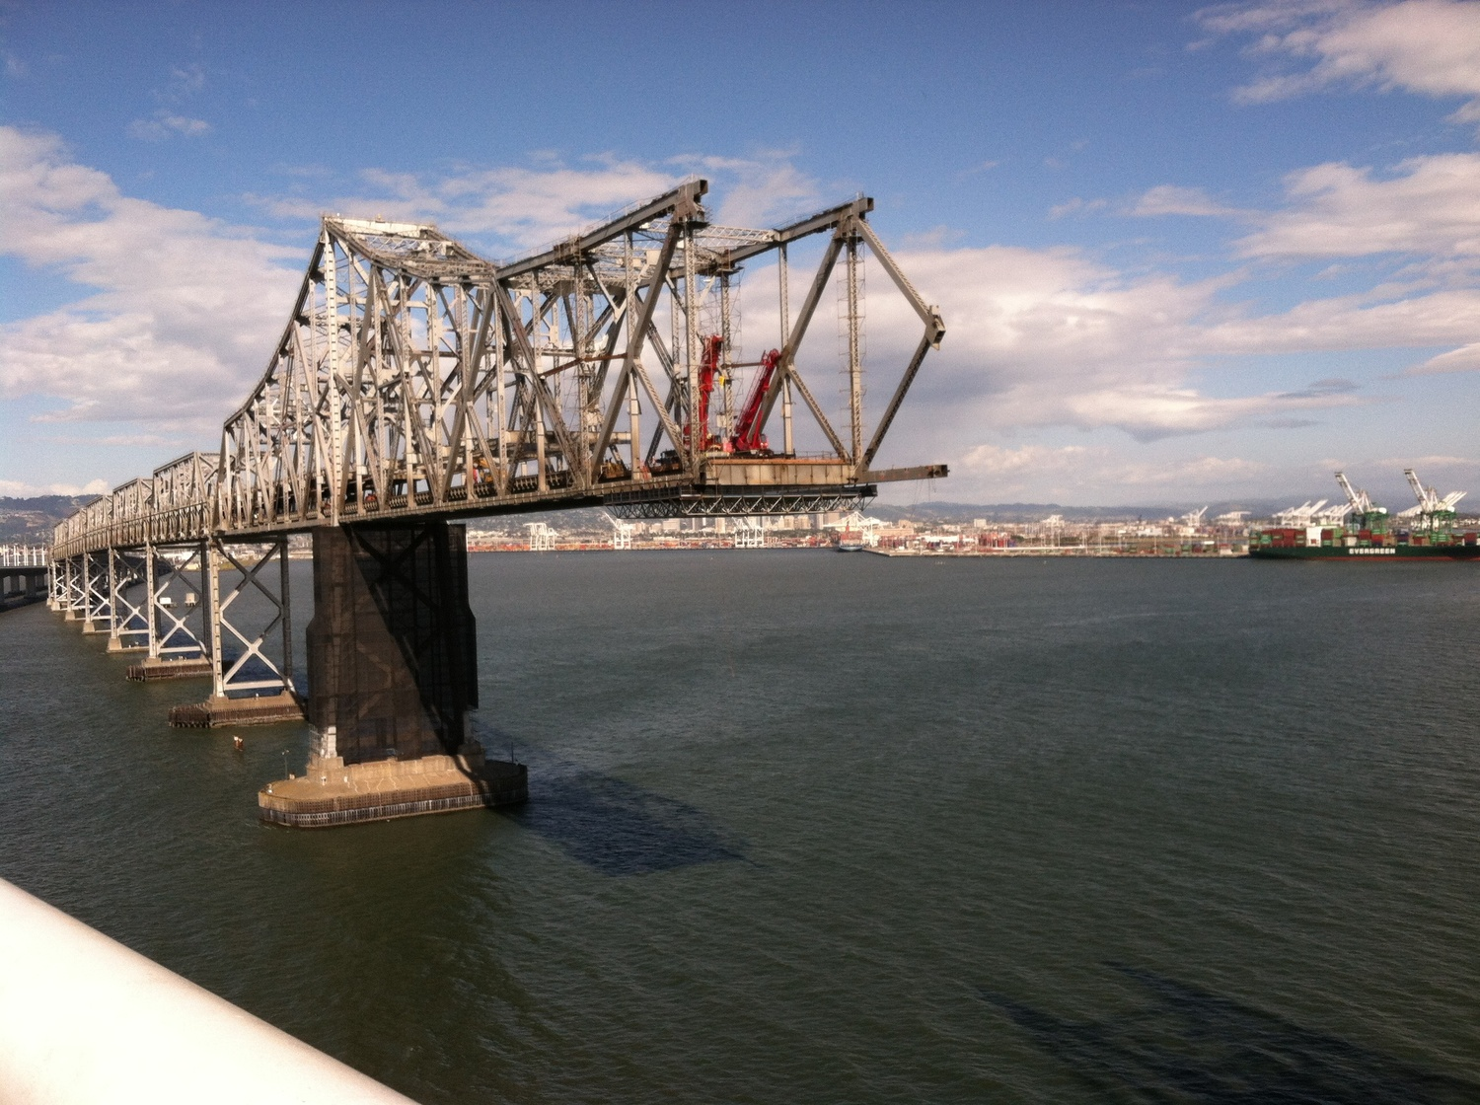
Notes:
A bridge that doesn’t completely get to the other side
The good news of Jesus is this bridge that gets us from death to life
From defeat to victory
But sometimes we say yes to new beginnings but then don’t know what the next steps are.
So today we want to focus on the complete bridge –
The beginning and the completion of this bridge
And we want to do it with these three passages of scriptures on page 4
But before we do – let me give you the big idea of this message
ITS THIS
So let’s read these scriptures that tell us all of what this new life includes

Slide 5
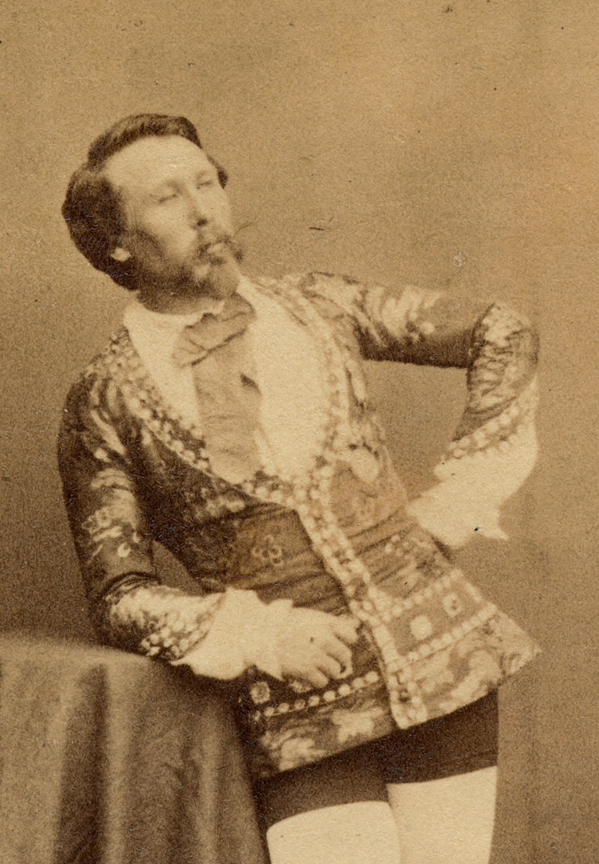
God’s new life of victory is completed in us when we live out His promises by faith and with others
Notes:
So let’s read these scriptures
[Read Scriptures]
Prayer – don’t just give people a new beginning
Give them the truth to a complete life of joy and victory today

Slide 6
Exodus 6:6-8 God’s Four Promises For Those Who Trust In Him (and what we should do with them)
Notes:
The passage in Exodus 6 show us four promises that God makes to anyone who will have trust in him
These Four Promises are the four parts to the bridge that get you all the way from defeat to victory
Without them – your new life
– turns into a road going no where
Or a bridge that doesn’t get all the way across
Without all 4 / the victory of Christ will never fully connect and arrive in:
your marriage, parenting, career, addicitions, or discouragements
These four promises were given to God’s people all the way at the time of Moses and they are still God’s promises today

Slide 7
1. God promises SALVATION We must choose to . . .
[Exodus 6:6] “Therefore, say to the Israelites: ‘I am the Lord, and I will bring you out from under the yoke [control] of the Egyptians.
Notes:
God’s people had 400 years of cruel slavery under Pharaoh In Egypt
And God sees their misery and pain
– enemies destroying their life: suffering, pressure, sin
Send Moses with a promise
“I will bring you out”
The first promise God makes to those who trust in Him is SALVATION
God did it for the Jews – he promised to bring them out from being slaves to being sons & daughters
When we trust in Christ
God promises to save us / rescue us from the death and power AND CONTROL of slavery
Jesus does this for us the instant we believe.
A matter of fact Heb 7:25 says . . .

Slide 8
1. God promises salvation. We must choose to KNOW JESUS
“Jesus is able to save completely﻿ those who come to God through Him, because He always lives to intercede for them.” (Heb 7:25)
Notes:
Read Heb 7:25
So our step / our mission in life should be to know Jesus
Jesus lives to help me!!!
He doesn’t need my help to do it!
He just needs your permission / decision / desire to know him
Over 35 people have chosen to do that
Someone here today – you need to do that
You feel trapped, lost and in the dark –
Just ask him by faith, with the support of those around you – rescue me
THE FIRST PART OF THE BRIDGE – KNOW JESUS

Slide 9
2. God promises FREEDOM We must choose to . . .
“I will free you from
being slaves to them”
[Exodus 6:6]
Notes:
God sent Moses with a second promise
To not just bring them out . . . save them
But free them from the slavery they are experiencinig
So its possible to be saved but not free
You can faith in God and still be in slavery to some sin or fear or pain in your life
Some people never get past the first part of the bridge
It’s not just about being saved – its about being free
Resurrection life begins in a moment – just ask God to rescue you
But God doesn’t just want to rescue you
He wants to free you from the sin that controls you
[those habits and patterns, insecurities and fears that control your behavior]
That takes time like it took time to free the jews from the actual slaveowners – 10 plagues
But also the thinking like a slave – 10 commandments
Freedom – is a process of no longer being around the sin that destroys you
And then learning how to stop thinking like a slave who doesn’t know how to live without the sin
What’s the difference?
Saving is a changing of whose you are
Freedom is a changing of who you are
Church – sanctification / Set you apart from sin
Salvation – we know how much we are loved
Freedom -is God loving you enough to change what’s broken
That takes time (a process)
Last week – I did like a lot of us do and hide this part of my life
Last year – dressed in a suit coat, tie and dress pants
This is what was broken in me

Slide 10
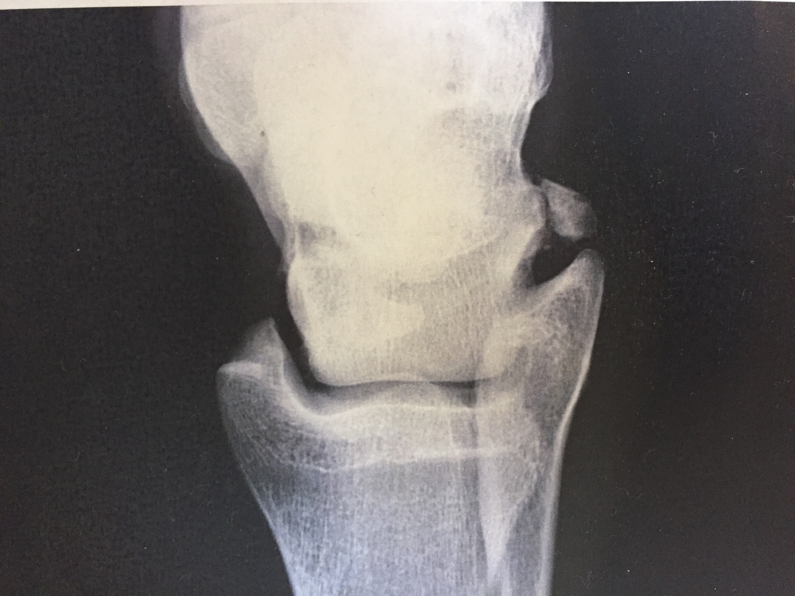
Notes:
The Monday before Easter/Resurrection – sprained my ankle playing basketball
Got an xray and they discovered this
Broken piece of bone – that’s been there for years
Supposed to wearing this
This would help my bone to heal / and give me the freedom to play again
But I did what a lot of us did / I hid my hurt
I didn’t want you to see this / I didn’t want to have to explain
Half the guys – claim they were the one who did it
So instead of finding healing and freedom
I just hid my brokenness
Most of us do this in church
We don’t want people to see it
Explain it / to be judged / to be thought less than
I hide your hurt and you hinder your healing (freedom)
So you do what I do – broken on the inside – never show it at church

Slide 11
2. God promises freedom. We must choose to FIND FREEDOM
“Jesus replied, ‘I tell you the truth, everyone who sins is a slave to sin. . . .So if the Son sets you free, you will be free indeed.”
Notes:
God offers us healing / freedom
We have to choose to find it – look for it / go after it – even if it causes people to see
Jesus (john 8) has offered to set us free – we have to find it
And since the church is the body of Christ – we have to do LIFE TOGETHER
Small groups

Slide 12
Sun 8:30a Men’s Group
Empty Nesters
Women’s Prayer Group
Sun 9:45a Victory Life Group
Tues 10:00a Young Moms Bible Study
Wed 7:00p Bondage Breaker
Marriage Class
Connecting To Cornerstone
NEW
Notes:
By going – saying I want to grow
Going is confessing - more

Slide 13
3. God promises REDEMPTION We must choose to . . .
“and I will redeem you with an outstretched arm and with mighty acts of judgment.” [Exodus 6:6]
Notes:
Now those two steps are great but there is more
This bridge isn’t complete
Some Christians get stuck on freedom but there is more!
God promised his people
He wouldn’t just save them, free, them – but restore them
I will redeem you
– put you back to the original intent – original purpose
make a purpose is (restoration)

Slide 14
3. God promises redemption We must choose to DISCOVER OUR PURPOSE
“[Psalm 57:2] “I cry out to God Most High...who fulfills his purpose for me”
Notes:
/ 87% of church do you know why you are on this planet – no? 1 cor 12 – part of the body
Imagine i87% of your body didn’t know its purpose
Outstretched arm – pull you up to greatness (psl 35)
Attack the plan of the devil on your life
WE DO THIS TOGETHER
Connecting to Cornerstone an important start

Slide 15
4. God promises FULFILLMENT We must choose to . . .
“I will take you as my own people,
and I will be your God.”
[Exodus 6:7]
Notes:
We are saved, freed and redeemed
But the bridge isn’t complete until this one
God promised his people
He wouldn’t just save them, free, redeem them – but complete their purpose (always with others)
I will take you as my own people (plural)

Slide 16
4. God promises fulfillment We must choose to . . . MAKE A DIFFERENCE
[John 10:10] “The thief comes only to steal and kill and destroy; I have come that they may have life, and have it to the full.”
Notes:
ONLY HAPPENS TOGETHER
I will take you as my own people (plural)
– make a difference only with others (fulfillment)
- This is life!!!!!
- This is where life is fun, amazing, ama
True life – ends together
(Sermon series)

Slide 17
- Know Jesus - Find Freedom - Discover Purpose - Make A Difference
BY FAITH
Notes:
[

Slide 18
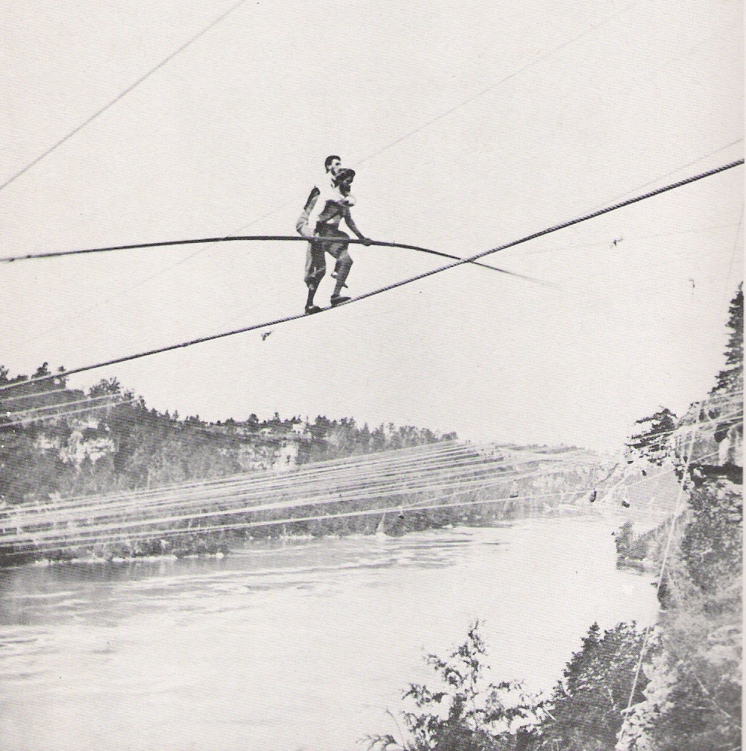

Slide 19
- Know Jesus - Find Freedom - Discover Purpose - Make A Difference
Together!
Notes:
now Jesus – help get people across!
Find freedom – encourage you to go to a class/group
Purpose/Difference – Connecting To Cornerstone
Know Jesus – Spanish flyers – help someone know him / 10%
Know Jesus – you first

