Slide 1
Notes:
Welcome to Resurrection Sunday!
So glad you are with us for one of the most important messages of the year
Focusing on resurrection of Jesus from the grave is what separates Christianity from every other religion and is the heart of God’s good news (the gospel) that has absolutely changed all of our lives and billions around the world.
To most people resurrection Sunday is more commonly referred to as Easter
In church circles a lot of discussion of whether we like that or not
But the truth about easter is this:
Easter is the day we remember the greatest battle ever fought
against the greatest enemies you and I will ever face
Easter is about victory – but we can really get distracted by so many other things
A lot people just celebrate it as a beginning to spring
Others make about family traditions
I don’t know how many easter egg hunts you’ve see advertised over the past two weeks
[I don’t recommend going to this one]

Slide 2
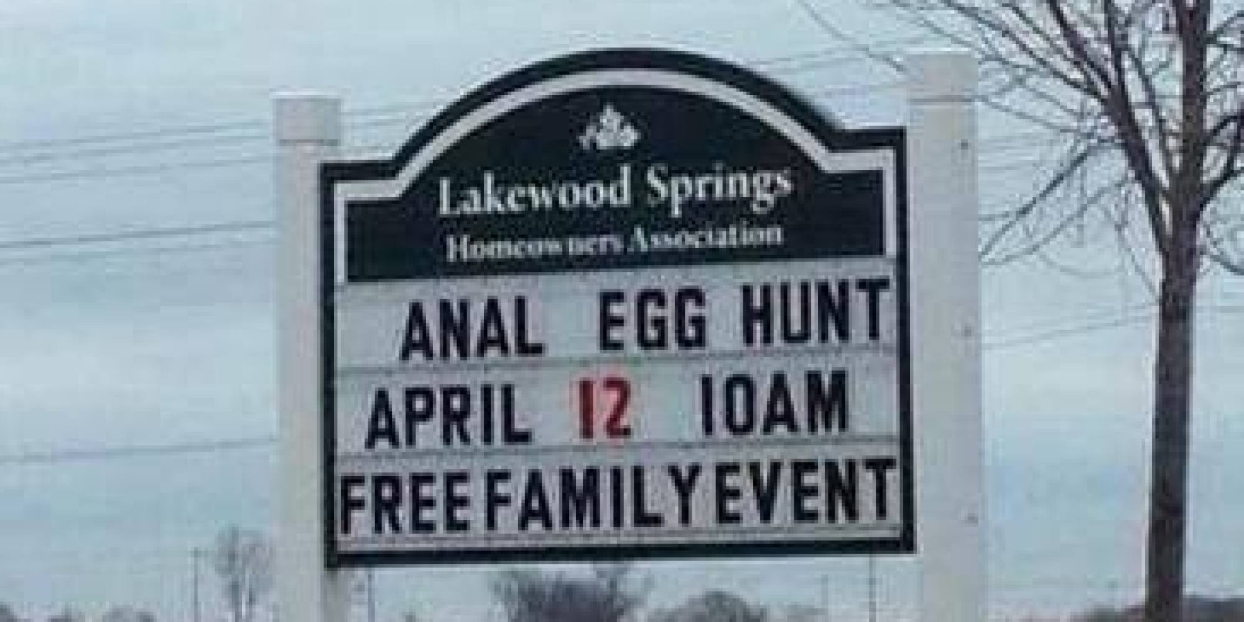
Notes:
Of course you could make it new outfits
And family photos with the easter bunny
But then again . . .

Slide 3
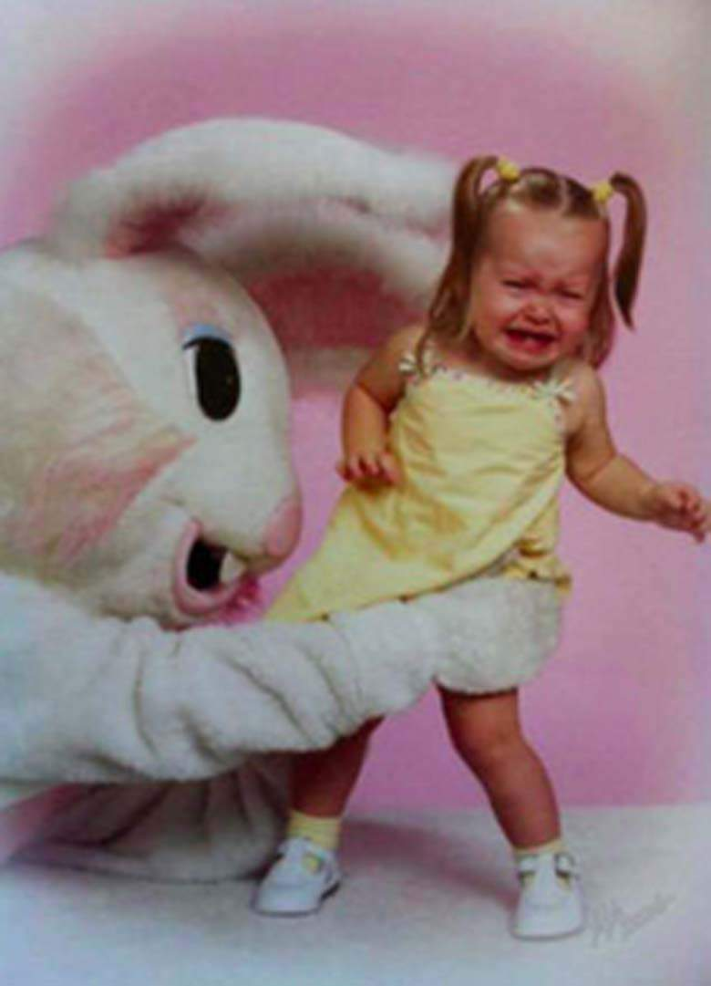
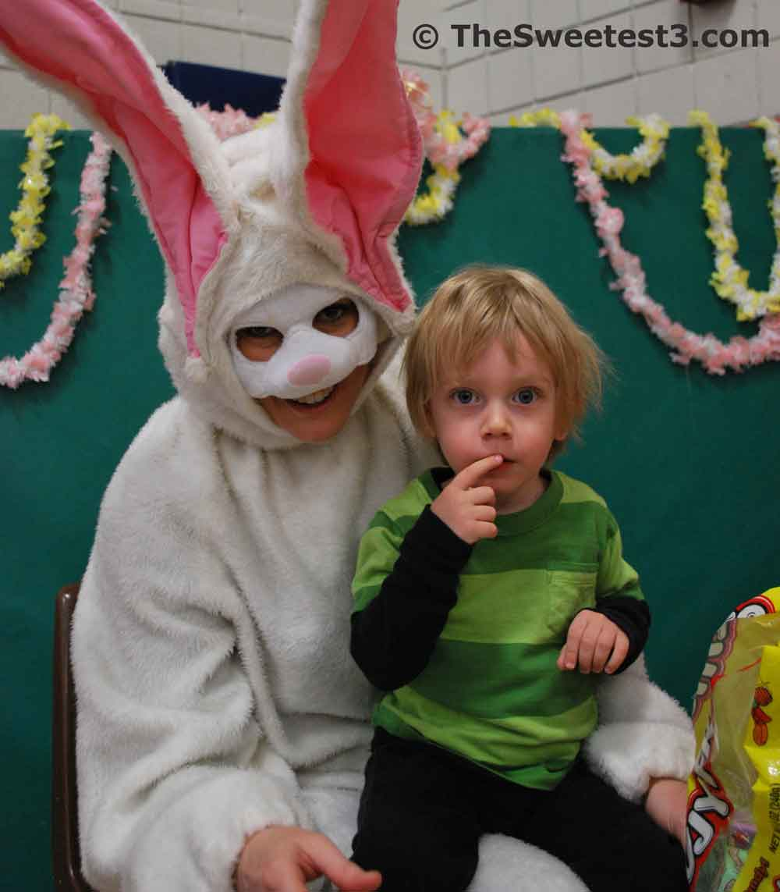
Notes:
Especially if he’s creepy
Well we could also celebrate easter because of the candy
[change slide]

Slide 4
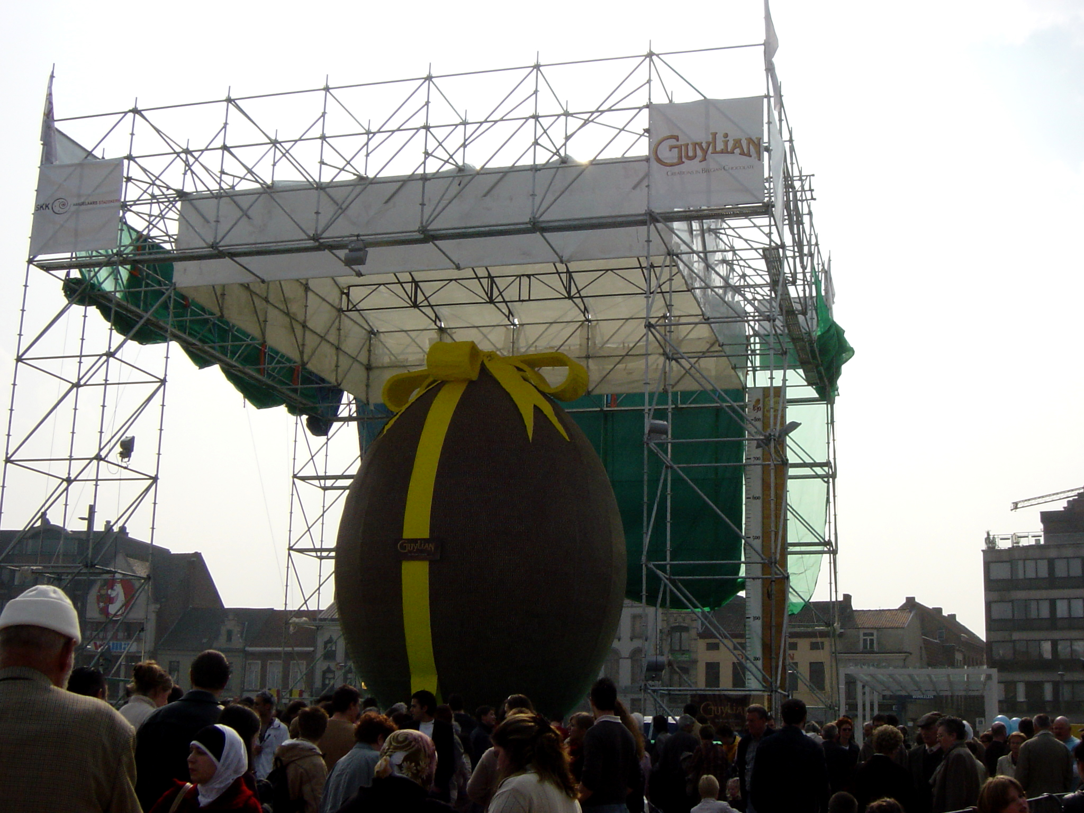
Notes:
Who doesn’t want an chocolate easter egg that ways over a thousand pounds
Or

Slide 5
Notes:
Or These famous Just Born Peeps - Easter chicks
Which have enough sugar in them to almost literally raise the dead
There are a lot of reasons to celebrate easter

Slide 6
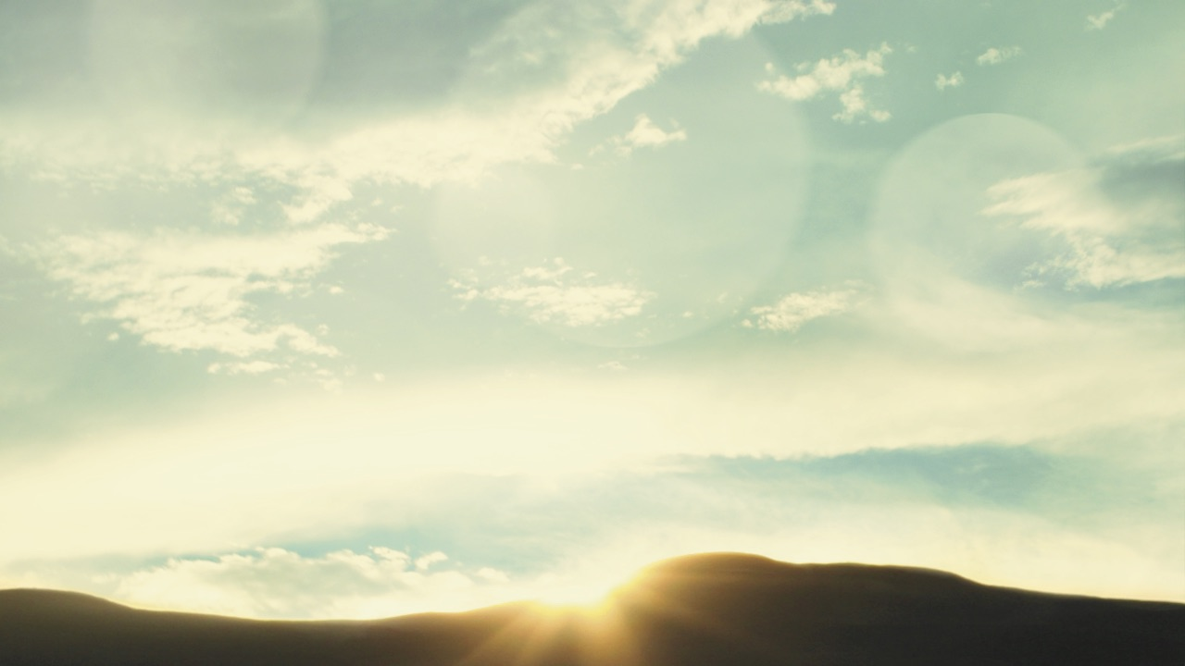
Why We Celebrate
The Resurrection
is our good news
that our great God
defeated our worst enemies
Notes:
What the world calls Easter is really about this [slide]
And more than something to celebrate one day a year
Its something that we should change the way we look at life
And the power of how we live every day of the year.
So read these Scriptures on the front of your handout with me
And look why the resurrection is all about victory for us and this broken world
[Read Scriptures] / Say out loud the bold italicized words
[Prayer]
Father in Heaven, in the middle of our broken and fearful world
And in the middle of our busy and often stressed out lives
Bring us the victory you have for everyone and over everything that would cause death in our lives.
Let today be a day that we don’t just celebrate resurrection but experience it.
The resurrection is the good news we all long to here
Based in the reality of pain and sin we all know exists in this world

Slide 7
Realistic & Supernatural Good News!!!
AT THE CROSS:
Jesus faced the enemies of this life.
AT THE RESURRECTION:
Jesus overcame them by God’s Spirit.
BY FAITH IN JESUS:
We have the same Spirit and victory.
Notes:
This is the good news
Why we celebrate
That every enemy of life that can destroy our lives
Jesus has faced and overcome
And the good news is – that victory can be ours
Last time you were waiting to hear good news?
High school
College job
Kate
When was the last time, you were desperate for good news
For news of victory instead of defeat.
Easter tells us
Jesus has faced everything enemy of this life
And wherever you feel defeated and discouraged –
Resurrcetion victory can come!!!
So let’s look at the enemies faced at the cross and overcome at the resurrection

Slide 8
Four Victories of The Resurrection
“But he was pierced for our transgressions, he was crushed for our iniquities; the punishment that brought us peace was on him, and by his wounds we are healed.” [Is 53:5]
Notes:
On the cross,
Jesus faced the greatest enemies of this life
and destroyed them for you and me
He won victories over the things that trouble you the most today
Look again at Isaiah 53:5

Slide 9
Victory over suffering (that weakens the body)
“by his wounds we are healed”
“But Pilate had Jesus flogged”
(Matthew 27:26)
Notes:
On the cross, Jesus faced suffering – overcame it by the Spirit
Jesus faced the enemy of suffering / at the resurrection had victory over it
We read that one sentence – but can never really imagine the torture of his wounds

Slide 10
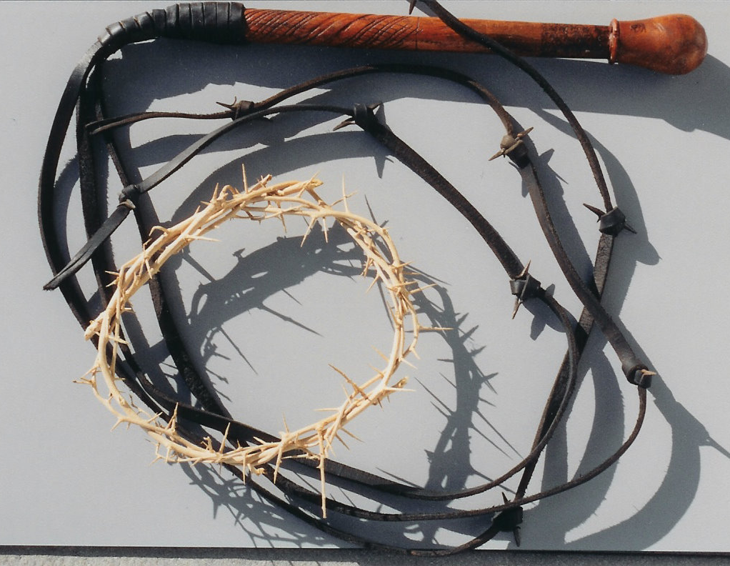
Sickness that weakens the body
“by his wounds we are healed”
“But Pilate had Jesus flogged”
(Matthew 27:26)
Notes:
Verberatio (Ver-ber-achtio)
WHIP OF 9 LEATHER STRANDS
- Glass, barb wire, bone, rock
Soaked in water
39 lashes
Two hands pull down
13 lashes acroos right trapezius
13 across left
13 down the spine
Jesus faced suffering at his resurrection & overcame it
Suffering didn’t stop him from completing his mission
Suffering didn’t define his future
So many look at the suffering of this world – WHERE IS GOD?
He is in the midst of it
Pouring out His Spirit to overcome it
Not to be indifferent in it – but to make a difference in it
Not just to survive but love others through it
Jesus has faced and defeated suffering by His Spirit
He had a resurrection that is yours today

Slide 11
Victory over circumstances (that worry the mind)
“the punishment that
brought us peace was on Him.”
“twisted together a crown of thorns”
(Matthew 27:27)
Notes:
On the cross, Jesus faced an overwhelmed mind – overcame it by the Spirit
Jesus faced the enemy of circumstances / and had victory over it
Pratetorium – punishing him
Crown of thorns
[Hand out]
4 inch thorns
Blood rushes to the center of the brain
Causing pressure beyond what you can imagine
Migraine of all Migraines
Jesus faced a mind filled with pressure and absent of peace
And by the Spirit – He had victory over it
In His resurrection, his first words to the room of disciples were this

Slide 12
“Jesus came and stood among them and said, ‘Peace be with you! . . . . As the Father has sent me, I am sending you.’ ﻿And with that he breathed on them and said, ‘Receive the Holy Spirit.’” (Jn 20:19,21-22)
Notes:
True peace isn’t because of circumstances
It’s because of the Spirit of God in you
You don’t need to escape from pressure
You need to be filled with a power
Today – if your greatest enemy is the worry in your mind
The resurrection is your good news
Today, God wants you to look at him and trust in Him
Jesus took the punishment & pressure to bring you peace

Slide 13
Victory over sinful nature (that dominates our hearts)
“He was crushed for our iniquities”
“there they crucified Jesus”
(Luke 23:33)
Notes:
On the cross, Jesus faced our sinful nature and overcame it – by the Spirit
He faced our greatest enemy – the one that is in us – our sinful nature
Iniquities are not the sins we commit – it’s the sin in us
Jesus was CRUSHED for it / that’s what crucifixion is
It wasn’t the blood loss – suffocation
The nails in his hands – excruciating
The nails in his bent legs – cruel
The crushing of his lungs – deadly
- Muscles to breathe give out
SIX HOURS
He was crushed for OUR iniquities
Bible: Spirit & breathe the same thing
Picture is we are born with a sinful nature into a sinful world that crushes God’s spirit in us
Sometimes in our culture, people want to say our sin is how we are born
They argue some people are born this way. Some born that way.
The Bible says – 100% of us are born the wrong way
100% of us are born with a sinful nature
That destroys what real love and real life are supposed to be
The bible says – the true spirit of god in us has been crushed by sin
So when you say to yourself, I’ll never change
When you say to yourself, there’s no use in trying
When the world tells you there is no hopr
You can say these words

Slide 14
“I have been crucified with Christ and I no longer live, but Christ lives in me. The life I live in the body, I live by faith in the Son of God, who loved me and gave himself for me. I do not [and will not] set aside the grace of God” (Ga 2:20-21)
Notes:
Jesus faced what crushes you – and rose again over it
You can too
Loud and clear to you today – THERE IS HOPE
By the grace of God you are more than who you have been
You are more!!!
Your marriage is more!
Your family is more!!!
Your future is more
Its not a nice thought – it’s a fact that this world can’t receive but can see in you!

Slide 15
Victory over sin & guilt (that destroy relationships)
“He was pierced for our transgressions”
“the soldiers pierced Jesus’ side with a spear, bringing a sudden flow of blood and water.” (John 19:34)
Notes:
The good news of Jesus
Is that he faced your enemy of guilt over what you have done
YOUR TRANSGRESSIONS
And he overcame it so you can too
He faced it on the cross and defeated by the Spirit – in the resurrection
We think of pierced – usually think nails
Only Bible use – SPEAR
We think spear – as a way to check that he was dead
No it was to insure he was dead
Spear up and under the ribs to the heart
To a heart that was under so much stress
That water built up on it, overwhelmed it, ruptured it
Jesus literally died of a broken heart
It wasn’t the suffering, the pressure, the crushing
It was that sin kept him from you
It was a broken heart
His heart stopped so yours could start
And medical doctors will tell you – one of t

Slide 16
“I will give you a new heart and put a new spirit in you; I will remove from you your heart of stone and give you a heart of flesh. ^{﻿27﻿} And I will put my Spirit in you”
Eze 36:26-27
Notes:
We all have sin that has destroyed our relationships
That have left us with guilt
That caused our heart to become like stone
Jesus faced your worst guilt – forgiven
Faced your enemies – and said start again
Saw your heart,, stopped his so yours could start again
Can’t think of a better person to show you that then my daughter Kate
The one who the doctors said shouldn’t breathe again
But who, nine weeks later – found no bubble, no problems, just good news

Slide 17
Kate Dance

Slide 18
“Don’t be alarmed,” the angel said. “You are looking for Jesus the Nazarene, who was crucified. He has risen! He is not here [in defeat]. See the place where they [his enemies] laid him.” Mk 16:6
Notes:
On the cross Jesus faced your greatest enemies
Those enemies thought they defeated him
They thought they placed him where they wanted him
The resurrection is the shout – victory
You don’t have to stay where your enemies have placed you
You have a promise – a promise of a new heart and new spirit

Slide 19
“everyone who has new [resurrection] life from God overcomes the world. And this is the victory that has overcome the world—our faith. Who is it that overcomes the world except the one who believes that Jesus is the [resurrected] Son of God?” (1 Jn 5:4–5)
Notes:
What is faith?

Slide 20
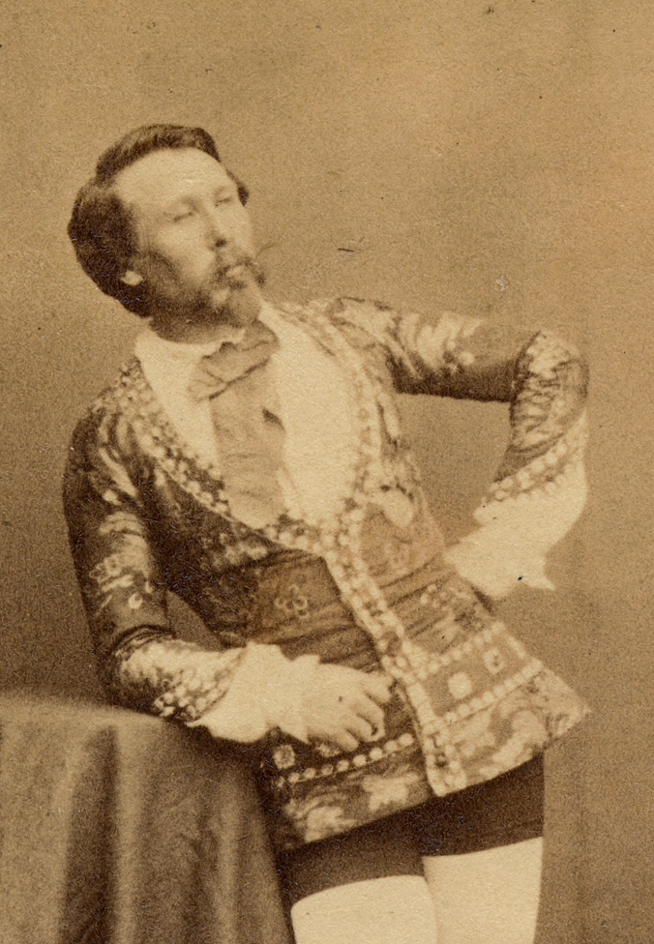
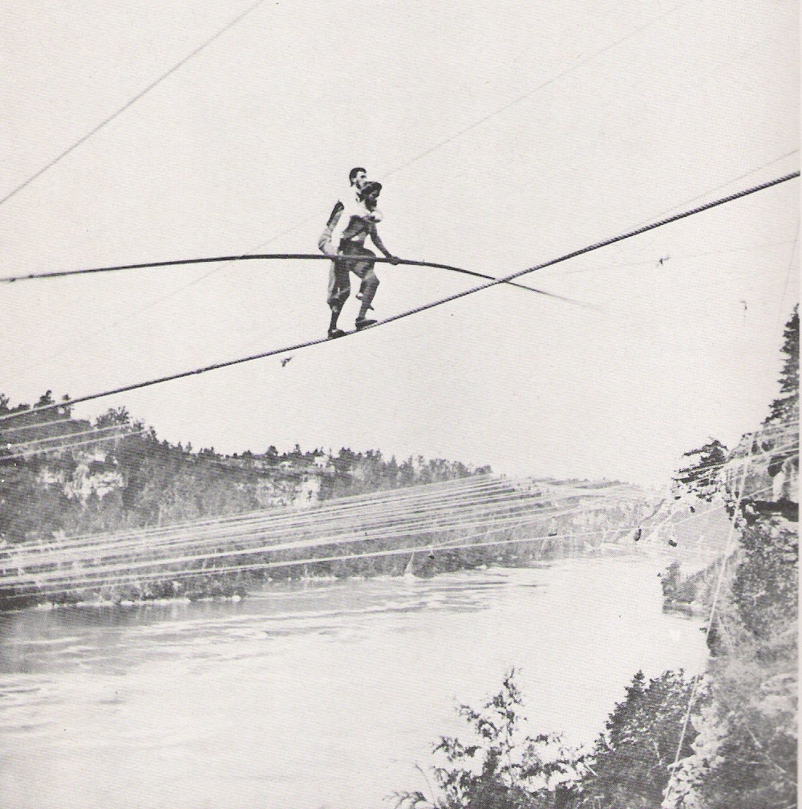
Notes:
Blondin

Slide 21
Today’s Survey
[A] I’m Already believe in Jesus and want to live in his victory more
Notes:
Renew ur faith in his victory or begin for the first time

Slide 22
Today’s Survey
[B] I would like to Begin a true and saving relationship with Jesus today. I choose to believe in Jesus today.
Notes:
Mention who did it in service before

Slide 23
Today’s Survey
[C] I will Consider The Gospel more but I’m undecided about Jesus today

Slide 24
Today’s Survey
[D] I Don’t ever want to make a decision to believe in Him as my savior

Slide 25
Today’s Survey
[A] Already believe
[B] Begin today
[C] Consider but undecided
[D] Don’t want to believe
Notes:
Let’s take this time to not just celebrate it but let it in.
Pray
Lord, do this now / show your good news to hearts no matter how
Suffering, pressure, wickedness, or guilt have overpowered us
Set people free today – to live in your new life and victory
You’re going to make that decision –
Honest: God, yourself, one other
Celebrate
If you are believer – new victory today
But let’s not stop there – let’s believe for the resurrection to change circumstancecs today
Call up / Donna & Don Magee
Call up / Jamal (Sabrina) Riley, Director of Chester Y
Call up / Brittney & Mary – Director & Community leader

