Slide 2
Luke 2:8-10
And in the same region there were shepherds out in the field, keeping watch over their flock by night. ⁹ And an angel of the Lord appeared to them, and the glory of the Lord shone around them, and they were filled with great fear. ¹⁰ And the angel said to them, “Fear not, for behold, I bring you good news of great joy that will be for all the people.

Slide 3
Hope In Unlikely Places
Main Idea: The local church is the primary way God shows the world that Jesus is for them.
Question: How can I be the “hands and feet” of Jesus extended to a broken world?

Slide 4
Luke 4:18
"The Spirit of the Lord is on me, because he has anointed me to proclaim good news to the poor. He has sent me to proclaim freedom for the prisoners and recovery of sight for the blind, to set the oppressed free, to proclaim the year of the Lord's favor.

Slide 5
Our prayer should always be: “Lord make me like Jesus”

Slide 6
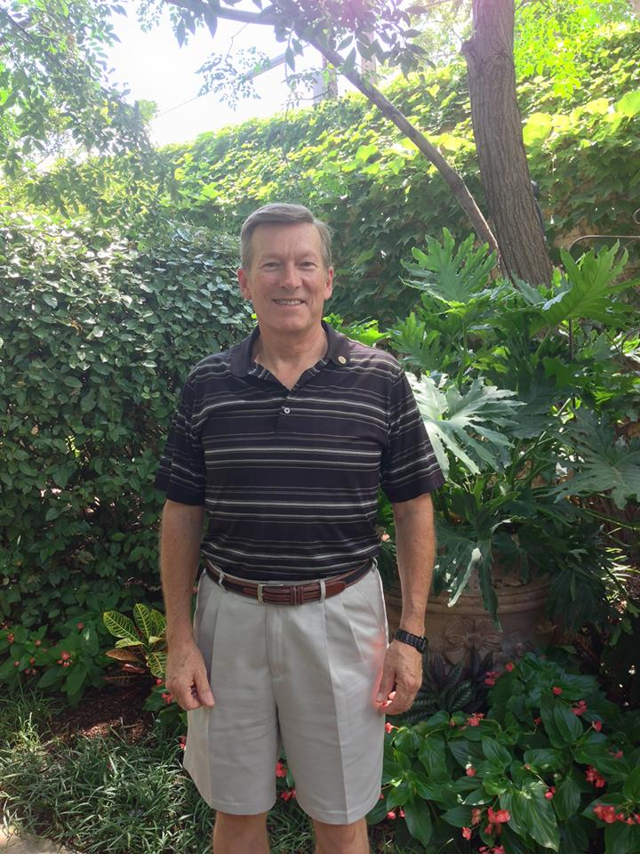
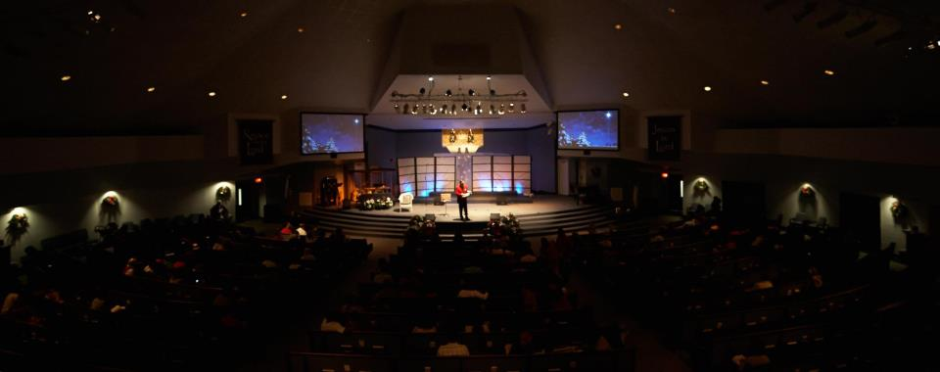

Slide 7
¹ Soon afterward, Jesus went to a town called Nain, and his disciples and a large crowd went along with him. ¹² As he approached the town gate, a dead person was being carried out—the only son of his mother, and she was a widow. And a large crowd from the town was with her. ¹³ When the Lord saw her, his heart went out to her and he said, “Don’t cry.”¹⁴ Then he went up and touched the bier they were carrying him on, and the bearers stood still. He said, “Young man, I say to you, get up!” ¹⁵ The dead man sat up and began to talk, and Jesus gave him back to his mother.
¹⁶ They were all filled with awe and praised God. “A great prophet has appeared among us,” they said. “God has come to help his people.” ¹⁷ This news about Jesus spread throughout Judea and the surrounding country.

Slide 8
We are to go where the pain is and LOOK for the hurting.
Jesus focused on the pain before the ­­­problem.

Slide 9
2. We are to have compassion toward the hurting.
Compassion is allowing others hurt into your heart.

Slide 10
3. We are to be moved with actions to those who are hurting.

