Slide 2
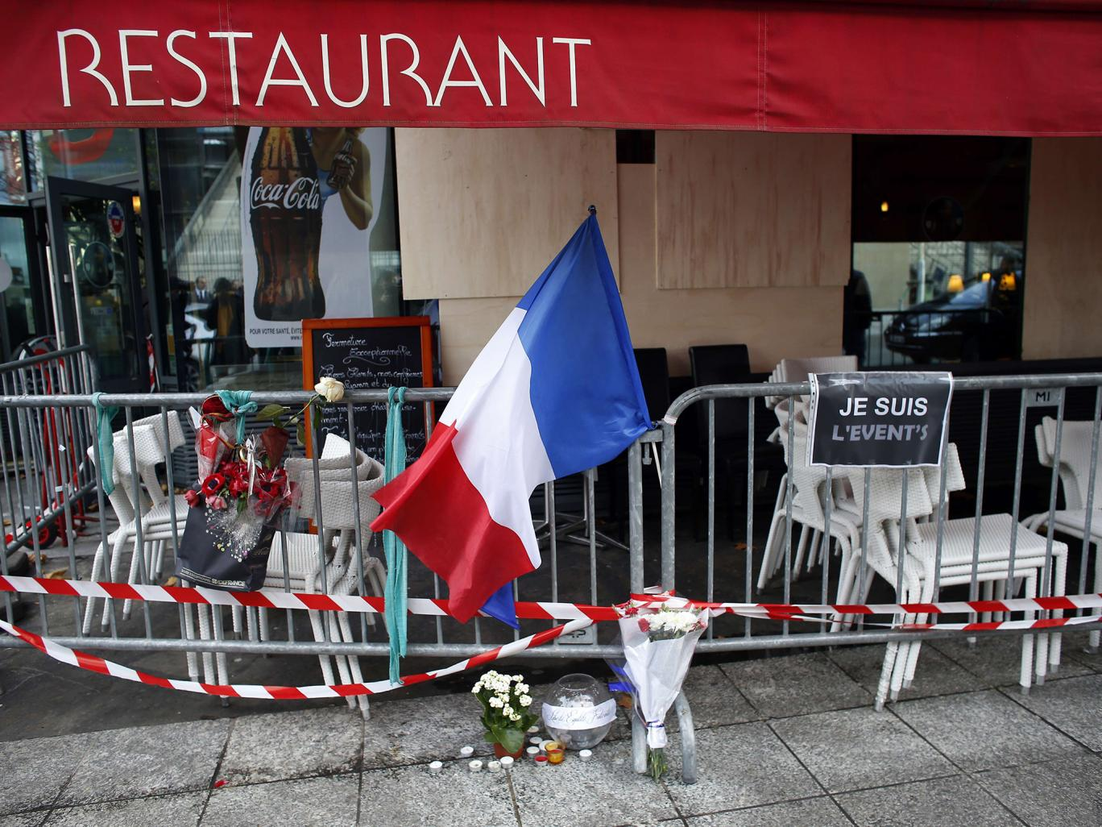
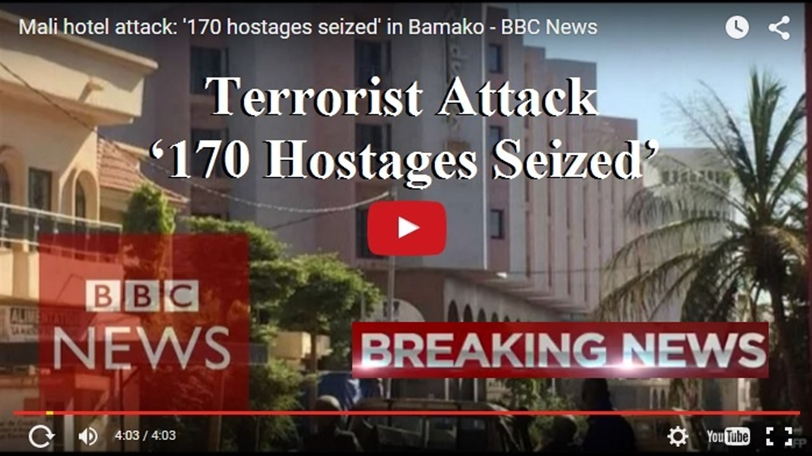

Slide 3
WHY is church so important?
Because Jesus uses groups of people filled with faith to bring His healing & peace to others

Slide 4
How does the church bring His healing?
Carrying people in their weaknesses
Tearing down the barriers to Jesus’ work

Slide 5
How?
Everyone needs 3 or 4 people who
- are filled with faith in Jesus
- know when you’re paralyzed
- give time to carry you to Him

Slide 6
How does the church bring His healing?
Carrying people in their weaknesses
Tearing down the barriers to Jesus’ work

Slide 7
Breaking Barriers - 2015 Advent Offering
$12k – Project Hope Clinic Upgrace / Ethiopia
$11k – Project Hope Clinic Salaries
$10k – CRC Director / Jeff Davis Corridor
$4.5k – Bensley, Ecoff & Salem Elementary
$2.5k – Convoy Of Hope / South Carolina Recovery
$1k – Kairos Prison Ministry / Central VA
Many more

Slide 8
How?
Together we give like the Father gave so we can “make openings” for the hurting to go through and experience Jesus’ work

Slide 9
What causes the healing?
The Gospel – that people’s sin can be forgiven
At one time you were separated from God. You were his enemies in your minds, and the evil things you did were against God. ^{﻿22﻿} But now God has made you his friends again. He did this through Christ’s death in the body so that he might bring you into God’s presence as people who are holy, with no wrong, and with nothing of which God can judge you guilty. - Col 1:21

Slide 10
What?
Social justice without spiritual justice
Is eternally and tragically incomplete.

Slide 11
What will you do?
If you’re paralyzed & isolated
Will you connect to the healing God has for you?
If you’re whole and connected
Who are you carrying and how will you give?
Great Commission Home:
When will you intercede this week for the hurting?

