Slide 1
Notes:
Video – who Jesus is to you matters.
At Cornerstone, we know that Jesus is the center & source of everyday life
We know He is Lord & Savior and so much more.
But Jesus also told us in the Great Commission to go and make disciples.
He told us to make sure other people know who He is – in our homes and in our community
In our private and public lives
And in Matthew 16 – at the very peak of the popularity and power of Jesus ministry
Jesus asks his disciples both a very public and a very private question about who He is
It’s a question about home and community that Jesus wants to ask us today
Look at it with me
[next slide]
And who Jesus is to the world around you matters too
A year of making disciples that starts in our homes but ends in our community – the world around us
We want this school year at Cornerstone to be a year of discipleship in private places of our home and public places of our county
This relationship between home and the world is in the Great Commission
The disciples are in home town of galilee and they are told to go make disciples of all nations
In Matthew 5, Jesus says a city on a hill can’t be hidden to the world around them
and also a person in the privacy of their house shouldn’t hide their light under a bushel

Slide 2
When Jesus came to the region of Caesarea Philippi, he asked his disciples, “Who do people say that I, the Son of Man, am?”
^{﻿14﻿} They replied, “Some say John the Baptist; others say Elijah; and still others, Jeremiah or one of the prophets.”
^{﻿15﻿} “But what about you?” he asked.
“Who do you say I am?”
[Mt. 16:13-15]

Slide 3
^{﻿16﻿} Simon Peter answered, “You are the Christ, the Son of the living God.”
^{﻿17﻿} Jesus replied, “. . .﻿ on this rock I will build my church, and the gates of Hades [or Hell]﻿ will not overcome it.﻿﻿ ” [Mt 16:16-18]
Notes:
Jesus, at the height of his popularity and power
Prepares the disciples to get on mission with him as he goes on the cross
Up to this point, the disciples are just rock stars on a rock star tour with Jesus
Every place jesus goes – the crowds follow, the sick are healed, the Pharisees are defeated and miracles happen
The crowds love Jesus and want to make Him king
The Pharisees hate Jesus but they can never win against him.
The disciples are living the good life – with Jesus they are undefeated and never in want
And Jesus pulls them to this story – to get their minds out of the clouds and their feet on the ground
He wants them to live for heaven but avoid being no earthly good.
Jesus hasn’t called the disciples to a popularity parade and a rock star tour.
They’ve got to get on mission with him.
They’ve got to remember what being with him is all about
And so before Jesus asks them about their private understanding of Him
He wants them to get real about the public’s understating of Him
And that’s when He asks the question in verse 13
“Who do people say that I, the Son of Man, am?”
[next slide]

Slide 4
Jesus’ first missions question
for His disciples:
Who do the people around you
say that I am?
Notes:
When Jesus wants to get his disciples on mission
This is the first question Jesus has for His disciples
Jesus expects them to know this answer.
Peter, James and John – you see the crowds around me – but what does it mean
Am I just a free meal to them?
Am free healthcare to them?
Am I just a way for the poor to stick it to the rich?
Am I a way for religious people can control people who don’t believe?
Peter, James, John, Andrew, Judas . . .
Who do the people around you say that I am
Because their souls, eternities and their families depend on that answer
And Philip, Barthalomew, Thomas . . .
After you answer who they say I am then tell me this:
Do you know who I am
Because If you don’t know – then how can you tell them
And so Jesus – with His life about to head to Jerusalem and the cross
Confronts the disciples with this first question
A question that He expects them to have an answer for
A question that Jesus expects every disciple on mission with Him to have an answer for
But the power and revolution of what Jesus is doing in this moment isn’t just about the question
[next slide]

Slide 5
The Point Of Matthew 13:13-16
It’s not only WHAT Jesus is asking
It’s WHERE Jesus is asking it!
Notes:
The power and mission of what Jesus is doing
Isn’t just what Jesus is asking the disciples!
IT’S WHERE HE IS ASKING THE DISCIPLES THAT QUESTION!

Slide 6
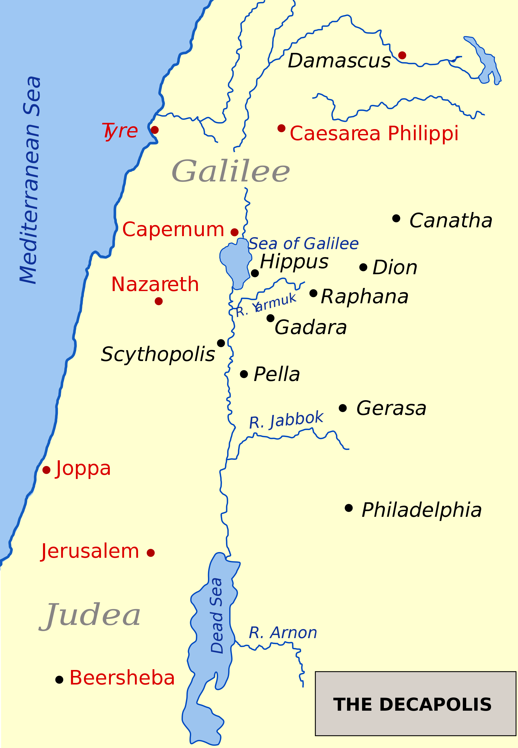
Caesarea Philippi
25 miles north of Sea of Galilee
At the foot of Mount Hermon
Upper Galilee region
Almost entirely pagan city
Center of cult worship
Notes:
Matthew 16:13 says they are in caesaria philippi
At the height of Jesus popularity around his home area of the Sea of Galilee
And at the height of his confrontation with the Pharisees of Israel
Jesus takes the disciples practically outside of Israel
Outside of the jewish life and acceptance of Judaism
Jesus takes the disciples 25 miles north to this pagan city
This place that in classic civilization was a center of cult worship
Because Jesus choice of words, give away the exact location of where He is at Matthew 16
Jesus isn’t at some small synogue in the middle of this pagan city
He isn’t out in outskirts in a field or in the mountains beholding God’s creation
No this is exactly where Jesus has taken His disciples
[next slide]

Slide 7
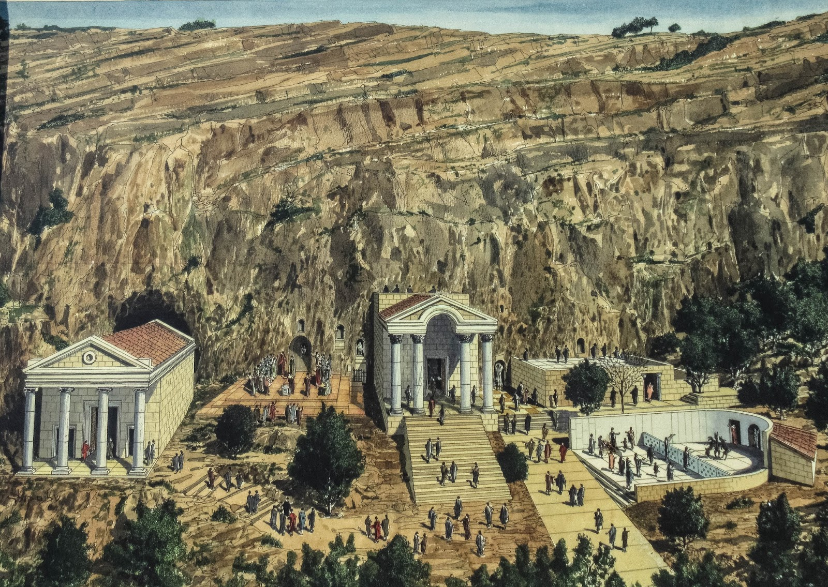
“At the time of Jesus the Temple of Pan, stood imposingly over the entrance to the cave, known as ‘The Gates Of Hades.’ It was believed to be the entrance to the underworld and where the gods came out to reek havoc on man. At the front of the cave was an open altar perched at the brink of the abyss below. There pagan worshipers would offer sacrifices of all kinds” (Unfinished, p193)
Notes:
Jesus has taken them to what the ancients called Panius that is in Caesaria Philippi.
Jesus has taken the disciples to the center of cult worship to ask them who people say He is.
Jesus has taken them to the place known as “The Gates of Hades”
Notice the quote on the screen
When Jesus asked the disciples who he was and then stated that on the truth that He was the Christ He would build His church,
Jesus said these words “And the gates of Hades will not overcome it.”
The disciples were seeing this cave and knew what Jesus was referring to
Why is this where Jesus is having this conversation?
Why is this where Jesus is calling His disciples to know what those around them think of him?

Slide 8
Why does Jesus ask the question here?
Because that’s where He wants us to ask the same question of others
Notes:
Because that’s what the Great Commission mission is about
Jesus is the light of the world
He is the ruler over all things
And Jesus wants the disciples to remember that its not just about the crowds in the church
It’s about Jesus being known to people who are worshiping everything wrong and untrue

Slide 9
﻿“when I am lifted up from the earth
[on The Cross and people stop to see and think about how I gave my life for them] I will draw all men to myself.”
[John 12:32]
Notes:
Jesus wants the disciples to remember who He is and who they are.
He isn’t about the crowds who accept him and the people who treat him with respect
Jesus needs to be about the people who want to crucify him and the people who don’t accept him
Jesus needs those people to be asked – who do you think Jesus is?
And while the disciples in their own strength may be afraid to ask that question
Jesus is dying for them to ask that question
Because Jesus knows who he is and that all authority in heaven and earth will be his
As John 12:32 – he knows he can draw them if they will just take time to see him for who he really is

Slide 10
﻿When Jesus spoke again to the people, he said, “I am the light of the world. Whoever follows me will never walk in darkness, but will have the light of life.”
[John 8:12]
Notes:
As John 8:12 says,
Jesus knows he is the light – and he wants his disciples to be in dark places to shine Him
Jesus wants the disciples to ask those in the middle of pagan worship to ask – who do you think Jesus is?
Jesus wants his light to be seen and offered in the darkest places

Slide 11
﻿“You [plural/disciples] are the light of the world. A city [a gathering of homes shining my light] . . . cannot be hidden. ﻿^{15﻿} Neither do people [inside a home] light a lamp and put it under a bowl. Instead they put it on its stand, and it gives light to everyone in the house …. let your light shine before men” [Mt. 15:14-16]
Notes:
Jesus has the disciples in front of the Gates of Hades to remember that the Gates of Hades our powerless against His light and His love.
This is where His light and love belong.
That’s why in Matthew 15:14-16 Jesus has said
You, plural, disciples – you have the light for the darkest places
Together [everyone say the word together],
Together as a gathering of homes – you’re a city for all the world to see
But disciples, you can’t be hiding your light in your homes.
You can’t let the mission and meaning of Jesus be hidden in your home
You’ve got to make time to put who I am and what I want on a stand in your home
If you do that, every one in your home will have light
If you worship in your home
And if you encourage each other in the scriptures at home
If you as a home, remember your calling to a dark world in your home
If you intercede for the lost and hurting in your home
If you do those things – it will be a stand for my light to shine in your home
And if it shines in your home – it will shine in this world

Slide 12
2015-16
School Year
August
2015
Notes:
And so that’s why we spent August talking about great commission homes.
Because we need to put the light of jesus on a stand in our homes
And if we do that, the light of Jesus in our homes should shine out to the darkest places around us.
And so that’s why we are going from Great Commission Homes
To a school year theme of Jesus Is

Slide 13
Notes:
Jesus is _______
Is the question Jesus was asking of the disciples.
Do you know what the people around you think of me.
Jesus is _______ is our chance as a church of disciples to ask (in a non threatening way) who your friends think Jesus is.
Jesus is _______ is a outreach plan that gives you a reason to ask people about Jesus
The campaign revolves around this website we just created

Slide 14
www.jesus-is.ag
Notes:
www.Jesus-is.ag
Is a website where your friends and your enemies can tell the world who they think Jesus is.
Like Jesus in front of the Gates of Hades – its not Christian place – it’s a place for the world to share what the believe
Of course, we are going to filter anything too offensive or anything obscene
But, we aren’t going to require people to give Christian or even reverent answers.
We want people to think about who Jesus is – and then start looking at him closer
This idea came for Pastor Judah Smith in Seattle.
As they were praying for their community to know Jesus
They decided that the #1 enemy keeping people from Christ wasn’t witchcraft, humanism or secularism.
The #1 enemy of Jesus was apathy – of a lack of awareness and interest
So they made this campaign to get people to look at Jesus
And then through their prayers, servanthood and belief in Jesus’ own words
They believed that if Jesus and His cross where lifted up before people
Jesus Himself would begin to draw people unto His saving love and grace
So this is what the website looks like:

Slide 15
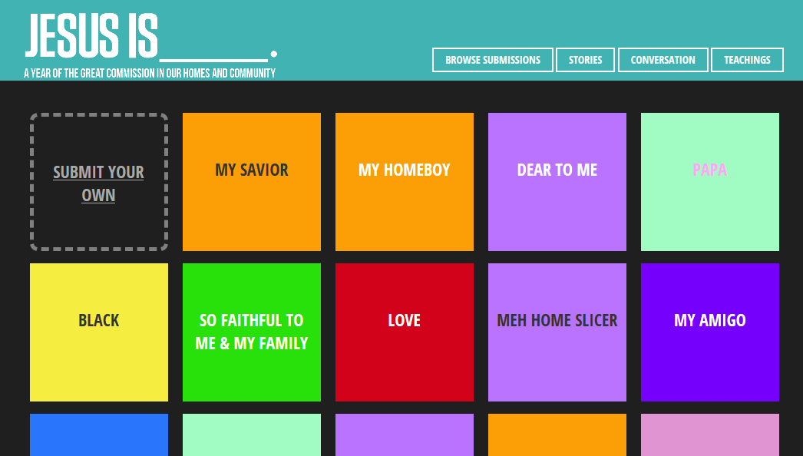
Notes:
Every 6 seconds, this website updates and flashes the next answeres submitted.
The task is for you to get as many people as possible to go to that website and have them put in the answer.
Of course the real goal is for you to get people talking about Jesus in a way that gets them taking an honest look at him.
So together, we want to dedicate this year to “Jesus is”

Slide 16
Notes:
As a home and then in our community – we want to be on mission with Jesus – asking those around us
“Who do you think Jesus is?”
Together, as the church, Jesus promised that the gates of hell – all the forces of evil – would never be able to stop us from telling the world about him.
But that means we have to do it together as a church

Slide 17
ON MISSION: Asking People About Jesus & Making Disciples
Wristbands at work & play
T-shirts to wear in the community
Banner above Route 10 in Chester during October
Every member: one monthly FB & one “touch” idea
Website: www.jesus-is.ag
Notes:
So this is how we are on mission together . . .
And of course, we have to follow the pattern of Matthew 16
If we are going to ask others who they think Jesus is,
Then we have to be able to answer it ourselves

Slide 18
Sunday Sermons @ Cornerstone
Oct: Jesus is SAVIOR
Nov: Jesus is HEALER
Dec: Jesus is FOR US
Notes:
So our Sunday morning services are going to be dedicated to Peter’s answer in mt 16:16
We are going to declare the five fold gospel this year
Jesus as savior, healer, sanctifier, baptizer in the holy spirit and soon coming king
Each month we will take one and focus on it like a Great Commission home would.
We will look at Jesus as savior
In worship
In the encouragement of Scripture
In our witness
And in our interceding for the world
So anytime someone you are talking with wants to know who more about who Jesus is – they can come to church and hear it

Slide 19
Great Commission Homes
Wk 1: Worship
Wk 2: Encourage
Wk 3: Witness “Jesus Is ___.”
Wk 4: Intercede
Notes:
And they don’t have to go to church to hear it – your Great Commission home will be ready to tell them
Since you are taking the time to put Jesus on a stand in your home
The Jesus Is _________ outreach won’t make you any busier
We are just asking you to make it the witnessing part of your great commission home
Whether you have a home as a college student, single, a family with children, empty nesters or widowed.
We as the church are equipping you to be a witness through the Jesus is campaign
Every month – we will give you a social media idea for Jesus is (since you should be on mission and not in a mess with your social media)
And we will give you an idea that your home could do in a more face to face way.

Slide 20
^{﻿17﻿} Jesus replied, “. . .﻿ on this rock I will build my church, and the gates of Hades [or Hell]﻿ will not overcome it.﻿﻿ ”
Notes:
But in the end we need to do it together!
We need to defeat the gates of hell as a church – not as individuals
Jesus said “The church” – not the individual.
You are part of God’s true church but you are not all of it
You and I are just one dominoe
We are each just one domino – of every size, color and stuff – and each one of us – isn’t all that much
By ourselves – none of us can knock down the Satan’s empire state building of lies.
But if you and I would submit to the master’s plan
If we get together and fall in line with the master’s design
Together – even the biggest gate of hell would fall
But we’ve got to do it together.
That’s why we are having this one service
And this one Jesus Is church wide campaign
Together – we don’t have to busier to be a better disciple
Instead of us, individually trying to defeat the gates of hell
We can each just line up and do our parts
We can be great commission homes – shining our light together
We can be great commission homes – playing our part in His song
Like Dominoes
We have to accept – we all have different positions in the design and everyone of us is critical to the movement God is creating
We are interdependent. We are each critical. We are stronger together than we are apart
So I’m asking you this school year
Let’s not busier disciples – but let’s all be better disciples
Let’s get the light of jesus on a stand in our homes – and together ask the world –who jesus is
And then show the world who Jesus is
If you’ll commit to this Jesus is plan – Jesus will be lifted up in this community like never before
You’ve got a part in God’s orchestra
You’ve got a part to play in the song of heaven being heard over the noise of daily life.
This world is filled with busyness, noise and distraction
But if you will let Jesus lead us together in an orchestra of praise
Our community will stop and hear his song
Just like this:
[video: orchestra]

Slide 22
Cornerstone’s 2015-16 Great Commission Goals
7,000 Touches [#JesusIs / www.jesus-is.ag]
700 Visitors [Services Or Conversations]
170 GC Homes [On Mission With Jesus]
70 New Disciples [By May 1, 2016]
Notes:
We want you to join us
600 in this room
What song of joy could our community hear if we all took our instrument and played together
If we all played the #jesusis & www.jesus-is.ag song together
7000 touches – each of us getting our FB friends to go to www.jesus-is.ag and putting there answer
- each of us wearing our tshirts once a week someplace
- even (or especially) in the places the world rejects Him
700 visitors - If we all bring one visitor – by Christmas – we are almost there
- if we each invited one person to our home – bought them a bible for Christmas
170 homes - that’s a city on a hill – monthly worship, encouragement, witness & intercession
- How isn’t our community going to see and feel that?
70 New Disciples in our church family – 7 new Christians in every adult life group / - 3 new Christians in every kids life group
- really changed and learning to be a great commission home
So as we finish – there is a song to be sung
If you will say yes to being a great commission home – magnet up here
If you will join the social media campaign – here
Book mark
T shirts - $5 in foyer
Most of all the holy spirit
Lift your hands to the Lord
Pray this prayer – and then sing

