Slide 2
To Finish Well
We Must Know What
The Finish Is
John 12:19-33
(see text in handout)

Slide 3
There are three times in the Gospels when Christ’s life on earth causes The Father to audibly speak [“thunder”] from Heaven
First time: Matt 3:17
Second Time: Matt. 17:5
Third Time: John 12:28
Notes:
There are three places in the Gospels, where God audibly speaks from Heaven for all the world to hear:
1. Is Jesus’ Water Baptism (Matt. 3:17)
2. Is Jesus’ Transfiguration (Matt 17:5)
And the third is here: John 12:28
3. Jesus’ Passion Week / Hour Of His Glorification – when He dies

Slide 4
Three Times God’s Glory & Truth
“Thunder” From Our Lives
“THEN A VOICE CAME FROM HEAVEN, “I have glorified it, and will glorify it again.” ﻿²⁹﻿ The crowd that was there and heard it said IT HAD THUNDERED;”
(John 12:29-29)
Notes:
There are three times in your life when God will use you in the greatest way to shout His voice to the world:

Slide 5
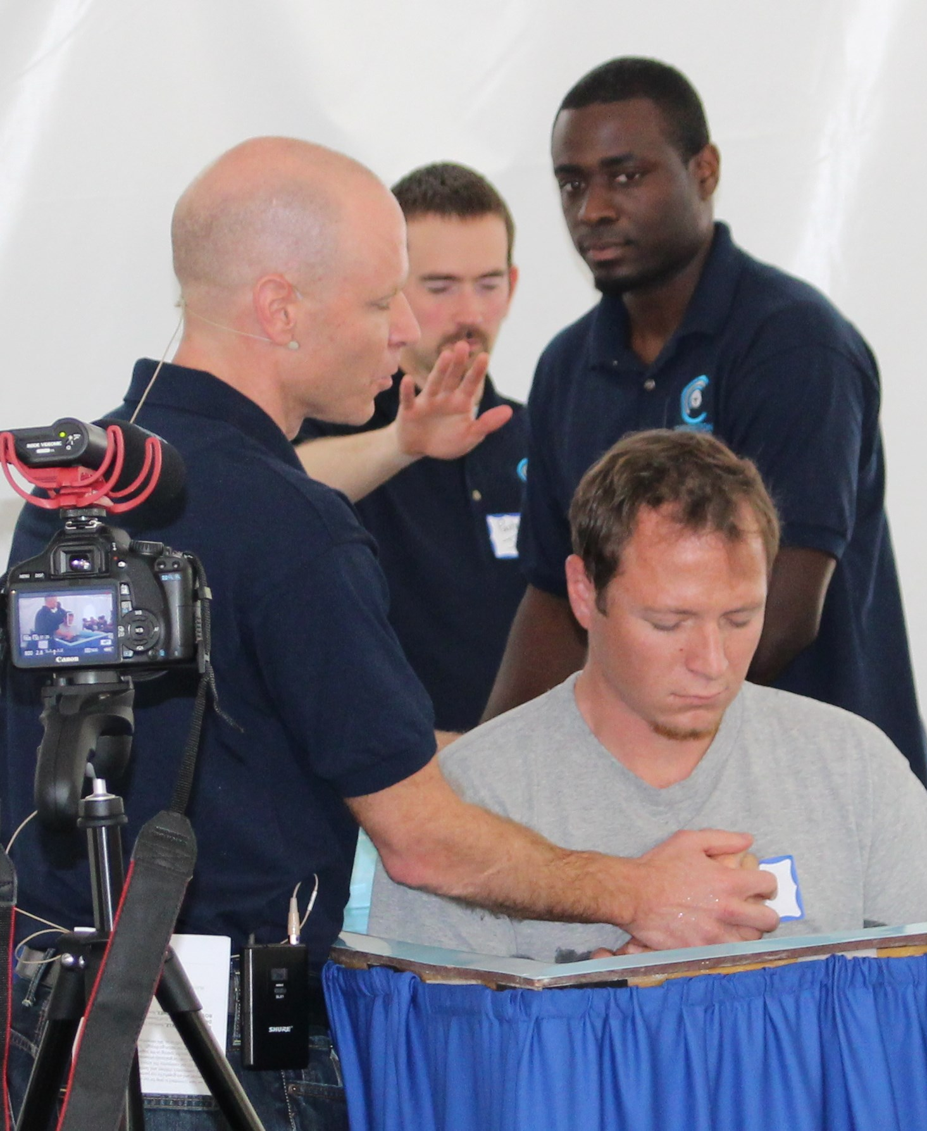
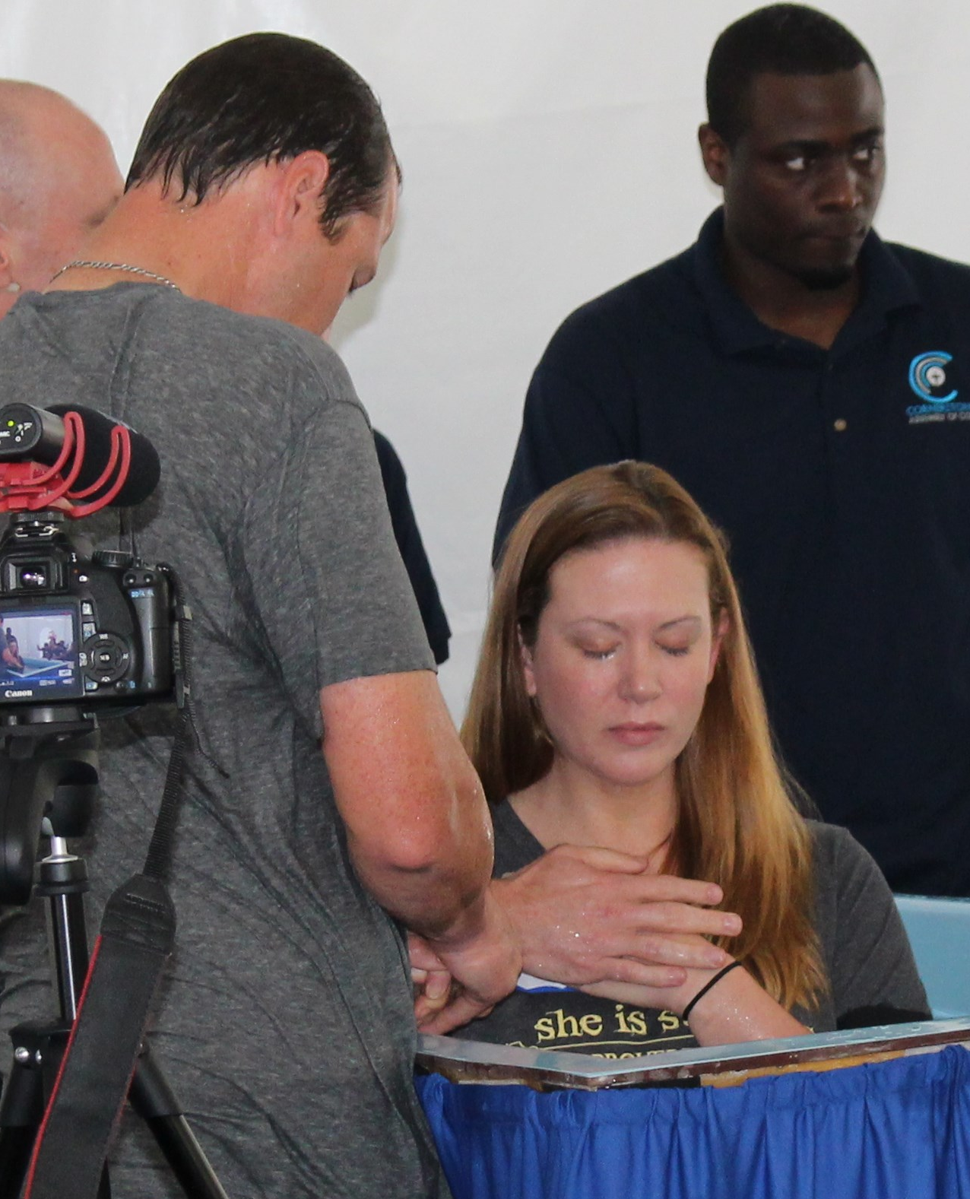
Baptism
Next Baptism
Sunday, June 7
Notes:
1. When you truly repent of your sin and are baptized
who can forget the water baptisms of this past Anniversary Sunday (pic)
not a water baptism out of tradition but out of radical repentance
- sister church in Ethiopia – to be water baptized out of muslim faith is to be dead to them
- in that moment – whether the world understands the voice or not – the world shakes with His voice
- have you not been baptized but are in love with jesus and want God to shout to the world through you to all your friends, family and coworkers? – June 7

Slide 6
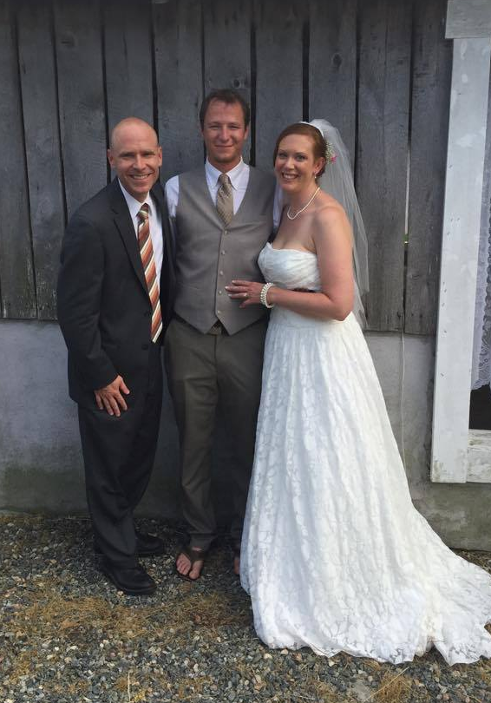
2. Transformation
When a part of your life truly begins to reflect Christ
Notes:
jesus was transfigured but we are transformed
- when your character (not just your behavior) is radically transformed – God shouts to the world
- this past Sunday afternoon – I did the wedding of Jessica & Daniel / footwashing
- Jessica & Daniel’s friends from AA, family – seen what they been through & who they’ve been
- God was shouting – one guy who obviously a “Greek” person from outside church culture
- “That was ________ing awesome!
- When the world sees your transformation
– when you grow up in grace and become mature
- growing up into the full measure of Christ
- God shouts to the world – I AM GLORIFIED / THIS IS WHO I AM –SEE ME IN THIS DARK WORLD
And there is a third place . . . God shouts to the world who He is

Slide 7
3.
Your Death
When you give your life & last days for Him to be known
“I tell you the truth, unless a kernel of wheat falls to the ground and dies, it remains only a single seed. But if it dies, it produces many seeds.”
(John 12:24)
Notes:
As the time approached for him to be taken up to heaven, Jesus resolutely set out for Jerusalem. (Lk 9:51)
For even the Son of Man did not come to be served, but to serve, and to give his life as a ransom for many.” (Mk 10:45)
﻿“We are going up to Jerusalem, and the Son of Man will be betrayed . . . and crucified. On the third day he will be raised to life!” (Mt 20:17-9)

Slide 8
Jesus Knew His Greatest Purpose & Accomplishment Was To Give His Life
“Now my heart is troubled, and what shall I say? ‘Father, save me from this hour’? No, it was for this very reason I came to this hour. ﻿Father, glorify your name!” Then a voice came from heaven, “I have glorified it, and will glorify it again.” (Jn 12:27-28)
Notes:
He knew what His finish was on this earth

Slide 9
You have a
BIG GIVE
[Your Finish Line]
Notes:
All of Heaven shouts at earth – when you give your life for His purpose.
When you resolve and purpose in your heart – to live and die for why He made you
Jesus knew that his greatest work on earth would be how he died for God
And believe it or not – that’s true of you and me
- God gets the most glory in the way you give your life!
- It’s the purpose of your life. The place you give your life where you don’t have to
- the place where you sacrifice it all for His name and for His glory!
I call it “The Big Give”
Everyone has “The Big Give”
It’s the place god plans to get more glory from your life in the way you die than anything you ever did while you were living.
Contrary to this world that says the end of life is where you stop working and stop giving . . .
The model of Jesus says – the end of life is where you give the most
- its not about work or striving – its about laying down your life
God has a place for you to die – according to the world: its a place you don’t have to be, a place you don’t have to go, something you don’t have to do – but it’s the place of God’s greatest message and voice through you.

Slide 10
Notes:
Even the world knows this
This Monday, we celebrate Memorial day – the day we remember the legacy and freedom we have because of the honor and duty of American soldiers who gave their lives for us.
We honor them because their greatest contribution wasn’t who had the higher rank, who had the best PT scores in bootcamp, who was the best sharp shooter, who was the richest, had the prettiest wife or drove the nicest car – we honor them because they gave their lives.
And that’s the world – the world only sees 3-5% of reality and even it knows the way you die is more important then the way you lived

Slide 11
God Plans To Use The Way We Die
As Our Greatest Way To Glorify Him
﻿ I tell you the truth, unless a kernel of wheat falls to the ground and dies, it remains only a single seed. But if it dies, it produces many seeds.^{﻿25﻿} The man who loves his life will lose it, while the man who hates his life in this world will keep it for eternal life.
Notes:
God has a place for you to die – according to the world: its a place you don’t have to be, a place you don’t have to go, something you don’t have to do – but it’s the place of God’s greatest message and voice through you.
And if you want to finish well in life – if you want to bring Him glory
Then you have to understand the Kingdom truth Jesus says in John 12:24

Slide 12
The Greatest Grace . . .
(outside salvation itself)
Is that no matter how we lived (in the past) to hurt or take,
there is grace to give and use our final days to heal & glorify

Slide 13
Finishing well doesn’t mean . . . We are seen well
But I, when I am lifted up from the earth, will draw all men to myself.”
Notes:
They want to see Jesus and his miracles and his wisdom
Jesus wants them to see the cross

Slide 14
They overcame him [Satan] by the blood of the Lamb and by the word of their testimony; they did not love their lives so much as to shrink from death. (Re 12:11)
“Blessed are you when people insult you, persecute you and falsely say all kinds of evil against you because of me. ^{﻿12﻿} Rejoice and be glad, because great is your reward in heaven (Mt 5:11-12)

Slide 15
Finishing well doesn’t mean . . . You always feel well
Now my heart is troubled [“unsettled and stirred up”], and what shall I say? ‘Father, save me from this hour’? No, it was for this very reason I came to this hour. (v27)
Notes:
We get troubled
We cry out in gethsemane
﻿ I want to know Christ and the power of his resurrection and the fellowship of sharing in his sufferings, becoming like him in his death, ^{﻿11﻿} and so, somehow, to attain to the resurrection from the dead.
^{﻿12﻿} Not that I have already obtained all this, or have already been made perfect, but I press on to take hold of that for which Christ Jesus took hold of me. ^{﻿13﻿} Brothers, I do not consider myself yet to have taken hold of it. But one thing I do: Forgetting what is behind and straining toward what is ahead, ^{﻿14﻿} I press on toward the goal to win the prize for which God has called me heavenward in Christ Jesus.
^{﻿15﻿} All of us who are mature should take such a view of things
Php 3:10-15

Slide 16
For I am already being poured out like a drink offering, and the time has come for my departure. ^{﻿7﻿} I have fought the good fight, I have finished the race, I have kept the faith. ^{﻿8﻿} Now there is in store for me the crown of righteousness, which the Lord, the righteous Judge, will award to me on that day (2 Ti 4:6-8)
Notes:
Last months were not easy
Family there every day
Pain and frailty
No one prayed for him without being prayed for
No one knew him without knowing the word
(project – harvest still)

Slide 17
Finishing well doesn’t mean . . . You play it safe
The man who loves his life will lose it, while the man who hates his life in this world will keep it for eternal life. ﻿²⁶﻿ Whoever serves me must follow me; and where I am, my servant also will be. My Father will honor the one who serves me.

Slide 18
I have fought the good fight, I have finished the race, I have kept the faith. ^{﻿8﻿} Now there is in store for me the crown of righteousness, which the Lord, the righteous Judge, will award to me on that day—and not only to me, but also to all who have longed for his appearing.
2 Ti 4:7-8

Slide 19
Ask for grace to
FINISH WELL!
(Joshua 1:8-9)
Notes:
Grace is in this word
Don’t be wreckless . . Quit job,
Don’t be fearless . . . No such thing unless your blind / holy spirit comes upon you
BE COURAGEOUS

Slide 20
Do not let this Book of the Law depart from your mouth; meditate on it day and night, so that you may be careful to do everything written in it. Then you will be prosperous and successful. ^{﻿9﻿} Have I not commanded you? Be strong and courageous. Do not be terrified; do not be discouraged, for the Lord your God will be with you wherever you go.” (Jos 1:8-9)
Notes:
Grace is in this word
Don’t be wreckless . . Quit job,
Don’t be fearless . . . No such thing unless your blind / holy spirit comes upon you
BE COURAGEOUS

