Slide 1
The Story & Heart Of The Returning King
Notes:
Did you ever meet someone, maybe dates someone and the whole time they only talked about themselves?
You never got to share your story.
You never got to tell them who you are or what you think?
They will leave the date thinking they know you – but they don’t
We can be that way with God
So caught up in ourselves – that we never take the time to listen
We never really know Him.
We miss His story – what is really amazing about him
Holy Week – what most people use as meaningless tradition is Jesus telling His story
It’s our chance to listen and understand His heart
Most of us are so busy thinking about ourselves and what God should do for us that we never really listen to Him and know His story
Even the disciples, as Jesus was preparing to go to Jerusaelm and die – were so busy thinking about themselves that when Jesus tried to tell them what Holy Week was really all about they – they missed it

Slide 2
The True Story Is Easy To Miss (even the disciples miss it)
Luke 18:31-34
Luke 19:11-14
Notes:
As the disciples go into Holy Week
Scripture records Jesus words to them
The Disciples, themselves, MISS his very heart and the story Jesus is saying is about to happen in what we now know as Holy Week
[Jesus’ Final Foretelling Of His Upcoming Death]
Jesus took the twelve [disciples] aside and told them, “We are going up to Jerusalem, and everything that is written by the prophets about the Son of Man will be fulfilled. ﻿He will be handed over to the Gentiles [unbelieving Roman rulers]. They will mock him, insult him, spit on him, flog him and kill him. On the third day he will rise again.” The disciples did not understand any of this. Its meaning was hidden from them, and they did not know what he was talking about.
Luke 18:31-34
[Final Story Before Palm Sunday/Triumphant Entry]
Jesus went on to tell them a parable, because he was near Jerusalem and the people thought that the kingdom of God was going to appear at once. ﻿Jesus said: “A man of noble birth went to a distant country to have himself appointed king and then to return. ﻿So he called ten of his servants and gave them ten talents.﻿ ‘Put this money to work,’ he said, ‘until I come back.’ ﻿“But his subjects hated him and sent a delegation after him to say, ‘We don’t want this man to be our king.’ Luke 19:11-14

Slide 3
Holy Week is about Jesus the rightful king returning to rule what belongs to Him
“But I tell you, Do not swear at all . . .
by Jerusalem, for it is the
city of the Great King [God’s Messiah]”
Mt 5:34-35
Notes:
Holy Week isn’t about religious traditions and past people.

Slide 4
Holy Week [Combining All The Gospels]
Palm Sunday | Monday | Tuesday
Triumphant entry into Jerusalem | Weeps over Jerusalem, goes to the temple, cleanses it & heals | Becomes the authority in the temple & pronounces woes upon His enemies
Notes:
Important to Remember
Each night Jesus returns to Bethany
Jerusalem belongs to Jesus, the Great King
But he never lives there
he never lives their because it has never truly welcomed him in to be there.

Slide 5
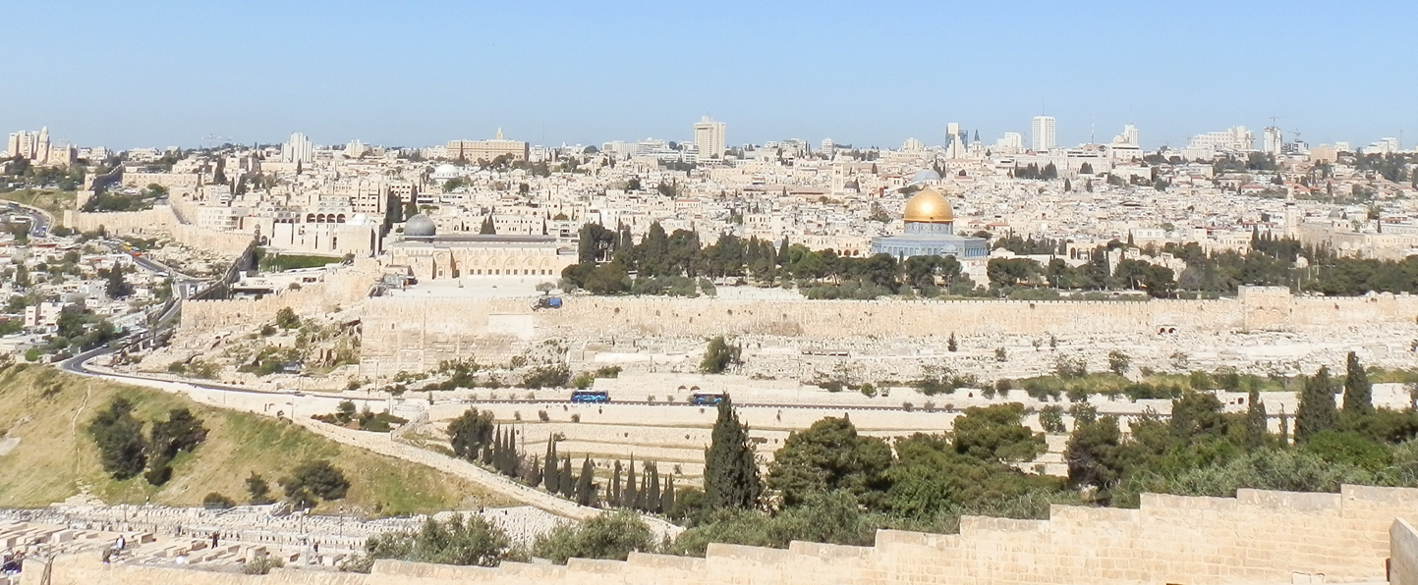
No record in the Gospels
5
6
2
4
1
3
Wednesday
Places Jesus will be 24-48 hours:
Passing the temple
Upper Room in the city
Gethsemane
Caiaphas House
Pilate’s Prateorium
Calvary
Notes:
It’s his last day of complete freedom
This view is from the mountain of Bethany
The day before He gets arrested Jesus is looking at this knowing what is ahead
– jesus can turn west and never be found.
It’s the day the fourth day of this recreation of the world

Slide 6
Holy Week [Combining All The Gospels]
Thursday | Good Friday | Saturday
• Lord’s Supper • “Love One Another” • Gethsemane • Betrayal • Trials begin | • 6 trials • Suffering • Cross • 7 sayings • Darkness • Death - 3pm | Jewish leaders request Roman guards to watch the tomb
Notes:
Jesus never returns to Bethany – even to sleep – he stays outside the gates –allowing for His arrest
Maundy Thursday – This one comes from the Latin Vulgate version of John 13:34 “A new commandment I give unto you: That you love one another, as I have loved you, that you also love one another.” In Latin, the verse begins with Mandatum novum do vobis. The word “maundy” is a corruption of “mandatum” meaning commandment.

Slide 7
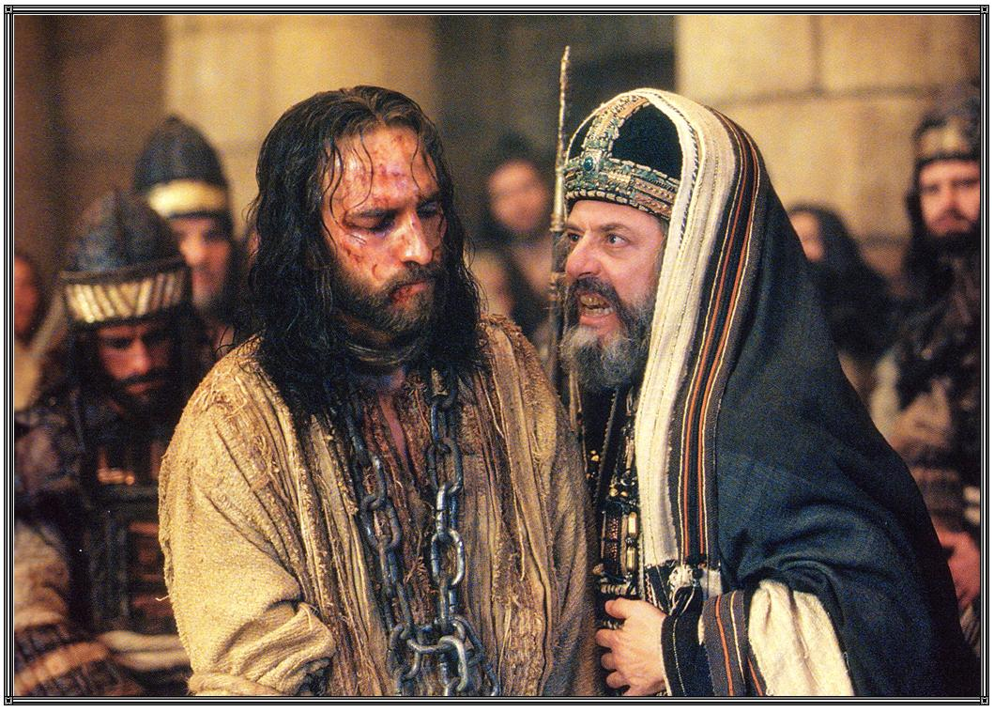
The Six Trials Of The Rightful King
Annas (night) – Sanhedrin preparation / Jn 18:12
Sanhedrin (night) – main trial / Mt 26:63
Dawn – official death sentence / Mt 27:1
Pilate – finds no fault in Him / Lk 23:3
Herod – local leader, desires a miracle / Lk 23:7
Pilate – Barabbas freed, final sentence / Jn 18:39
Notes:
SIX TRIALS
Annas (night) – looking for accusation and biding time till the Sanhedrin gathers at the High Priestly Villa
Then the detachment of soldiers with its commander and the Jewish officials arrested Jesus. They bound him﻿ and brought him first to Annas, who was the father-in-law of Caiaphas, the high priest that year. Jn 18:12-13
Sanhedrin Trial (night) – main trial
The high priest said to Jesus, “I charge you under oath by the living God: Tell us if you are the Christ,﻿ the Son of God.” “Yes, it is as you say,” Jesus replied. . . “He is worthy of death,” they [the Sanhedrin] answered. Mt 26:63,64,66
Dawn trial – darkness rules even in day
Early in the morning, all the chief priests and the elders of the people came to the decision to put Jesus to death. ﻿2﻿ They bound him, led him away and handed him over to Pilate, the governor. Mt 27:1-2
Pilate – man’s power
So Pilate asked Jesus, “Are you the king of the Jews?” “Yes, it is as you say,” Jesus replied. Then Pilate announced to the chief priests and the crowd, “I find no basis for a charge against this man.” Lk 23:3-4
Herod – the official ruler of galilee where Jesus is from
Pilate sent him to Herod . . . when Herod saw Jesus, he was greatly pleased, because for a long time he had been wanting to see him . . . he hoped to see him perform some miracle. (Lk 23:7-8)
People (Pilate) – rules the world – takes the judgement of
With this he went out again to the Jews and said, “I find no basis for a charge against him. ^{﻿39﻿} But it is your custom for me to release to you one prisoner at the time of the Passover. Do you want me to release ‘the king of the Jews’?”
^{﻿40﻿} They shouted back, “No, not him! Give us Barabbas!” Now Barabbas had taken part in a rebellion. Jn 18:38-40

Slide 8
“But he was pierced for our transgressions, he was crushed for our iniquities; the punishment that brought us peace was upon him, and by his wounds we are healed. . . .it was the Lord’s will to crush him and cause him to suffer . . . he poured out his life unto death, and was numbered with the transgressors. For he bore the sin of many, and made intercession
for the transgressors.” Isaiah 53:5-12
Notes:
[Is 53:5-12]

Slide 9
Holy Week is about Jesus the rightful king returning to rule what belongs to Him
“Jesus said, ‘My kingdom is not of this world . . . ‘You are a king, then!’ said Pilate. Jesus answered, ‘You are right in saying I am a king. In fact, for this reason I was born, and for this I came into the world”
John 18:36-38
Notes:
Holy Week isn’t about religious traditions and past people.

Slide 10
Holy Week [Combining All The Gospels]
Palm Sunday | Monday | Tuesday
The rightful King comes in peace to rule what is His | The King judges & restores what is His | The King rules what is His and judges His enemies
Notes:
Palm Sunday: Triumphant entry into Jerusalem
Jerusalem is the city of the great king – its his city.
He has the right to come back with vengeance and destruction.
But he doesn’t. He comes in peace. He comes offering to be received.
Monday: Weeps over Jerusalem, goes to the temple, cleanses it & heals
Jesus comes as a visitor and judges what is wrong and begins what is right
Tuesday: Becomes the authority in the temple & pronounces woes upon
His enemies
Jesus demonstrated his truth and confounds every enemy
And then Jesus leaves – knowing they will not repent
He leaves giving them a chance to turn
He gives them Wednesday
Wednesday – the day that the Bible says nothing
Church tradition calls it “Spy Wednesday” for it is that day it is believed Judas came to meet with the jewish leaders to plan Jesus’ betrayal.
“Spy” refers to Judas
But the truth is Wednesday should be really called
Amazing Grace Wednesday
And here is why

Slide 11
The rightful king chooses to sacrifice Himself at the hands of His enemies to allow what is rightfully His to be saved
Wednesday
Notes:
It’s his last day of complete freedom
This view is from the mountain of Bethany – jesus can turn west and never be found.
Wednesday is Amazing Grace Wednesday because
Wednesday – before even Judas knows he is going to betray Jesus
Jesus can just leave – he can leave town before any of it begins
But the king chooses to stay and sacrifice himself

Slide 12
Holy Week [Combining All The Gospels]
Thursday | Good Friday | Saturday
The rightful King is betrayed by what is His | The King is judged & condemned by His enemies | The enemies foolishly try to rule over the rightful King
Notes:
Thursday: Lord’s Supper • Gethsemane • Betrayal • Trials begin
- Betrayed by his disciples
- Maundy Thursday – variation of Mandate – Love one another – no one loves him
Friday: 6 trials • Suffering • Cross • 7 sayings • Darkness • Death - 3pm
- Jesus, the son of God, is put on trial by the world – found guilty and then crucified
Saturday: Jewish leaders request Roman guards to watch the tomb

Slide 13
The Six Enemies Of The King In Our Own Hearts
(Annas) Tradition/Past: He is not what has been
(Snhdrn) Religion: He is not how we want God
(Dawn) Darkness: He is light that must die
(Pilate) Man’s Power: He is insignificant
(Herod) Ethnic Pride: He is not like us
(Pilate) All: The rebel must live. He must die!
Notes:
Under man’s power because that is who is given dominion in this world
No one can crucify him but man

Slide 14
Jesus Takes What Will Destroy Us
Tradition: Isolate you in your pain and lost-ness
Religion: leave you filled with bitterness & fear
Darkness: leave you blind and condemned
Man’s Power: leave you helpless & powerless
Ethnic Pride: leave you rejected & abandoned
All: sacrifice you for whoever will do their bidding
Notes:
What Jesus is on the Cross – is what these judges will do to you by the end of your life.
This is what they do to every life!!!
Jesus on the cross is a picture of you and me
Our marriage. Our family. Our careers. Our health. Our society. Our government. Our nation
When man allows these things to rule
Because only man can
It’s his dominion – only he crucifies jesus in schools. In families. In public. In private. Only man chooses to destroy morality and life.
It’s you – jesus, the rightful king – chooses to take your place
That’s you and your future you are looking at
Isolated
Bitter
Blind
Rejected
Abandoned
Sacrificed
You aren’t the exception. Your family isn’t. your ethnic background isn’t. your nation isn’t
He sacrifices himself to save you.
How do I know
Because of Barabbas

Slide 15
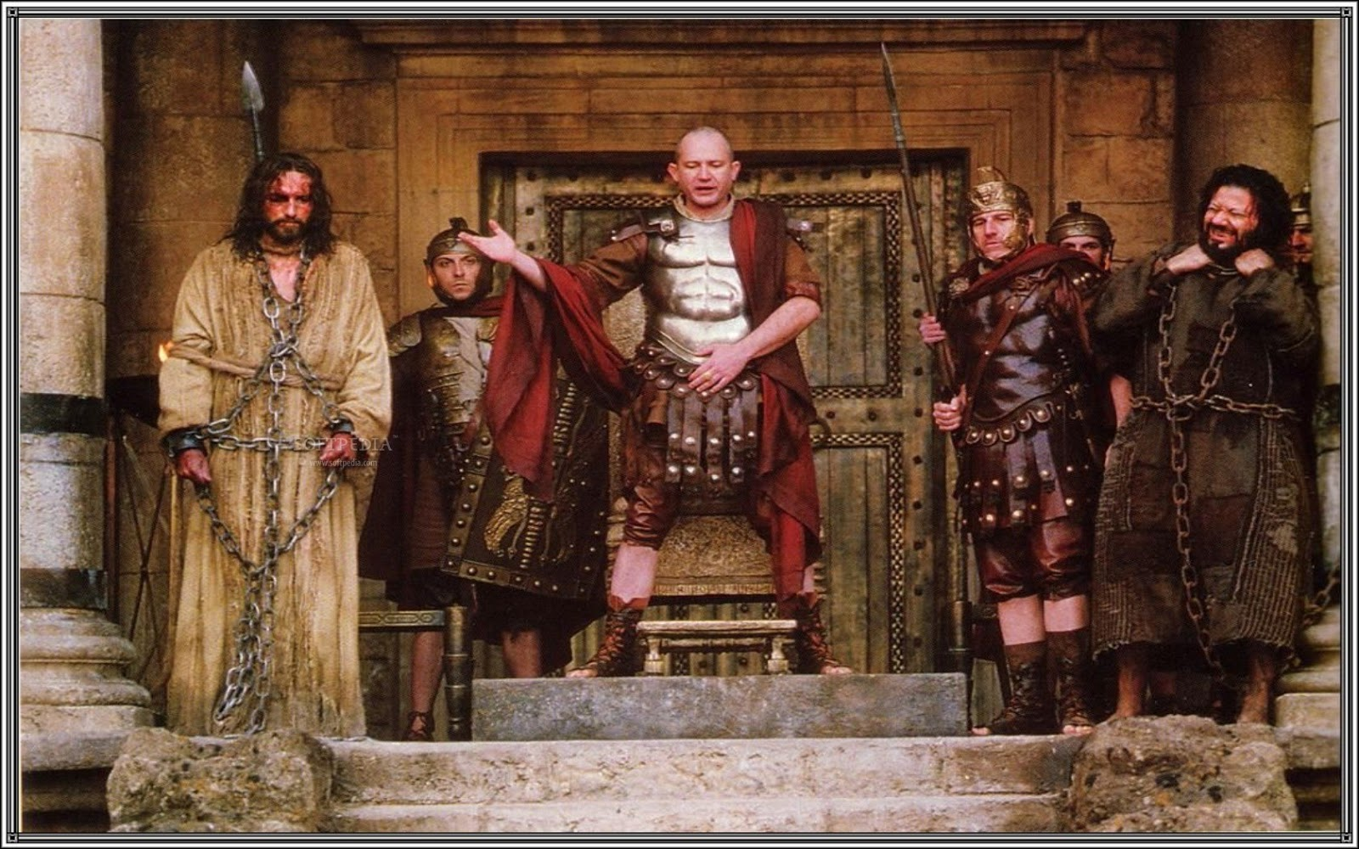
Barabbas = “bar” + “abbas”
Condemned rebel = (son of) + (fathers)
Notes:
Barabbas is chosen over Jesus.
Barabbas is the Aramaic for “son of fathers”
In front of the world is the son of god AND the son of men
Here someone has to pay – someone has to be condemned and die:
Barabbas has been a victim of all these judges
He most likely was either a land owner or farmer who lost his living to rome’s taxes and oppression
Historians say the rich use to gain more wealth by mercilessly buying property of harvesters who defaulted on their loans because of drought
He most likely was most likely part of the Zealot resurrection that happened the final year of Christ ministry
As a zealot, he is a hero the common people because they hate Rome’s rule.
So here is Barabbas
he has given his life to tradition, religion, darkness, man’s power and ethnic pride
And has revolted. He is a rebel to God and what God wants.
He has killed in the name of god- Israel (ethnic), in his own power, for his ethnic group.
And now it has landed him in line for crucifixion.
He has followed all these powers of the world and now his life is about to mutilated on a cross.
And in Matthew 27:15 onward we read that although Barabbas – son of fathers / son of men
Is condemned because he has rebelled, sinned and killed.
Although he deserves to die.
He is set free because all the powers of the world want Jesus dead instead.
Think – why is this guy getting off
The nerve and blaspheme
Not a fair trade – why jesus and not him
Why is the one who has done no wrong condemned instead of the one in rebellion
Why is the son of God crucified instead of the son of men
And the answer is: because that’s what the rightful king wanted
It’s not because the crowd wanted it.
It’s not because religion, tradition and all the enemies of the rightful king wanted it
It’s because the rightful king wanted it.
Jesus the king wants Barabbas – the son of men – released and set free
He wanted to take the punishment of the son of men

Slide 16
https://youtu.be/RwX_EpNR4CA
1:50 to 5:55

Slide 17
Barabbas = “bar” + “abbas”
Condemned rebel = (son of) + (fathers)
Notes:
You and I are Barabbas – we are the son of men
And we deserve and are walking towards crufixion – our marriage, our families, our morality, our integrity, our future
Someone who is going to the cross – someone is already in chains
Barabbas is in chains because of rebelling against God
Jesus is in chains because He is faithful to father God and is coming to take our place.
We have the choice when the king returns to what is his
We have a choice when the king returns to our hearts and our attention.
He is the rightful king of you and of me.
But he chooses to give himself to the cross and all the powers of this world so we can be saved and not destroyed.
The powers and chains of this world are leading someone to be crucified.
And Jesus stands before us and all the power of the world and says – you can give those to me if you want.
Give me the chains and the sin and go free.
Give your sin back to Jesus today.
Give him your broken life –and let him put it to death.
Give him your failure and let him bury it.
Let him set you free today.
And just like Barabbas – you don’t know how what to do.
Where do you go when you get to be free?
Well there’s more to Holy Week than Palm Sunday to Saturday.
There is more to the story of the returning king than those six days.
Because the end of the story is what we will celebrate next Sunday –Easter.
Its not just a historical event about a historical person.
Its this:

Slide 18
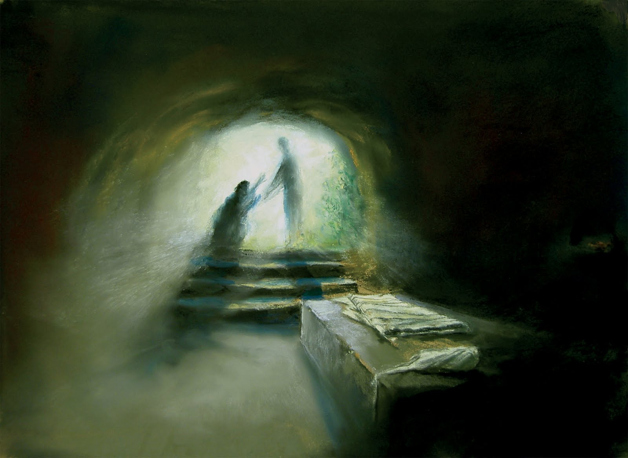
Easter Sunday
The rightful King overpowers and eternally defeats His enemies without destroying His people but walks with them in new life.
Notes:
Jesus walks out of the tomb that he spared you from!
The rightful king overpowers and eternally defeats His enemies without destroying His people.
He offers His forever presence to anyone who will believe and restart.
We never know what happens Barabbas – the son of all of our fathers.
But we do know what happens to every son of men who says yes today.
The king comes and sets you free and starts a new life that He (not you will lead)
Give your sin back to Jesus today.
Give him your broken life –and let him put it to death.
Give him your failure and let him bury it.
Let Jesus take what your life should look like and start again.
Don’t be too proud to pick up one of these chains – and bring it to the altar
And with praise in your heart – give it to Jesus to take from you
Whether you bring up a chain so he can:
take your sin for the first time come
Take the place of king as you rededicate your life to one who takes your sin – come
Receive your worship as you say thank you and rededicate your life to sharing his love with others – come

Slide 19
Give The Rightful King Your Chains
“Take my sin and be my Savior”
“Take your rightful place as my King again”
“Take my life in new ways to glorify Your Name”
Notes:
Jesus walks out of the tomb that he spared you from!
The rightful king overpowers and eternally defeats His enemies without destroying His people.
He offers His forever presence to anyone who will believe and restart.
We never know what happens Barabbas – the son of all of our fathers.
But we do know what happens to every son of men who says yes today.
The king comes and sets you free and starts a new life that He (not you will lead)
Give your sin back to Jesus today.
Give him your broken life –and let him put it to death.
Give him your failure and let him bury it.
Let Jesus take what your life should look like and start again.
Don’t be too proud to pick up one of these chains – and bring it to the altar
And with praise in your heart – give it to Jesus to take from you
Whether you bring up a chain so he can:
take your sin for the first time come
Take the place of king as you rededicate your life to one who takes your sin – come
Receive your worship as you say thank you and rededicate your life to sharing his love with others – come

